Slide 1
ILL 101: Copyright 101
Hosted by the IDS Project as part of
OCLC’s RSC23 Web Series
Cindy Kristof
Copyright & Scholarly Communication Librarian
Kent State University Libraries
March 22, 2023

Slide 2
This is not legal advice
I am not an attorney.
Webinar participants should contact their institutional counsel to obtain advice with respect to legal questions.
No ILL practitioners should act, or refrain from acting, on the basis of information provided in this webinar, without first seeking legal advice from counsel at their respective institutions.

Slide 3
Interlibrary Loan Code for the United States
ILL Code is linked from this site
https://libguides.ala.org/Interlibraryloans
4.0 Responsibilities of the Requesting Library
  4.8 Comply with U.S. copyright law (Title 17, U.S. Code) and be aware of related guidelines for copy requests.

Slide 4
Copyright’s Primary Purpose
“The Congress shall have the power…to promote the Progress of Science and useful Arts, by securing for limited Times to Authors and Inventors exclusive Right to their respective Writings and Discoveries.”
United States Constitution
Article 1, Section 8

Slide 5
Copyright Law
Title 17, United States Code
  Grants a set of exclusive rights to copyright owners for a limited period of time
  Exclusive rights are balanced with exceptions
  Text of the law:
    http://www.copyright.gov/title17/
    https://www.law.cornell.edu/uscode/text

Slide 6
Exclusive Rights – Section 106
Copyright Law gives copyright holders a limited monopoly over their works, to serve as an incentive for authors and creators. The rights include the following:
Reproduce the work in copies
Distribute the work publicly
Make derivative works
Publicly display the work
Public performance
Public performance by means of a digital audio transmission

Slide 7
Some of the Exceptions to Exclusive Rights
Fair Use – Section 107
Reproduction by Libraries and Archives – Section 108
First Sale – Section 109
Exemption of certain performances and displays (including classroom use, TEACH Act, and exhibits) – Section 110
Reproduction for people with print disabilities – Section 121

Slide 8
Section 109 – Right of First Sale
First Sale Doctrine
Allows us to make book trees for the holidays
Allows us to borrow and lend returnables, or put them on Course Reserve:
  Books
  Theses and dissertations
  DVDs
  CDs
  Whole issues or bound volumes of journals
Applies to materials that are purchased and not licensed
  Netflix
  Amazon Prime

Slide 9
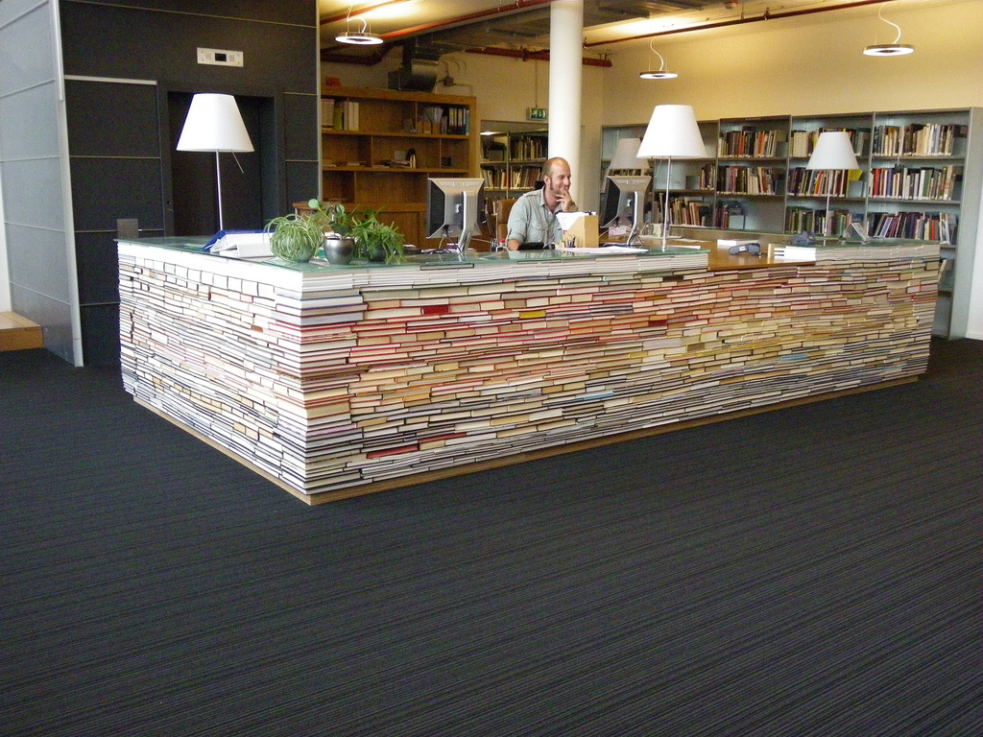
Section 109 Example
Ownership of Copyright vs. Ownership of a Copy
  https://copyrightalliance.org/education/copyright-law-explained/copyright-ownership/ownership-copyright-vs-copy/

Slide 10
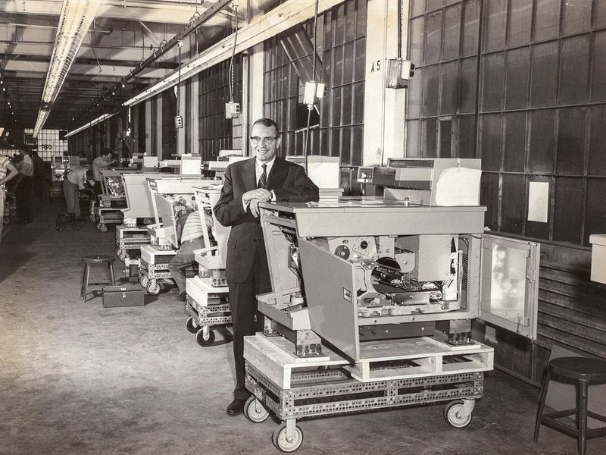
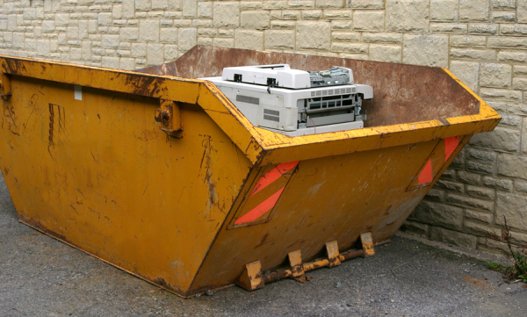
Section 108 - Reproduction by Libraries & Archives

Slide 11
17 U.S. Code § 108 – OUTLINE
Library or archive can make copies for its patrons – “one copy”
Three copies of an unpublished work for preservation, security, deposit in another library
Three copies of a published work – replacement, deposit in another library
ILL can make a copy – “no more than one article” from an issue of a journal or portion of book; must have “notice warning” where orders are taken
ILL can make an entire copy of book “not available at reasonable price”; must have “notice warning” where orders are taken
The copying equipment in your library – label
Single copies of same material on isolated, unrelated occasions is okay, but what’s NOT okay is related or concerted copying, systematic copying, or copying by interlibrary loan arrangements in such quantities as to substitute for a subscription or purchase.
Copies of materials in the last 20 years of their copyright terms
Does not apply to a music, art, or motion pictures.

Slide 12
Can your library or archive use Section 108?
Section 108 (a)
Your reproduction and distribution must be without any purpose of direct or indirect commercial advantage.
Your collections must be open to the public or to persons unaffiliated with the institution but doing research in a specialized field.

Slide 13
Reproduction by Libraries & Archives
Section 108 (d)
The copy becomes the property of the user
Library has had no notice that the copy will be used for any purpose other than private study, scholarship, or research
Library displays prominently, at the place where orders are accepted, and includes on its order form, a warning of copyright.

Slide 14
Reproduction by Libraries & Archives
Section 108 (g)
The rights to make copies extend to isolated and unrelated reproduction or distribution of a single same material on separate occasions, but the rights…
  …do not extend to related or concerted reproduction or distribution of multiple copies of the same material, whether made once or over time
  …do not extend to systematic reproduction or distribution
Nothing in this clause prevents interlibrary arrangements, but they must not be in such aggregate quantities as to substitute for a subscription to or purchase of a work.

Slide 15
Notice Warning mentioned in Section 108(d),(e)&(f)
Notice Warning Concerning Copyright Restrictions
The copyright law of the United States (title 17, United States Code) governs the making of photocopies or other reproductions of copyrighted material.
Under certain conditions specified in the law, libraries and archives are authorized to furnish a photocopy or other reproduction. One of these specified conditions is that the photocopy or reproduction is not to be “used for any purpose other than private study, scholarship, or research.” If a user makes a request for, or later uses, a photocopy or reproduction for purposes in excess of “fair use,” that user may be liable for copyright infringement.
This institution reserves the right to refuse to accept a copying order if, in its judgment, fulfillment of the order would involve violation of copyright law.
Source: Code of Federal Regulations
37 CFR § 201.14 - Warnings of copyright for use by certain libraries and archives
https://www.law.cornell.edu/cfr/text/37/201.14

Slide 16
Commission on New Technological Uses of Copyrighted Works (CONTU)*
An appointed congressional commission of publishers, librarians, lawyers, people in industry, and other stakeholders, pursuant to the Copyright Act of 1976
  Final Report – 1978
  Chapter 4 - Guidelines on Photocopying under Interlibrary Loan Arrangements
    http://digital-law-online.info/CONTU/PDF/index.html
    http://digital-law-online.info/CONTU/contu24.html
  Williams & Wilkins Co. v. United States, 487 F.2d 1345 (Ct. Cl. 1973)
*Not to be confused with CONFU, which took place in the mid-1990’s

Slide 17
CONTU Guidelines
An attempt to provide clarification for Section 108 (g)(2)
  What constitutes “systematic reproduction”?
  What “... aggregate quantities…substitute for a subscription to or purchase of [a] work”?
Attempt to mitigate the effects of library subscription patterns on publication market and sales
“As part of the review provided for in sub-section 108(i), these guidelines shall be reviewed not later than five years from the effective date of this bill.”
“Rule of Five” or "Suggestion of Five”

Slide 18
CONTU Guidelines are NOT LAW

Slide 19
National ILL Code Explanatory Supplement
4.8 Copy Requests (Requesting Library)
  ...responsible for complying with U.S. copyright law (Title 17, USC), in particular, 107 (Fair use) and 108 (Reproduction by libraries and archives). …related regulations, guidelines, policies, and/or procedures…CONTU Guidelines (1979).
5.4 Material Format or Collection (Supplying Library)
  …consider providing a copy in lieu of a loan rather than giving a negative response.
  Be aware of…license agreements for electronic resources that may either permit or prohibit…[ILL]
  Encouraged to work with those negotiating licenses…
5.11 Copy Requests (Supplying Library)
  Comply with U.S. copyright law or applicable license agreements when providing copies.

Slide 20
CONTU Guidelines – Borrowing Library
Suggestion of Five | Rule of Five | 5/5 Rule
  For the BORROWING/Requesting library to track
    Track by Journal Title, by calendar year
    The LENDING/Supplying library does not track when gets sent
  Your library may receive five articles per journal title, per year, published within the last five calendar years
  Receiving six or more articles exceeds this suggestion

Slide 21
CONTU Guidelines – Borrowing Library
All requests for non-returnables must include a copyright compliance statement by the borrowing/requesting library.
Requests for returnables do not need copyright compliance statements.
  CCG – “Compliance CONTU Guidelines”
    ILL request complies with 108 (g) (2) Guidelines
    ILL requests for articles published within the last five years
    May be subject to the 5/5 Suggestion
  CCL – “Compliance Copyright Law”
    Indicates that the ILL request complies with other provision of copyright law
    Applied to articles that fall outside the years of the 5/5 Suggestion

Slide 22
CONTU Guidelines – Borrowing Library
Keep records of all BORROWING requests for non-returnables
  Filled and Unfilled
  Three years – statute of limitations in a civil copyright lawsuit
    Your state law or institution may require other or longer record keeping

Slide 23
What to do if you’ve exceeded CONTU?
  Report through Copyright Clearance Center - http://www.copyright.com
  Order a copy of the article from a copyright-cleared commercial source…
    British Library Document Supply Services
    Get It Now
    Reprints Desk
  Purchase a copy of the article from the publisher’s web site
  Purchase the entire issue
  Borrow the entire issue or bound volume
  Refer the patron to a nearby library that has the journal
  Start a subscription to the journal
  Refuse the order/Close the title
  Evaluate for possible Fair Use

Slide 24
CONTU Guidelines – Lending/Supplying Library
Check licenses for ejournal lending rights
  Frequently automated
Check for use of CCG or CCL
  Automated
Include copyright statement on copies provided
  Scan the copyright statement on the piece (1998 DMCA change)
    If you cannot locate it, articles being delivered electronically can carry this message on an extra sheet added to the article:
      Notice: This material may be protected by copyright law (Title 17 U.S. Code). (ALA wording)
      Notice: This material is subject to the U.S. Copyright Law; further reproduction in violation of that law is prohibited. (Gasaway-Wiant wording)

Slide 25
Law vs. Guidelines
CONTU has been around for years and has served as a pretty good guideline.
It’s relatively easy to follow.
Is CONTU out of date? Journal prices have skyrocketed since the late 1970’s. Subscription practices have changed drastically since the 1970’s. Licenses now play a role, as does Open Access.
Some ILL practitioners are beginning to rethink approaches to copyright compliance in resource sharing.
If it works for you, don’t feel guilty about using it.
You may consider some alternatives to CONTU.

Slide 26
2020 ARL White Paper on CONTU
By Meg Oakley, Laura Quilter, and Sara Benson
https://www.arl.org/resources/modern-interlibrary-loan-practices-moving-beyond-the-contu-guidelines/
  https://www.arl.org/wp-content/uploads/2020/08/2020.08.31-modern-interlibrary-loan-practices-moving-beyond-the-CONTU-guidelines.pdf

Slide 27
Considerations for alternatives to CONTU
Work with your University Counsel, library administration, library copyright officer, collection management
Journal subscription prices then v. now
Journal subscription practices then v. now
Look at borrowing patterns over multiple years
Read the law
  Look for what might be considered “systematic reproduction”
  Define what “aggregate quantities substitute for a subscription or purchase” in your library
Integrate Fair Use into your ILL practice
What else?

Slide 28
Fair Use – Section 107
Four Factors
  Purpose & Character of Use
    e.g., non-profit vs. for-profit
  Nature of Work Used
    e.g., factual vs. creative; published vs. unpublished
  Amount & Substantiality of Work Used
    e.g., small portion vs. large portion or “heart” of work
  Effect of Use on the Market
    e.g., little effect on market vs. huge impact on market value

Slide 29
Fair Use Tools
Checklist (Kenneth Crews and Dwayne Buttler)
https://copyright.columbia.edu/basics/fair-use/fair-use-checklist.html
Evaluator (Michael Brewer & ALA OITP)
https://librarycopyright.net/resources/fairuse/index.php

Slide 30
Fair Use Facts
Fair Use is used as an “affirmative defense” in U.S. courts of law
  https://digitalcommons.law.uw.edu/cgi/viewcontent.cgi?article=4853&context=wlr
Fair Use supports the First Amendment
If your intended reproduction or use is not covered by a separate section of the U.S. Copyright Law, it may still be lawful under Fair Use.
  “Fair Use Savings Clause”
Fair Use evaluations do NOT
  carry the weight of a legal decision
  substitute for the advice of an attorney
Keep records of your fair use evaluations
  They demonstrate a “good faith effort” to comply with the law
  Statutory damages – up to $150,000

Slide 31
The Public Domain
Works created by the U.S. Government
  Section 105
Some works are placed into the public domain by their creators
They age into the public domain
  Date of publication before 1928
  Life of the author + 70 years
  Works made for hire – 95 years from the date of publication or 120 years from date of creation, whichever expires first
Eighty percent (80%) of books published before 1964 never had their copyrights renewed
  https://www.crummy.com/2019/07/22/0
  https://www.vice.com/en/article/epzyde/librarians-are-finding-thousands-of-books-no-longer-protected-by-copyright-law

Slide 32
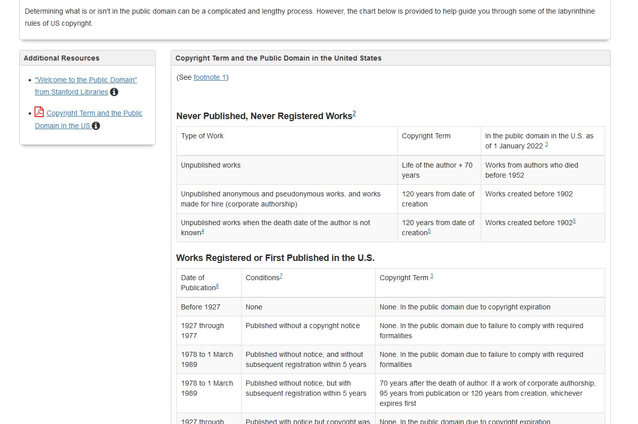
Public Domain Guide/Chart
Peter Hirtle
https://guides.library.cornell.edu/copyright/publicdomain

Slide 33
Licenses
LICENSES can supersede LAW
  Licenses are agreements between parties for use of materials for specified purposes
    Resource sharing is a frequent point of negotiation
  Look for the fine print:
    “Terms of Use”
    “Conditions of Use”
    “Terms and Conditions”

Slide 34
License Negotiation
Communicate with your acquisitions folks, ask for what you want…
You want:
  ILL lending rights
  Rights that follow Title 17 USC
  Rights to deliver items through current electronic delivery systems – do not name them by brand
You DO NOT want:
  Print-only ILL rights (but are they better than nothing?)
  Required record-keeping beyond what CONTU suggests
  Any mention of CONTU within the license
Be understanding…ILL rights are just a portion of the negotiation process

Slide 35
International Copyright
ILL Code US - http://www.ala.org/rusa/guidelines/interlibrary
  3.2 United States libraries are encouraged to engage in interlibrary loan with libraries in other countries. International transactions are governed by the International Federation of Library Associations and Institutions [IFLA].
IFLA - https://www.ifla.org/units/copyright-a2k/
  IFLA works to deliver copyright reforms at the global, regional and national levels to give libraries clear and enforceable legal rights to carry out their missions, as well as to promote the adoption of open practices in knowledge production and sharing.
IFLA - https://www.ifla.org/units/digital-lending/
  IFLA advocates for laws and practices globally that enable libraries to lend works digitally, and so support learning, research and cultural participation.
Berne Convention - https://www.wipo.int/treaties/en/ip/berne/
  Supports international ILL

Slide 36
World Intellectual Property Organization (WIPO)
A self-funding agency of the UN, WIPO is a global forum for intellectual property services, policy, information and cooperation
  http://www.wipo.int/about-wipo/en/
Copyright Topics and Issues
  http://www.wipo.int/copyright/en/
2013 – Marrakesh Treaty – facilitates access to works for people with print disabilities
  http://www.wipo.int/treaties/en/ip/marrakesh/
  U.S. was the 50th member, in 2018

Slide 37
FAQs
What if our journal license is silent on interlibrary loan?
What if there is an embargo in our subscription?
What about that weird message from the Copyright Clearance Center when I’m trying to clear copyright for requesting?
Has a library ever been the subject of a copyright lawsuit over interlibrary loan?

Slide 38
Controlled Digital Lending by Libraries
& Internet Archive
https://controlleddigitallending.org/
  “Lend like print…”
  Technical controls prevent copying and redistribution
  1:1 “own-to-loan” ratio
  Ideal for older books that may never made available commercially
Hachette Book Group v. Internet Archive
  https://www.authorsalliance.org/2023/03/20/judge-hears-oral-arguments-in-hachette-book-group-v-internet-archive/

Slide 39
Questions to ask yourself…
Is the material within the Public Domain?
Is the material licensed for your purpose?
  Commercial licenses
  Open Access materials with Creative Commons Licenses
Is your use permitted by law?
  Sections 108, 109, 110, 121
Can you make a case for Fair Use?
  Section 107
Do you need to seek permission, license, or purchase?
Source: Smith, Kevin L., “Coaching Copyright: Rules and Strategies for the Game.” Coaching Copyright (Kevin L. Smith and Erin L. Ellis, eds). American Library Association, 2019.

Slide 40
Recommended Reading
Kenneth D. Crews. Copyright Law for Librarians and Educators: Creative Strategies and Practical Solutions, 4th ed. Chicago: ALA Editions, 2020.
Ruth Dukelow and Michael Robak (eds.) Legal Issues in Libraries and Archives. https://mlpp.pressbooks.pub/librarylaw/
WIPO. Understanding Copyright and Related Rights. https://www.wipo.int/edocs/pubdocs/en/wipo_pub_909_2016.pdf

Slide 41
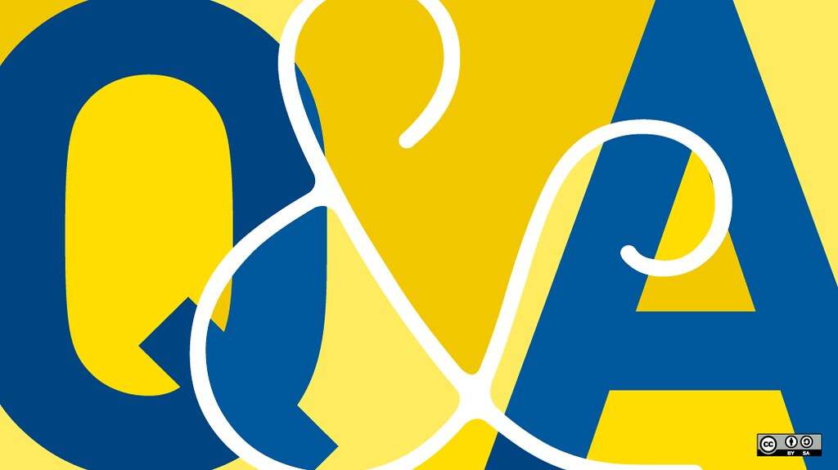
Questions?
ckristof@kent.edu

Slide 42
Thank You! ckristof@kent.edu

