Slide 1



The Information Delivery Services (IDS) Project:
Creating a Highly-effective & Innovative Resource Sharing System at Low Cost
Sunday, August 29, 2008 10:30am – Noon
Anaheim Convention Ctr., Room 209A
OCLC Innovative Trends in Resource Sharing
Cyril Oberlander and Ed Rivenburgh
SUNY Geneseo
IDSProject.org
2008 IDS Conference
Notes:
ALA OCLC Presentation

Slide 2
Problems with "Normal" Interlibrary Loan
Hat-in-hand approach to acquiring needed resources--begging for a handout or favors
Totally dependent upon whims of lending library
Fees for loaning materials or they don’t loan at all
Frequently limited staff time is committed to local ILL operations
Borrowing first priority--lending later
Quality of material provided is uneven
Time of delivery is undependable
Offers no guarantees to users (borrowers)
Does not fit undergraduate (or our) pattern of doing research-last minute (“We need 5 to 10 days to get your item.”)
With students using so many electronic indexes and bibliographies today-- we don’t have material in-house--on the shelf--we have to retrieve from outside

Slide 3

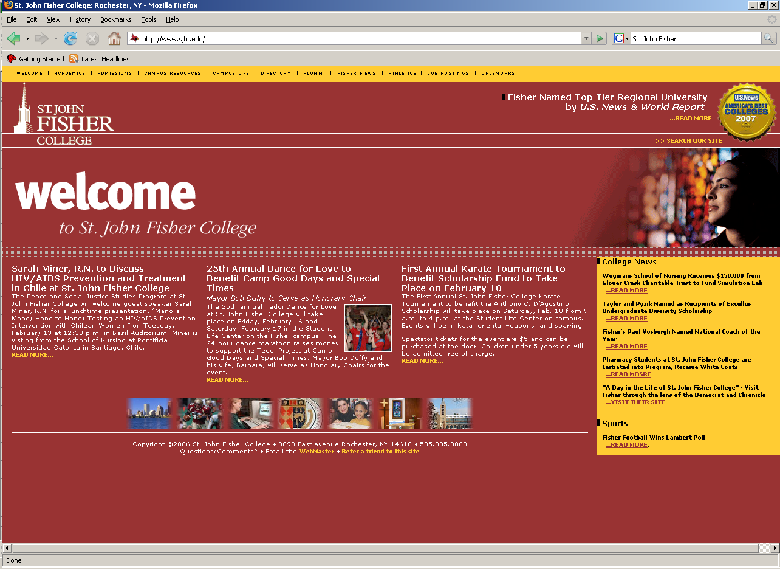













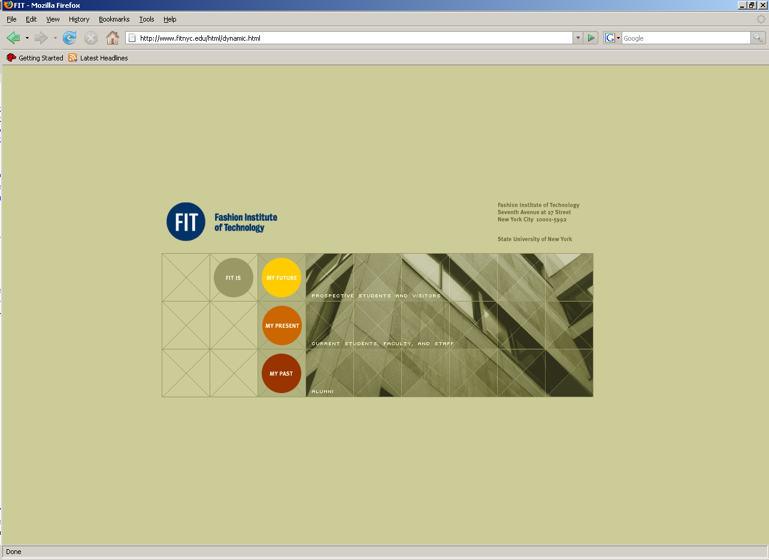
















IDS Project
Summer 2008
Student Head-Count: ~ 185,226
Faculty Head-Count: ~ 11,687
Total Volumes: ~ 12,440,648
CUNY

Slide 4
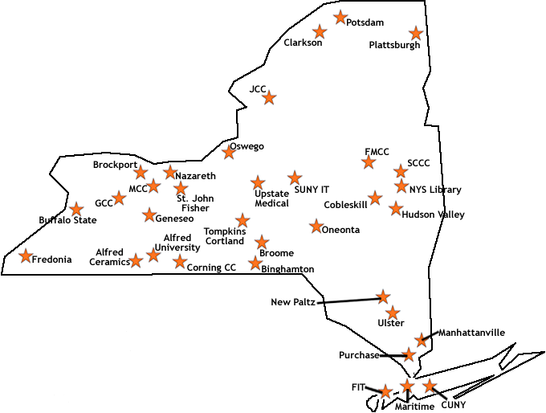
Current Libraries

Slide 5
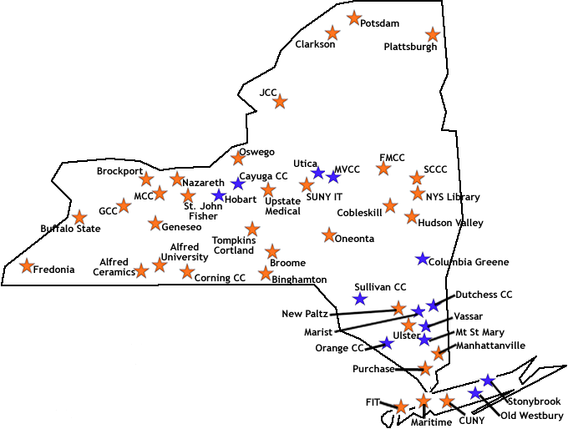

Slide 6

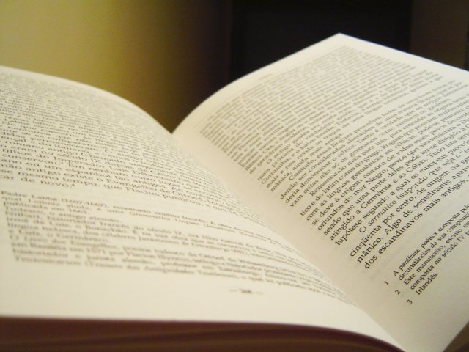




Thank You
SUNY ’s Office of
Library and
Information Services
2008 IDS Conference
6
Notes:
Add Serials Solutions?

Slide 7
Major Features of IDS Project
Emphasis on building “a unified community of trust & support”
Trained teams of volunteer mentors (applications & technical)
User-centric definition of an ILL transaction
Handle both physical items (books, media, etc) AND articles
Contractual performance standards
Real-time, multi-level ILL transaction performance data
Objective data for decision making & policy development
Extensive sharing of eJournals via eJournal Availability Server
No startup or annual membership fees
Commitment of talent and time of members
2008 IDS Conference

Slide 8
A unified community of trust and support built around a critical and clearly understood common purpose: effective resource sharing.
2008 IDS Conference
8

Slide 9
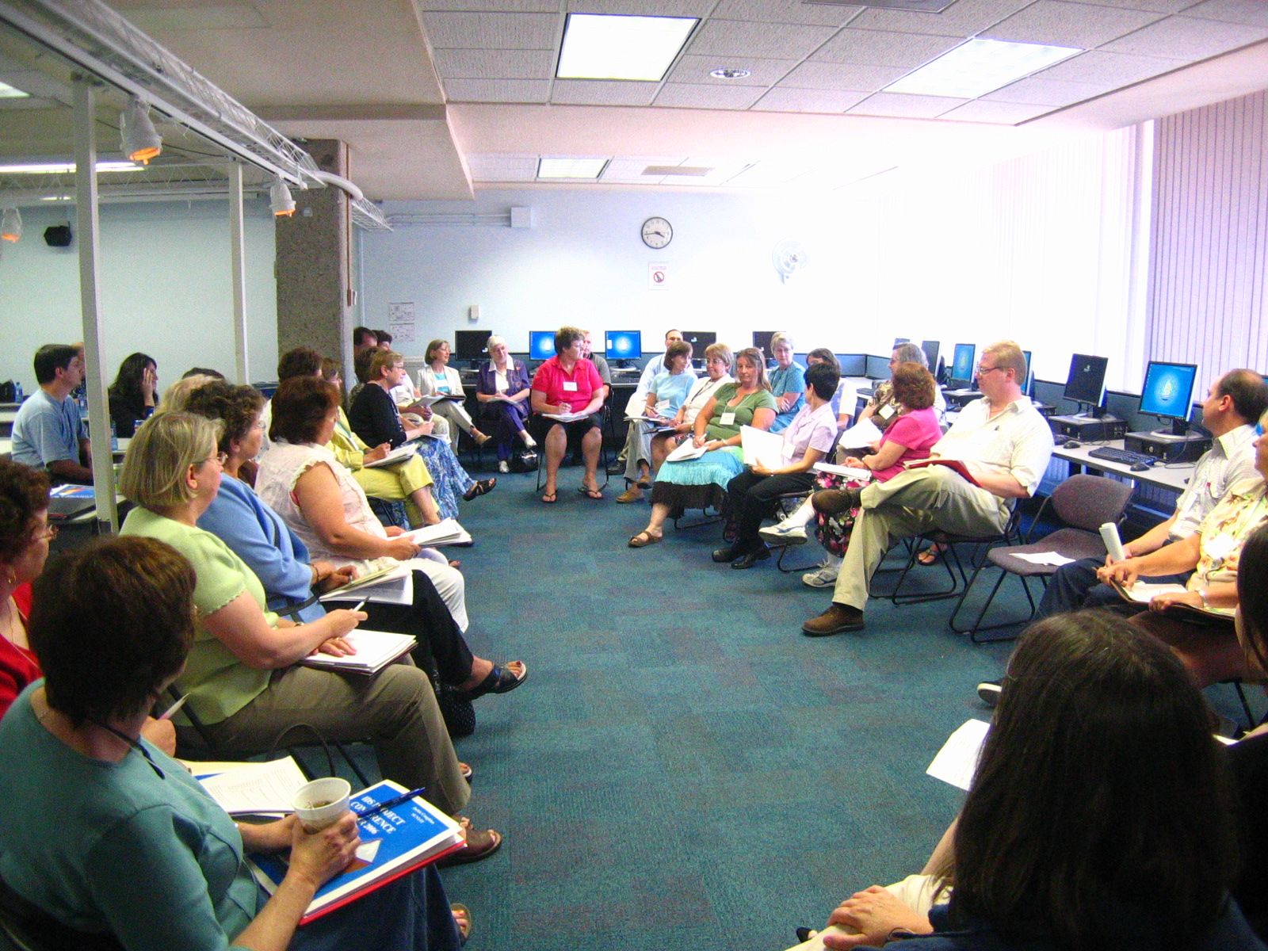
2008 IDS Conference
9

Slide 10
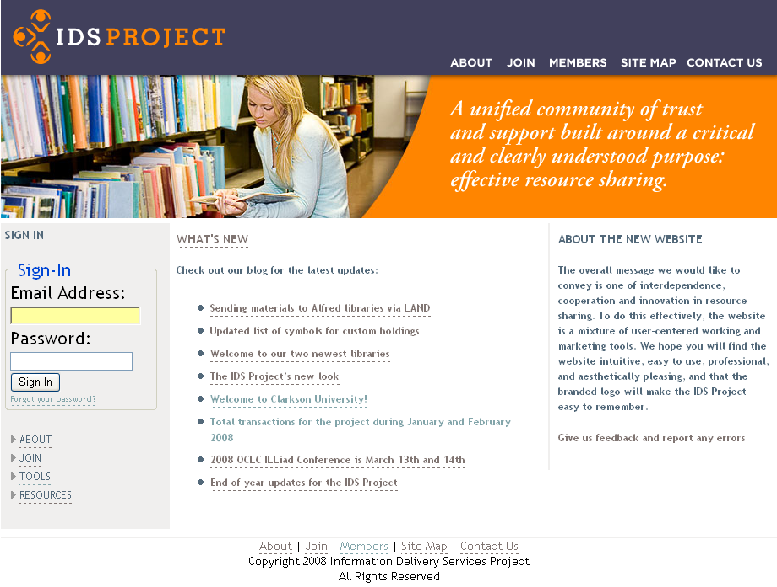
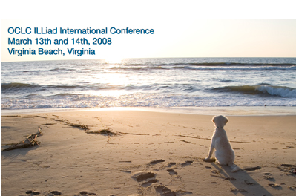
WHAT’S NEW
Check out our blog for the Latest updates:
Sending materials to Alfred libraries via LAND
Updated list of symbols for custom holdings
Welcome to our two newest libraries
The IDS Project’s new look
Welcome to Clarkson University!
Total transactions for the project during January and
February 2008
2008 OCLC ILLiad Conference is March 13th and 14th
End of year updates for the IDS Project
Download the IDS Project
presentation
here (.zip file)
10
Notes:
Discuss photos and contact information for all staff and directors, Summer Conference – group meetings, practitioner discussion groups, and evening social events.

Slide 11
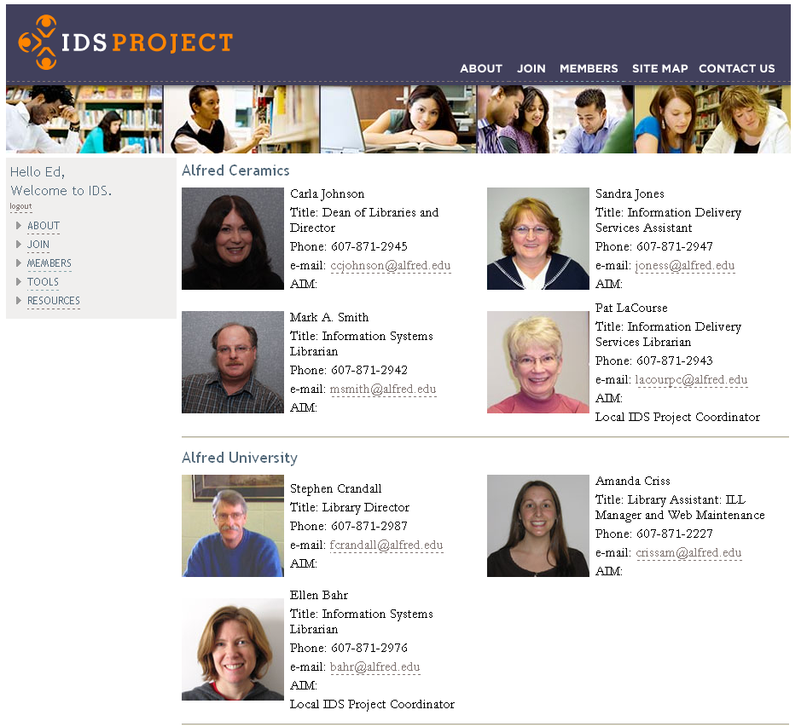
11

Slide 12
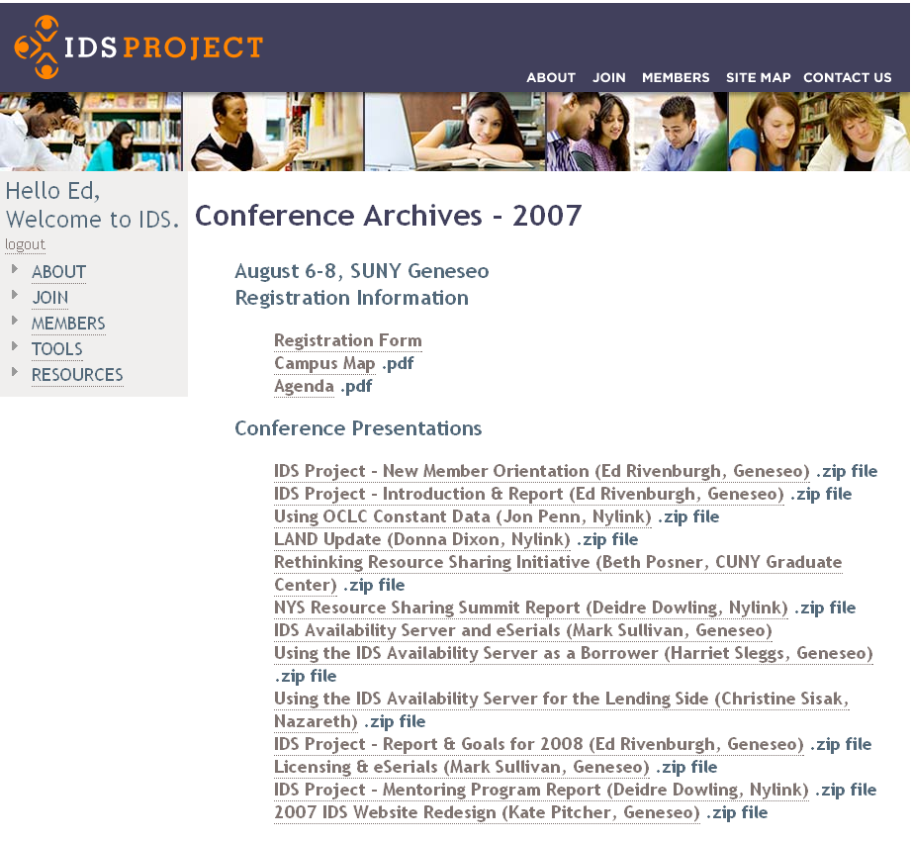
12

Slide 13
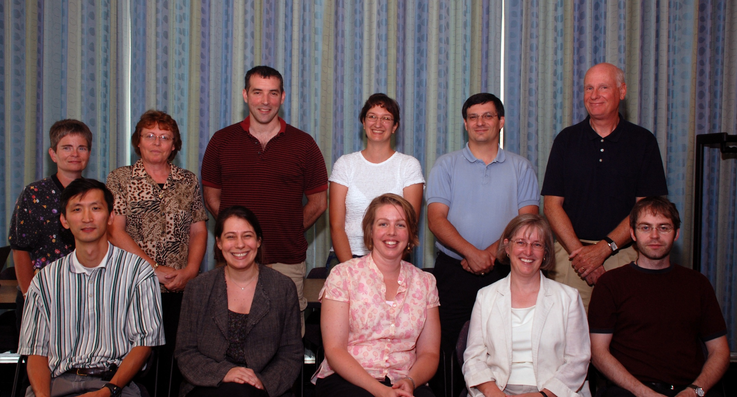
Back: Janet Ferry, Harriet Sleggs, Gregg Kiehl, Chris Sisak, Mark Sullivan, Andy Perry
Front: Corey Ha, Beth Posner, Carrie Eastman, Michelle Parry, Mike Curtis
13
2008 IDS Conference
13
Notes:
TRAINED TEAMS of volunteer mentors – applications and technical mentors – elaborate.

Slide 14
User-centric Definition of IDS Transaction
From the time the user places a request until the time the user is notified the loan is ready for pickup or the article is ready to be retrieved from the Web
2008 IDS Conference

Slide 15
Adherence to contractual performance standards
Articles: 48 hours
Loans: 72 hours
(Weekends and Holidays Excluded)
2008 IDS Conference
15
Notes:
Besides turn-around times…
Ensure that all transmitted items meet requirements for bibliographic accuracy and high-quality reproduction
Mutual accountability – Trust but verify… Real-time, multi-level ILL transaction performance data

Slide 16
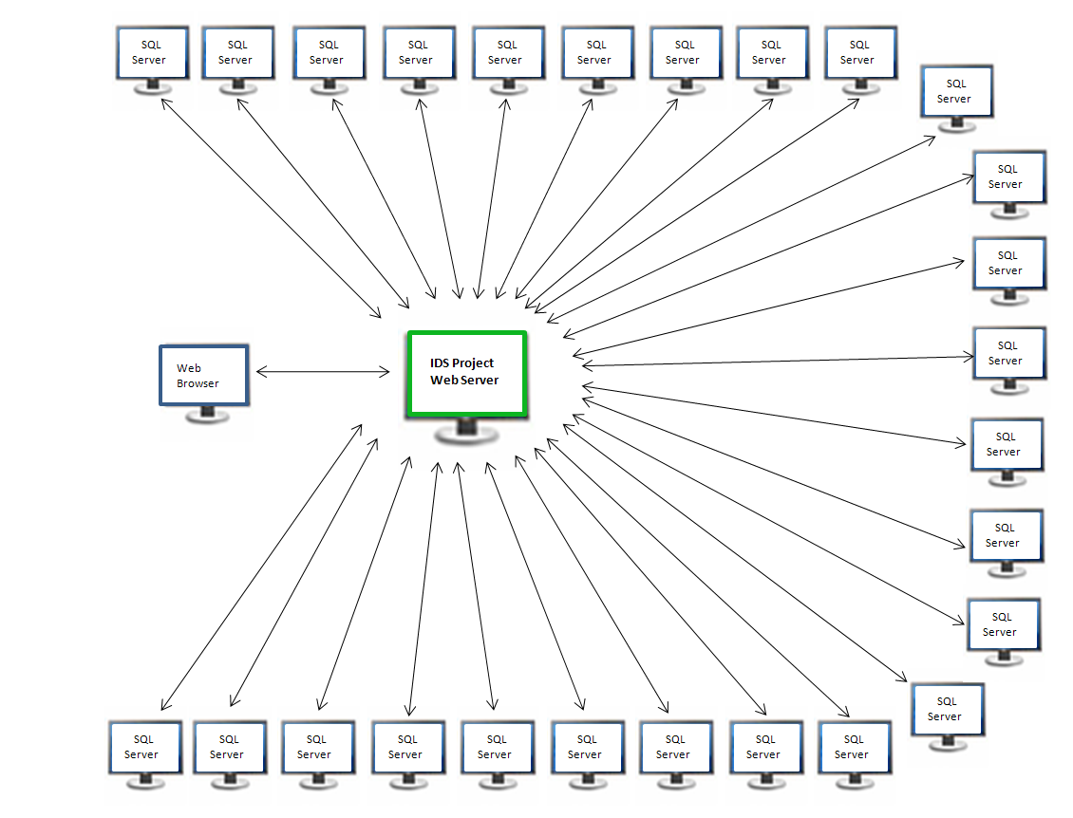
16

Slide 17
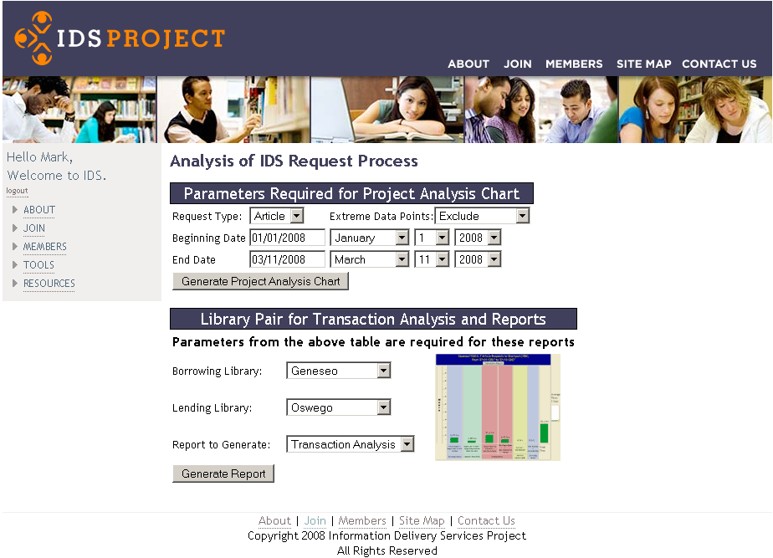
17

Slide 18
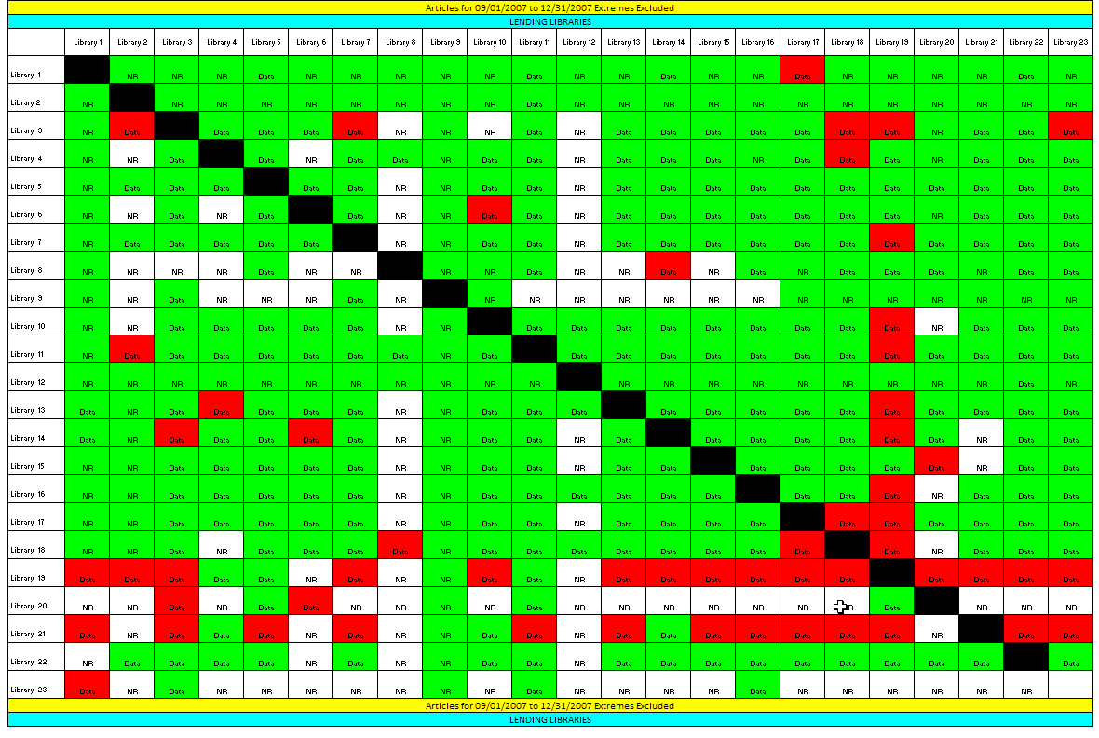
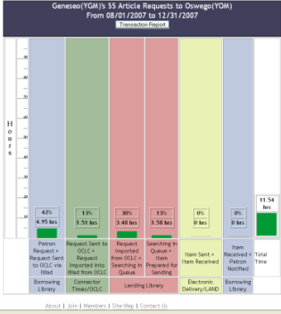
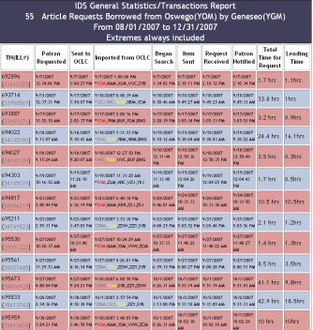
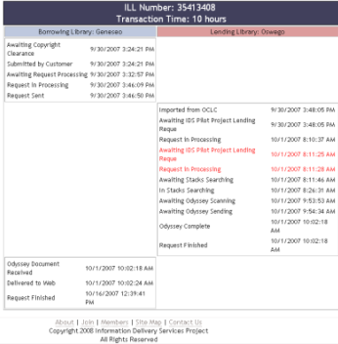
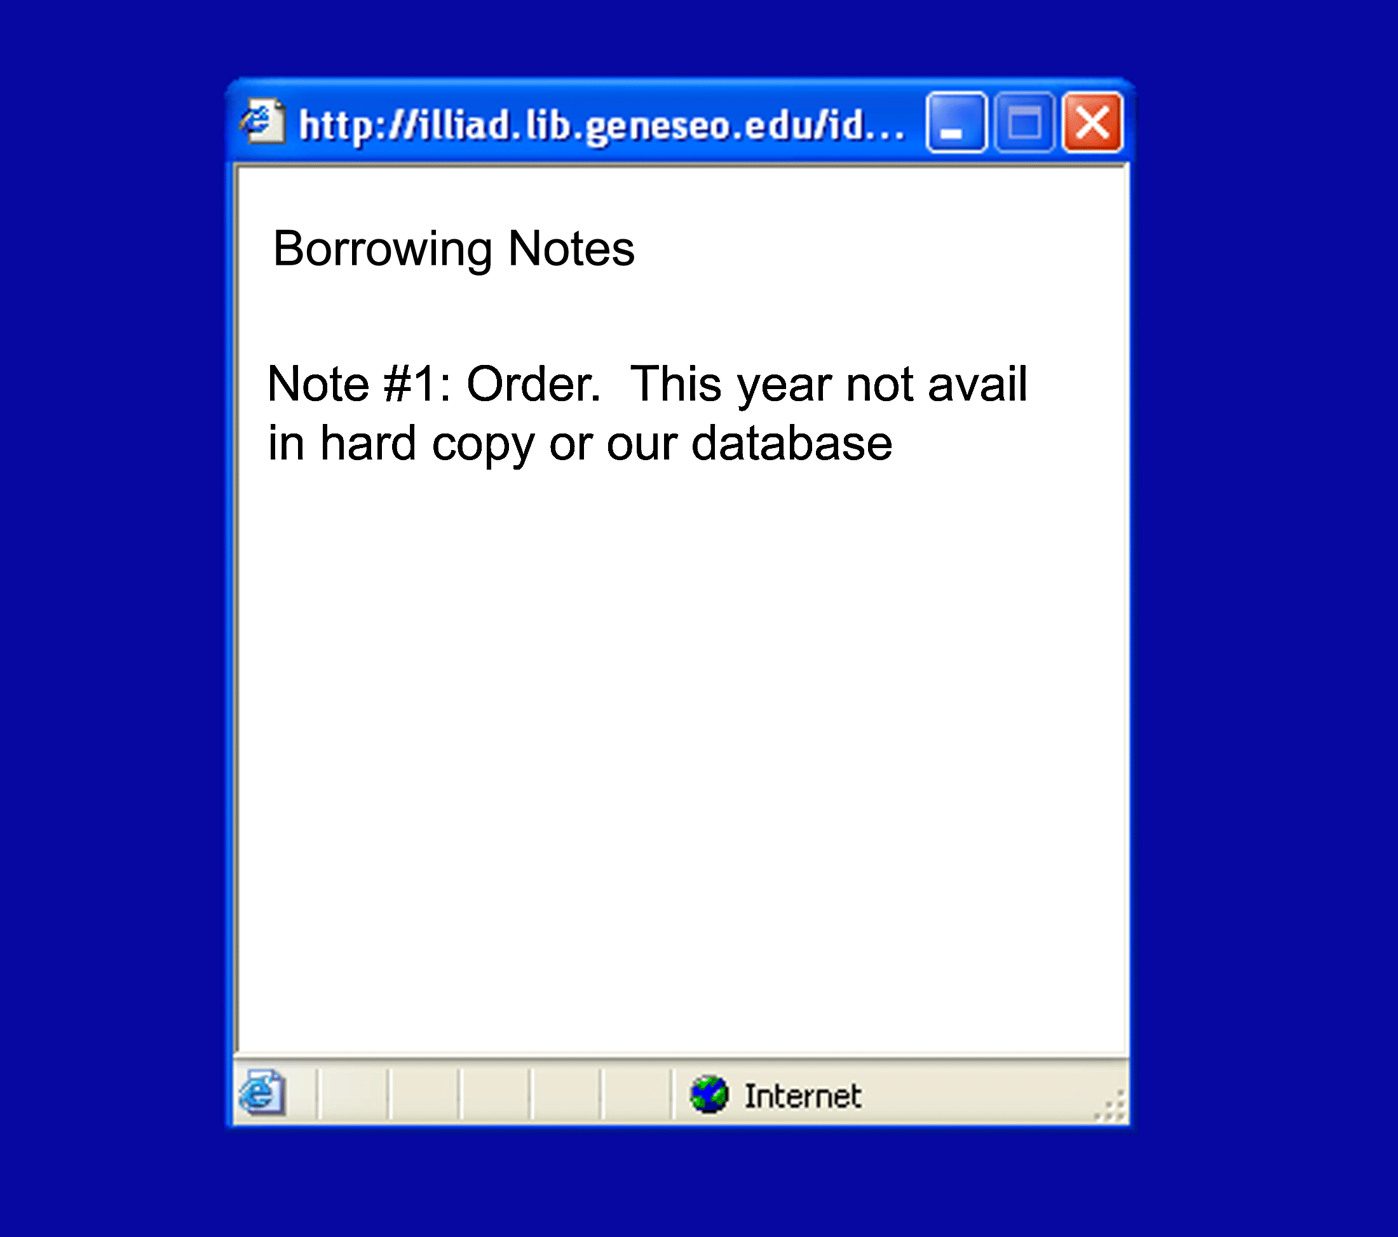
ILL Transaction Performance Analysis Module
2008 IDS Conference
18
18

Slide 19
Project Overview Chart
19

Slide 20
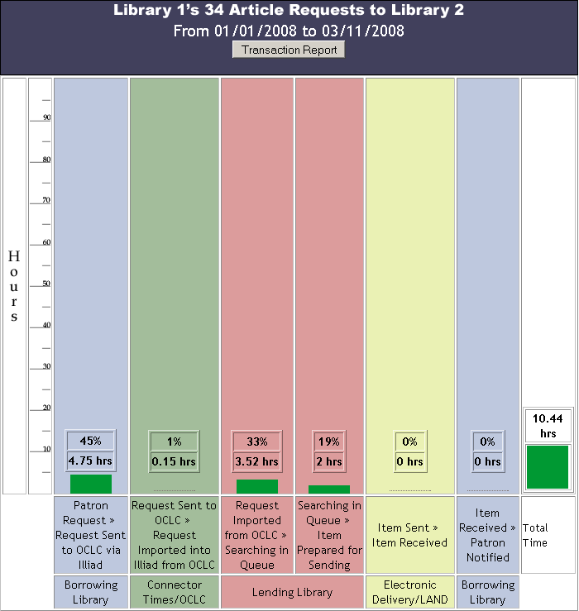
Process Overview Chart
Library 1’s 34 Article Requests to Library 2
From 01/01/2008 to 03/11/2008
Transaction Report
20

Slide 21
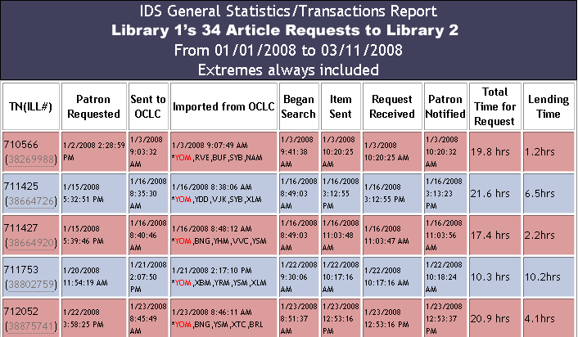
Transactions Report Table
IDS General Statistics/Transaction Report
Library 1’s 34 Article Requests to Library 2
From 01/01/2008 to 03/11/2008
Extremes always included
21

Slide 22
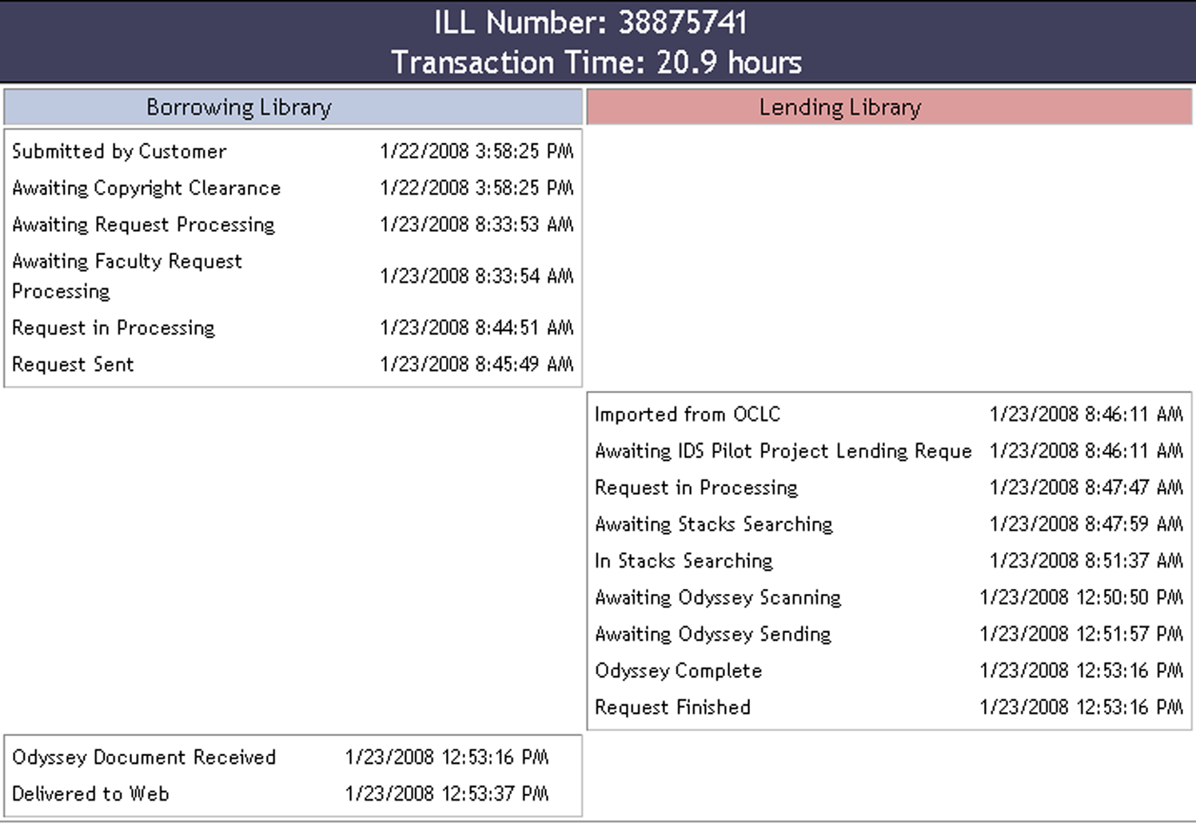
Individual ILL Transaction Report
22

Slide 23
2008 IDS Conference
23

Slide 24
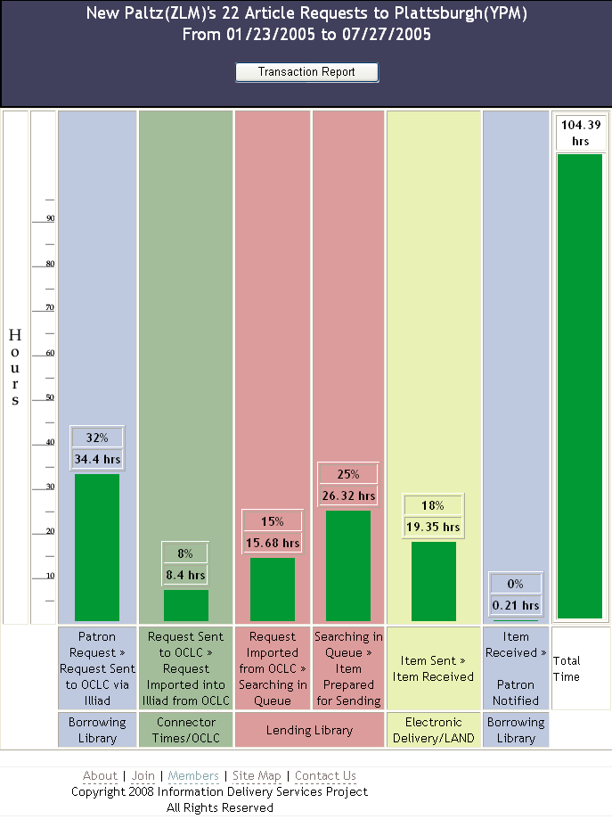
24
Notes:
Objective data for decision making & policy development

Slide 25
 | Libraries in Spring 2004 | Libraries in Spring 2005 | Libraries in Fall 2005 | Libraries in Spring 2006 | Libraries in Fall 2006
ILLIAD | 4 | 12 | 14 | 15 | 17
Odyssey | 2 | 10 | 12 | 13 | 15
Electronic Delivery to Web | 2 | 8 | 10 | 10 | 15
Custom Holdings (within Pilot Project) | 2 | 11 | 12 | 12 | 14
Direct Request in Use | 1 | 2 | 11 | 11 | 14

Slide 26
Library staff allocation and responsibilities – cross training
Work flow modifications
Staffing schedules
Odyssey Trusted Sender
26
2008 IDS Conference

Slide 27
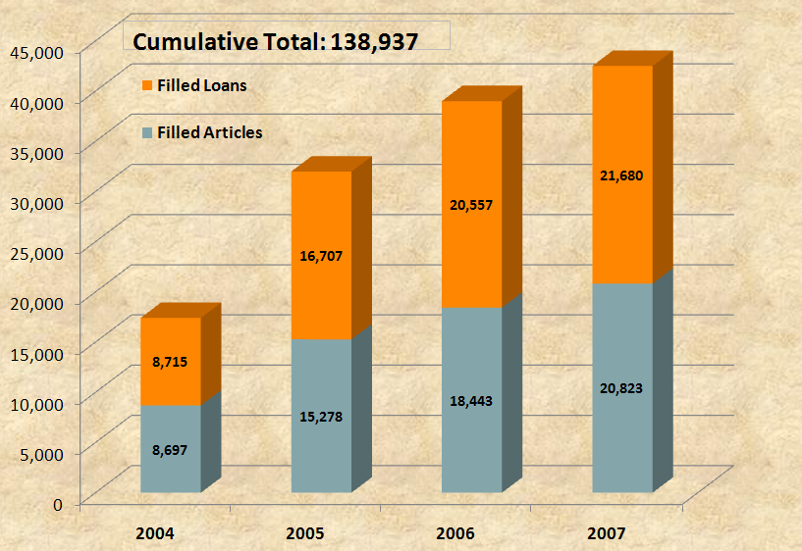
Outcomes
2008 IDS Conference
27
Notes:
APRIL 2008 ~160,000

Slide 28
Notes:
Speed of delivery – how did we do matching our benchmarks?

Slide 29
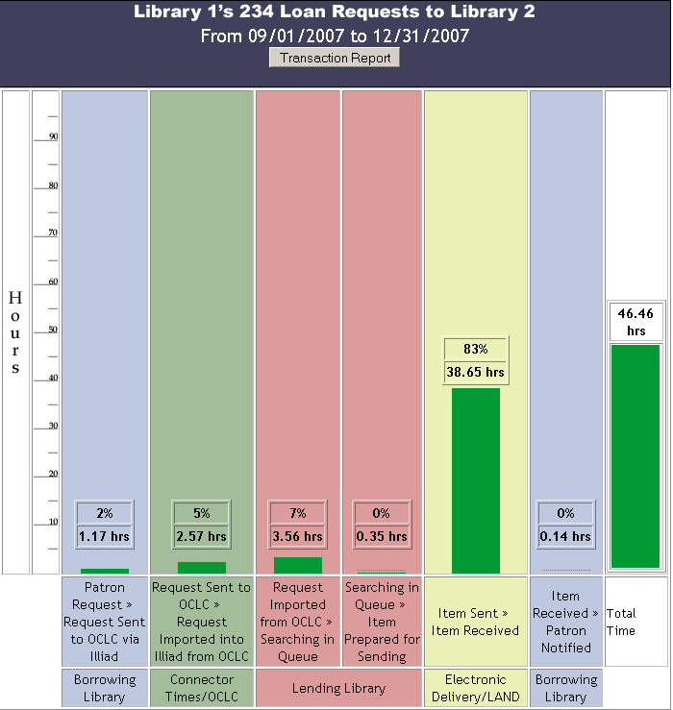

Slide 31


Slide 32
Request Type | % filled within the Project
Loans | 39%
Articles | 35%
32
2008 IDS Conference

Slide 33
But we have more journals than that!
SUNY Oswego’s Current Journal Subscriptions
Electronic: ~35,000
Print: ~300

Slide 34
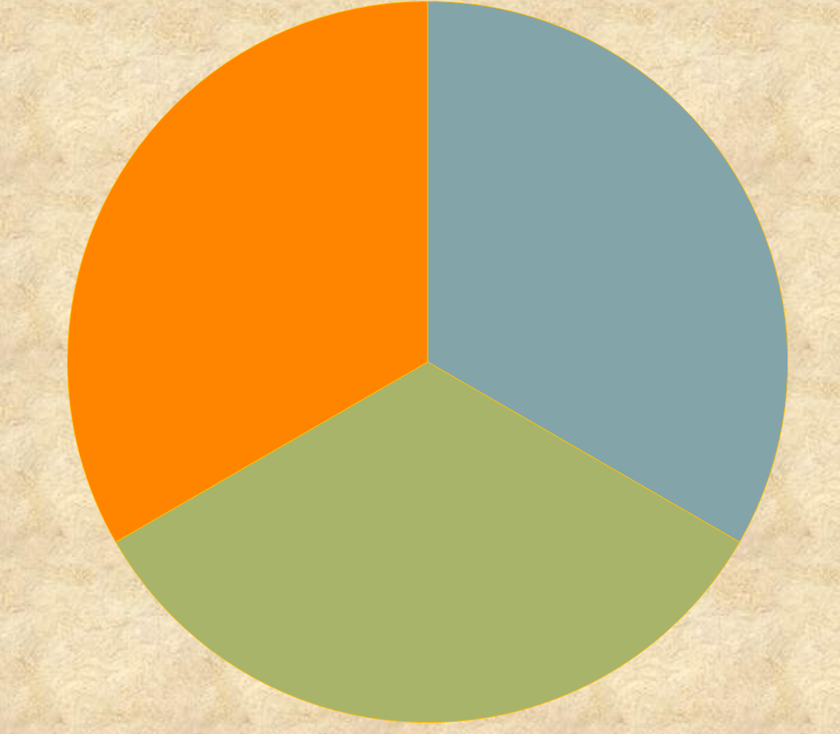
1/3 Article Requests filled within IDS Project
1/3 Article Requests unfillable within IDS Project
1/3 Article Requests fillable with Electronic Journals within IDS Project
2008 IDS Conference
34

Slide 35
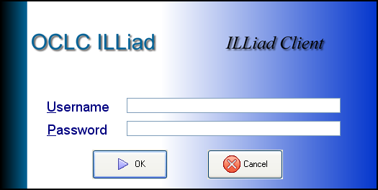
IDS Project eJournal Availability Server
IDS eJournal Availability Server
Z39.50 catalog displays ILL availability
Title, Year, Volume, Issue, License
Database of eJournals held by IDS Project libraries
Licensing Database
OpenURL
Resolvers
Notes:
Extensive sharing of eJournals via eJournal Availability Server

Slide 36

Search Process for Licenses
TARGETS | URL | License | Date Checked | Checked by | Comments
INSTITUTE OF PHYSICS JOURNALS | http://www.iop.org/EJ/librarians/-page= librarians/0031-9120/1#print | P | 2/28/2007 | Tiede | Under “librarians” page
Search for
Provider
in a
Search Engine
Enter
Information
in Database
Yes, No,
Unclear, etc.
This License
is Paper
Copy Only
1.
3.
2.
http://www.iop.org/EJ/librarians/-page=librarians/0031-9120/1#print
Q. What about interlibrary loans?
  A. Institutions October use hard copies derived directly or indirectly from the electronic edition of the publications for the purpose of inter-library loan with the same limitations that apply to paper copies for that purpose made from the print edition of the journals. Specifically, copies must be made in compliance with Section 108 of the Copyright Act of the USA and Technological Uses of Copyrighted Works (CONTU Guidelines), the text of which is available as part of USA Copyright Office Circular 21. The electronic transmission of copies of articles for inter-library loan purposes is not allowed.
Record
Response
on Table/
Chart
Can’t find?
4.
2008 IDS Conference
36
publisher

Slide 37
ILL Rights
1,830 Targets = Aggregators, providers, & publishers for over 76K journal titles
2008 IDS Conference
37
Notes:
Need # of titles…

Slide 38
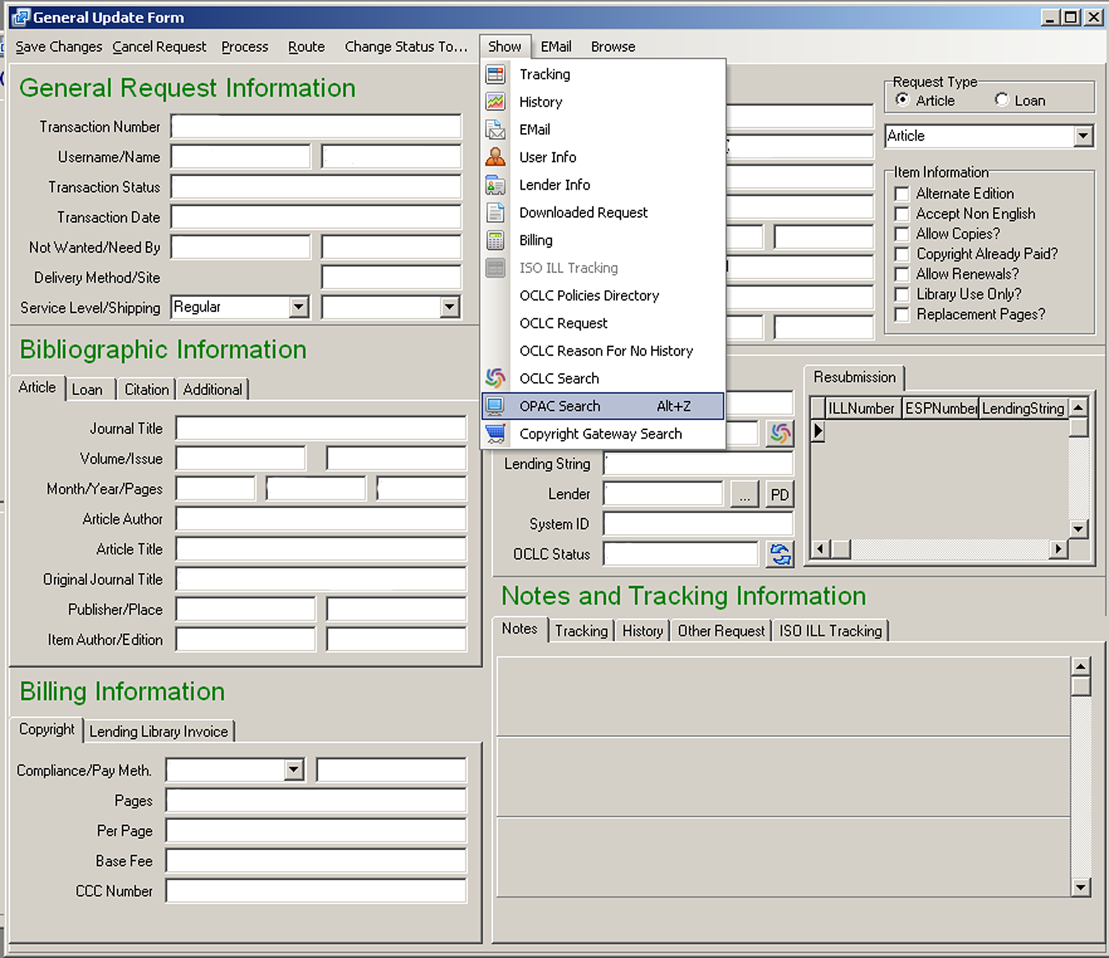
38

Slide 39
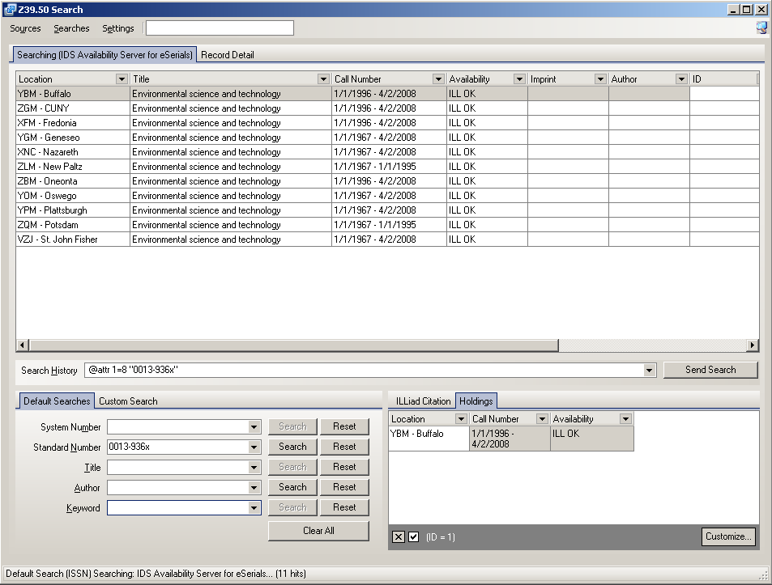
39

Slide 40
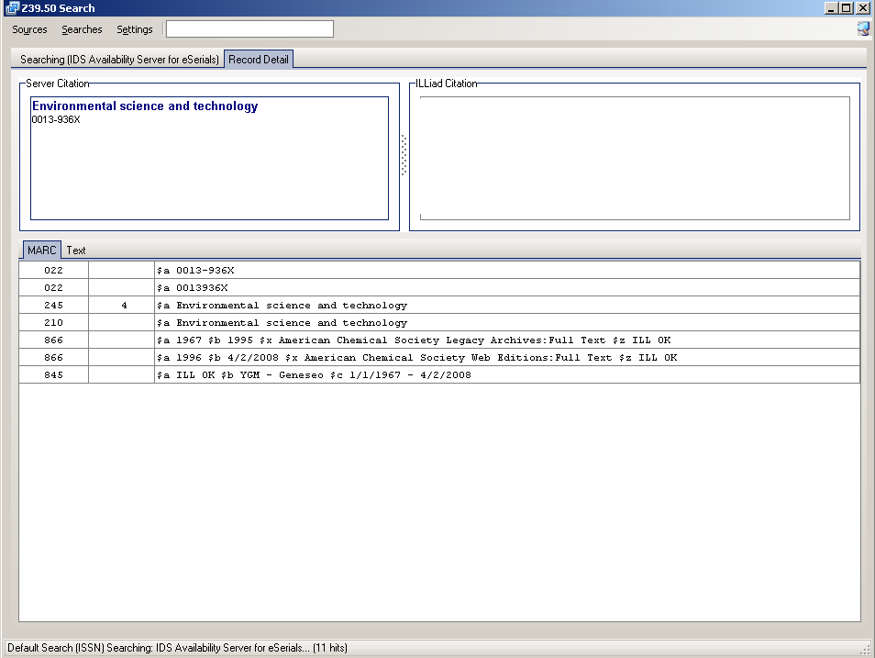
40

Slide 41
Major Features of IDS Project
Emphasis on building “a unified community of trust & support”
Trained teams of volunteer mentors (applications & technical)
User-centric definition of an ILL transaction
Handle both physical items (books, media, etc) AND articles
Contractual performance standards
Real-time, multi-level ILL transaction performance data
Objective data for decision making & policy development
Extensive sharing of eJournals via eJournal Availability Server
No startup or annual membership fees
Commitment of talent and time of members
2008 IDS Conference
Notes:
$40K is the actual dollar amount used in the project to date, money came from SUNY OLIS and 3Rs grants.

Slide 42
Thank you
IDS Project Contact Information
URL: IDSProject.org
42
2008 IDS Conference

