Slide 1
Resource Sharing: Where Are Requests Taking Us?
SYLLABICATION: | re·quest
TRANSITIVE VERB: | Inflected forms: re·quest·ed, re·quest·ing, re·quests 1. To express a desire for; ask for. Often used with an infinitive or clause: requested information about the experiment; requested to see the evidence firsthand; requested that the bus driver stop at the next corner. 2. To ask (a person) to do something: The police requested her to accompany them.
NOUN: | The act of asking. Something asked for.
IDIOMS: | by request In response to an expressed desire: We are offering these scarves for sale again by request. in request In great demand: a pianist in great request. on (or upon) request When asked for: References are available on request.
ETYMOLOGY: | From Middle English requeste, the act of requesting, from Old French, from Vulgar Latin *(rs) requaesita, (thing) requested, from alteration of Latin requsta, feminine past participle of requrere, to ask for. See require.
Cyril Oberlander, SUNY Geneseo
IDS Project Conference 2008
Notes:
Does anyone know what our users really want? How valuable is that information to your organization and your allocation of resources? Sometimes outside consultants are even paid to do this kind of work. What would you do with their needs assessment? Imagine if you had a list of what they wanted? PAUSE
Wait a minute, we already have an active and ongoing list of what users want, in the form of a ILL request.
So our fundamental question is what do we do with their requests, rich with bibliographic data such as publisher, LC#, date, and user data, such as departments, status, format and language preferences, etc. I guess it depends on our policies, for example, 10-15% of borrowing requests received by most ILL shops are routinely cancelled because the materials the user is asking for is on the shelf or available online. I call this cancellation notice the go fish email, and it’s often a result of how we perceive the user’s discovery competence, the discovery tools effectiveness, and/or our capacity to go fish for our users. More and more, libraries are migrating to free document delivery because they are realizing that the request is to GET IT, not filter it.
Sometimes when we go out looking for answers, we only need to question the perspective to value what is delivered to our doorstep. Requests are a lot more than just asking for something, CLICK Requests are a form of collaboration with our users, it’s a unique point at which we share a task, and together, we learn a great deal about each other. How many people here are expert at borrowing processing? How many of you know what your faculty researchers are up to? Do we realize the opportunity and value we provide researchers, sponsored research, and promotions and tenure?

Slide 2
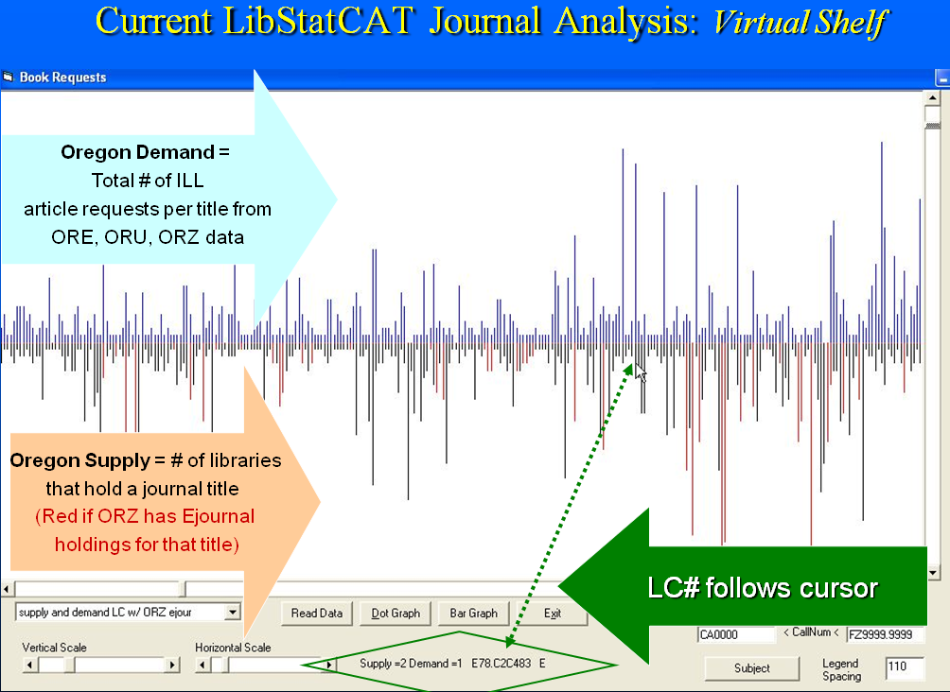
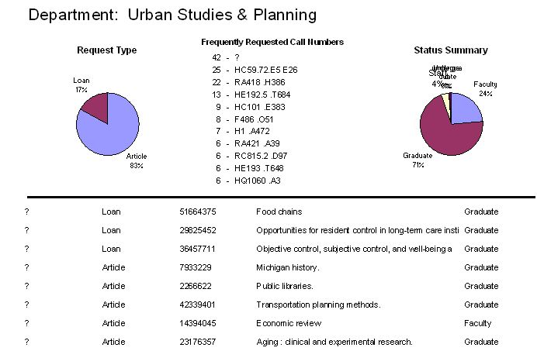
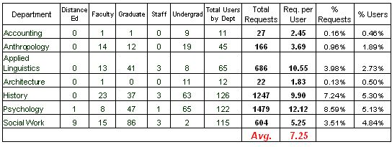
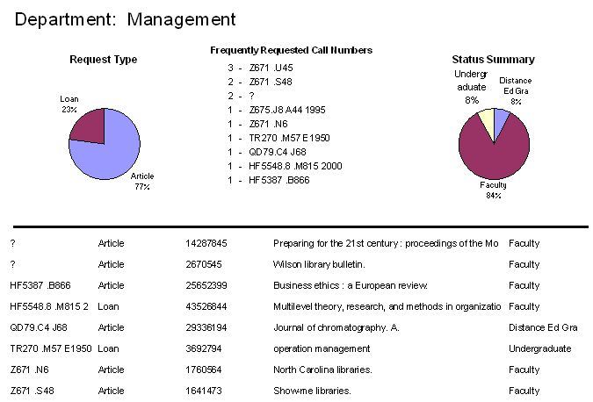
Resource Sharing: Where Are Requests Taking Us?
SYLLABICATION: | re·quest
TRANSITIVE VERB: | Inflected forms: re·quest·ed, re·quest·ing, re·quests 1. To express a desire for; ask for. Often used with an infinitive or clause: requested information about the experiment; requested to see the evidence firsthand; requested that the bus driver stop at the next corner. 2. To ask (a person) to do something: The police requested her to accompany them.
NOUN: | The act of asking. Something asked for.
IDIOMS: | by request In response to an expressed desire: We are offering these scarves for sale again by request. in request In great demand: a pianist in great request. on (or upon) request When asked for: References are available on request.
ETYMOLOGY: | From Middle English requeste, the act of requesting, from Old French, from Vulgar Latin *(rs) requaesita, (thing) requested, from alteration of Latin requsta, feminine past participle of requrere, to ask for. See require.
Cyril Oberlander, SUNY Geneseo
IDS Project Conference 2008
Notes:
Does anyone know what our users really want? How valuable is that information to your organization and your allocation of resources? Sometimes outside consultants are even paid to do this kind of work. What would you do with their needs assessment? Imagine if you had a list of what they wanted? PAUSE
Wait a minute, we already have an active and ongoing list of what users want, in the form of a ILL request.
So our fundamental question is what do we do with their requests, rich with bibliographic data such as publisher, LC#, date, and user data, such as departments, status, format and language preferences, etc. I guess it depends on our policies, for example, 10-15% of borrowing requests received by most ILL shops are routinely cancelled because the materials the user is asking for is on the shelf or available online. I call this cancellation notice the go fish email, and it’s often a result of how we perceive the user’s discovery competence, the discovery tools effectiveness, and/or our capacity to go fish for our users. More and more, libraries are migrating to free document delivery because they are realizing that the request is to GET IT, not filter it.
Sometimes when we go out looking for answers, we only need to question the perspective to value what is delivered to our doorstep. Requests are a lot more than just asking for something, CLICK Requests are a form of collaboration with our users, it’s a unique point at which we share a task, and together, we learn a great deal about each other. How many people here are expert at borrowing processing? How many of you know what your faculty researchers are up to? Do we realize the opportunity and value we provide researchers, sponsored research, and promotions and tenure?

Slide 3
Resource Sharing: Where Are Requests Taking Us?
SYLLABICATION: | re·quest
TRANSITIVE VERB: | Inflected forms: re·quest·ed, re·quest·ing, re·quests 1. To express a desire for; ask for. Often used with an infinitive or clause: requested information about the experiment; requested to see the evidence firsthand; requested that the bus driver stop at the next corner. 2. To ask (a person) to do something: The police requested her to accompany them.
NOUN: | The act of asking. Something asked for.
IDIOMS: | by request In response to an expressed desire: We are offering these scarves for sale again by request. in request In great demand: a pianist in great request. on (or upon) request When asked for: References are available on request.
ETYMOLOGY: | From Middle English requeste, the act of requesting, from Old French, from Vulgar Latin *(rs) requaesita, (thing) requested, from alteration of Latin requsta, feminine past participle of requrere, to ask for. See require.
To a user-centric focal point - where they want us to be.
To a point of need – a unique opportunity.
Towards a new model – a dialogue & participatory migration plan
Cyril Oberlander, SUNY Geneseo
IDS Project Conference 2008
Notes:
Does anyone know what our users really want? How valuable is that information to your organization and your allocation of resources? Sometimes outside consultants are even paid to do this kind of work. What would you do with their needs assessment? Imagine if you had a list of what they wanted? PAUSE
Wait a minute, we already have an active and ongoing list of what users want, in the form of a ILL request.
So our fundamental question is what do we do with their requests, rich with bibliographic data such as publisher, LC#, date, and user data, such as departments, status, format and language preferences, etc. I guess it depends on our policies, for example, 10-15% of borrowing requests received by most ILL shops are routinely cancelled because the materials the user is asking for is on the shelf or available online. I call this cancellation notice the go fish email, and it’s often a result of how we perceive the user’s discovery competence, the discovery tools effectiveness, and/or our capacity to go fish for our users. More and more, libraries are migrating to free document delivery because they are realizing that the request is to GET IT, not filter it.
Sometimes when we go out looking for answers, we only need to question the perspective to value what is delivered to our doorstep. Requests are a lot more than just asking for something, CLICK Requests are a form of collaboration with our users, it’s a unique point at which we share a task, and together, we learn a great deal about each other. How many people here are expert at borrowing processing? How many of you know what your faculty researchers are up to? Do we realize the opportunity and value we provide researchers, sponsored research, and promotions and tenure?

Slide 4
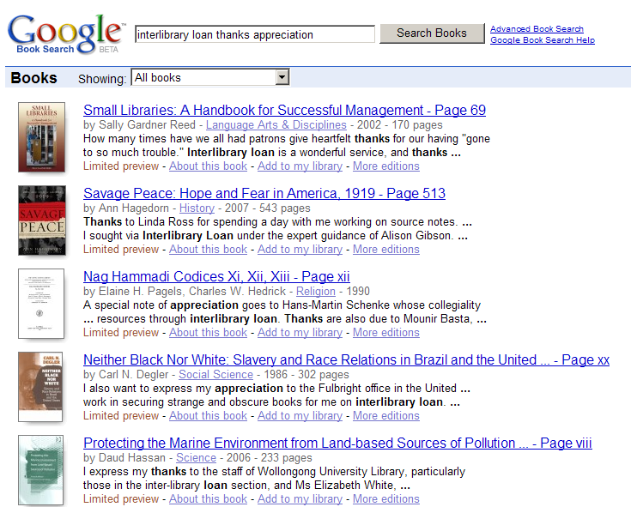
Resource Sharing: Where Are Requests Taking Us?
Notes:
It is pretty obvious, because of your service to research, scholarship, teaching and learning, ILL staff are cited very frequently in books, and with a easy search in Google books, we can begin to take notice of that fact.
Accolades' aside, how is the information from your user’s request (their voice) and the knowledge you possess about their needs relate to the design of service and allocation of resources at your library? Amazon’s recommendation services can be a model, but what is the academic counterpart? Asking research interest, level (conspectus style)PAUSE

Slide 5
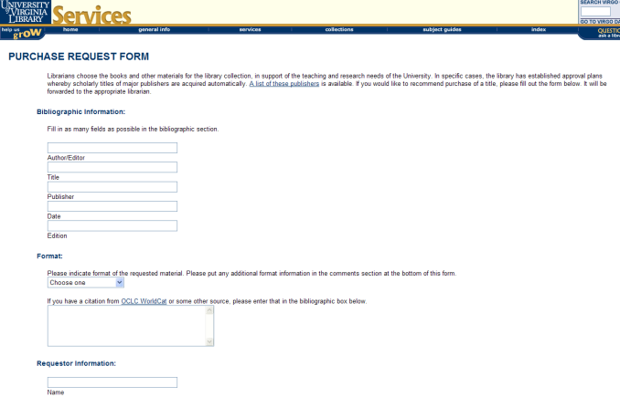
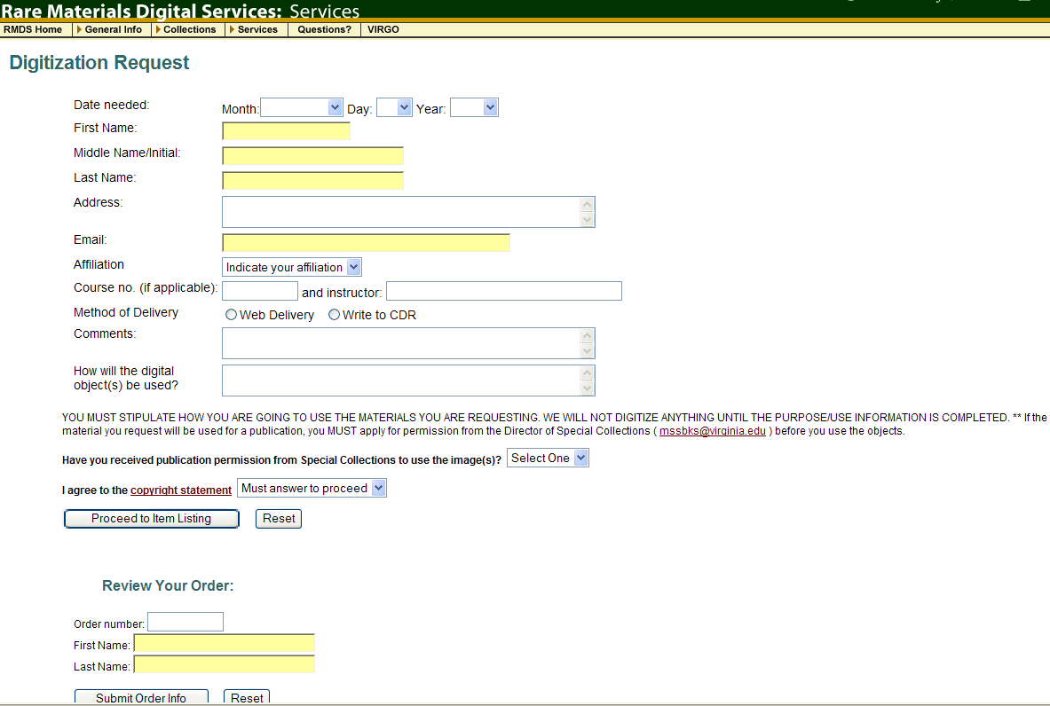
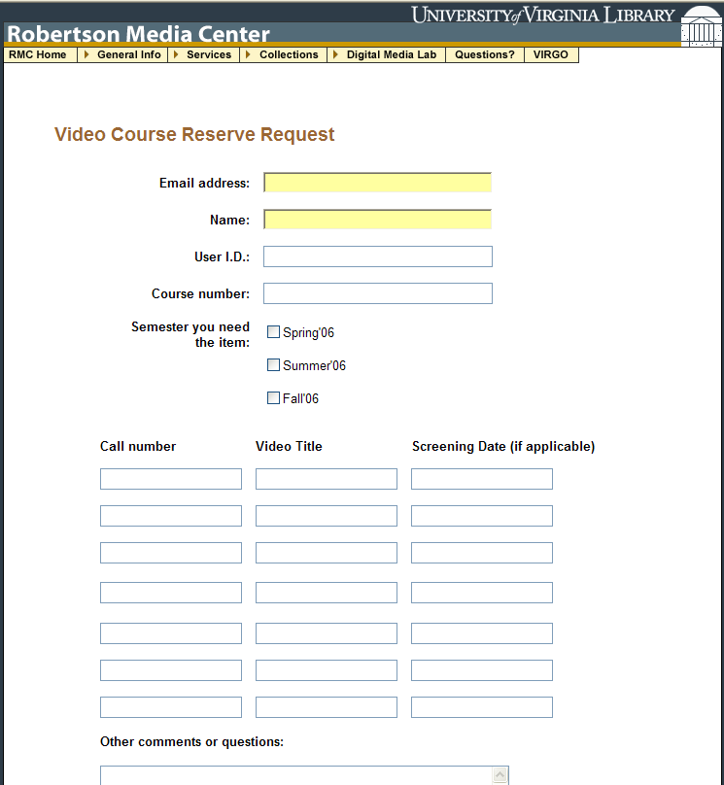
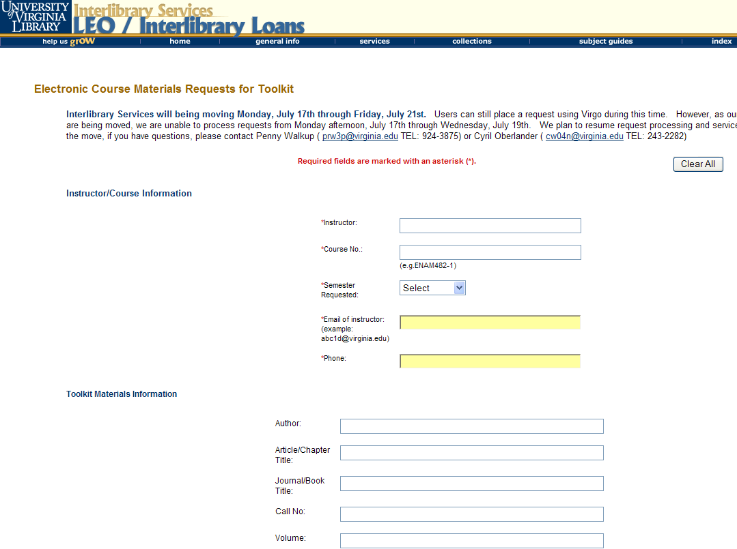
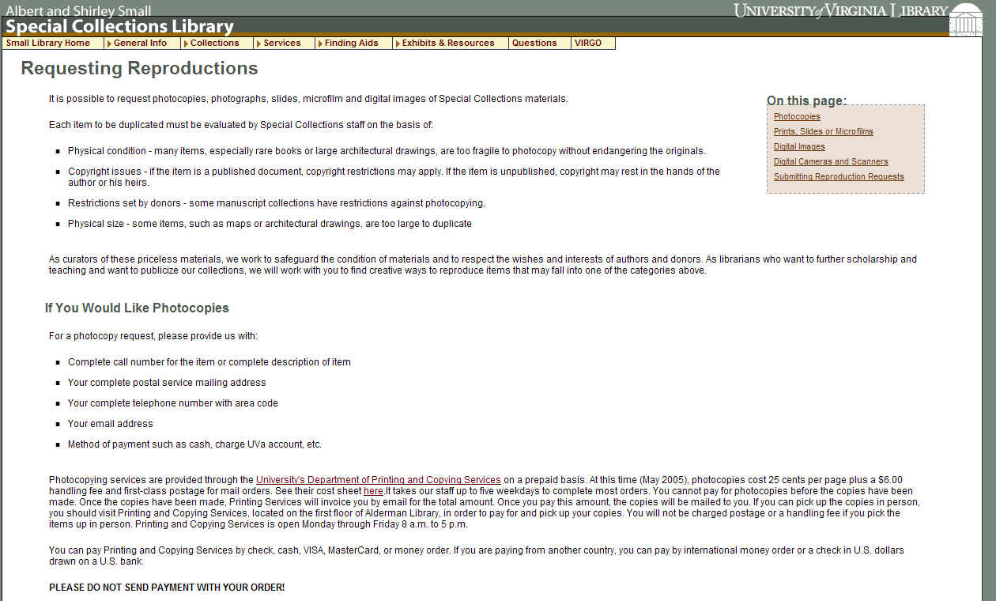
Service Request – in what context?
Rare Materials Scan Request
Purchase Request
Video Booking Request
Services are segmented by
Request Systems that
Reinforce functional divisions
E-Reserve Request
Special Collection Duplication Request
Notes:
Moreover, how does the very fractured service design or request environment make sense to users? CLICK Seems to me, they only reinforce the internal and legacy divisions of a library, and therefore reduce any benefits from rethinking what a request really is, and what context and workflow can do with building partnerships between libraries and users.

Slide 6
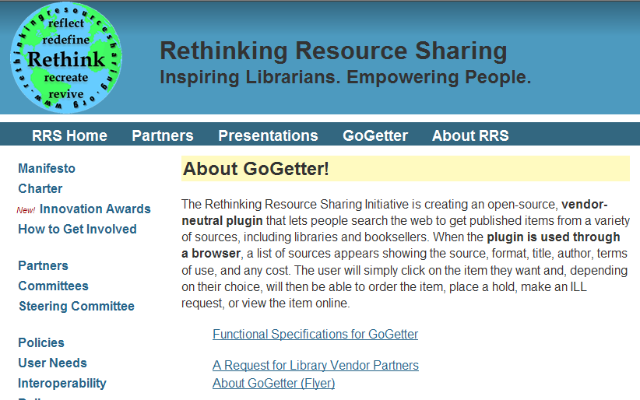
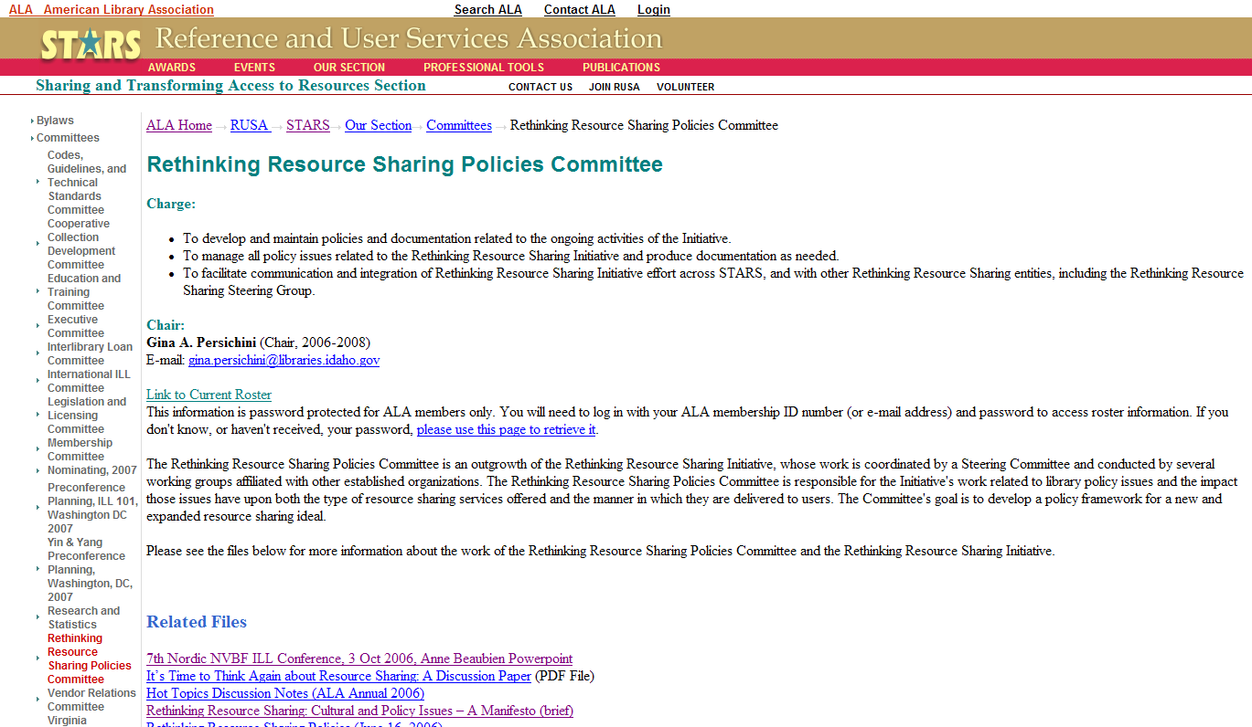
Rethinking Resource Sharing
http://www.ala.org/ala/rusa/rusaourassoc/rusasections/stars/starssections/committeesa/rrscomm/rrscomm.htm
Paraphrasing the Cultural and Policy Issues Manifesto:
Keep any service restrictions to the lowest-possible-barriers-to-fulfillment.
Expand and/or provide delivery options.
Encourage global access.
Share resources and expertise.
Provide reference service opportunities with any “can’t supply” messaging.
Offer fair or fee based service to non-authorized users, in lieu of refusing service.
Make registration as easy as signing onto a commercial web service.
Everyone can be a library user.
Notes:
Rethinking RS Initiative AD HOC The various groups in RRS is looking to rethink resource sharing, and although the slightly touch upon the relationship between service points, they are still very focused on how libraries share materials between libraries. Perhaps the project that has the most potential for changing what a request means, is the GoGetter firefox toolbar, which promises to enable users an easy way to place ILL requests from any website, which means requesting just about anything. Is everyone ready for that? Did I mention that the tool is designed for users, not libraries. LibX is interested in offering something similar. If people are following worldcat local implementations, the often reported increases of over 100% in borrowing may only be a small measure of the potential impact from user interfaces that mash up our request systems. Did I mention the good news – it’s likely ILL business will continue to grow, and with the hundreds of millions of bibliographic items being added to OCLC from foreign libraries, our work is only getting more interesting. So what makes sense to expect?

Slide 7
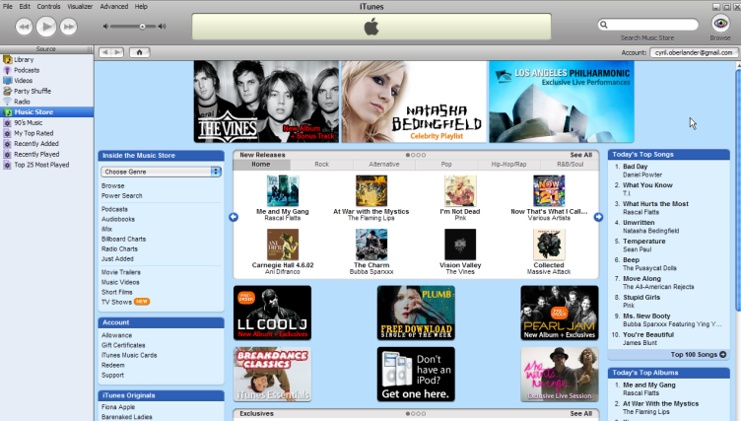
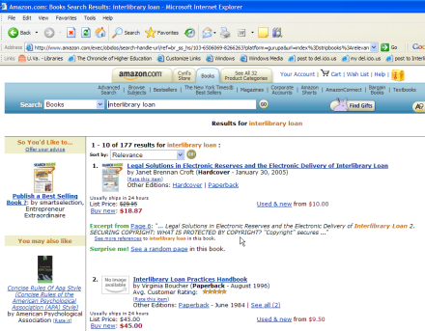

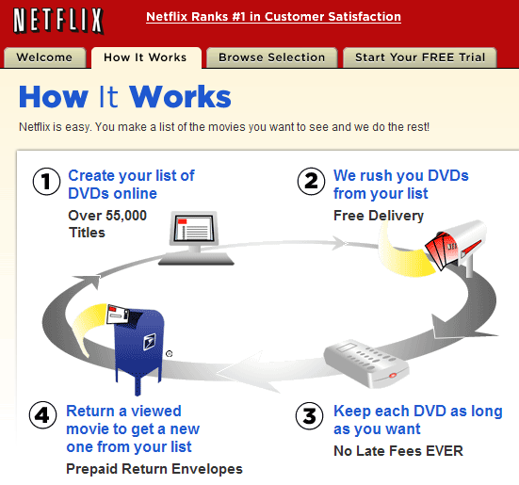

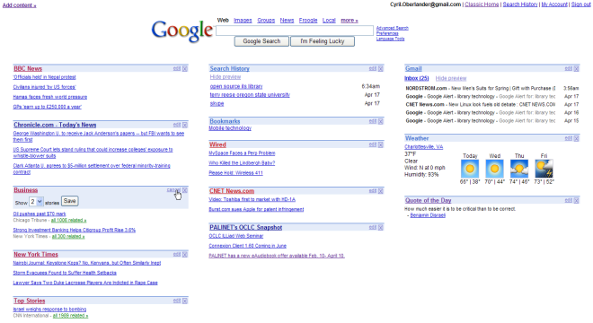
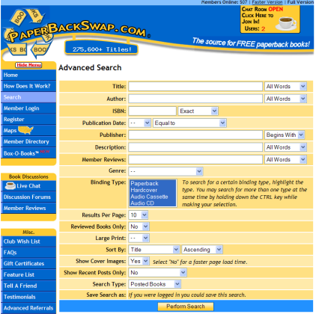
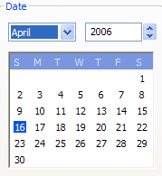
Workflow=
Service Sense Making
User Search
& Discovery
Get Options
Find it @ your Library
or drive to another library,
or ILL from your Library,
or request Library buy it.
Notes:
User expectations will continue being shaped by web services, and we have to rethink how we deliver services.
What are core assumptions about discovery and delivery services?
What make’s sense is to ask our users, however, do we really want to know?

Slide 8
Transforming Focus
Discovery isn’t our problem – Service Delivery is
“main frustration is not with the research discovery services themselves, but with the problem of subsequently accessing identified sources and materials.” Research Information Network (2006) survey of researchers.
“We now have a situation in which users may discover items in online indexes or online library catalogues then hit a dead end as far as delivery is concerned. This is a dangerous situation for the role of libraries in general. If libraries collectively do not seek to find ways to get around these dead ends others will.” Gatenby & Goldner, 2005
Notes:
While libraries are increasingly focusing their programming talents and money on their discovery systems, hoping this isn’t a tragic irony, the real problem may be one of access and delivery.
Point out the disparity between how much effort libraries are undertaking on discovery, at a time when delivery is a significant user need/challenge. But how do we know what users really want?

Slide 9
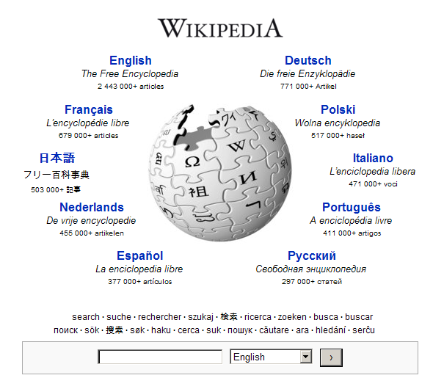
Emerging Content & Community
Library’s collection and resources focus on: Structured & Fee Content
Fee
Library &
Publishers
World
Wide
Web
Unstructured
Structured
Free
Notes:
The world of content is growing, and much of it focuses on new online communities, however, our traditional focus is on scholarly works. What should our role be (as library or resource sharing service) with unstructured and semi-structured resources? And How will our service be affected by it? CLICK (Anyone see wikipedia in the citedin ILLiad field lately?)
2001 - the year we were supposed to be talking to Hal the computer, turned out to be more human or community centered knowledge than we thought – 2001 was the year an incredible multilingual, web-based free content encyclopedia project began, and now it’s ranked the top educational site that contains more than 10M articles with over 250 languages and over 75K contributors. Is this resource sharing too? Do we partner with it; some libraries for instance contribute to wikipedia to dramatically enhance the discovery and access of their digital collections. Emergent content and distribution channels are important to us, not only in the context of our user’s environment, but increasingly, what opportunities that new environment offers our services.

Slide 10
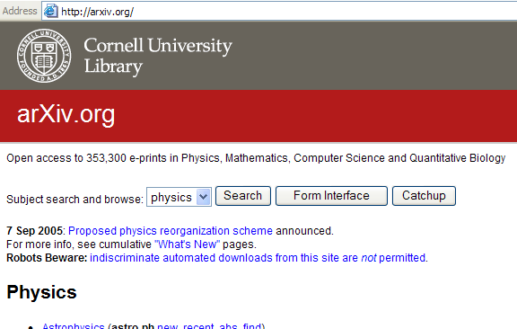
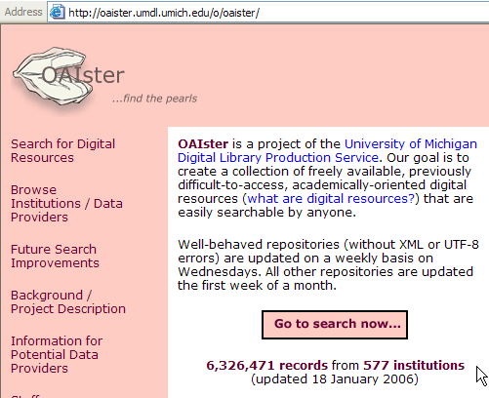
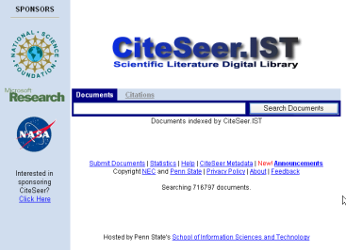
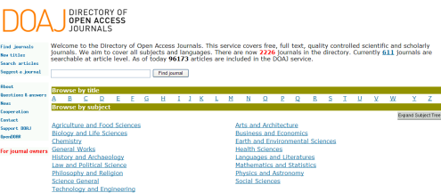
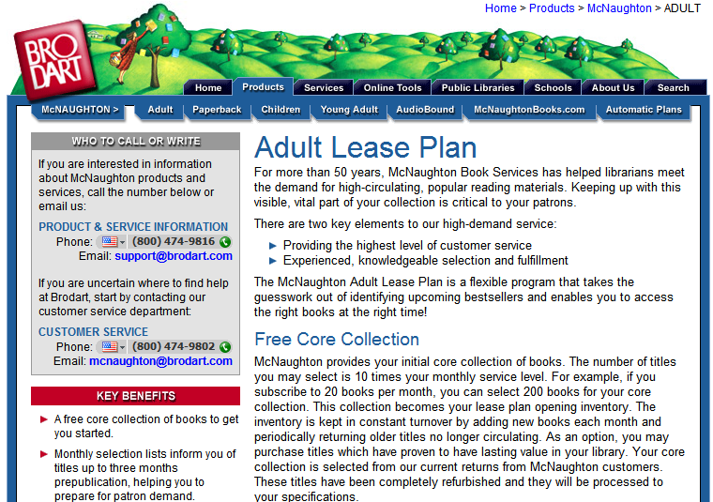
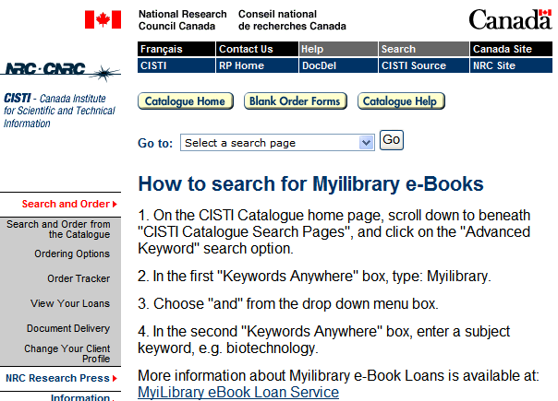
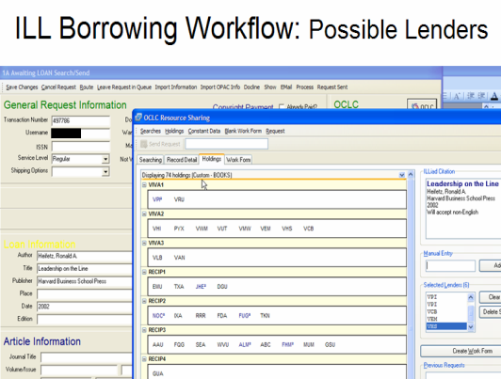
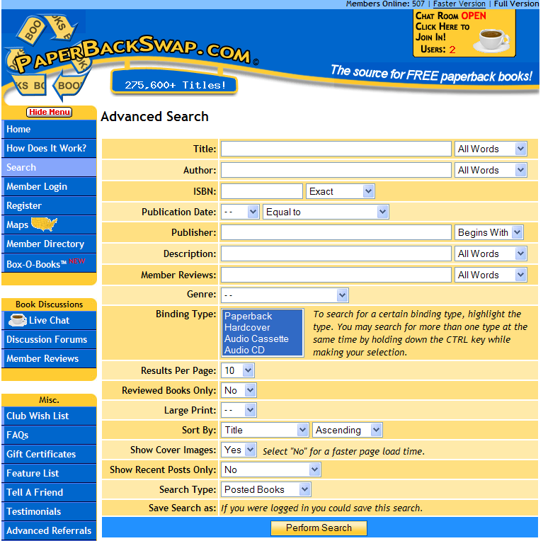
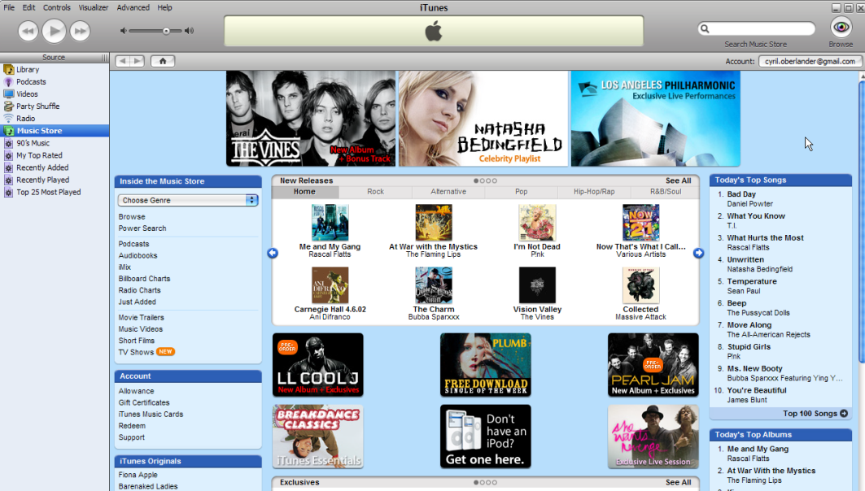
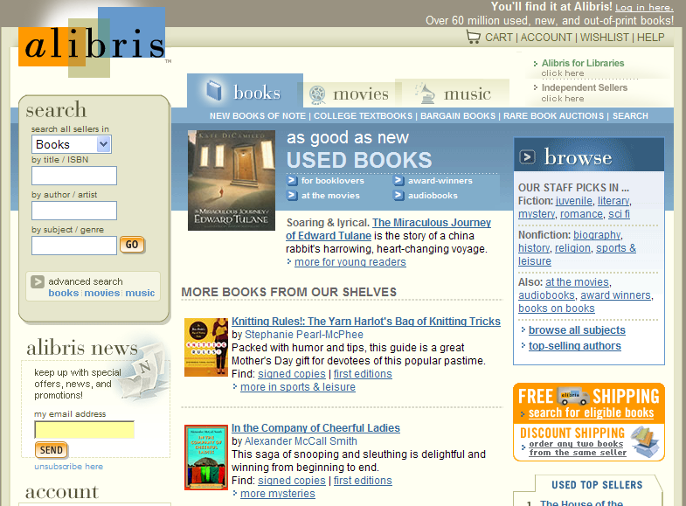

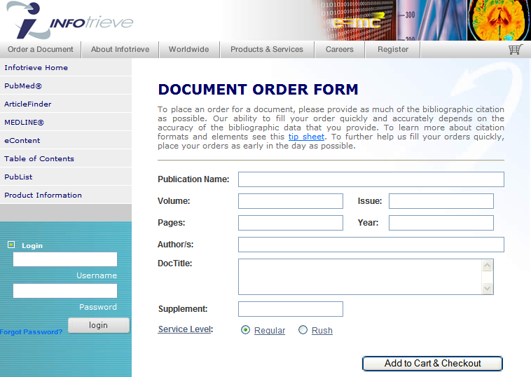
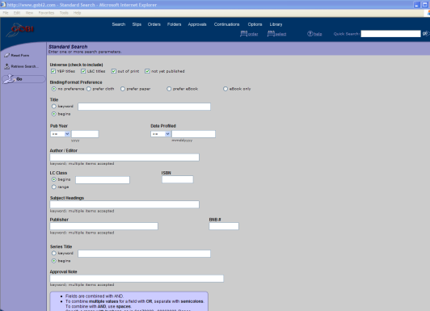
Sense-making depends: format, rent, buy, or borrow
Free Domain
Context
Sensitive
Workflow
Borrowing / Library Domain
Renting
Domain
Buying Domain
Notes:
While the name Interlibrary Loan conveys traditional library to library partnering, which successfully filled over 41K requests per day in OCLC in 2003, the reality of our workflow is increasingly being pulled to other resources of interest because it makes sense to the needs of the user and to the library. EXPLAIN domains – show playbook.
While we attempt to scale best practices and automated workflow for the traditional borrowing domain, the workflow for the emergent domains have far to go. While I encourage experimenting with these services, these explorations will scale well once we ask the right questions of our users by expanding the range of questions about format, etc., but also develop the profiles, like collection development policy and profiles, that help us make better sense between what the user and what the library want.
Besides diversifying our potential sources, we have to decide what weight, or criteria to apply for user requests and content containers and providers. Let’s apply some scenarios that may help illustrate what I mean…

Slide 11
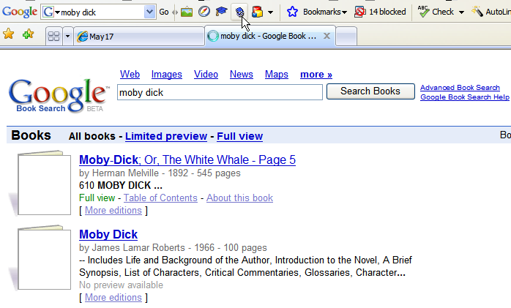
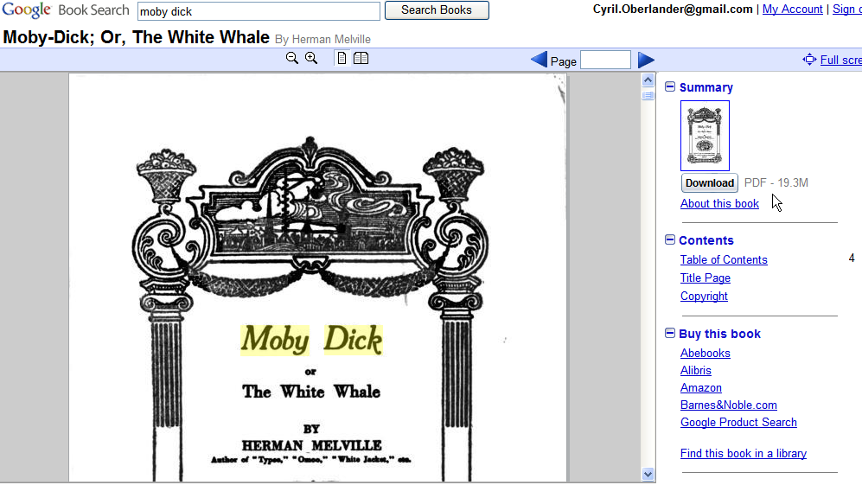
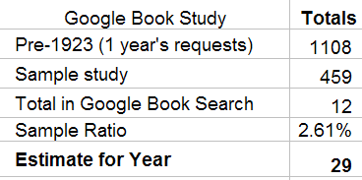
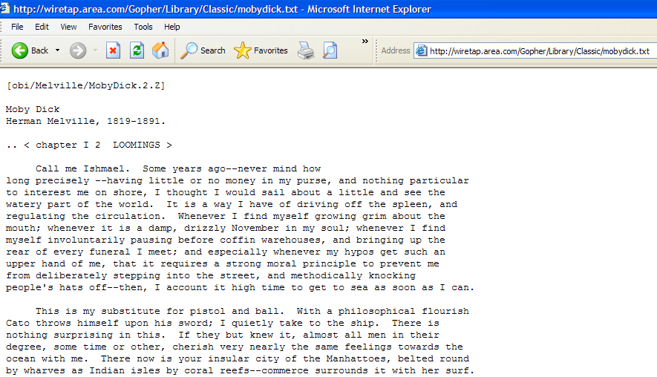
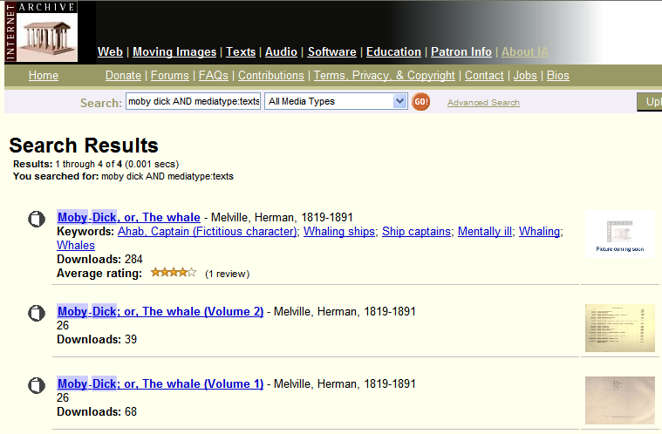
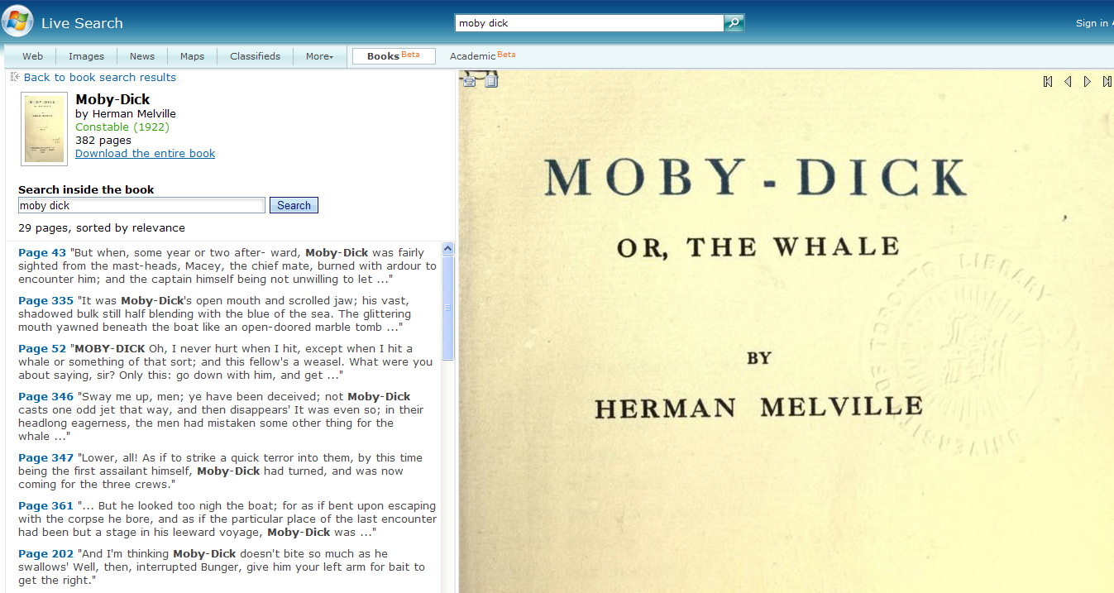
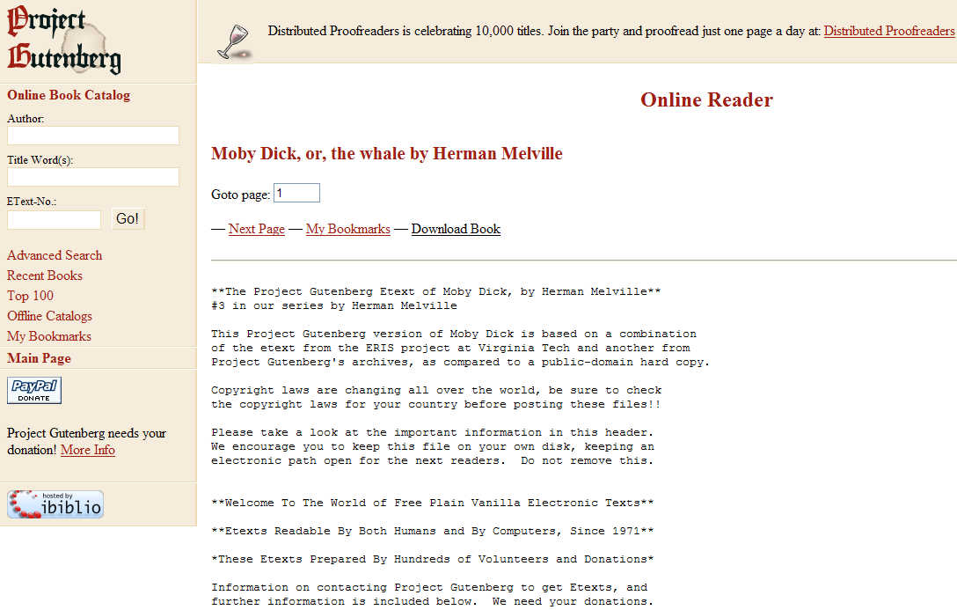
Looking for Moby
UVA ILL 2005/2006 Data
2006/2007
Over 23% were found in Google Book
Notes:
How many of us check Google Books, or other catalogs of free e-books to satisfy user requests? When looking for a white whale, it’s clear the internet is rich with them. CLICK to 23% - When is the tipping point for changing our workflow to look here first?
Maybe that is the cart before the horse though, are we asking the right question: How many of us ask users if electronic books is an acceptable format in our request forms?

Slide 12
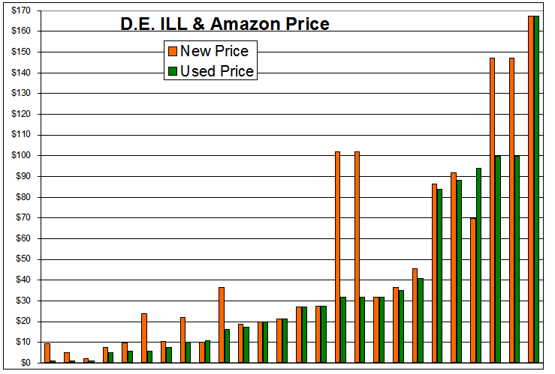
What makes sense with dollar books?
Sample of 52 D.E. ILL requests:
50% available to purchase in Amazon
Avg. cost to acquire & catalog: $83.10
Almost 6%
for $1
Est. cost of ILL & D.E. Service: $26.78
Avg. cost for ILL: $17.50
Avg. cost for Consortia Circulation: $2.04-14.70
Notes:
As we look more closely into the idea of purchasing instead of borrowing, the case of remote users or distance education ILL requests are the most bizarre.
CLICKS Looking at these costs of doing business, and that the Internet book market, many thanks to library weeding projects, make it possible to buy good condition used books for one dollar; we have to face the question, do we really want to borrow, or even own these books?
Looking at the realities of the Internet book market isn’t the only emergent service that makes me question assumptions that point us continually at borrowing.

Slide 13
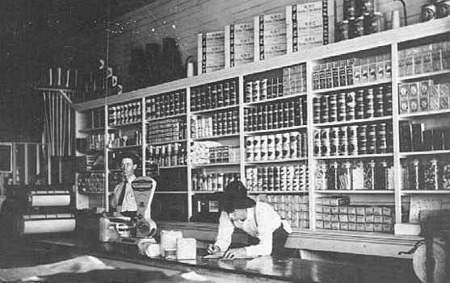


Resource Sharing
Resource Shopping
In 2004, OCLC ILL traffic’s frequently requested titles included:
3,187 requests for The DaVinci Code
1,197 requests for The Secret Life of Bees
Average ILL cost $17.50 for borrowing library Almost $30 for borrowing + lending libraries (ARL 2002)
$13.79 New
$9.44 Used
$22.94 New
$12.94 Used
Save
Over 26%
Save
Over 46%
Notes:
Image: http://www.d.umn.edu/cla/faculty/troufs/Buffalo/images/pf056932.jpg
2004 Data on DaVinci Code and Secret Life of Bees comes from a report prepared by Aric Rubin, Alibris.
Buy New Buy Used Borrow 22.94 12.94 17.5 davinci code 13.79 9.44 17.5 secret life of bees secret life of bees davinci code 53.9% 73.9% 1197 req. 46.1% 26.10% 3187 req. 4.5675 12.94 2004 Aric Rubin, Alibris

Slide 14
April 6, 2008 a day in the life of ILL…
On April 6, 2008, 110 borrowing requests for loans came into SUNY Geneseo, of these…
20.9% or 23 items could not be purchased from Amazon
79.1% or 87 items could be purchase from Amazon
  If monograph budgets didn’t matter…
  Of those 87 items that could be purchased from Amazon:
  Purchased used for a grand total of $2,224.71 coming to $25.57 per item.
  Purchase new (3 could only be purchased used) for a grand total of $2,851.27 coming to $32.77 per item.
However…
Over 1/3 could be purchased used for less than $10 (almost 1/5 for less than $5).
Over 1/5 could be purchased new for less than $10.
46% could be purchased for under the ARL unit cost for borrowing: $17.50
2 DVD requests could be filled for under $6 each (used), or under $10 each (new).
2 Music CD requests could be filled for under $9 each (used), or under $14 each (new).
When should we evaluate buying options?
Notes:
Sometimes it just takes looking at one day’s requests to see possibilities. Highlight
Explain that reality of weeding for 10-20 years.
Explain that while one strategy is an individual library’s choice, there are other models to consider…

Slide 15
IDS Project 2006/2007 Data: Unfilled within IDS Libraries
Articles Subscription Cost
79 requests for Early Child development and Care $2,973
57 requests for Terrorism and Political Violence $610
51 requests for Archives of general psychiatry $490
Loans New Cost
15 requests for Synthesis and optimization of digital circuits $135.69
7 requests for Treatise on harmony $10.10
6 requests for The pursuit of happyness $3.24
What does this data mean to us? Options:
Coordinated Collection Development
Shared Collections, including shared leased collections
Workflow and Service opportunities

Slide 16
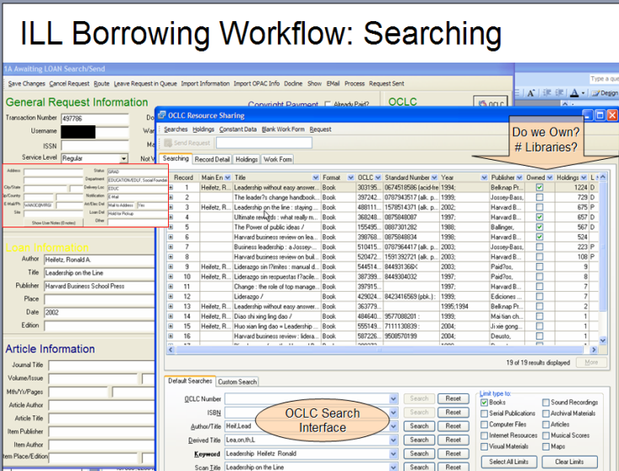
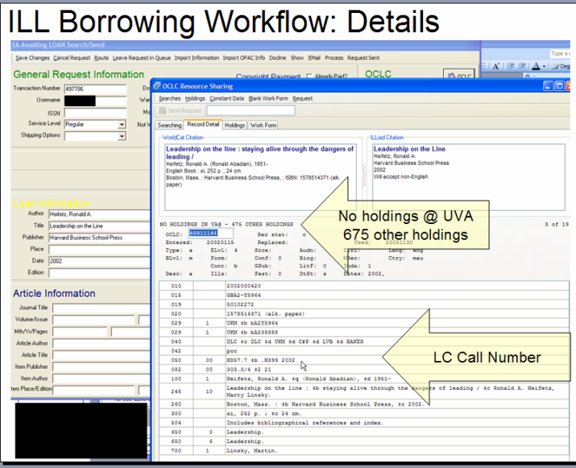
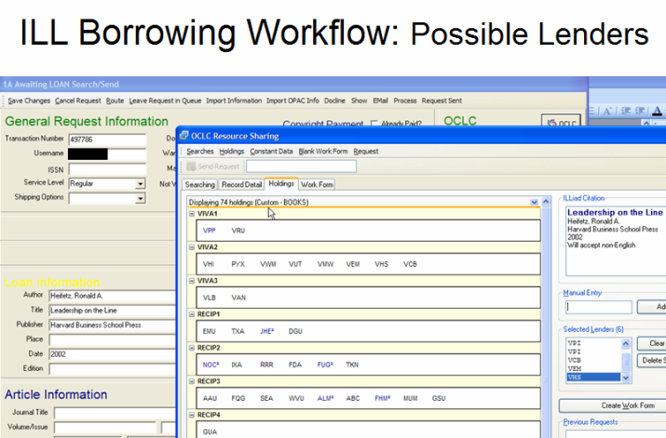
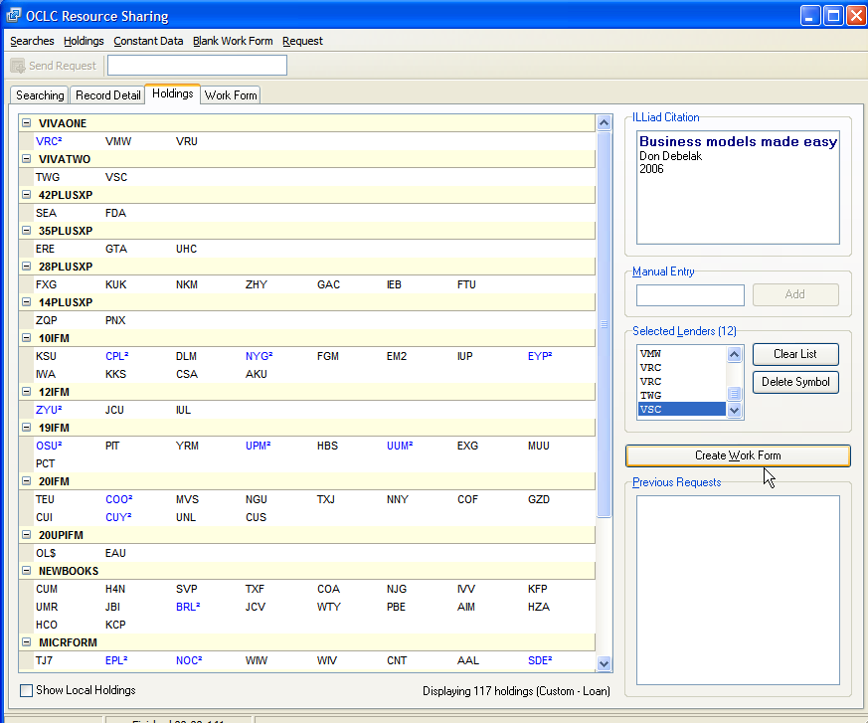
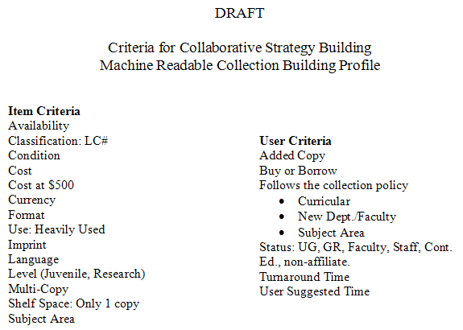
Goal for transforming workflow: Options blur functional divides
$
Just in Time Acquisition
(buy for Library) & attach
OCLC symbol, or
Refer to selector, or
Buy for user
Rent for user
Notes:
Many have heard about purchase on demand, that could mean that the ILL department forwards request information to a subject or acquisitions librarian for evaluation, and others have a fund for ILL to purchase books. This is a model I proposed to OCLC. Explain flow…
CUSTOM HOLDINGS
The number and variety of options are growing, and I would argue that is one of the realities that is making libraries such an exiting place to work. Another option of interest is new suppliers.

Slide 17


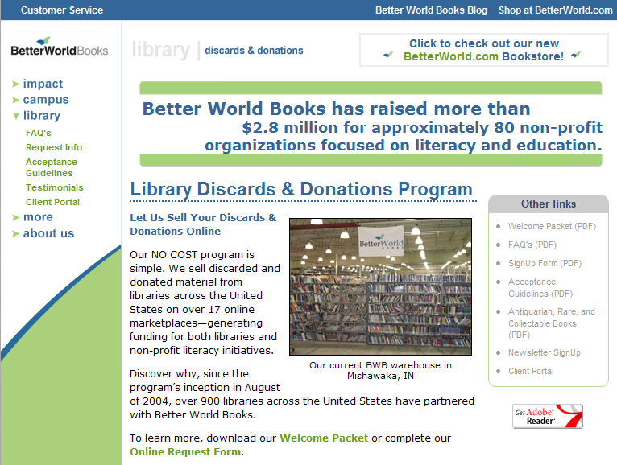
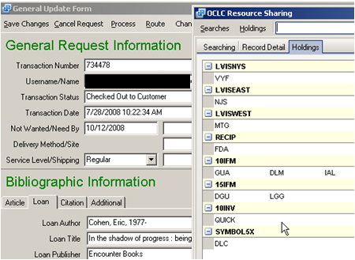
Better World Books - OCLC Symbol QUICK
http://www.betterworldbooks.com/Programs/Library.aspx
$10 to borrow…
QUICK Features
Return postage/envelope enclosed
Users/Library have option to buy the book
Direct Delivery
Real Example: $17.24 for user to buy
Notes:
While many in ILL are now used to the idea of using Alibris to purchase books using OCLC and ILL funny money, I mean IFM. OCLC and Better World Books have recently come up with a new variation on fulfilling requests.
EXPLAIN real example. EXPLAIN WHY – Direct Delivery (Double Delivery Dilemma) & Distance Education services.
Most interesting aspect to this new supply chain is that the bulk of their materials comes from library discards, so what we weed today, may find its way to be borrowed or purchased by another library and user, all through the OCLC system.

Slide 18
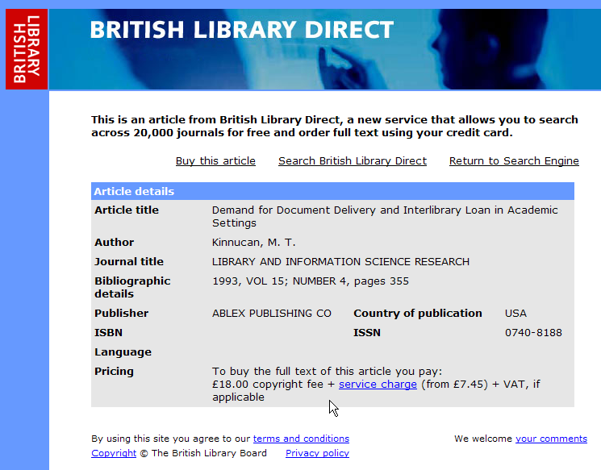
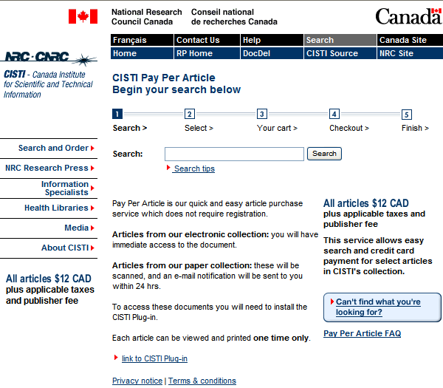
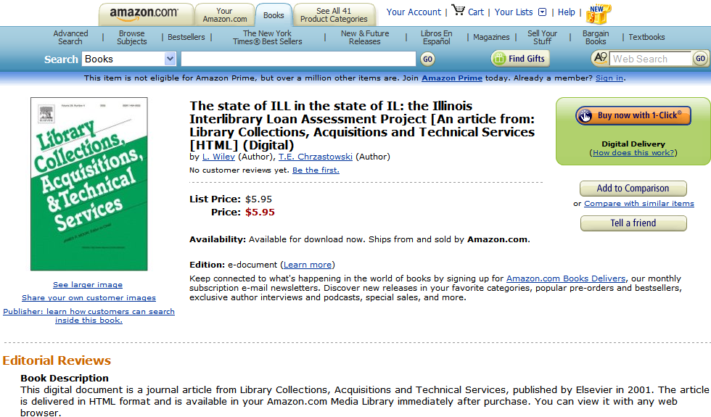





Article Pay Per View – Dialog Again?
Amazon $5.95
Avg. ILL Cost $17.50
CCC Royalty Fee $32
Science Direct Download $30
Notes:
Articles can also be purchased by a variety of pay per view venues, including CISTI’s Pay per view, priced at about $12 CAD per article – which includes some digital rights management, or Infotrieve, a full range of pricing that includes copyright royalties. Citation databases vendors increasingly offer pay to download. or CLICK how about…
Looking at copyright royalty fee transaction data and comparing the fees incurred to fill a borrowing request with the fees for purchasing articles online from the publisher illuminate why sometimes it makes more sense to buy the article for a user. Over the last two years, SUNY Geneseo paid 290 copyright royalty fees on 70 titles, and in analyzing this data, we found that 279 or 88.6% of the articles could have been purchased full-text immediately from the publisher, and in a few cases, from a secondary online document supplier. While the overall cost, including copyright fees, for the 279 articles was $6,662, the fees for purchasing immediate access to the online articles from the publisher would have been $6,100. Interestingly enough, the cost between royalty and purchase varied widely; for example, the royalty fee on The Journal of Clinical Psychiatry was $9 per article, the cost of the online article was $20, on the other hand, the royalty fee for the Journal of Health Psychology was $26, while the cost of the online article was only $15.
Let’s get back to

Slide 19
Collection Development & Resource Sharing
What is our current strategy?
Framework: Who’s on First?
ILL or Acquisition?
Separate workflows
What is the service relationship between Acquisition, Collection Development and Resource Sharing?
It’s changing…
What service model & unit functional relationships make sense?
See: ALA (2002), Levine-Clark (2004), & Holley (2005)
“for monographs, purchase may be a reasonable substitute for interlibrary loan.” (Holley, 2005)
Notes:
Requests for a book that a library doesn’t own usually falls prey to a “who’s on first” strategy:
If the user places an ILL request, it gets filled by resource sharing using a shared circulation or ILL system
If the user knows to suggest a title for purchase and knows that a rush service is applied to that process, then the request gets filled by acquisition using the ILS system to place an Order & Hold record.
Two or more channels, each with different entry points.
Service Channel Surfing is common to users and library staff, however experience quickly tells us which doors delivers, and those service channels (processes, tools, etc.) become integrated into our lives as favorites. Who’s on first and Favorites I propose are key to the organizational transformation process in collaborative strategies. Library services such as; Acquisition, Collection Development and Resource Sharing are traditional units that … CLICK

Slide 20


Get It or Purchase Request
Just-in-Time Acquisitions
Acquisitions Order Forms
Book Order form
Book Purchase Recommendation
Book Purchase Request Form
Book Request Form
Book Suggestion Form
Collection Development
Library Collections
Library Order Recommendation
Library Recommendation Form
Materials Request
Material Selections Policy
New Materials Order
Order Items
Purchase Recommendation
Purchase Request
Purchase Requests for Library Collection
Recommend a Purchase
Request a Purchase
Suggest a Purchase
Suggest a Title for the Collection
Suggest New Library Material
Suggestions for Acquisition
Titles to consider for Library Purchase
Interlibrary Loan
Borrow Direct
Document Delivery
Get It
IDS
Information Delivery Service Request
Interlending
Interlibrary Loan
InterLibrary Service
Place Requests
Request It
Requests
Resource Sharing
Requests are opportunities
Notes:
What’s in a name?
Explain the divide in requests and names…
Library literature reveals that ILL is increasingly looking towards purchase on demand as a way to handle requests and budget service, similarly, Acquisitions sees just-in time acquisition as a potential key service. Are we in the same organization? If we examine the roles of Acquisition, Collection Development, Copy Cataloging, and Resource Sharing, we see traditional units with disparate workflow that share very similar practices and systems, and increasingly, overlapping functions.
Do we want to refocus the request service function as an opportunity to dialogue with users?
If requests are a vehicle, can they also be a collaborative point within the library, and with our users?

Slide 21

Parallel Partnerships
Notes:
Provide examples; using ILLiad as an electronic reserve request system with a specific doc type, the plan at Uva was also to add the alternate text requests – as a result of collaboration… digital library and digital ILL are also potential collaborations…

Slide 22
Example partnerships Digital Library & ILL
Digitize on Demand for ILL & Digital Library…
  “Small items that are too fragile to circulate on interlibrary loan are usually supplied through a photocopy. But photocopying often shortens the life of the original… LOC now scans this type of material and delivers the images via the Web… A scanned item will be accessible from this page for at least six months… then be permanently accessible from the Library of Congress catalog…, and an 856 tag will also be added for the DLC holdings record in OCLC.”
  Digital Interlibrary Loan, Library of Congress: http://www.loc.gov/rr/loan/illscanhome.html
  Others doing this…
    National Library of Australia, for public domain Australian works that are requested by ILL: http://www.nla.gov.au/policy/digitisation.html
    Europe eTen DoD: http://www.uibk.ac.at/ub/dea/eten/
Notes:
Connected with supporting open access, and diversifying potential sources, diversifying services is important too. Instead of scanning for one time use, why not digital ILL where ever possible, scan for two uses; one for ILL lending, the other to contribute to your repository.
This type of request processing and partnership has many benefits, including multiple delivery options, including print on demand options.

Slide 23


Digitizing and Printing – Borrowing options for medium rare
Print on Demand - a solution to rare material ILL, or another acquisitions program?
There are over 12K books from the Michigan Historical Reprint Series in Amazon; prices range between $12-$43.
“Print-on-demand is an attractive alternative for scholars on a budget. Another top seller, the 1898 textbook "A Treatise on Universal Algebra with Applications" by Alfred North Whitehead, is available from Cornell for $35.99 versus $600 for the original from a used book dealer. “ http://www.news.cornell.edu/stories/April07/LibAmazon.dea.html
Notes:
Not everyone is crazy about reading a 300 page PDF file, but again, expanding our scope, diversifying the service and the source to include print on demand is very important.
Explain the re-print project underway…

Slide 24
Reference, ILL, Collection Development Partnerships
Request for Grey/Gray Literature or unpublished materials are golden opportunities for collection development, ILL, and reference.
How do we handle requests for unpublished materials?
Opportunities to teach about scholarly publishing, connect user to subject librarian, or user to author?
Do you treat the request as copies; non-returnables?
Why not acquire and catalog, or request rights to digitally maintain an open access copy from the author?

Slide 25


“I wish that I could jump into a book…”
Kate Oberlander
Jumping ahead…
Each request may be a glimpse into the future

Slide 26
Future of Request Workflow
Predictions for the next 2-3 years?
Strategic purchasing new/used print books will get easier in the context of new workflow:
  Automated purchase price and lending fees comparisons
  New supply chain options and services
  Machine readable collection development profiles
Full-text access via Google Books and Live Books can fill almost all requests for materials published before 1923.
Print on Demand for Google Book, Live Books, and Amazon is an attractive alternative to ILL under certain conditions.
Purchasing full-text articles from pay-per-view will get easier and less costly than copyright royalty fees.
Service convergence expected between acquisitions & copy cataloging, and ILL.

Slide 27
How do we redesign Service & Request?
What services do our users want?
What resources make sense?
What strategies make sense?
What workflow/system enables strategies for user and libraries? What questions do we ask our users in our request forms?
What policies make sense today?
  Short Due Dates?
  Overdue Fines?
  Recalls

Slide 28
Flexible Request Construct:
Allow for parallel (many to many) and distributed capabilities
Request
Request Management
& Workflow
Get It
Deliver It
Integrate It
ILL - Borrow
Pickup
Reserves
Purchase
Link to
Reference
Reference
Email to
Learning
Management
System
Doc. Del.
Fax to
Digital
Library
Other
Mail to
Other:
user preferences
Annotation
& Tagging
Other:
User Tools
Notes:
Explain integrate it... Need for odyssey delivery to learning management systems because it makes sense that in document delivery, a faculty member might place an e-reserve request, and want the resulting PDF loaded onto their course.
Can we pick delivery targets that are more thoughtful to the scope of user needs and within a context, by simply asking them the right questions; you want this article, in what format, where, when, what condition, etc. based on their status – because we can customize ILLiad main menu and various requests based on user status.

Slide 29

Resource Sharing: Where Are Requests Taking Us? RECAP
Where ever our users are…
To unfamiliar content and formats…
Toward unfamiliar service expectations and workflow.
Customer Relations Management

Slide 30
Thank you
Questions?
Cyril Oberlander
cyril@geneseo.edu
Skype: cyriloberlander
AIM: electronicCyril
GoogleTalk: cyril.oberlander

Slide 31
Bibliography
ALA, Patron-Focused Services: Models of Collaborative Interlibrary Loan, Collection Development & Acquisitions: Presentations by: Suzanne Ward, Tanner Wray, Karl E. Debus-Lopez, Megan Allen, 2002. http://www.ala.org/ala/rusa/rusaourassoc/rusasections/stars/starssections/committeesa/illcom/ILLProgram2002.ppt
Hilyer, Andrew, “Introduction to Interlibrary Loan,” Journal of Interlibrary Loan, Document Delivery & Electronic Reserve, vol. 16 (1/2) 2006, p. 1-74 (special issue)
Holley, Robert, Kalyani Ankem, “The effect of the Internet on the out-of-print book market: Implications for libraries,” Library Collections, Acquisitions & Technical Services, 2005, vol. 29, p. 118-139.
Levine-Clark, Michael, “An Analysis of used-book availability on the Internet,” Library Collections, Acquisitions & Technical Services, 2004, vol. 28, p. 283-297.

