Slide 1

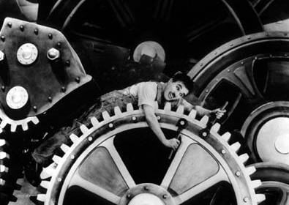

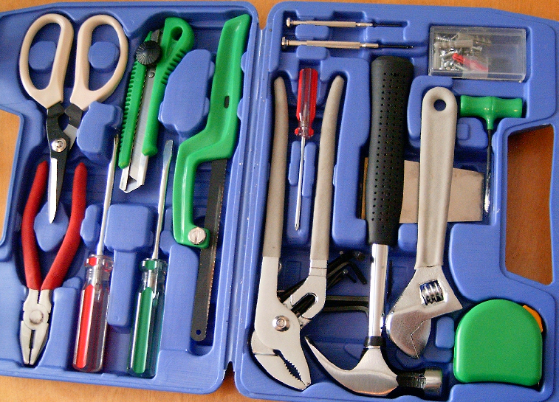
Workflow Toolkit
IDS Project
Workflow Toolkit
Cyril Oberlander & Harriet Sleggs, SUNY Geneseo
IDS Project Conference 2008
Cyril Oberlander, SUNY Geneseo
&
Harriet Sleggs, SUNY Geneseo
Presented @ IDS Conference, August 4-6, 2008
Materials available for download at www.idsproject.org
Notes:
Has anyone felt like they would like to change the system to make the computer do more work, and reduce the steps in the process? We can do a lot to change systems around our workflow, a word of caution though, our policies and workflows also have a way of making our systems clunky.
Balancing what matters and what requires our attention is key, so let’s throw a monkey wrench into this discussion…Click
Actually, the workflow toolkit is all about giving you more tools to make the system work the way you want to. How you use and adapt those tools is up to you. What we are doing is sharing the documentation in hopes that we all benefit, and don’t feel like Charlie in Modern Times.
How many people have seen Charlie Chaplin’s Modern Times?
http://en.wikipedia.org/wiki/Modern_Times_%28film%29
http://upload.wikimedia.org/wikipedia/commons/f/f4/20060513_toolbox.jpg

Slide 2
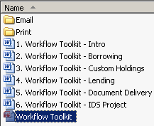
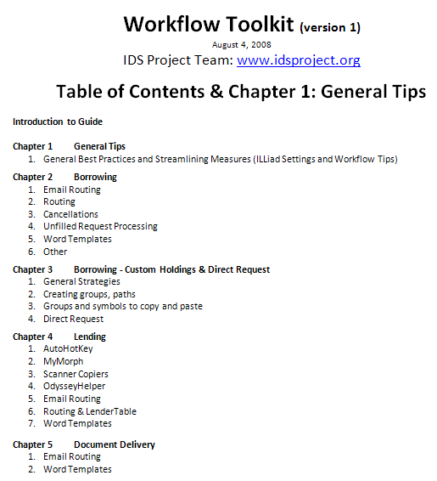
Workflow Toolkit
What is it?
Collection of documentation to improve workflow
ILLiad Settings & Templates
Best Practices & Techniques
Email.txt files & Word Templates
Version 1 is a download of useful files today
Version 2 will be a wiki with dynamic tutorials

Slide 3
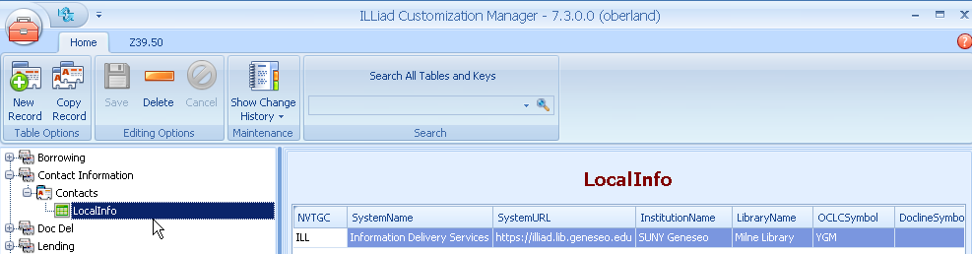

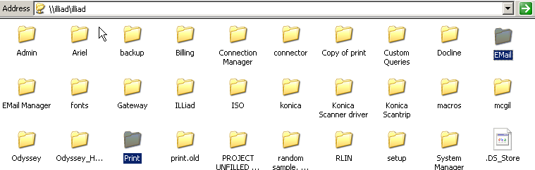
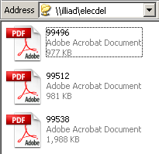
Workflow Toolkit
Requirements before we start…
In order to implement most of these, you need access to the ILLiad’s customization manager, and write access to your server’s Email, Print, and PDF or Elec Del Folders.
Most of the files in the Workflow Toolkit use ILLiad Local Info values and don’t require editing, but some of the illustrations for email routings require local emails, etc., so configure those to your own needs.
Notes:
Remind everyone there are options for where these files are located, and administered. OCLC hosted, network versus client installs, alternate locations for some of the ILLiad files, etc. CLICK
Everyone know what the LocalInfo table does in ILLiad?

Slide 4
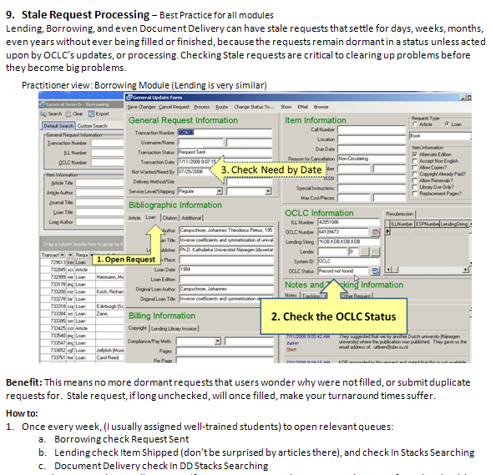
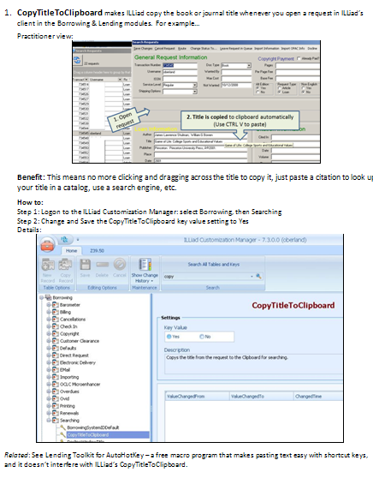
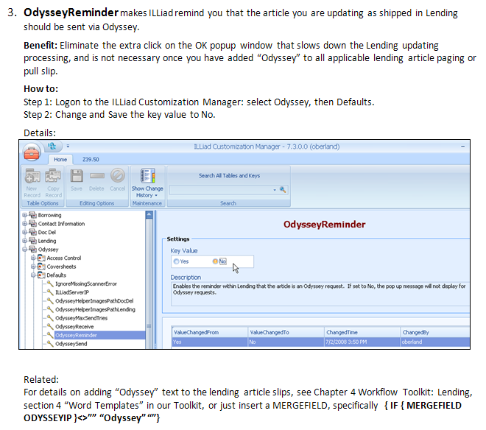
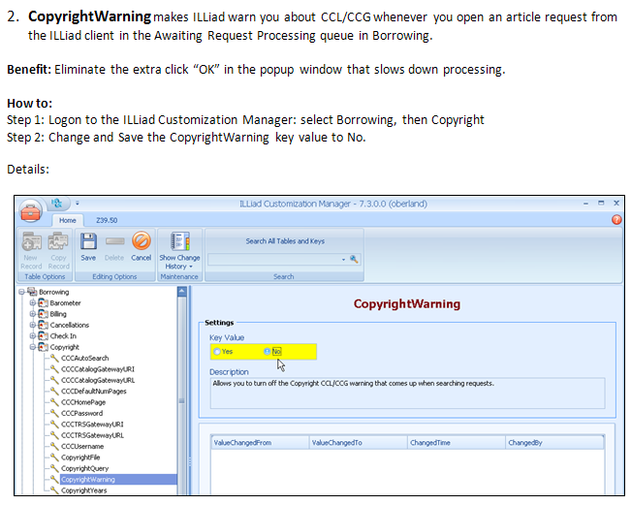
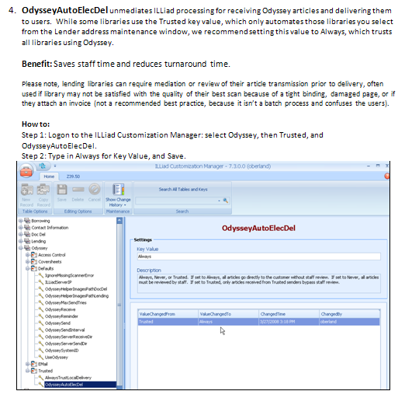
Workflow Toolkit Chapter 1 – General Tips & Intro
Notes:
Each page is a particular topic or tip.
CopyTitleClipboard – fantastic feature that copies the book or journal title immediately when you open a request in Borrowing & Lending modules, but not document delivery. Early ILLiad implementations had the default setting on off, but even though the default has been Yes for awhile, there are still libraries not taking advantage of this feature.
CopyrightWarning – Anyone like popups in the middle of processing? I confess – I never like popups getting in my way.
OddysseyReminder was a good idea, because of separating the scanning workflow, but ideally the paging slip gives you that information – so let’s get that popup out of there…
Speaking of Odyssey, how many Trust Always? This is a key setting that makes all articles sent to you via odyssey, from any library, go unmediated – unless of course, the lending library selects the please review this button on the odyssey sending screen.
One example of a best practice, stale request processing on page 12, is something that needs to be done periodically, because it’s easy for requests to go stale – hidden in pending queues like Request Sent or In Stacks Searching. My favorite is the articles found in Item Shipped status in Lending – how many have gotten overdues for those?

Slide 5
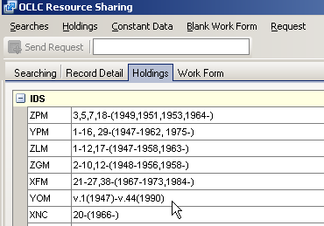
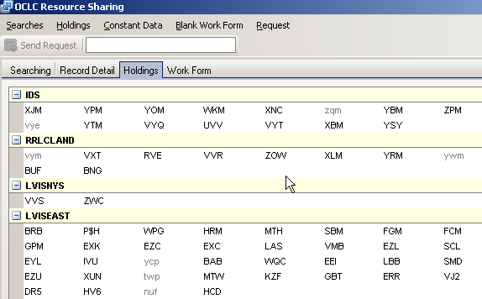
Best Practice and Holdings
OCLC Print holdings closed
OPAC Print holdings closed but refer to Online holdings
OCLC eSerials Holdings Update only attaches symbol, not holdings
A Solution?
PRINT v. 1-44 (1947-1990) |ONLINE v. 38- (1984- ) ILL OK
Notes:
Explain the holdings problem, three discovery points. What is the solution? CLICK

Slide 6
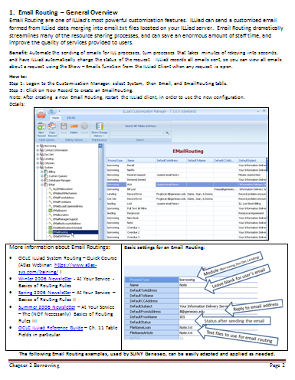
Chapter 2 Workflow Toolkit – Borrowing
Email Routing for Borrowing means you can use an email to…
Send ALA forms
Send NLM a request
Send other libraries a request for renewal or resend
Bill users for lost materials
Automate delivery of full text
Send Acquisitions a purchase request
Send users; renewal or recall notices, or just a question about a request.
And More…
Email Routings record all emails sent about a request, and it can change the transaction status of the request.
Notes:
Explain Email Routing, basics and text files, includes… and what you can do with them in general.
Harriet – take it away.

Slide 7
Streamlined Routing for
Full Text Requests to
Document Delivery
IDS Conference
SUNY Oswego
August 4-6, 2008
Notes:
Article photocopying for faculty and staff
Ask audience for show of hands - are they currently offering this service for full text articles and are you using ILLiad Document Delivery?

Slide 8
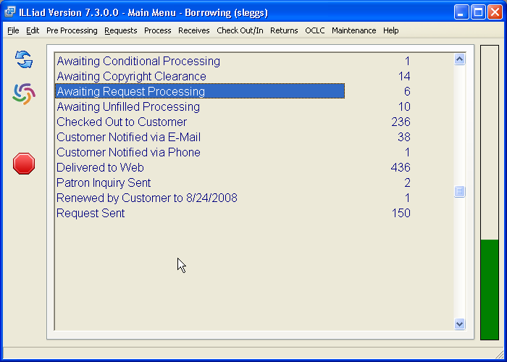
Double Click on Awaiting Request Processing
Notes:
Quickly run through first 7 slides as the steps are familiar to many of us using ILLiad. Open the ILLiad Client and go to the Main Menu – Borrowing
Double Click on AWAITING REQUEST PROCESSING

Slide 9
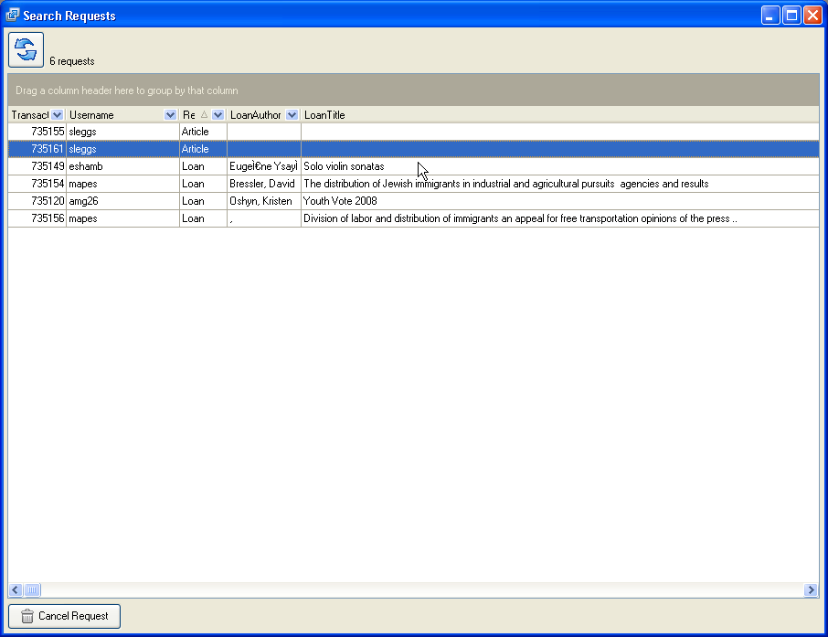
Double Click on Article request
Notes:
Double Click on an article request to open the search request screen

Slide 10
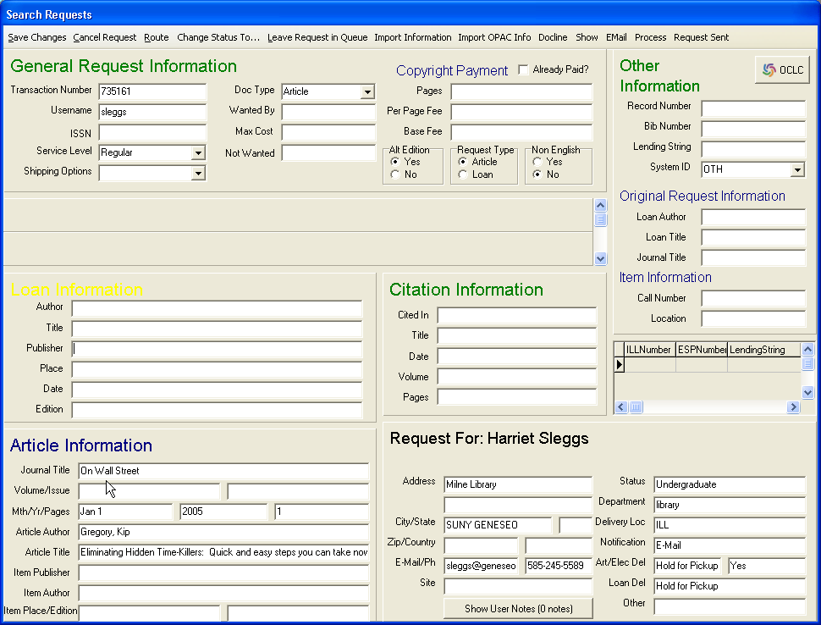
Search for journal
Notes:
Once you have the Search Request screen open you are ready to search for the journal. At Geneseo we check our journal finder for ownership.

Slide 11
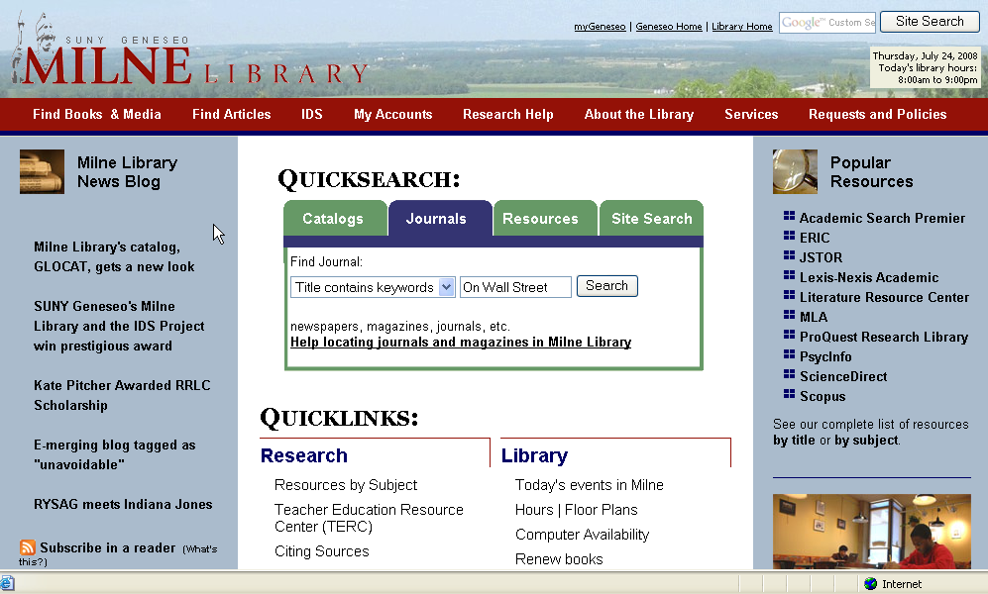
Open journal finder and paste title in journals tab
Notes:
Open your journal finder and paste the title in the journals tab. Reminder: When you open a request in ILLiad it automatically copies the title so all you have to do is Right click and paste the journal title in the space provided (Refer to Toolkit, Chapter 1, #1,pg 4 - CopyTitleToClipboard

Slide 12
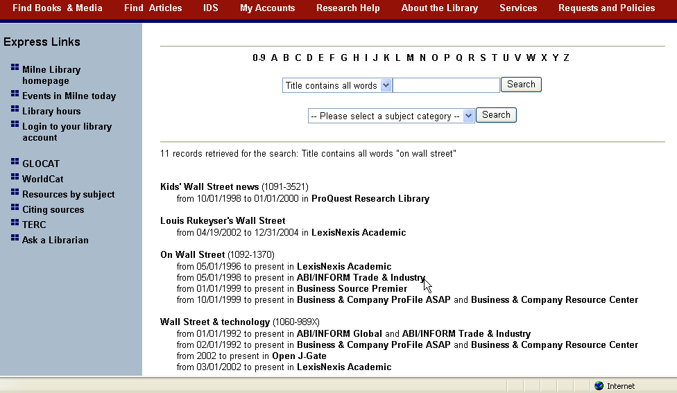
Double Click on database
Notes:
Notice that the journal has full text holdings in several databases. Double Click on a database that includes the year needed.

Slide 13
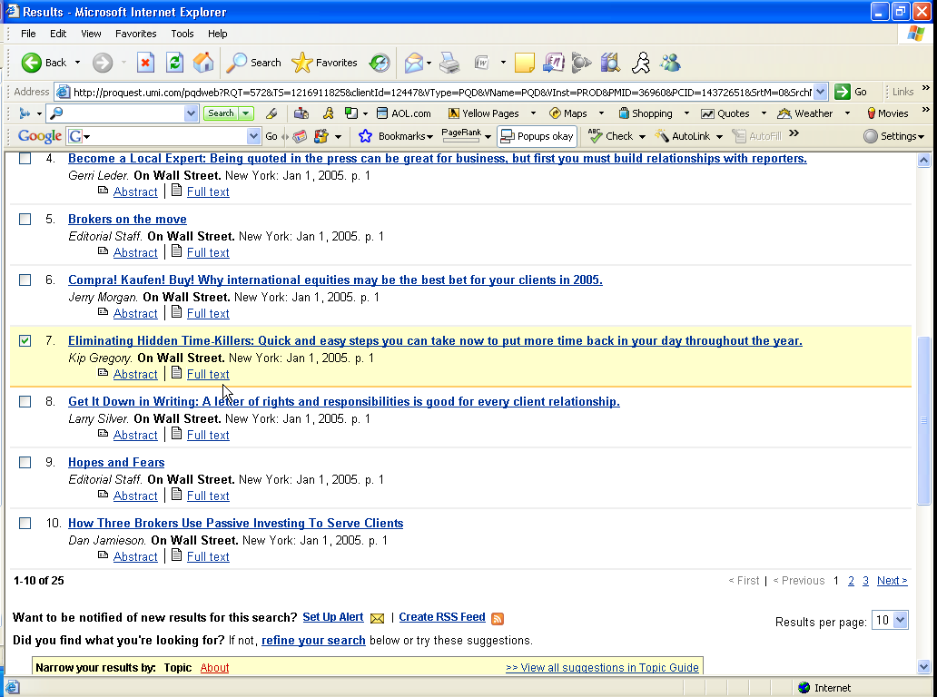
Double Click on Full Text link to open article as PDF
Notes:
Note that #7 matches the article cited in the ILLiad request. Double click on the Full Text link to open the article.

Slide 14
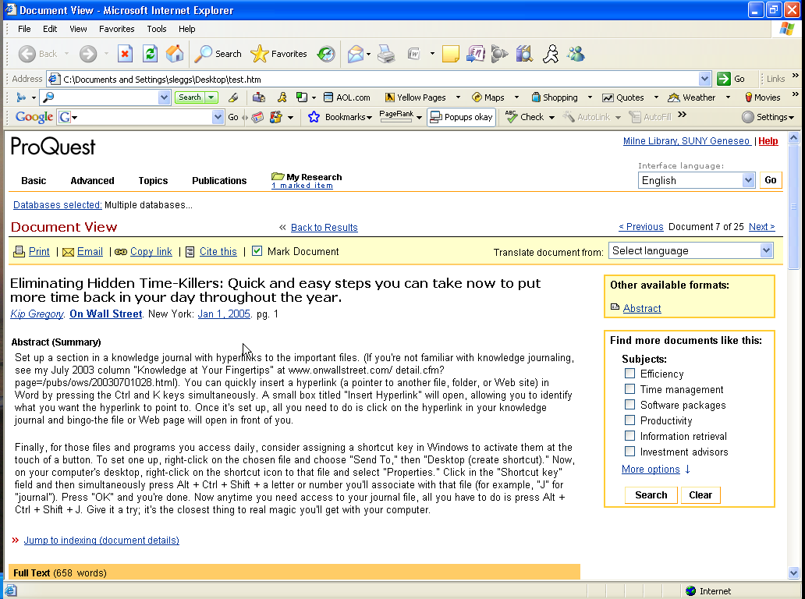
Click on File and then Save to PDF folder by TN #
Notes:
Save the article to your ILLiad/elecdel (pdf) folder by TN #
Again all of the above slides are a brief overview of procedures many of us are already using. This next slide shows the steps we were using to process full text material owned at our library.

Slide 15
Previous Process
Route request to Document Delivery
Switch to Document Delivery Menu
Print Document Delivery Pull Slips
Refresh Status Info
Update Document Delivery Search Results
Notify Electronic Delivery
Notes:
Previously we followed these steps to fill full text articles for patrons at Geneseo. Also, in some cases ILL staff would actually print the document delivery slip which would, of course, involve even more steps with the merging, etc.

Slide 16
Reminder - Click on File and Save to PDF folder by TN #
Notes:
So out with the old and in with the new! Just a reminder that you would still need to save the article to your ILLiad/elecdel (pdf) folder by the TN # with this new procedure I am about to show you.

Slide 17
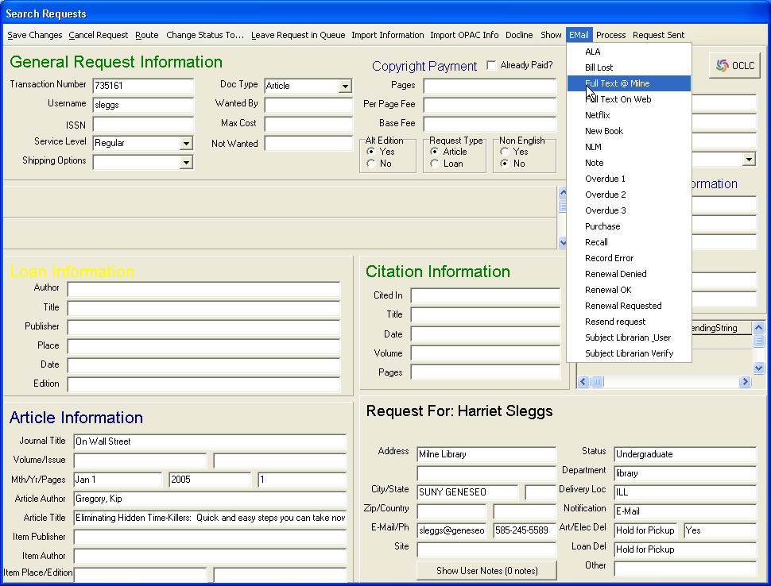
Click on email and select Full Text @ Milne
Notes:
New instructions begin Here. Instead of Routing the request to Document Delivery at this point in the request you would click on the email tab – select Full Text @ Milne –

Slide 18
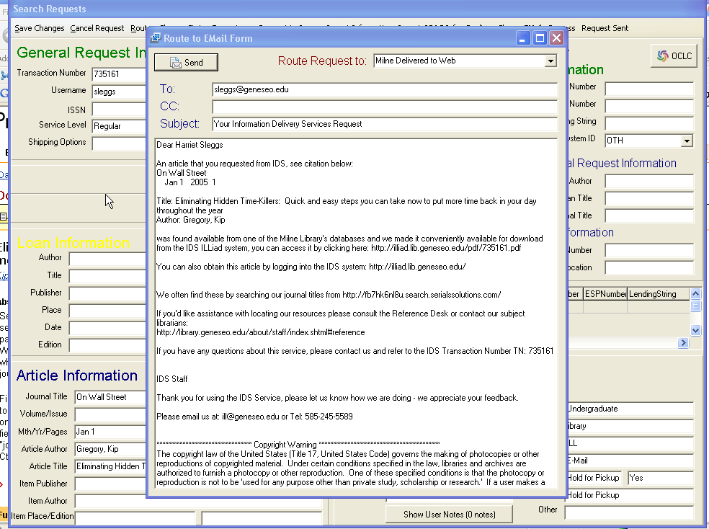
All that is automated…
Status changes to Delivered to Web
Email routing pushes to “Milne Del to Web”
Routing rule changes from Borrow to Doc Del to Del to Web
Counts as a Document Delivery fill
All you have to do…
Click Send
Notes:
Click on Send (3 quick clicks) Status – 1. Status changes to Milne Delivered to Web. 2. Email routing pushes to “Milne Delivered to the Web. 3. Routing rule changes from - borrow to doc del to Delivered to the Web – and 4. counts as a Document Delivery Fill instead of a cancelled request.

Slide 19

Notes:
After the email is sent you are automatically returned to the Search Requests screen to continue processing additional requests (questions/comments/concerns at this point)

Slide 20
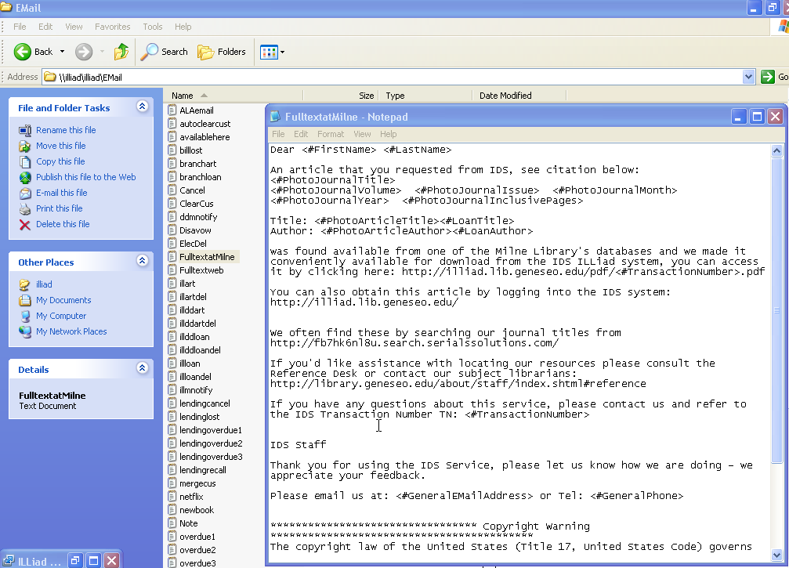
Create text file for this email routing.
(refer to Email Routing in Workflow toolkit)
Notes:
You will need to have 3 pieces in place before you can begin using this email routing feature.
1. The text file for email routing (refer to toolkit, Chapter 2, email routing #2 for instructions on setting this up)

Slide 21
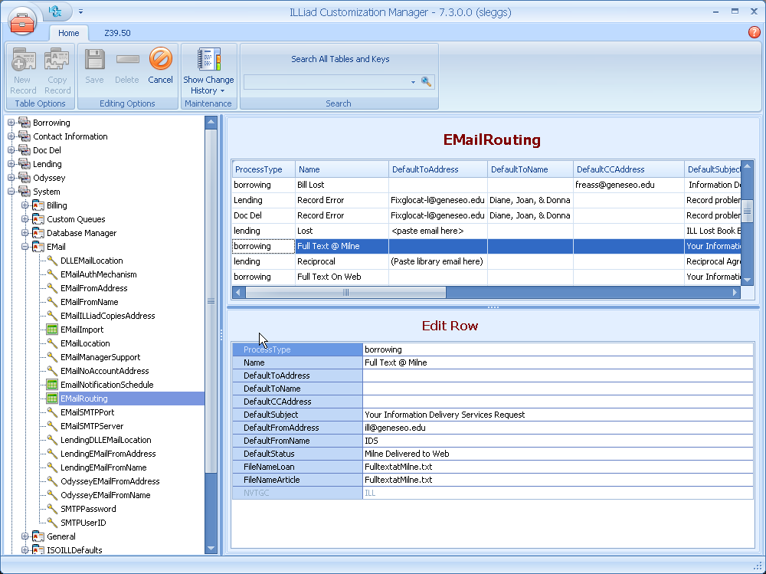
Create email routing
Notes:
2. In Customization Manager under System Click on Email and then Email routing, and the 3rd is (next screen)

Slide 22
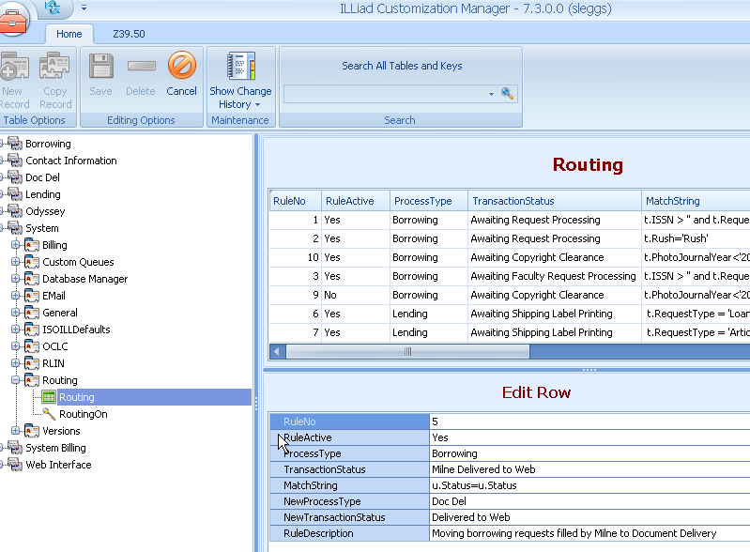
Create email routing rule
(For additional help – Refer to Toolkit and/or ILLiad Knowledge Base:
http://www.atlas-sys.com/kb)
Notes:
3. The routing rule. While still in the Customization Manager under System Click on Routing and then the Routing Tab to add the rule. (remind IDS staff about ILLiad Knowledge Base access from within ILLiad program (Click on Help = Atlas System

Slide 23
Reminder - there are 3 pieces that need to be in place before using the new email routing
Create text file
Create email routing
Create routing rule
Notes:
Reminder that 3 pieces have to be in place before the new email routing will work for you.

Slide 24
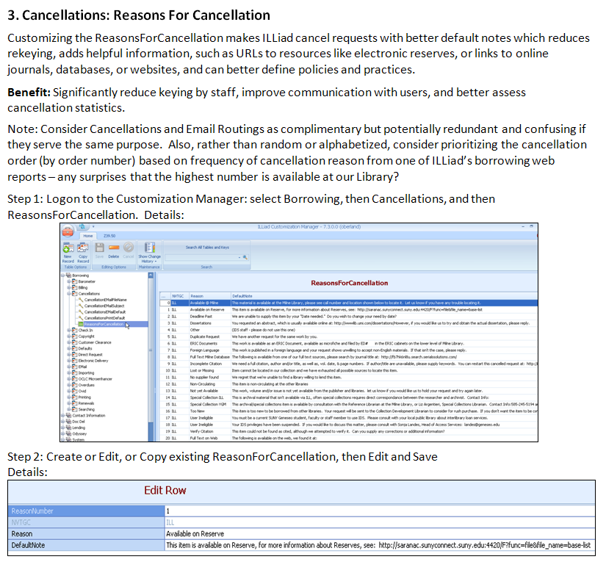
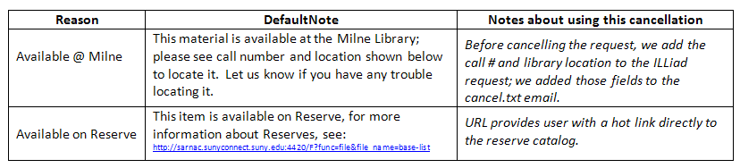
Workflow Toolkit Chapter 2 – Borrowing
Notes:
Another toolkit suggestion for Borrowing is looking at your Reasons for Cancellation – the toolkit describes how to change, add, and sort cancellations based on frequency of use – from the ILLiad web reports. CLICK
Customizing the name and default note that appears in the email helps to reduce rekeying by staff, and adding URL’s to the reserve catalog and other resources.

Slide 25
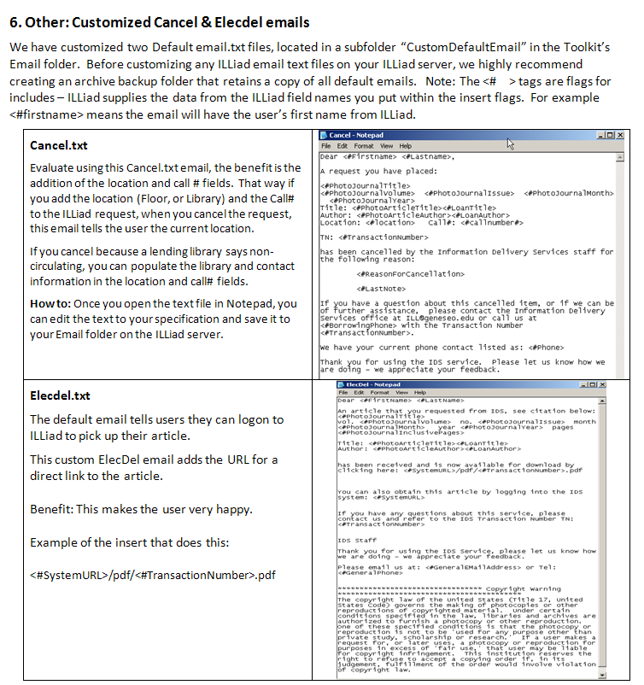
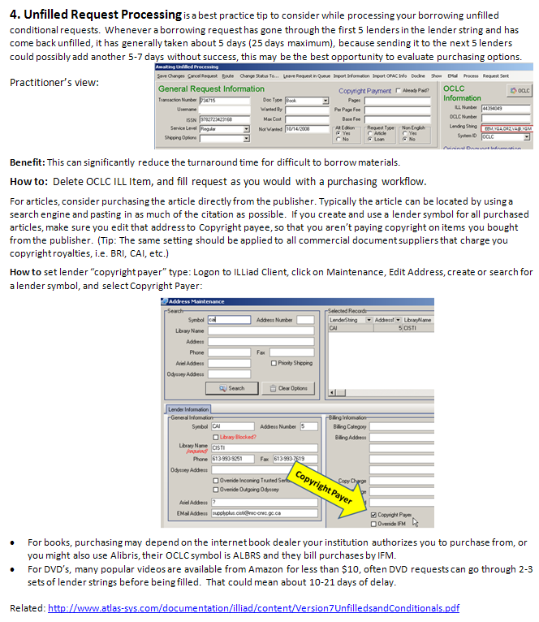
Notes:
Unfilled Request as criteria for consideration of purchasing options; the more strings tried, the more costly the request is in both staff time and turnaround time.
CLICK
Customizing the Cancel Text and ElecDel.text files are useful, not only to include feedback suggestions, but also to make the emails more useful to the user. In the Cancel.txt, we added inserts for the call number and location, by adding that data to the illiad request, the information enhances our statistics, and is sent to users for the “go fish” message, or letting the user know that the item is unavailable at a library.
One of the most useful text emails for users is the ElecDel.txt – this is the one that let’s users know that they have an article available – once they log on to ILLiad. Rather than making the user logon to obtain the article, it is much more user friendly to just provide the direct link to the article, using the include statement we provide.

Slide 26
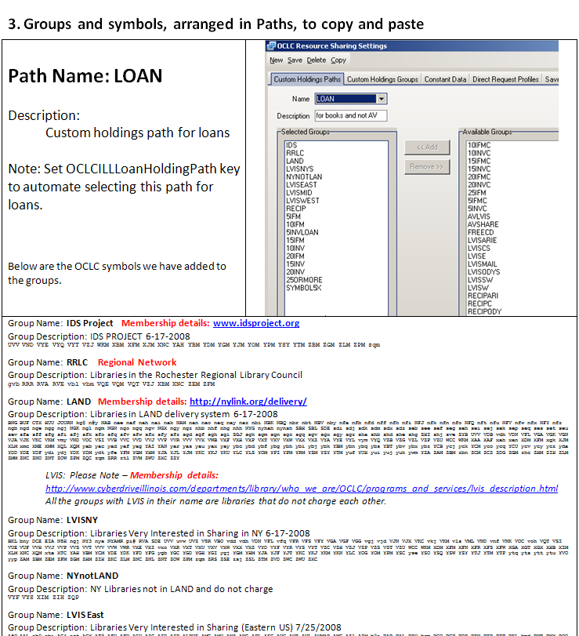
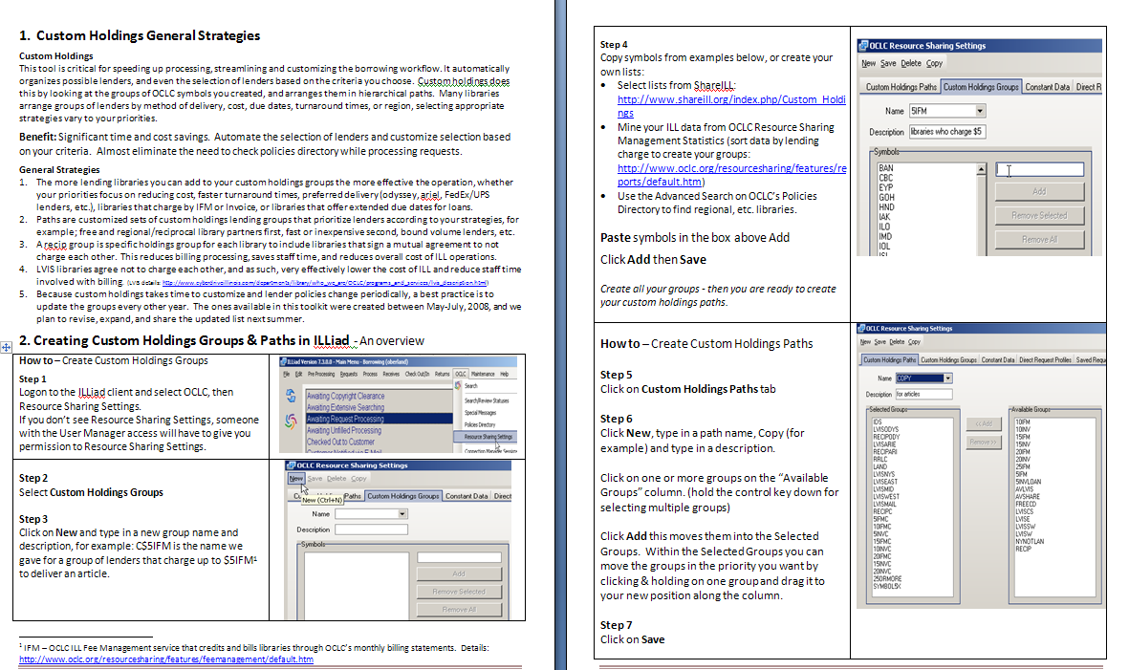
Workflow Toolkit Chapter 3 – Custom Holdings & Direct Request
Notes:
Custom Holdings is chapter 3 in the toolkit, it provides description for general strategies, but provides example Groups and Path – examples that you can copy, adapt, and easily implement. This chapter also explains how we customized the path for Direct Request, for example, if no lender can supply for under $15, we want to consider purchasing before borrowing.

Slide 27
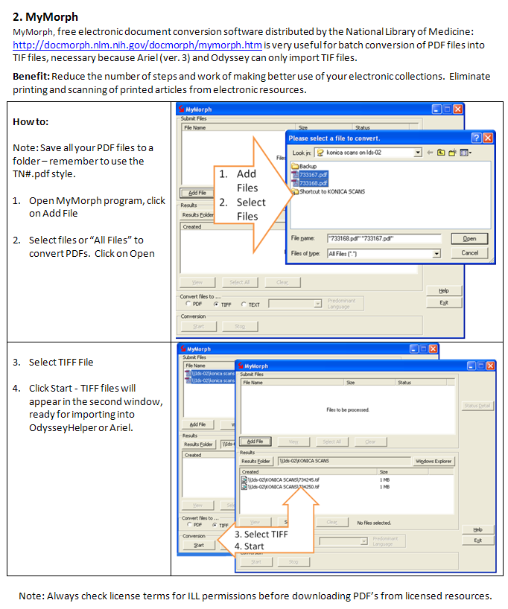
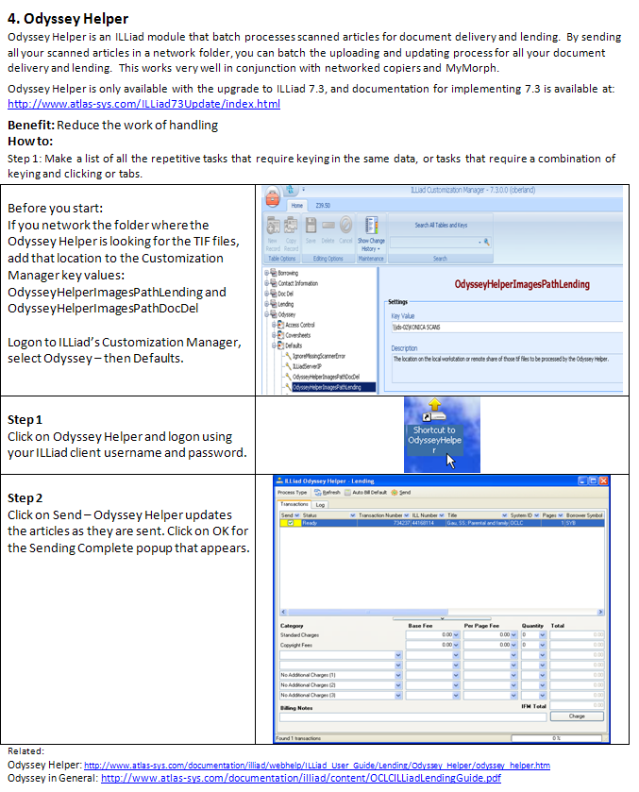
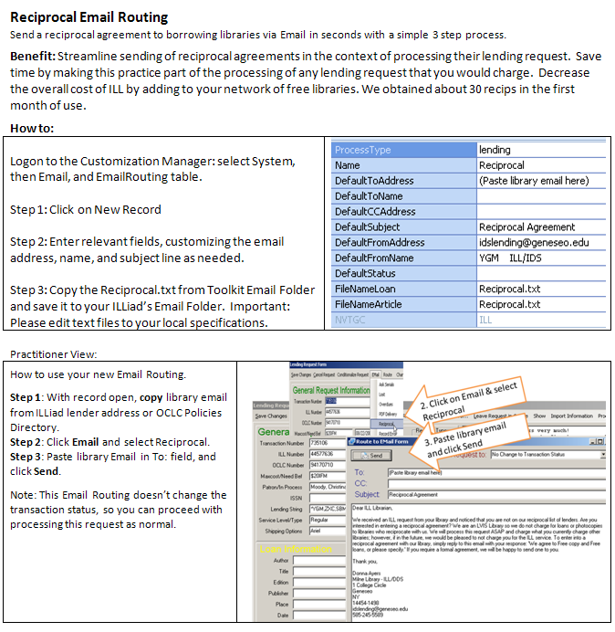
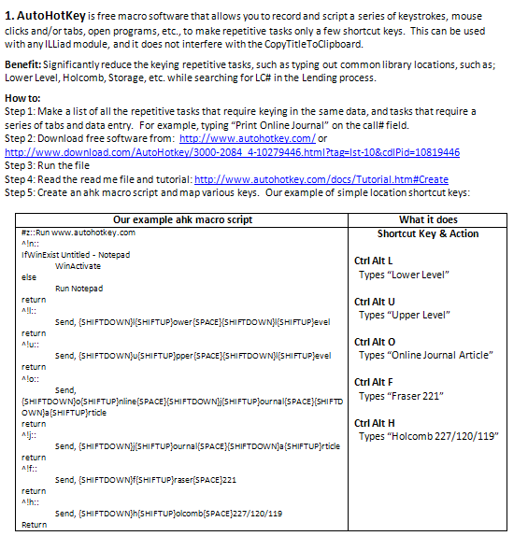
Workflow Toolkit Chapter 4 - Lending
Notes:
AutoHotKey
MyMorph
Odyssey Helper
Reciprocal Email Routing

Slide 28
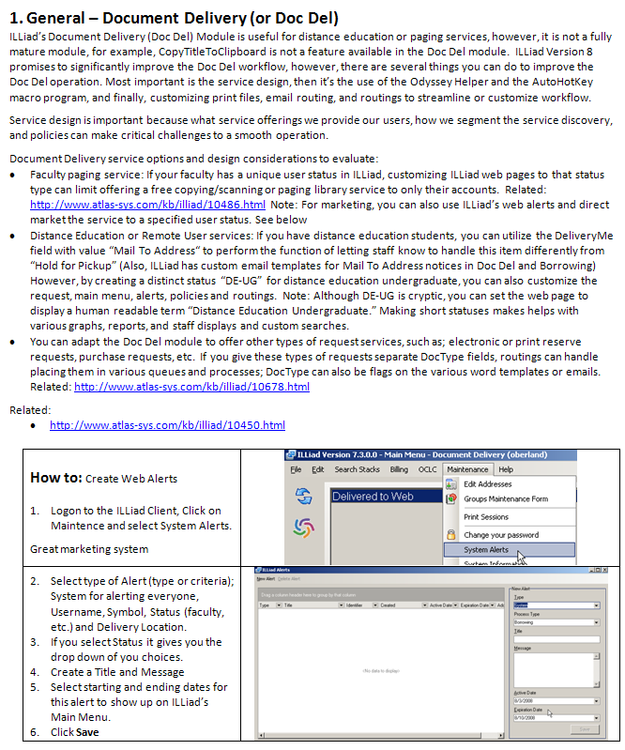
Workflow Toolkit Chapter 5 – Document Delivery
Notes:
Document Delivery – Least favorite module, but one of my favorite service designs – free paging services, free document delivery, or direct mail to users. How many provide free copies or digitization services to faculty? How about for students?

Slide 29
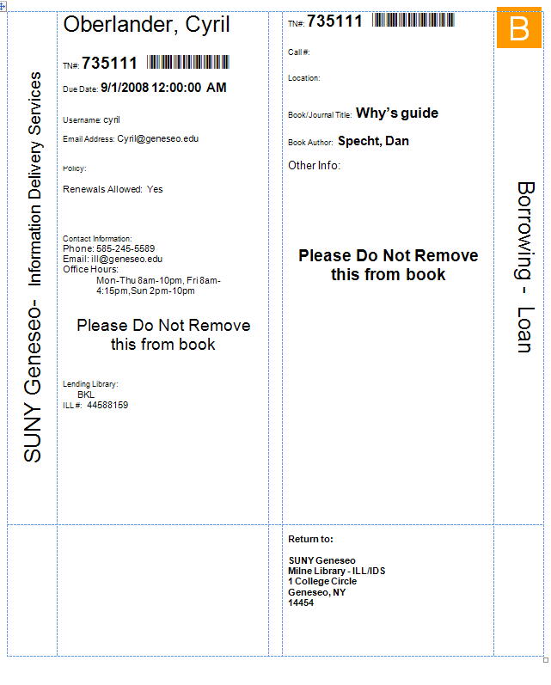
Workflow Toolkit – Word Templates
(See chapters: Borrowing, Lending, Document Delivery)
BorrowingLoanSlips
Notes:
I thought I would put all the word templates together at the end to discuss their similarities. You may have noticed that Geneseo did away with the book straps recently, that’s because we went with a one page per request print out for all lending, document delivery and borrowing printing.
Significant improvements to workflow are possible from how you adapt these word templates to make better use of ILLiad data, and how to adapt these forms to make it extremely versatile, and easy to handle. So what do I mean – take this Borrowing Loan Slip…

Slide 30
Easy to find on the holds shelf
Quick module guide:
B=Borrowing
D=Doc. Delivery
L=Lending
User & Processing
Info.
Citation Information
CITEDVOLUM
Used for notes
Quick module & request type indicator
Paper folds
In half
No user mailing address info; my deliverme = Hold for Pickup
Return to Borrowing Library
(When ILLiad 8 arrives, it will include a return to lending library label)
Notes:
First, the design – show example - most of this template was designed at University of Virginia, however, I made some changes that are useful for LAND and the IDS Project. Explain the features. Now for what’s behind all this work?

Slide 31
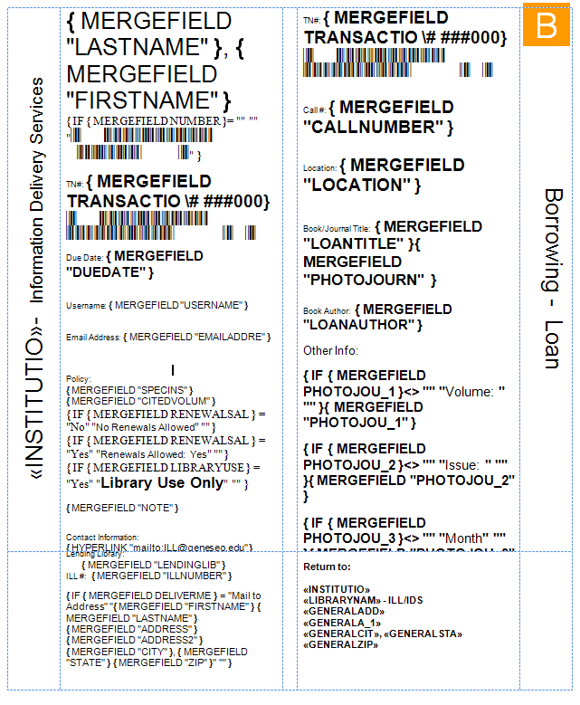
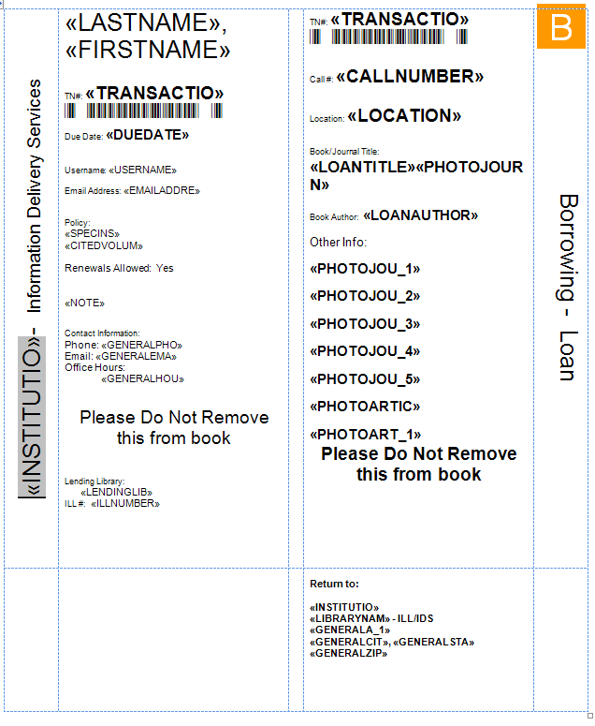
Warning; as you edit… MERGEFIELDS HIDE
Using IFs to hide irrelevant fields – no value – not visible
Article fields in Loan slips are for chapter requests

Slide 32
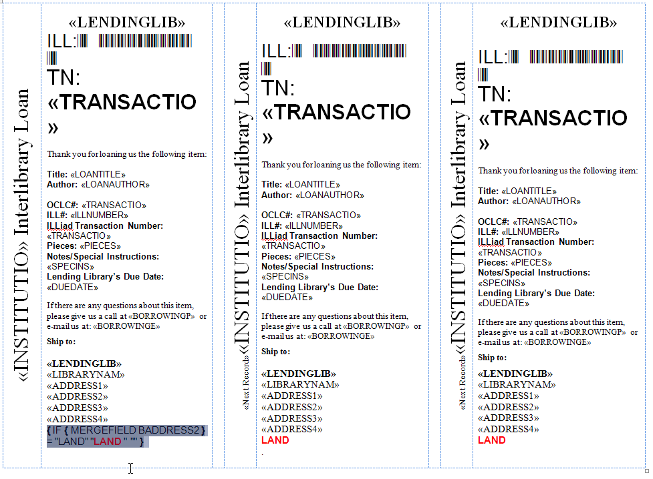
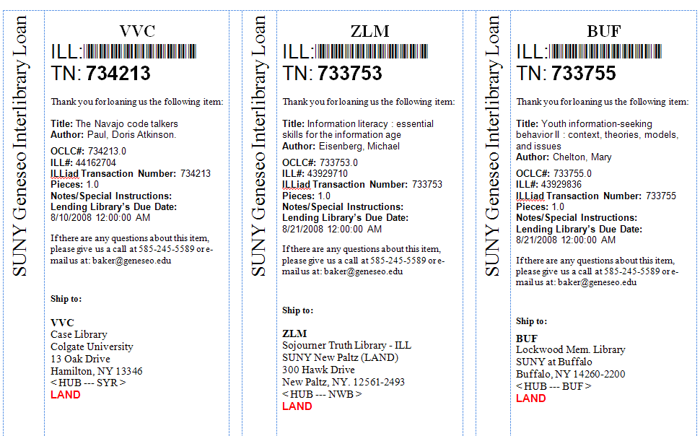
Borrowing Return Slips
For regional courier services, IF BillingAddress2 has text LAND, it prints LAND in Red; IDS Project is BillingAddress1, and HUB is Address4

Slide 33
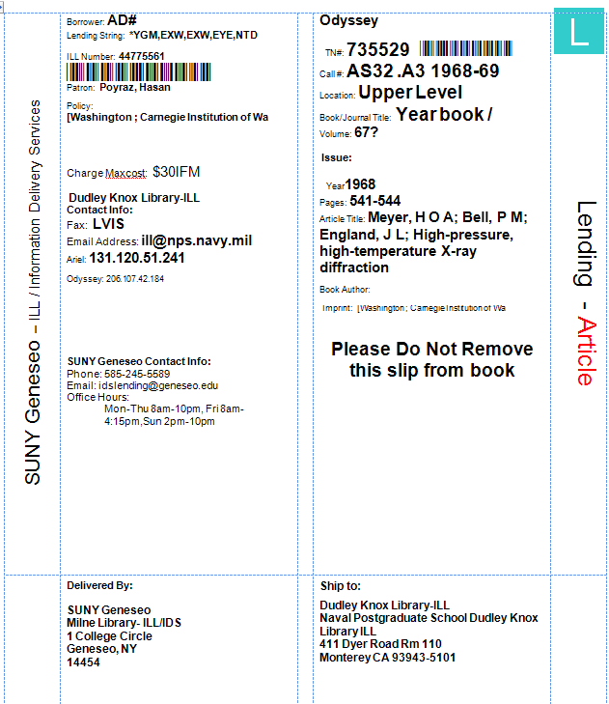

Lending
Odyssey flag
Quick module guide:
B=Borrowing
D=Doc. Delivery
L=Lending
Library, User & Processing
Info.
Citation Information
CITEDVOLUM
Used for notes
Quick module & request type indicator
IDS Project
Delivered
By
Ship To
IDS Project
LAND & RRLC
Notes:
Describe Lending’s similarity, CLICK for the additional fields Odyssey Flag, IDS Project, LAND & RRLC

Slide 34
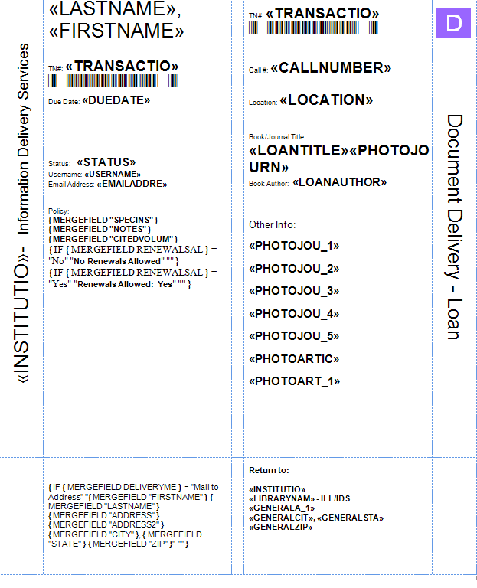
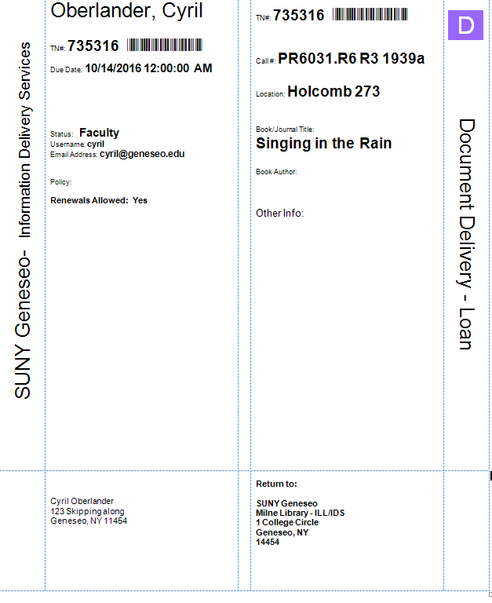
Document Delivery (loan) – for home or department Delivery
I chose “Mail to Address”
So ship to my address
appears here
You can do the same with which library to pickup from, i.e. NVTGC, and other ILLiad fields
Notes:
Document Delivery

Slide 35
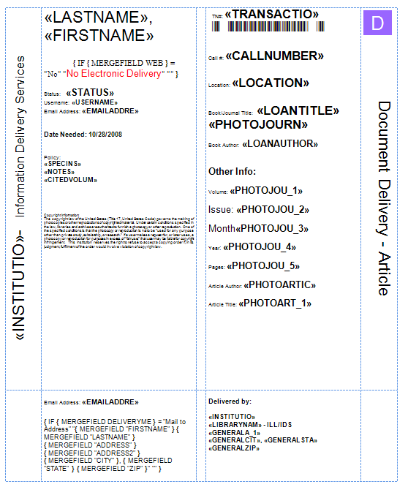
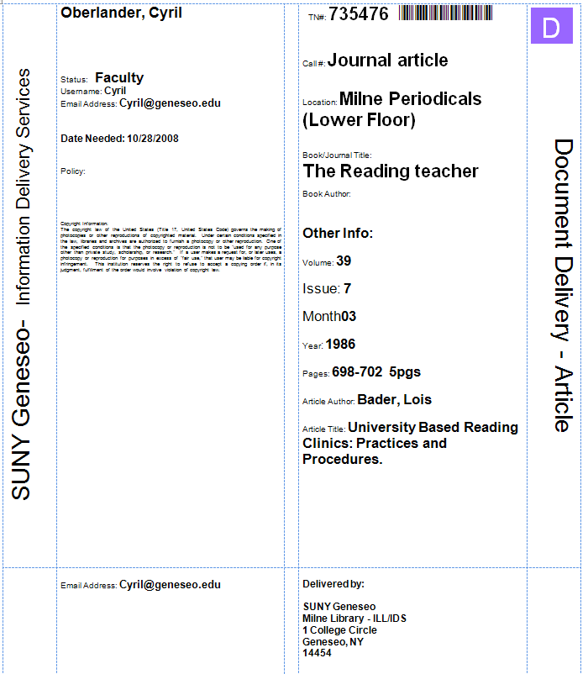
Document Delivery (articles) – for Paging or Storage requests
Quick module guide:
B=Borrowing
D=Doc. Delivery
L=Lending
For users who don’t want electronic delivery, the form says “No Electronic Delivery”
Citation Information
Library, User & Processing &
Copyright Info.
Delivery Info
Delivered by Info
Notes:
Document Delivery
Explain that for user’s who don’t want electronic delivery, the web field flags the request with “No Electronic Delivery”
Click
The Delivery Info appears when/if the Mail To Address Deliveryme field is valid.

Slide 36
Workflow Toolkit
Thank you & Questions? Suggestions?

