Slide 1
Direct Request for Articles
Article Licensing Information Availability Service
Mark Sullivan
IDS Systems Administrator

Slide 2
Current IDS Availability Server
The Good
  Search all Project libraries from within ILLiad
  Shows holdings information for each library
  Has licensing information for each publisher
  Is currently the only way to access this information
  No member work to update the ejournal database

Slide 3
Current IDS Availability Server
The Bad
  A lot of work to maintain ejournal databases for each library (for me…)
  A lot of work to update licenses – currently an annual process
  No one is really happy with the solution – it’s clunky

Slide 4
Current IDS Availability Server
The Ugly
  Staff time – staff needs to check 866 fields for each publisher’s holdings and licensing information
  Lender strings and workforms need to be generated manually (memorize 5 three letter symbols)
  Adds steps to borrowing process instead of eliminating them
  Do not use ejournal url that is in
  the Serials Solutions data

Slide 5
Borrowing and Lending
Does the IDS Availability Server help with Borrowing?
Does it help with Lending?
What can we do to improve it?

Slide 6
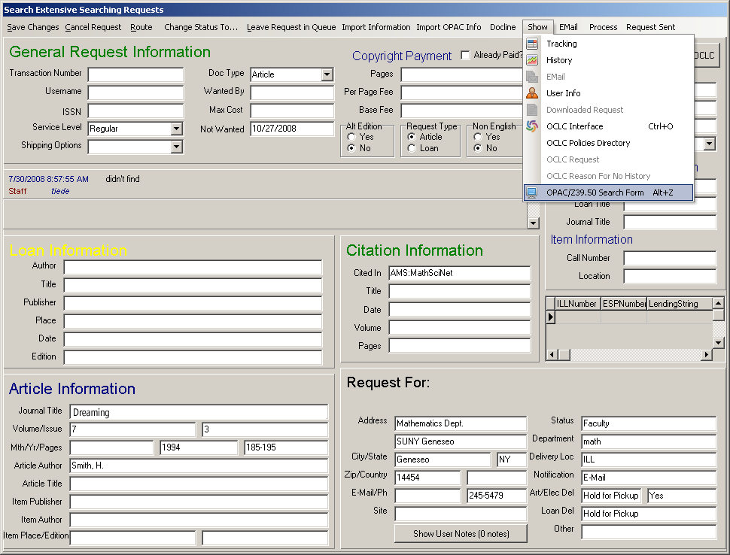
Notes:
Once the request is open click on the Show menu and select the opac/Z39.50 (ALT + Z) command

Slide 7
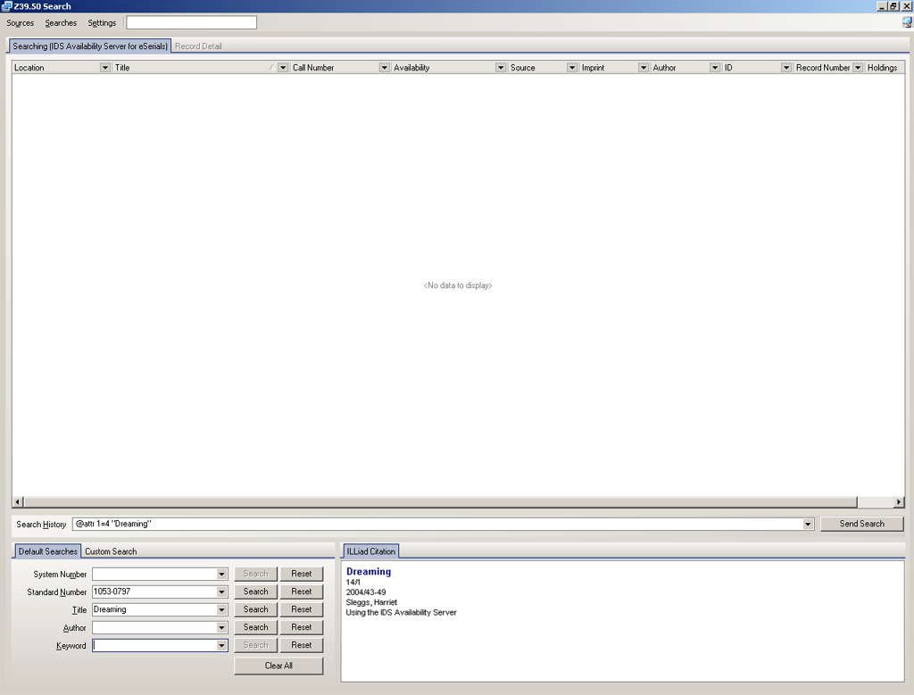
Notes:
Which will bring up the Z39.50 search screen. A search may be done by standard ISSN number or by title

Slide 8
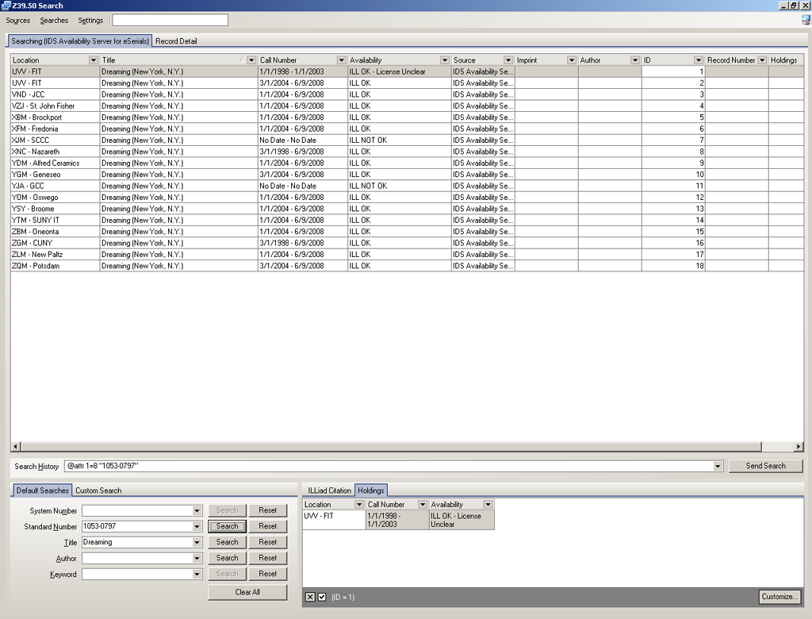
Notes:
The list of project libraries will appear. Double click on each record to check for lenders who hold the volume, issue, and year and if the license agreement is ILL OK

Slide 9
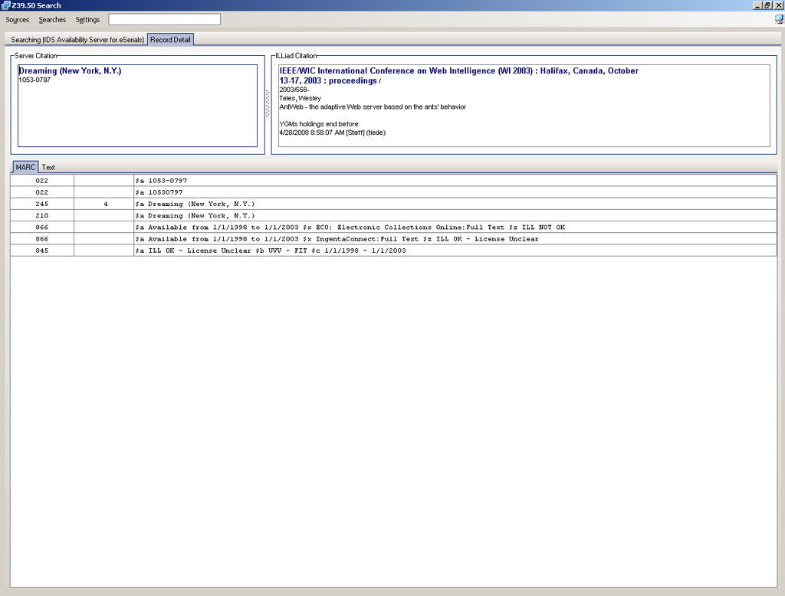
Notes:
Double click on each entry until you have exhausted the list or retrieved enough lenders to reach the five limit for the oclc ill lender string. Close out of the Z39.50 screen

Slide 10
These are the borrowing problems:
  Additional steps
  Need to memorize the OCLC codes of the libraries that have the journal and can loan it
  Need to build a work form manually instead of letting OCLC populate it automatically
But…
  You are making it easier for the Lending library to fill the request quickly and with a perfect copy
  Speed and quality make you look good to your patrons.

Slide 11
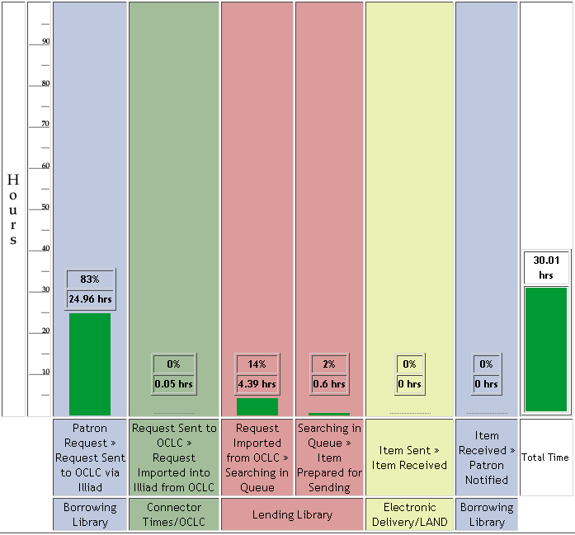
11 Article Requests
Article Borrowing
25 hours on average before article requests were sent
Total average time was 30 hours
ALIAS would have reduced Total average time to 5 hours…
25 hours

Slide 12
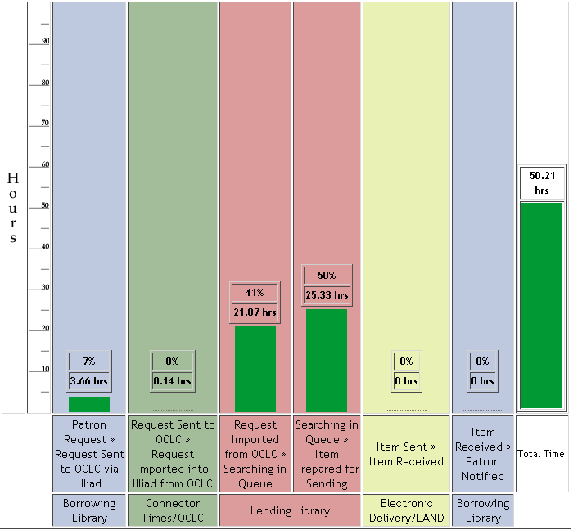
66 Article Requests
Article Lending
46 hours on average for Lending turnaround
Total average time was 50 hours
How much time would using eJournals have saved? How much effort?
46 hours

Slide 13
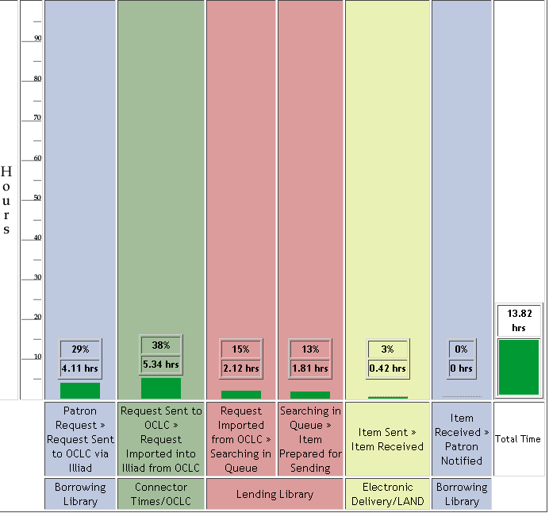
188 Article Requests
Libraries using current Availability Server
Average turnaround is 14 hours
Could be reduced another 4 hours with the new ALIAS for an average turnaround time of 10 hours or less.

Slide 14
Libraries using current Availability Server
These are the lending problems:
  No url in ILLiad so staff needs to search for article
  PDF conversion adds a few steps. We need to be able to import pdf’s directly into ILLiad.
But, no need to…
  search the library’s local journal database
  go to the stacks and search for the volume
  scan or photocopy – already have a perfect digital version

Slide 15
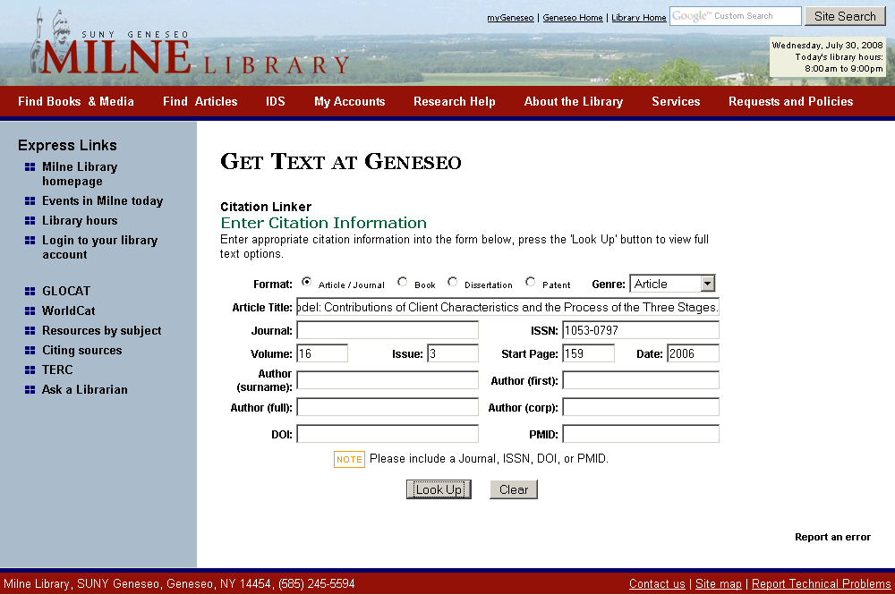

Slide 16
What to expect this year?
Patron Request
Query ISSN, date
ILLIAD
ALIAS: Licensing Database
Library Codes for valid dates and licenses
Article Direct Request – Automatic Process
Awaiting Request Processing – Manual Process

Slide 17
Article Direct Request and Trusted Sender
Patron Request
The patron receives the requested article within a few hours…
Borrowing Library
The borrowing library never touches the request…
The lending library downloads from eJournal and sends through Odyssey. The staff never photocopies or goes to the stacks…
Lending Library
Notes:
Why is this so important? 11 hours? Reducing staff time? More time for the difficult requests?

Slide 18
ALIAS Lending
Library Request through OCLC
ILLIAD
Query ISSN, year, license
URL for provider with proper license and holdings
ALIAS: Licensing Database
Double click URL and download article – No searching needed

Slide 19
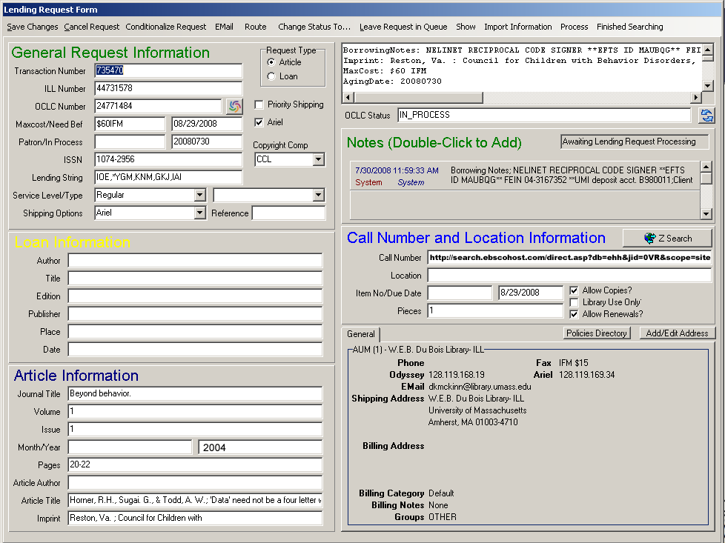

Slide 20
Plans for the Future
Work with Atlas to
  add additional project-based load balancing
  Add Lending version that would
    Include only one library’s holdings and URL’s
    automatically insert url into Call Number or Location field
Work with OCLC and Serials Solutions to explore new discovery options
Work with you to determine needs, evaluate the system requirements, etc.
Notes:
Include urls, scenarios, labels

Slide 21
Plans for the Future
Determine:
  if Z39.50 is the best choice or if another protocol or system would serve our needs better
  If local ERM support is needed by IDS libraries
Take ALIAS Open Source
  Have a web based service (like Jake) that will allow other libraries to lookup and update the licensing information
  Other libraries and consortia will gain the benefits of the ALIAS while helping to improve the system
  Work to adapt ALIAS to the NISO Universal licensing format
Notes:
Include urls, scenarios, labels

Slide 22
Expected Rollout
Testing
Evaluation and Feedback
Redesign
Final Testing
Rollout….January 2009
Options:
  Lending Only
  Borrowing Only
  Filters
    Library Owns
    Rule of 5

