Slide 1



IDS Project Future Act 1
Your participation is essential
2010
1
Notes:
Staff support: $60K
Mentors travel & training: $10K

Slide 2
IDS Project Future Act 1
Strengthening the community
  Sustainability
  Support
    Financial
    Volunteerism
  Scalability
  Webinar and regional meetings
  Mentors and toolkit implementation
  Leadership for staff competencies and communication
  Membership
  Scalable conference that still builds ties : Acquisitions and ILL, staff and administrator, and across libraries.
2010
2
Notes:
Staff support: $60K
Mentors travel & training: $10K

Slide 3
Strengthening Community
Sustainability
Support
  Financial
    SUNY Geneseo
    Grant Funding: RRLC (RBDB), seed money from NY3Rs & SUNY OLIS, ongoing server support by SUNY OLIS.
    Vendors for Conference support
    In kind staff support varies
  Volunteerism
    Mentors, TAG, GIST Team, Licensing Team, ILL lending and borrowing teams, and Workflow Toolkit contributors
2010
3

Slide 4
Strengthening Community – changes afoot…
Donna Howe is retiring from SUNY Geneseo, she is Ed’s and the IDS Project’s primary administrative support.
IDS Project is growing larger and more complex.
The need for a dedicated administrative support personnel is essential.
Ed will retire as Milne Director soon, but is interested in continuing interim appointment as Director of the IDS Project.
Cyril will be the new Director of Milne Library, and after a transition period, appointed as Director of the IDS Project.
The Projects future depends on how the community handles local and collaborative efforts.
2010
4

Slide 5
Strengthening Community
Volunteerism
  Mentors,
  Technology Advisory Group (incl. IDS Search Team),
  GIST Team,
  Licensing Team,
  ILL lending and borrowing teams,
  and Workflow Toolkit contributors
Reflections about distributed working teams
Tools help;
gotomeeting,
gotoassist,
basecamp (project management)
but effective teams require time and effort…
Future development team projects need face-to-face time that cost and support.
2010
5

Slide 6
Strengthening Community
Sustainability
Support
  Financial – we need more funding.
    How shall we seek funding?
    What can you do?
  Volunteerism – we need more support.
    How do we coordinate volunteerism?
    What can you do?
    Administrative council?
2010
6

Slide 7
Act 1 over Act 2 next
Stay Tuned…
2010
7

Slide 8

IDS Project Future
Act 2
IDS Search
Interest
IDS Project Branding
IDS Project Support as Service Provider
Other
  OCLC Reclamation & Synchronization
  Future Enhancements; Articles, Circulation Availability Service, etc.
  Release to any library
2010
8

Slide 9
IDS Search
What is the interest level in using IDS Search?
2010
9

Slide 10
IDS Search
What level of use? Main, Secondary, Other
2010
10

Slide 11
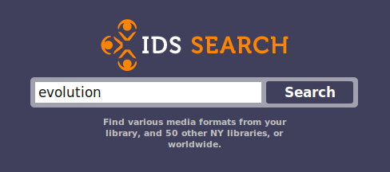
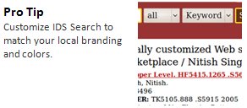
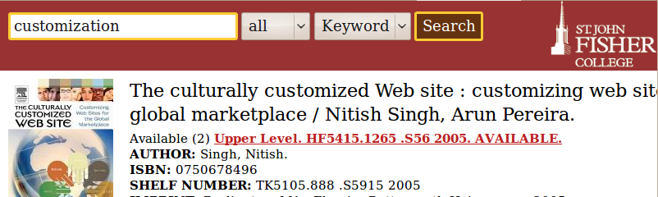
IDS Search Branding
How important is it to brand instances with IDS Project?
2010
11

Slide 12
IDS Search Support
IDS Search support & service provider:
Maintenance team: 3 ‘volunteers’
How do we build teams (maintenance & development) and keep development going?
Not 24 x 7, but commercial server is robust
Service calls on IDS Search Listserv: idssearch@project.org
Libraries need to monitor OCLC system alerts if they want to know the status of Worldcat services such as Worldcat API.
Questions or concerns?
2010
12

Slide 13
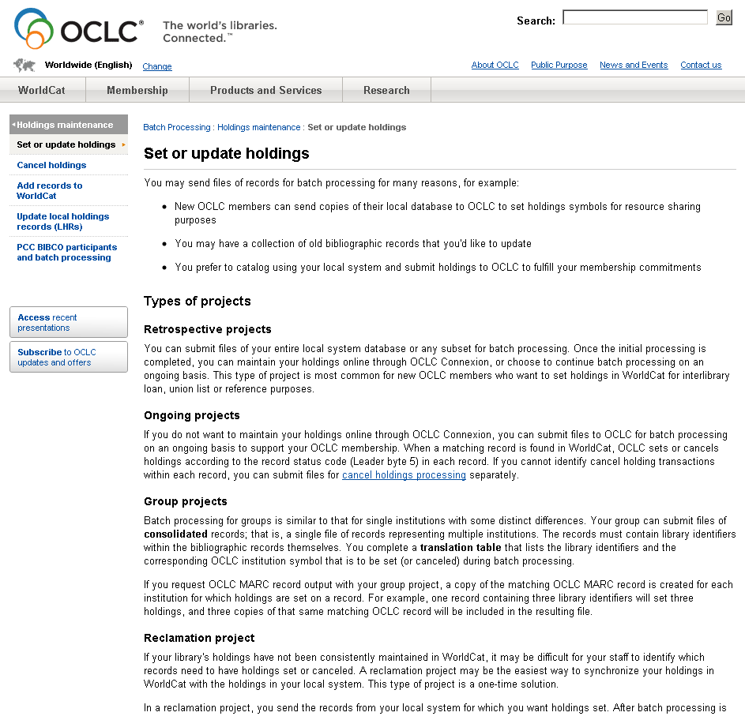
IDS Search – OCLC Holdings
Worldcat API relies on up-to-date OCLC holdings
OCLC Reclamation & Synchronization
  http://www.oclc.org/batchprocessing/options/holdings/set/
  Maggie Horn, SUNY OLIS
2010
13

Slide 14
IDS Search
Worldcat API relies on up-to-date OCLC holdings
Problems with ‘local’ data:
  Reserves personal copy
  Collection codes
  eBook Purchase-on-Demand and other eBook subscription cataloging conundrums.
2010
14

Slide 15
IDS Search
Future Enhancements
Articles – metadata searching
Circulation Availability Service
Digital Libraries – OAI searching
Other?
2010
15

Slide 16
IDS Search Release
Option to release this to all libraries
Download your own IDS Search with license to alter code.
What is our commitment to support outside the Project?
Questions?
2010
16

Slide 17

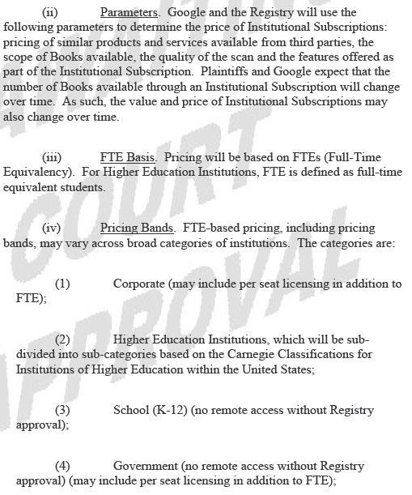
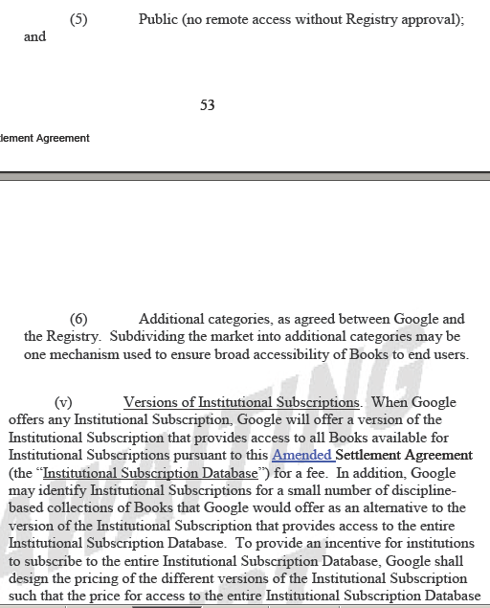
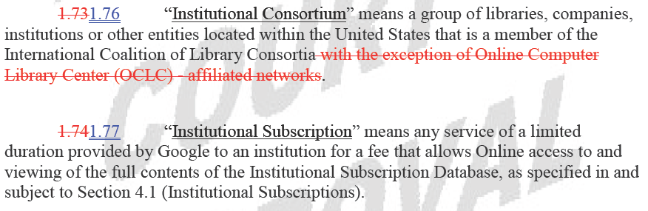
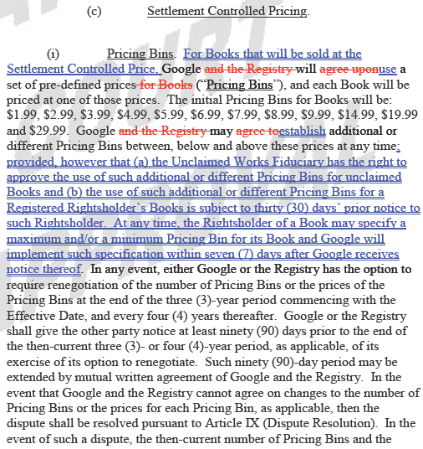
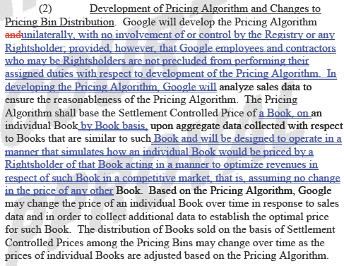
Other Issues of Importance
Google Books subscription
2010
17

Slide 18
How do we continue the administrative dialogue in a distributed environment?
Ross Atkinson, “Six Key Challenges for the Future of Collection Development,” writes primarily of research libraries…
“Cooperation does not, for the most part, put a collection or library on the map… cooperation… will not happen by someone standing up and presenting a lot of PowerPoint slides that contain graphs and charts and dazzlingly innovative cooperative models…” it will entail…
Libraries “coalescing and operating as a group”
“to relinquish some leadership, to relinquish some distinctiveness”
“collective leadership to displace… the individual or institutional leadership”
2010
18

Slide 19

Library Cooperative
A unified community of trust and support built around a critical and clearly understood common purpose: effective resource sharing.
2010
19

Slide 20

IDS PROJECT.ORG
Do we have the individual and collective will to meet today’s users’ demands for information by dramatically transforming the current operations within our individual libraries—and by radically reshaping the historic organizational relationships among our libraries?
2010
20
Notes:
The IDS Project is built around this challenge.
To answer this question in the affirmative require that we confront and embrace two very scary ideas:

Slide 21
Thank you
2010
21
Notes:
Add ohiolink slide as example

