Slide 1
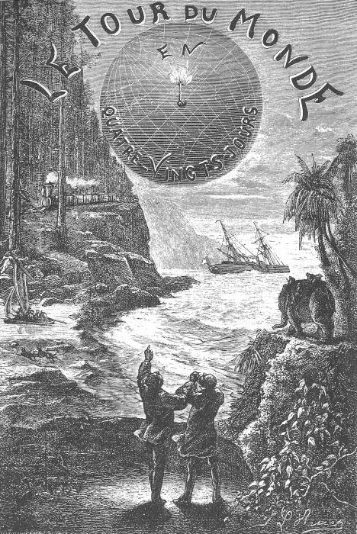
“Around the World in 80 Routing Days (or less!)”:
International ILL
IDS Project Conference 2010
Tom Bruno
Head of Resource Sharing
Harvard College Library

Slide 2
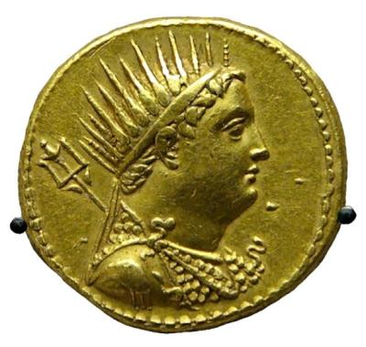
The Oldest Profession
As long as libraries have existed, there has been interlibrary loan
Earliest known instance of International ILL goes back to the reign of Ptolemy III “Euergetes” (246-222 BC) of Alexandria
Ptolemy borrowed the collected works of Euripides, Sophocles, and Aeschylus from the Athenians
Athens demanded a deposit of 15 silver talents = $300,000
The Great Library kept the originals and sent back copies, forfeiting their deposit

Slide 3
A Modern International Incident
True story- only a few months into my tenure as Head of ILL at Harvard College Library we got a series of angry letters from the National Diet Library of Japan
We’d lost one of their books in return transit, and the author who had donated it to the NDL was apoplectic
Not only did we have to pay a lost book fee, but we also had to write a formal letter of apology to the professor whose book we’d lost!

Slide 4
The Moral
International Interlibrary Loan is not for the faint of heart!
It is a challenging process for which there are no easy answers (e.g. OCLC), but there are useful tools and shortcuts
Requires you to be a librarian, a linguist, an anthropologist, and sometimes a bit of a scoundrel

Slide 5
Today’s Presentation
The non-OCLC Borrowing process- what to do, when to do it, how to customize your ILLiad client to help you and your staff
Basic search tools and strategies for advanced international searching (KVK and other global OPACs)
International copyright laws and how they impact global resource sharing
Payment methods and IFLA vouchers
Lending issues: Customs, Customs, Customs
Today’s goal- I hope you take one new thing home with you

Slide 6
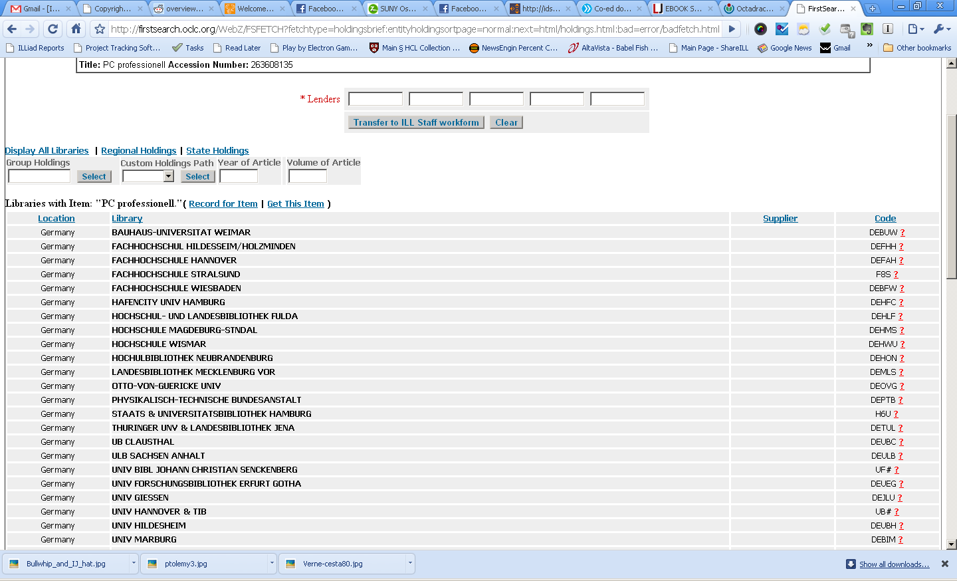
The End of the Line?
“I found something on OCLC but all of the holding libraries are lowercase. Can anyone help me?”
This is the beginning of the search, not the end!
OCLC’s reach is growing by leaps and bounds, but it is hardly the final word

Slide 7
One Big Happy Family
International ILL has come a long way from being an insider game where contacts were essential
Anyone can play the International resource sharing game, assuming that you are willing to: 1. Pay for service (alas, not too many International ILL shops do LVIS) and 2. Eat the cost of return shipping via a reliable courier
The good news: 1. Is actually pretty cheap
The bad news: 2. Not so much

Slide 8
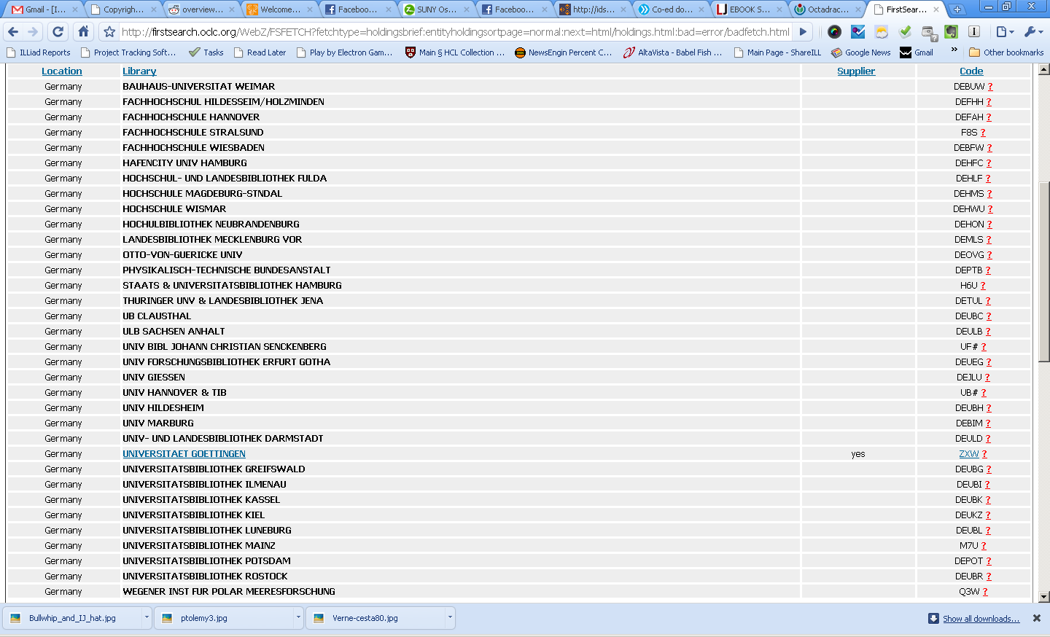
Step 1: Have you tried checking OCLC?
Hey, wait! Didn’t you just say…?
Yes, but OCLC is still the path of least resistance for your ILL request, and more and more international libraries support IFM payment!
Even if you think an item is only available overseas, check OCLC- new international lenders pop up every day
(We’re all still rejoicing when GEBAY- Bayerische Staatsbibliothek went uppercase in early 2009!)
“Scroll down- wait, what’s this? YES!”

Slide 9
But Be Careful!
Never trust the Policies Directory information for International libraries
Even for the big libraries, information can be nonexistent, inaccurate, or wildly out of date
This is especially so for “International Lender” settings! (I’ve had countless conversations with other librarians who’ve told me that “I didn’t think they honored Int’l ILL because they’d checked no in the ILL Settings”)
When in doubt, ask the lending library!

Slide 10
Step 2: You know what to do
This is IDS, after all! Google Search
Why? The standard reason: There’s more and more out there to be found online and for free
Not just for articles, but you never know with loans as well (we aren’t the only country with various digitization initiatives in place. See: Gallica, Europeana, etc.)

Slide 11
GOOG is My Spellcheckr
Another good reason to do a Google search: patron may have spelled something wrong (which may be why your OCLC search came up blank, so don’t forget to follow back on that!)
Also, transcription issues may be to blame
Great example: Greek. LoC uses a weird hybrid method of cataloging for items based partly on Ancient Greek that your patrons may not know and which is definitely not currently in use in Greece (where it’s all Greek to them)
More on this later!

Slide 12
Step 3: Okay, now what?
Consider the venue. Different geographic regions of the world are going to require radically different solutions.
Change the venue- i.e., cheat. For example, did you know that the British Library permits you to place orders for items held at other UK libraries through its Integrated Catalogue via its backup search?
Cold-call a venue, or enlist the help of a subject librarian. Just because we’re in the middle of an online discoverability revolution doesn’t mean that everything is discoverable (to you!)

Slide 13
Around the World: EUROPE
Weapon of choice: The KVK (Karlsruher Virtueller Katalog)
Search over 50 international OPACs at once, plus some electronic fulltext databases and global book vending websites such as Amazon.de
Mostly European, with Australia, Israel, Russia, LoC and NLM

Slide 14
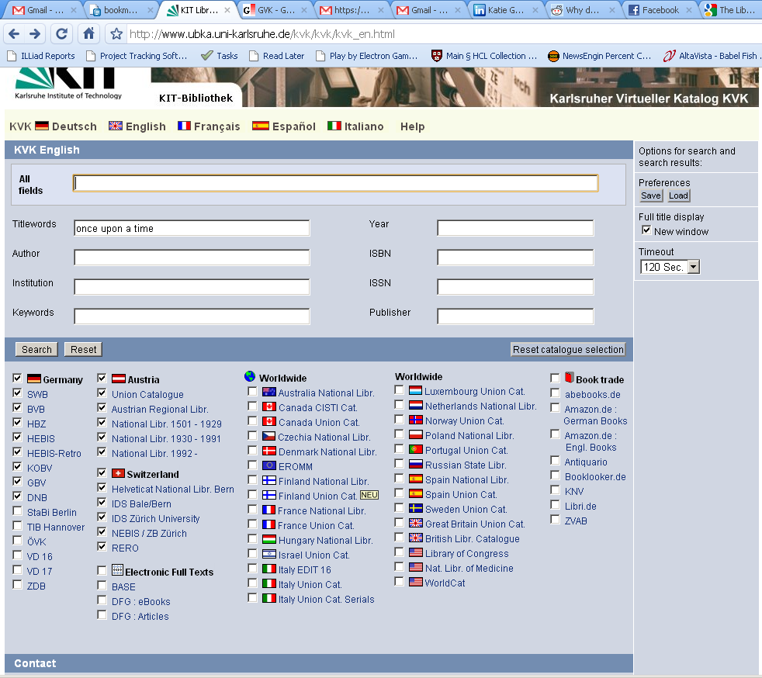
KVK- the BMW of library search

Slide 15
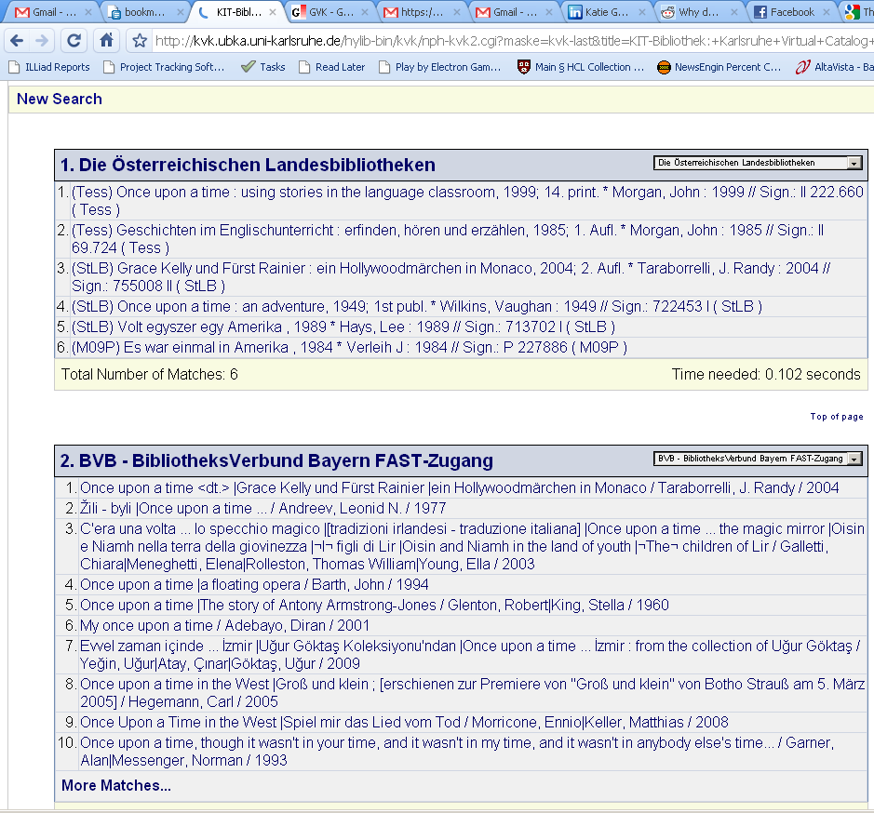
Search Results sorted by OPAC

Slide 16
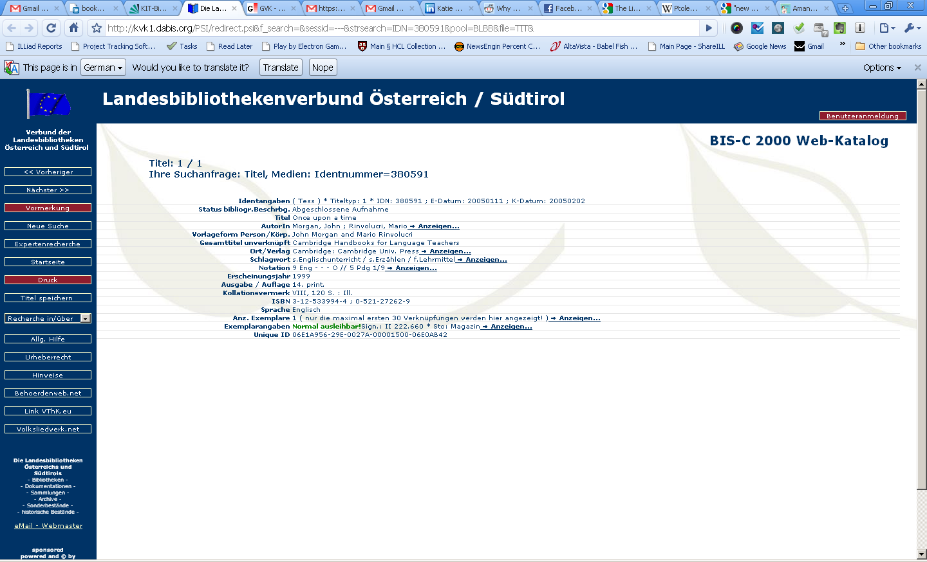
Follow Links to Local Holdings

Slide 17
Now for the tricky part- ordering
Most OPACs have an ordering option, but these are usually for local consortia and not external borrowers
However, don’t be afraid to ask: for example, CSIC in Spain (representing over 70 libraries) will set you up with an ILL account
Otherwise you need to look for an email address or a request form for external borrowers
Of course you will create an ILLiad Lending Address for this library, but you should also create an ongoing, easily-accessible (and easily updatable) database of your non-OCLC lenders- we had a binder, but now we have a wiki

Slide 18
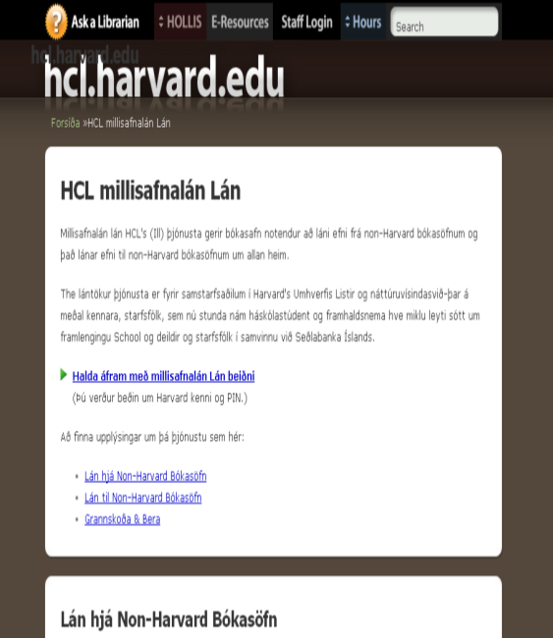
So many haystacks, so few needles
Remember all of those usability studies your library did to evaluate your school’s and library’s websites?
Now try to navigate these pages in a different language other than English!
Go back and ask your webmaster- if someone used Google Translate, could they find resource sharing links in their native language?

Slide 19
ALA? IFLA? Bueller?
The beauty of email is that one form looks more or less like another
Use your ILLiad ALA email template
You may want to add a field for Shelfmark or Call #, as some libraries won’t lend to you unless you provide it from their OPAC
Unless you hate trees and like to wait, don’t print out ALA forms and mail them unless you have no choice (e.g., libraries which require prepayment (but even then you might find that their requirement is actually a preference!))

Slide 20
You Know What This Means
Once you’ve set up a new international lender in ILLiad, you should create an email routing option for that library
Saves time, saves keystrokes, don’t need to re-invent the wheel every time you request from that library
Combine with “Change Status on Send” for even more labor-saving
Remember: Every non-OCLC resource sharing activity takes time, and that time adds up to a cumulative drag on the turnaround time of your patron’s request. If you go to all of the trouble to locate an international lender, you should take the extra time to set them up for email routing as well, because chances are you’ll be coming back to them at some point in the future.

Slide 21
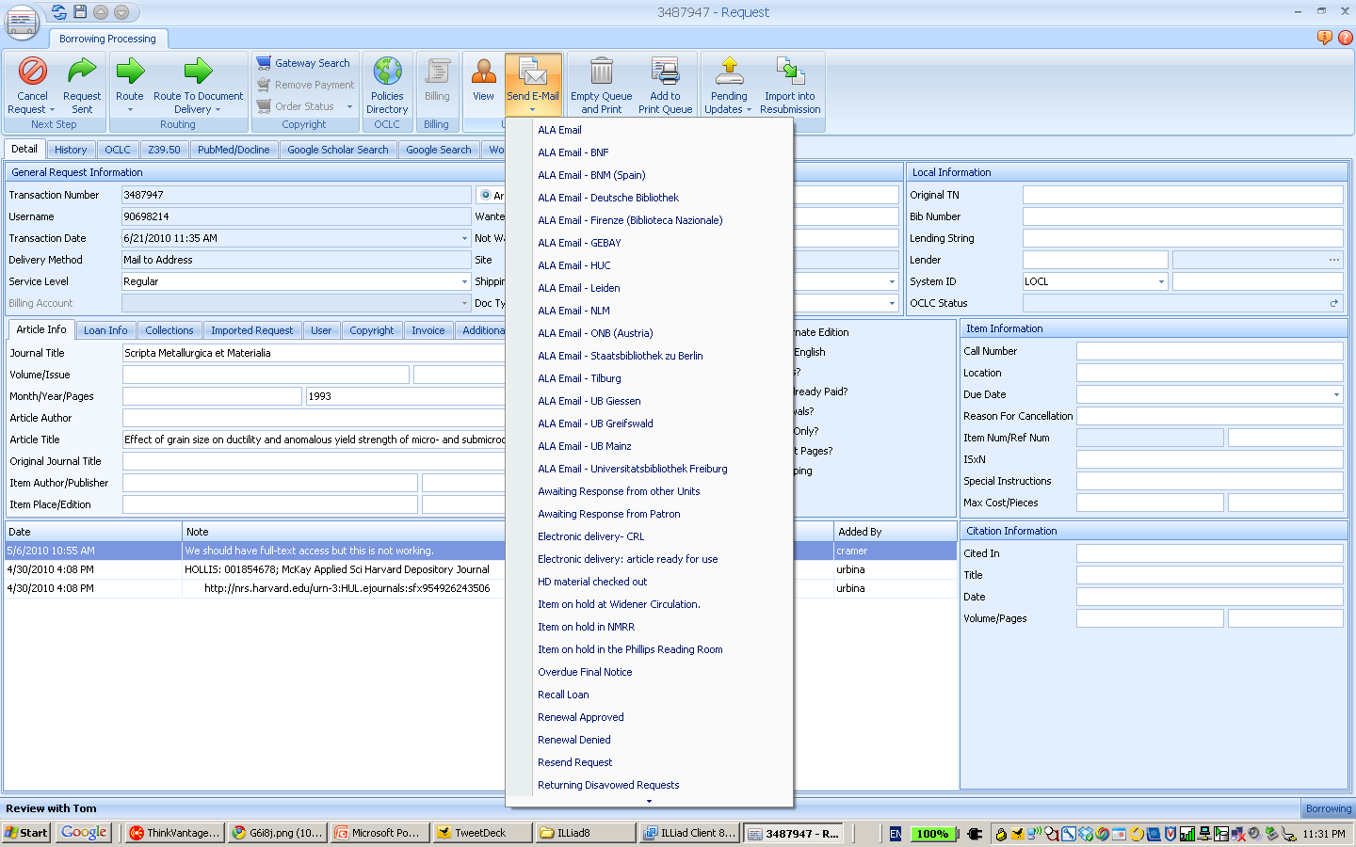
Email Routing Example

Slide 22
Other European Considerations
British Library and the Integrated Catalogue
Over 13 million items
Order directly from Catalogue- more delivery options than ordering via OCLC, plus addition of Backup Search if the item is not available through the BLDSC

Slide 23
EThOS
Digital dissertation service for all theses produced in the UK
Non-profit entity administered by the British Library
Digitized theses are usually available immediately for free download (requires registration with EThOs)
Theses not yet digitized can be ready in 30 days, for a fee (~34 pounds)
Once digitized, theses available at no cost to others
IMPORTANT NOTE: These theses may not be added to your own library’s collection

Slide 24
EROMM
European Register of Microform and Digital Masters
A third-party database to facilitate preservation microfilm/reformatting orders
Once you place the order, your transaction is with the holding library- not EROMM
This service can take a lot of time and a lot of money (which is ironically why faculty seem to know the most about it and ask for it by name)

Slide 25
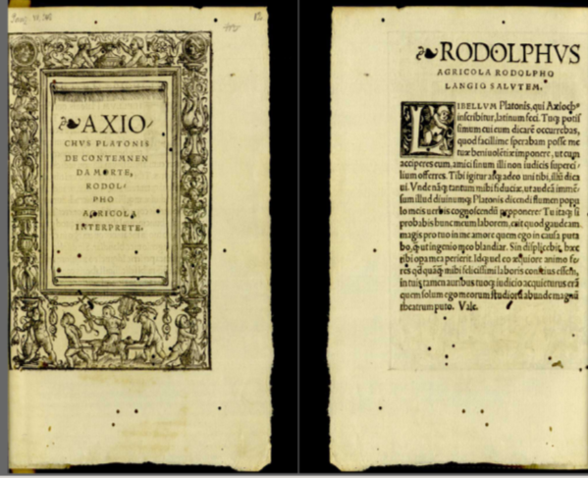
BnF
Bibliothèque nationale de France
They have a Reprographics division, but it is slow
BnF launched Gallica, its digital repository, in 1997- since then they have added more than a million items
Even better, it links out to other European digital holdings!

Slide 26
Other French Resources
SUDOC (Système Universitaire de Documentation)
9 million bibliographic records
Sudoc also catalogues the series collections of periodicals held by around 2000 non-Higher Educational library institutions (such as Town Libraries, other resource centres, etc.)
All theses and dissertations produced in France
No offense to the BnF, but this is usually our first stop for French resources

Slide 27
Germany- Great for loans, but…
The outcome SUBITO case of 2004 meant that German, Austrian, and Swiss libraries were breaking copyright law in providing electronic document delivery services
(Technically even photocopies ILL/DD was illegal, because it didn’t involve the actual loan of the material)
Germany moved to amend copyright law in 2008 to permit noncommercial reproduction and transmission of copyrighted material and the German-language publishing industry freaked out
Forced publishers to sign a license contract strictly limiting or forbidding such activities

Slide 28
From Russia, With IFLA Vouchers
Is Russia European or Asian? DISCUSS!
Whatever your answer, Russia presents a unique set of challenges for the would-be ILL librarian
Patrons often submit their requests in transliteration, unaware that the transliteration of Russian resources has gone through several historical phases
National Library of Russia’s catalogs must be searched according to time period and place of publication
Books in Russian cataloged between 1725-1998 are browseable by partially-lemmatized scans of the old card catalog!

Slide 29
Around the World- ASIA
OCLC/WorldCat has made huge strides in making these resources more discoverable, but ordering can still be a challenge
Language barrier is one factor, unless you have a resident expert on hand to assist you- many library websites and/or OPACs are not designed with the Western user in mind
No one search engine a la KVK, but National Diet Library, Academica Sinica Library, and University of Hong Kong Libraries are all excellent resources
Some institutions have very strict rules regarding loans (NDL) and do not take the news of lost items well
HCL has yet to develop good search tools for resource sharing in India and Pakistan. Has anyone out there been successful?

Slide 30
Around the World- OCEANIA
Australian and New Zealand libraries are mostly on OCLC and great resources for electronic document delivery, especially if you’ve enabled Trusted Sending for all incoming Odyssey deliveries
Take advantage of the time-shift= they fill while you sleep, sometimes on the same day!
Just avoid sending returnables on the Sydney-LAX flight to avoid any space/time anomalies…

Slide 31
Around the World- AFRICA
South African libraries have vastly increased their discoverability in OCLC/Worldcat over the past few years
Excellent suppliers for articles, but watch for return shipping costs if you borrow returnables
A new resource: AJOL- African Journals OnLine (http://ajol.info). Hosting 389 online journals with 43808 fulltext articles
The new Library of Alexandria/Bibliotheca Alexandrina is now on OCLC (Symbol: EGAXA), though it is not a supplier (you may also not want to lend them any Greek tragedians)

Slide 32
Around the World- LATIN AMERICA
Try Internet Resources for Latin America, compiled by New Mexico State University Library: http://lib.nmsu.edu/subject/bord/laguia/ (an old resource but still a viable collection of links)
Also LANIC (Latin American Network Information Center) http://lanic.utexas.edu/
And don’t forget the Digital Librarian’s guide to Latin American Resources: http://www.digital-librarian.com/latinamerican.html
Reliable shipping is a real issue in Latin America

Slide 33
Copyright
No fair use in most of the world (only US and Israel have a full “fair use” doctrine), or radically restricted “fair dealings” provisions
Costco watch IP case (Omega S.A. v. Costco Wholesale Corporation)- 9th Circuit ruled that First Sale Doctrine does not apply to materials created/published outside of the United States
ACTA and other global IP initiatives must be monitored by librarians carefully- our livelihood is at stake! More collective action is called for here in the United States, as our counterparts have already done in Europe (cf. Copyright for Creativity)
Keep up with copyright here with the Copyright Advisory Network: http://librarycopyright.net/wordpress/

Slide 34
Scoundrel? I like the sound of that
Warning: I Am Not A Lawyer
Rule of thumb for ILL= the copyright laws of the lending library apply
However, you may find that the service ethic is stronger than the copyright lawyer- especially if you ask nicely!
Don’t ask me why this is so, it just works
P.S. We never had this conversation

Slide 35
Payment
Silver talents are no longer the preferred medium of exchange between libraries, although you wouldn’t know it from some “lenders”
My advice? (If possible) avoid any libraries that require bank transfers or payments by foreign check, because your finance people will learn to hate you if they don’t already!
Credit cards, IFLA vouchers, and OCLC IFM
Remember that IFLA vouchers are valued in EUROS- currently 1 full voucher = 8 Euro = $10.58
You can buy them from places like BCR for $15/each, but some colleagues will sell for current valuation, rather than fixed $ amount (plus postage)

Slide 36
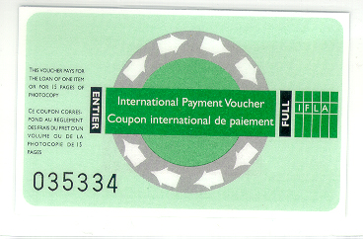
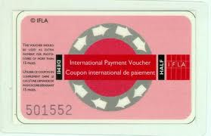
It’s all about the IFLAs!
Green are full vouchers= 8 Euro; Red are half= 4 Euro
Unlimited validity (though knuckleheads do staple them when sending)
Original concept- 1 voucher= payment for one loan or copying an article of 15 pages
May be redeemed at any time in Euros, less a €12 handling fee

Slide 37
Are you thinking what I’m thinking?
1st Invitational IFLA voucher poker tournament- Oswego ’11 (Who’s in?)
Also, IFLA vouchers are a system that can be gamed for financial advantage
Buy low, sell high?
If you’re a net International lender, why not redeem for the best exchange rate?
Are there potential ethical questions here?

Slide 38
Can we get some love for Lending?
Lending and International ILL is much more straightforward compared to Borrowing, but there are two major (interrelated) considerations: shipping and/or customs
Shipping made easy: if you’re going to lend internationally, use a trackable & insured method of shipping or don’t even bother
You think library rate is bad? Once your package leaves the U.S. it’s at the mercy of local mail handling service
Even FedEx and UPS are subject to third-party involvement in some countries, so let the shipper beware

Slide 39
Once Upon a Time in Mexico
True Story #2
I get a call from our FedEx Dispatch, informing us that there is a problem delivering a package to an address in Mexico
FedEx Mexico wants to know “if it’s okay to destroy it”
WTFBBQIFLAOCLCIDS?

Slide 40
Lending Shipping Caveats
Get the address right- most commercial shipping companies will assess a penalty fee for address correction
Get the address right, Take Two- shipping companies follow different protocols for undeliverable items, or may lose them entirely
Get the address right, Take Three- provide a positive ILL experience for an International Borrower and you foster the resource sharing ethos on a global scale

Slide 41
The Customs of Customs
Isn’t it ironic? Some of the thorniest customs problems for ILL shipping are with our neighbors just across the lake
Canada has a private customs company (Revenue Canada) and a system of 3rd party brokerages
Customs may be assessed, paid, and no one’s the wiser until 3-6 months down the line when it’s difficult to fix

Slide 42
Our Solution?
“Foolproof” labels for Customs:
ATTENTION REVENUE CANADA
Tariff/Tarif 9993.00.00
GST/TSP Code: 51
International Loans Between Libraries (International Act of 1978)
No Commercial Value: Any Value Stated is for Insurance Purposes Only
As this is hardly foolproof, we also set our default with FedEx so that we pay any assessed Customs
We eat the charge (then dispute the charges), but we also don’t pass on bad shipping karma to a poor unsuspecting borrowing library

Slide 43
FedEx is cheap, except when it isn’t
Our average international FedEx shipping rate was ~$28 per package
Some countries are wildly above this average: e.g., South Africa and the former Soviet Union (even Puerto Rico, although in the United States, costs a disproportionate amount for FedEx shipping)
You may want to adjust what you charge to compensate for additional shipping costs
Pay close attention to your FedEx data!

Slide 44
Final Lending Advice?
Make it easy to pay via IFLA, or even credit card
Require a trackable commercial shipping agent for return
Just do it! By lending internationally you are making it more likely for someone else to borrow further down the line
Practice good resource sharing karma and everyone benefits

Slide 45

Questions? Comments? Sharing?
Tom Bruno
Head of Resource Sharing
Harvard College Library
(OCLC: HLS)
617-496-7364
tbruno@fas.harvard.edu
IM: tcbruno2@yahoo.com
tom.bruno@gmail.com
Twitter: http://twitter.com/oodja
Facebook: http://facebook.com/tom.bruno

Slide 46
Special Thanks
Cyril Oberlander and Ed Rivenburgh of the IDS Project, for inviting me to speak
All of you IDS Project 2010 conference members, for being so gracious and hospitable
The Widener ILL team, for making all of this look so easy
My mentor, Susan Lieberthal, who helped me find my calling as a librarian!

