Slide 1
Article Processing
How to share your e-journal articles
By Tim Bowersox
Notes:
Welcome
Introduction
Lending from your e-journals is, in my opinion, a best practice that will allow you to lend a lot with little effort
It is also going to be increasingly important as libraries continue to reduce their print holdings in favor of electronic subscriptions
Today I’m going to present ways that you can share your e-journal articles more effectively. We’ll cover:
How to discover your license permissions
How to convert articles from PDF to TIFF
How to send those converted articles in batch via Odyssey Helper
Once we’ve covered the basics of e-journal lending, we’ll explore applying that workflow to pay-per-view articles

Slide 2
Benefits of e-journal lending
Less manpower
  No stacks searching
  No photocopying
Less time: just save and send
Better image quality
Better service quality
  Faster turnaround
  Easiest document delivery opportunity

Slide 3
Step 1. Discovery
Must determine your holdings & licenses
  Link resolver holdings (Serials Solutions or SFX)
  ALIAS licensing data
3 options
  Lending Availability Service (ILLiad 7.4 & 8.0)
  Serials Solution Citation addon (ILLiad 8.0)
  OpenURL Linker addon for SFX (ILLiad 8.)

Slide 4
Lending Availability Service
Pros
Cons
Z39.50 search in the ILLiad client
Returns your link resolver holdings & ALIAS license permissions
Works in ILLiad 7.4 & 8.0
No direct link to your link resolver interface
Requires Customization Manager setup
Manual search

Slide 5
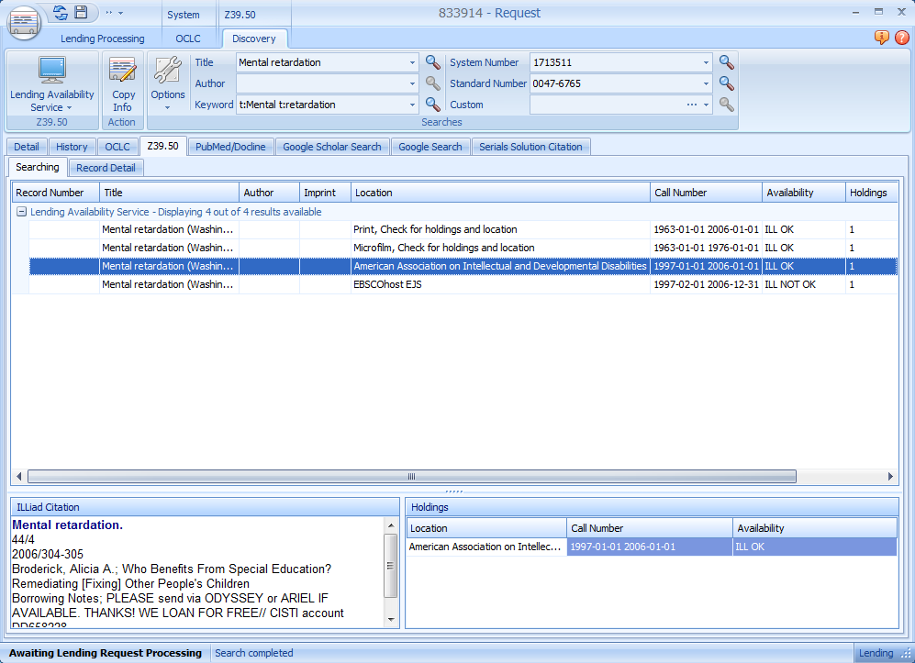
Lending Availability Service
Notes:
Screenshot of the Lending Availability Service
Runs within ILLiad’s Z39.50 interface
For each title, it displays your holdings and licenses for each provider
Search by title and ISSN

Slide 6
Serials Solutions Citation addon
Pros
Cons
Automatically searches Serials Solutions for the article
Displays the license permission alongside the resource
Works from within the ILLiad client
Will allow one-click PDF downloading & conversion
Unavailable for ILLiad 7.4 users

Slide 7
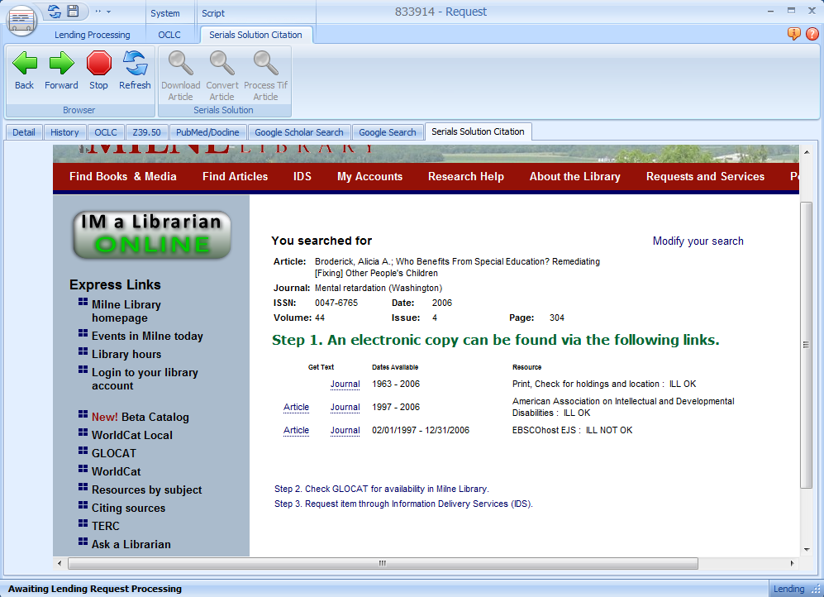
Serials Solutions Citation addon
Notes:
Screenshot of the Serials Solutions Citation addon developed by Mark Sullivan
This addon only appears in article requests
All you have to do is tell it the URL of your Serials Solutions
Then, any time you click on the tab it will automatically search your Serials Solutions Citation search
Like you’d expect, it will only return the holdings that you own for the date requested
But what’s better is that it displays the ILL license for each provider
In effect, it’s combining the Lending Availability Service with your Serials Solutions giving you just one place to search
You can also use this in borrowing requests to determine if you have local electronic holdings

Slide 8
OpenURL Linker addon
Pros
Cons
Automatically searches your link resolver for the article
Works with all link resolvers
Works from within the ILLiad client
Still requires searching the Lending Availability Service for licenses
Unavailable for ILLiad 7.4 users

Slide 9
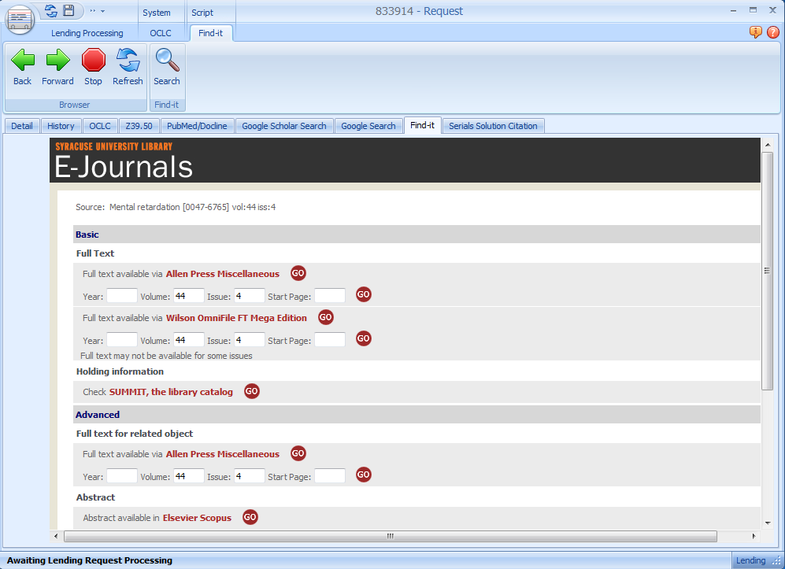
OpenURL Linker addon
Notes:
Screenshot of the OpenURL Linker addon developed by Kevin Reiss
This is compatible with all link resolvers, but is specifically targeted for SFX users
Again, just configure it with the URL of your SFX
Then click on the tab in article requests and it will automatically search SFX for you
However, to get to your licenses you still have to use the Lending Availability Service
But it is still great because you don’t have to leave the ILLiad client to locate electronic articles

Slide 10
Crash Course
Search for the journal title in either the LAS, Serials Solutions Citation addon, or OpenURL Linker addon
Verify you have the necessary holdings and license permissions
  If so, save PDF to a dedicated folder or network location
  If not, check print holdings or cancel request

Slide 11
Step 2. Convert PDFs to TIFFs
Odyssey will only send files in TIFF format
But online articles are all in PDF format
Solution: free and simple conversion tools!
MyMorph, DocMorph, MS Office Document Image Writer

Slide 12
MyMorph
Pros
Cons
Free download from NLM
Easy batch conversion between TIFF and PDF
Saves to same location each time
Requires Windows
Requires separate installation on each workstation
Larger files can convert slowly

Slide 13
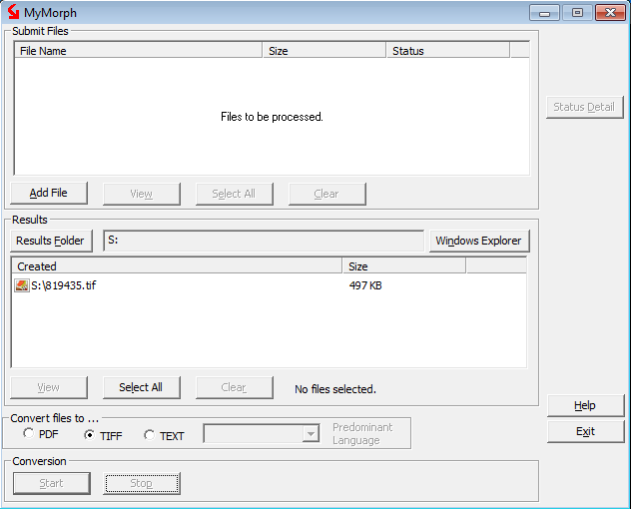
MyMorph
Notes:
Screenshot of MyMorph
Very simple to use: add files that you want to convert in the top pane
Then choose where you want the converted files to be stored
Select your format, click Start, and then voila

Slide 14
DocMorph
Pros
Cons
Free to use from NLM without any downloads
OS-neutral web tool
Option to rotate upside-down pages
Requires login each session
Slower than MyMorph
Must download file after conversion

Slide 15
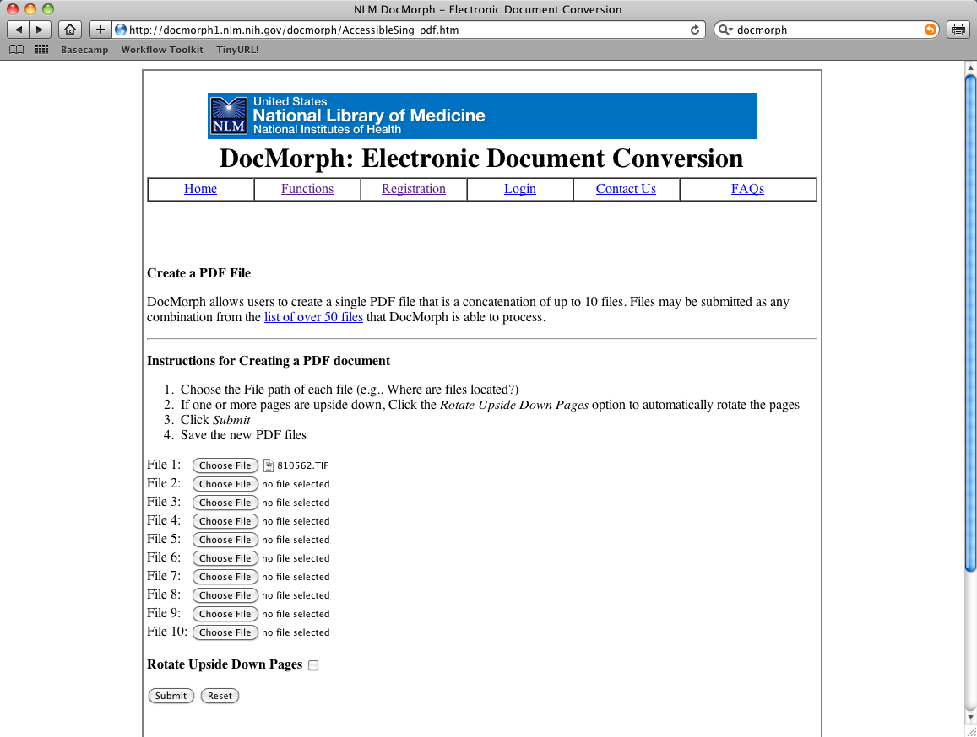
DocMorph
Notes:
Screenshot of DocMorph
Takes a few extra clicks compared to MyMorph and is a bit slower
But it doesn’t require Windows to use because it works in your browser
The Serials Solutions Addon will soon utilize DocMorph for converting articles within ILLiad (check out the lightning talks)

Slide 16
Crash Course – MyMorph/DocMorph
Select the saved PDF(s)
Choose TIFF as your desired output format
Save file(s) as TN # to your output folder
  MyMorph: before conversion, choose your results folder
  DocMorph: after conversion, download file(s) to that location
Delete the original PDFs to save space

Slide 17
MS Office Document Image Writer
Pros
Cons
Convert PDF to TIFF on-the-fly in browser/reader
Fast conversion times
Requires Windows
Does not work with 64-bit operating system
Requires MS Office

Slide 18
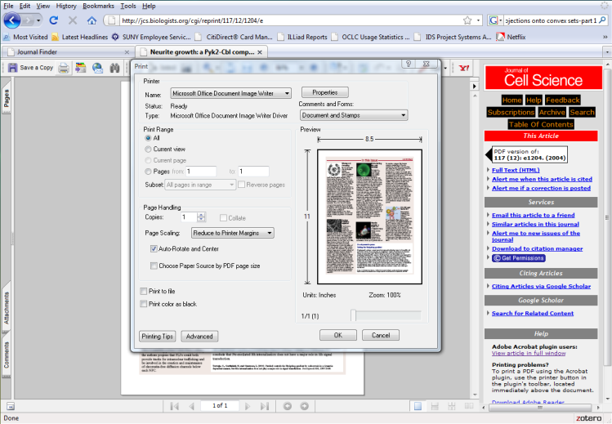
MS Office Document Image Writer
Notes:
Screenshot of MS Office Document Image Writer
Works just like a printer so you can convert on the fly

Slide 19
Crash Course – MS Office Document Image Writer
View the PDF in your browser
Go to File and Print…
Select the MS Office Document Image Writer as your printer
Print the document. When prompted, save to a folder or shared location as the TN #
NOTE: requires initial configuration before using. To see if you have it installed, view your Printers in the Control Panel.

Slide 20
Step 3. Deliver the articles
Odyssey
  Send all converted articles at once using Odyssey Helper (version 7.3 and higher)
  It imports files, delivers them, bills (if applicable) and updates the status to Request Finished automatically
Ariel
  Import either the PDF or TIFF and send to library
  Still have to Mark Found in ILLiad
Email Routing
  Alternative to Ariel for non-Odyssey borrowers
  Upload PDF to your elecdel folder and send download link to library
  Still have to Mark Found in ILLiad first

Slide 21
Crash Course – Odyssey Helper
Save TIFF as TN # to the folder specified under OdysseyHelperImagesPathLending in Customization Manager
Open Odyssey Helper after all files saved
Eligible requests will appear in list (i.e. those that have both a TIFF and are “In Stacks Searching”)
Click the deliver button to begin auto-processing.

Slide 22
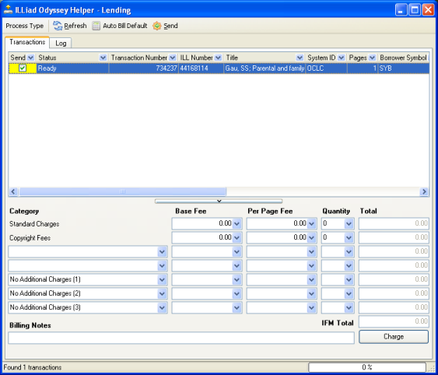
Odyssey Helper
Notes:
Screenshot of Odyssey Helper
It allows you to send in batch for Odyssey Lending & Document Delivery articles
It automatically applies billing charges and updates requests so you don’t have to
All it takes is just the click of a button

Slide 23
Odyssey Helper
Also works for Doc Del (files must be saved to OdysseyHelperImagesPathDocDel location in the Customization Manager)
To distribute, simply copy Odyssey Helper program to the desktop of each workstation
  Hosted sites: located in your C:\ILLiad folder
  Others: located in your ILLiad server’s Odyssey folder

Slide 24
Pay-Per-View Workflows
How to purchase and deliver pay-per-view journal articles to your users

Slide 25
Why use pay-per-view?
Evidence from Geneseo, 12/1/06-1/1/08
  Paid $6,662 for 270 royalty payments of articles also available pay-per-view
  Pay-per-view costs would have been $6,100
  On royalties alone, would have saved $562
CCC royalties aren’t all…
  Pay-per-view savings increase if you avoid lenders that charge
  Range from free IDS Libraries to $25 lenders
Summary:
  Why pay avg. $25 royalty + up to $25 in ILL fees?
  Pay-per-view gives immediate access for $23 on avg.
Analysis conducted by Cyril Oberlander, 4/21/08

Slide 26
What you need
Credit card
Email routing and access to your \ILLiad\PDF folder, or just Odyssey Helper
ILLiad lender record called “Vendor”
  Associate with each pay-per-view request
  Set as “Copyright Payer” to avoid pay-per-view articles showing up in CCC order

Slide 27
Considerations
What is your scope?
  Only for faculty? Or for all users?
  How much are you willing to pay?
When will you purchase articles?
  When CCC and/or lending charges exceed a certain amount?
  When articles are embargoed from subscriptions?
  When there is no other means of access?
    Foreign or obscure titles
    Recent publications not yet published or held in print
  Rush requests?

Slide 28
Keep in mind
Pay-per-view prices often cost less than copyright clearance, but more than lender fees
Article quality much better from vendors than through ILL lenders
Beware of articles in “Adobe Digital Editions” format because they cannot be shared (used by BL Direct)
Not all vendors are created equal
  Checkout is often clunky w/ no one-click ordering
  Not all articles available for purchase
  Obscure publishers may not have secure checkout or automated delivery
Follow all institutional guidelines for credit card records

Slide 29
Workflow example
Determine if purchasing the article is best option
Search Google for the article title to locate vendor
Buy the article from the vendor
Save the PDF to your \ILLiad\PDF folder or convert to TIFF for Odyssey Helper
In the ILLiad request, use “Vendor” as your lender
Deliver the article via email routing, or route to In DD Stacks Searching and use Odyssey Helper

Slide 30
Questions? Comments?
All workflows available at:
http://workflowtoolkit.wordpress.com/

Slide 31
Thank you
Tim Bowersox
Information Delivery Services Librarian
Milne Library, SUNY Geneseo
bowersox@geneseo.edu | 585-245-5589

