Slide 1
Getting It System Toolkit:
GIST for Web Installation
Tim Bowersox, Cyril Oberlander, Kate Pitcher, Mark Sullivan
State University of New York, Geneseo College
IDS Project Conference
August 3rd and 4th, 2010
Notes:
Cyril

Slide 2
What is GIST?
It is a system for:
enhancing user’s request experience & delivery service
enabling user-initiated purchasing requests for acquisitions and interlibrary loan;
enhancing coordinated collection development;
merging Acquisitions and ILL request workflow using ILLiad (ILL request management software)
Notes:
So what is GIST?
GIST is a customizable set of tools and workflows for ILLiad 8 that enhances:
interlibrary loan and just-in-time acquisitions services;
purchase request processing;
and coordinated collection development efforts.
GIST enables acquisitions staff to benefit from ILLiad’s request management system, and GIST makes ILLiad an even more powerful tool for ILL.

Slide 3
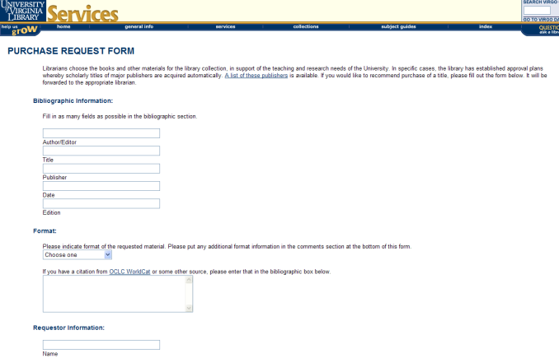
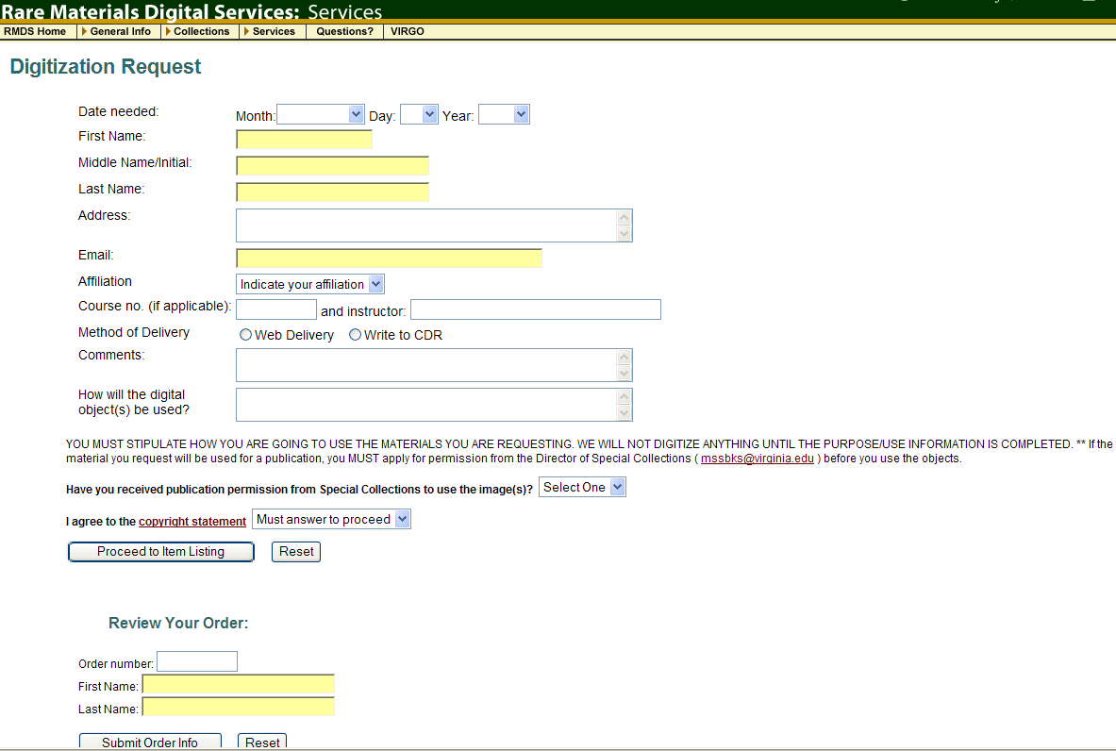
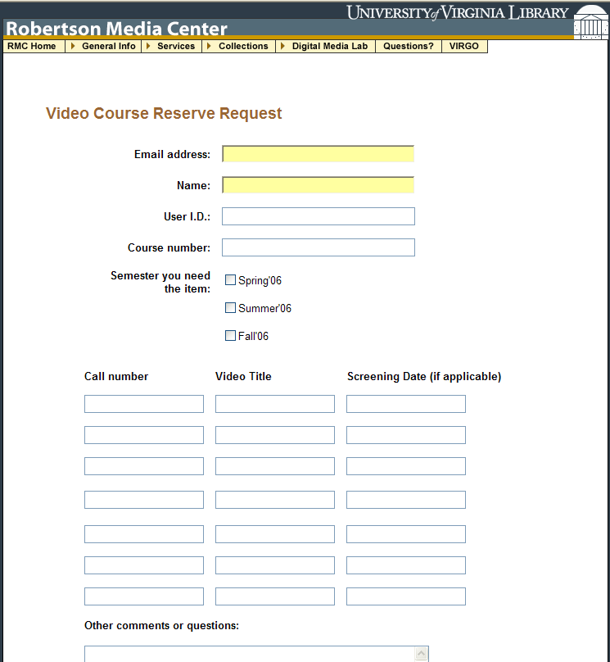
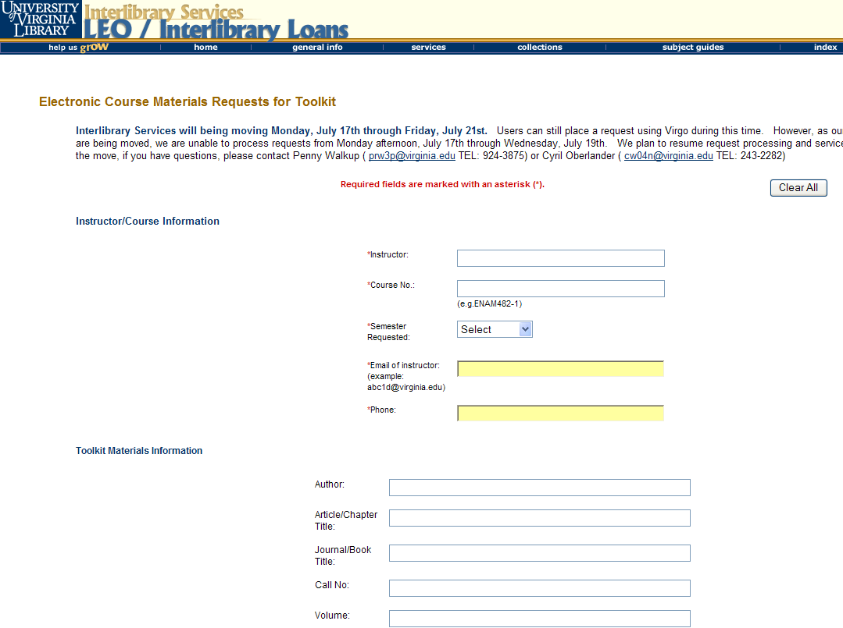
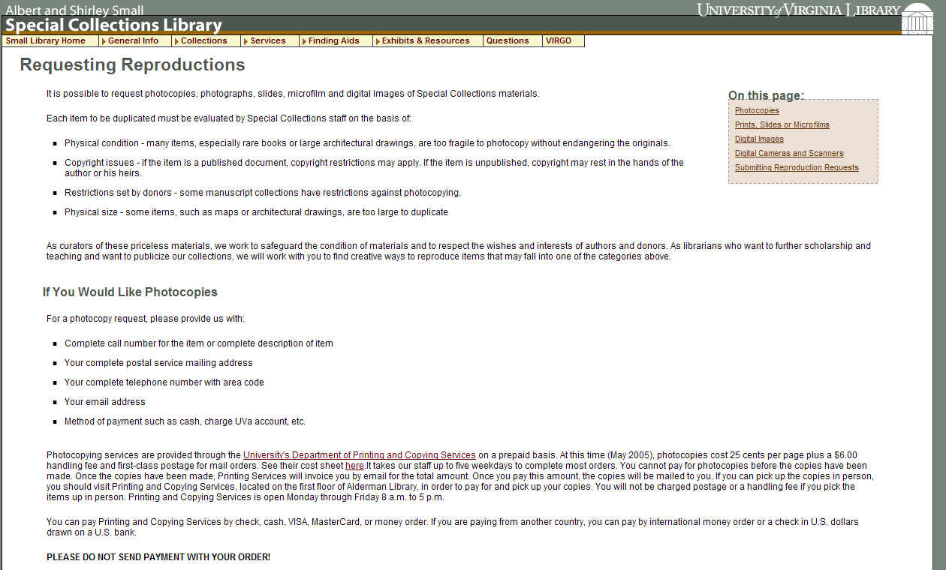
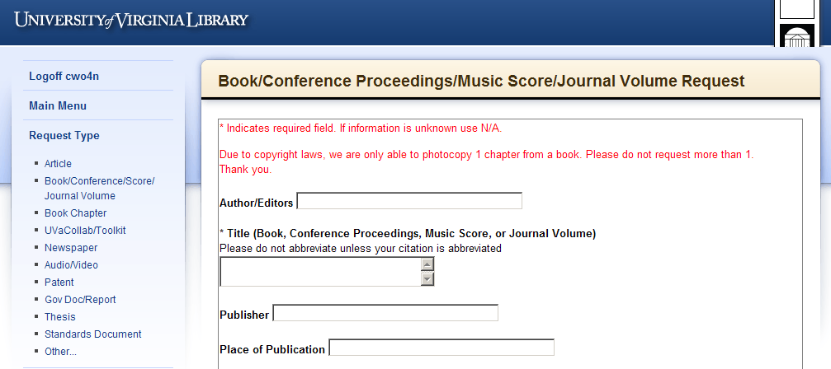
Service Request – what context?
Rare Materials Scan Request
Purchase Request
Video Booking Request
Library Services are fragmented by
Request Systems that
Reinforce functional divisions
E-Reserve Request
Special Collection Duplication Request
Interlibrary Services Request
Notes:
Add that the reality of our numerous disparate request systems, which serve as vehicles for end user services, sends the message that our creativity, well intentioned, has run amok with functional divisions.
How does the very fractured service design or request environment we offer make any sense to our users?
If anything, it is reinforcement of the internal reality…

Slide 4
We need a strategy that leverages strengths
Purchase Request Systems
Interlibrary Services Request Systems
Strategy?
Email from php website
Requests managed with;
  automation,
  links to Worldcat,
  email system (custom & canned),
  transparent process to user.
Staff mediated process
Black box process for user
OR
Notes:
GIST also provides acquisitions with a set of customizable templates and tools that enhance and ideally, transform acquisition, collection development and ILL workflows.
Traditional workflow: CD Librarian get an email from their php-email web form, Library Clerk looks up prices in Amazon or Gobi, looks up holdings in SUNY Catalog, looks up department budget, Decision tree may require a bibliographer or subject selector, or liaison review, and a few conversations, then it becomes an approved selection, which could mean handing it off to an acquisitions and/or cataloging person, and so on. The user is meanwhile in the dark about the status of this request, and what communication there is, is often made from someone’s email, rather than a system generated email that eliminates rekeying information.
ILL which had a similar website email system 10 years ago, now has a system that manages user requests and enables automated processes that free staff time and enables customizing and adding value to the service.
While it is relatively easy to leverage another system or workflow – workflow depends more on the local strategies that have political and individual dimensions – sort of the 400 lb gorilla in the room and on the elephant we are all trying to figure out. Thankfully, everyone at Geneseo was all on board – selectors were more interested in instruction, CD Librarian didn’t like the current workflow, and sees user-initiated requesting as the way to go…

Slide 5
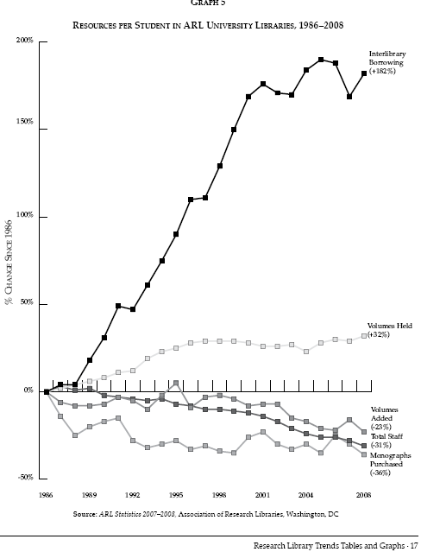
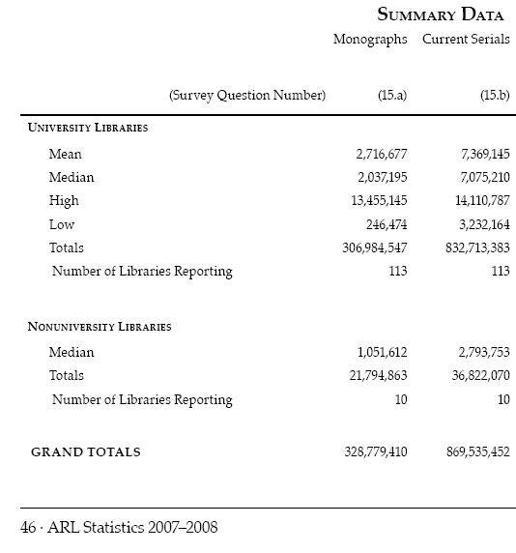
Monograph Spending & ILL
2009 over 11 Million ILL requests (ALA)
Association of Research Libraries 2007-2008
Notes:
http://www.arl.org/bm~doc/arlstat08.pdf p. 46, 17

Slide 6
It’s the Economy…
April 6, 2008 a day in the life of ILL…
110 borrowing requests for loans came into SUNY Geneseo, of these…
79.1% or 87 items could be purchase from Amazon; about 46% could be purchased for under the ARL unit cost for borrowing: $17.50
Over 1/3 could be purchased for less than $10 used
(almost 1/5 for less than $5)
Over 1/5 could be purchased new for less than $10.
Price of lending charges is often higher than the price to buy.
Massive weeding of libraries is exponentially increasing the availability and reducing prices of buying.
Print on Demand industry enables purchasing in lieu of problematic ILL of medium-rare books / purchase price is comparable to lending charges.
Libraries increasing their lending charges are more reliant on revenue that is going away.
“retrospective buying projects are feasible… and for monographs, purchase may be a reasonable substitute for interlibrary loan.” Holley & Ankem, 2005
Notes:
The economy is telling us…
Consider what I found searching 110 ILL book requests from one day spring 2008. Highlight screen findings
The reality of weeding for 10-20 years, & print-on-demand publishing will have a significant impact on the book market, and possible strategies for libraries.
But don’t let an old ILL Librarian just say that… CLICK Acquisitions and collection development librarians are saying that too.

Slide 7
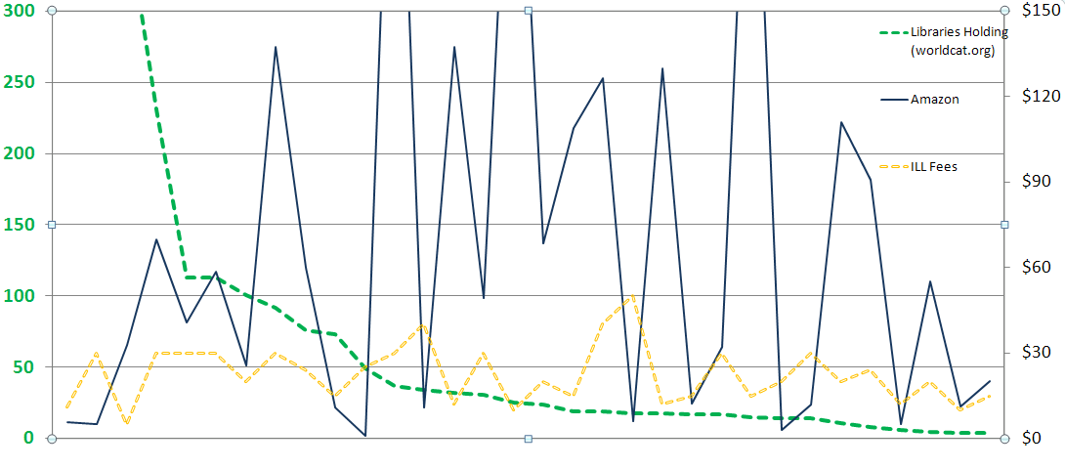
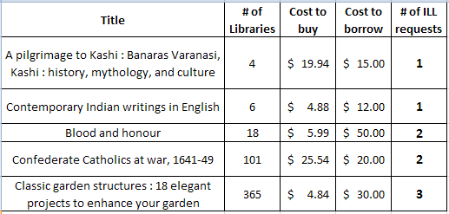
Strategies – Cost, Uniqueness, Use
Cost
# Libraries
Why Purchase on Demand / Just in Time Acquisition…
One study of Purchase on Demand books found that within 5 months
28.7% ILL Purchase on Demand books checked out again.
18% Regular Acquisition books were checked out once.
Ward, 2002
Notes:
From either an ILL borrowing or selection perspective, user initiated strategies can make a lot of sense. This graph is a look at Geneseo’s borrowing when we requested materials not held by SUNY and IDS libraries, and there were lending charges incurred for the request. The opportunity cost between borrow and buy, plus the collection diversification are key values useful for both ILL and collection development processes.
CLICK – here are some of the titles from the graphed sample. Pilgrimage & Garden examples.
CLICK – Lastly, if use is a measure of success in collection building, then Just in Time Acquisition has been shown to lead to subsequent use. How does that compare to many libraries selecting just in case that are fortunate if 50% of their new titles are ever checked out.

Slide 8
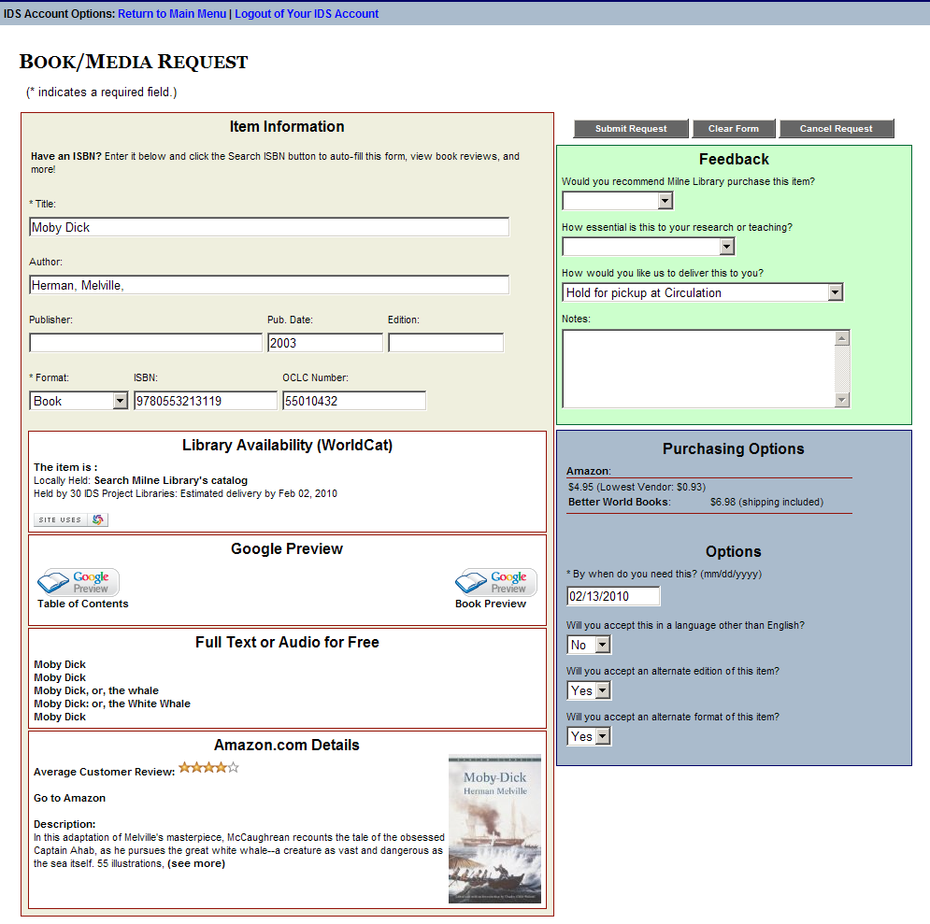
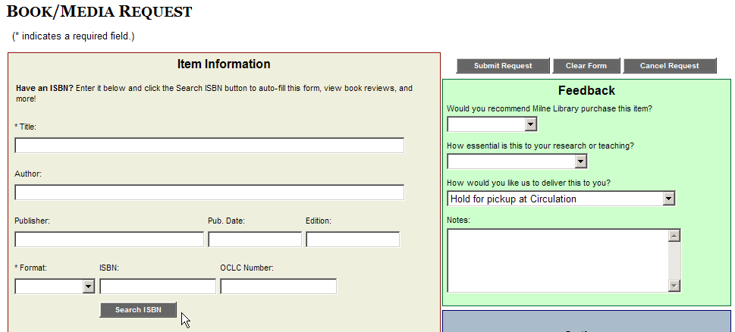
User Interface for GIST at Geneseo
Very customizable
Status specific
(Faculty, Distance Ed., Students, etc.)
Context sensitive
  Standalone w/ISBN search
  Default Loan Form
  Open URL
  Book Chapter Form
Smart components a la carte
  (Easy to turn a widget on or off, widget not displayed if no data, add widgets to Book Chapter form, etc.)
Notes:
MARK
So enough talking around GIST, let’s show you the details – this is a screenshot of the GIST ILLiad web interface, as seen from an open-url request initiated from the worldcat database.
This version has an ISBN lookup feature also, in case you are on the blank form and just want to add an ISBN and have all the information added to the form automatically.
This interface conforms to your local ILLiad web interface, so your stylesheets control the look. These forms can be customized to user status, and much more…

Slide 9
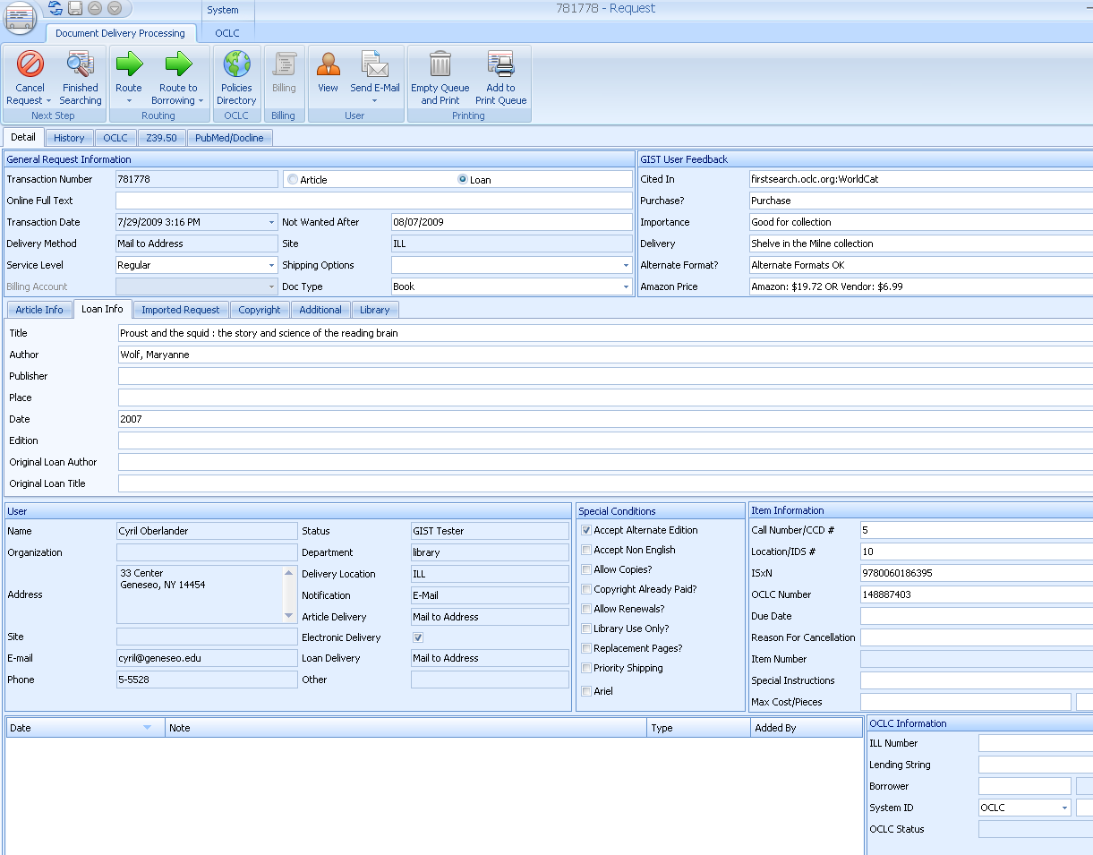
Customizable GIST Request Form
User
Interface
(Customizable display & fields)
Staff
Interface
(Customizable display & fields)
User Interface
Runs from ILLiad web server, all components can be turned off and/or hidden from user view.
Display text is configurable
Works with your style-sheets
And more…
Staff Interface
ILLiad 8+ customizable field names.
You can configure data the way you want staff to see data from user interface side, and run routing rules based on the values; i.e. available full text, purchase request suggested, holdings, etc.
And more…
Notes:
Perhaps most important is that the views the user and staff see are configurable and information dependent. So, in the basic view of the GIST Form, important to note is that the components that pulls in data from other services, i.e. Worldcat, Google, Amazon, etc., will not be shown if no data is matched during the requesting process, and in the configuration file, it is easy to turn a component on or off, or hide them within the web page, or customize the display values.
In the STAFF VIEW pre-searched data is automatically added to the staff view and turned into meaningful routing rules can be applied to route requests into specific process queues, or to make it easy to compare the cost of buying with borrowing. So let’s look @ more details…

Slide 10
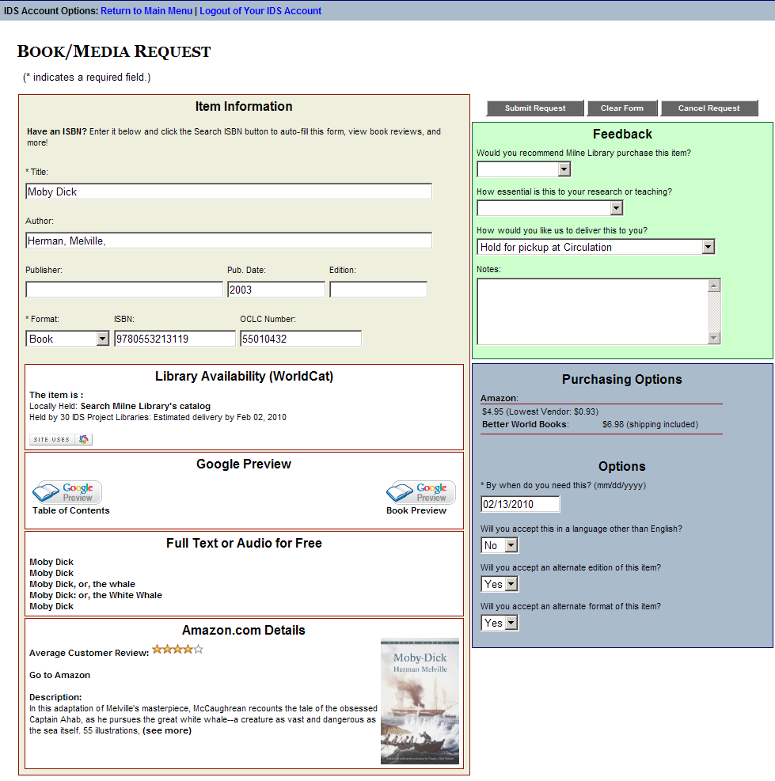
Worldcat API – Library Availability
User sees if owned locally, easy click to catalog, and sees estimated turnaround time.
ILL & Acquisitions staff see if held locally, and # holdings in 2 configurable groups (consortia, state, etc.)
ILLiad ILL
Request Form
Custom, Standalone, OpenURL, Status Specific
Google Books
User sees Table of Contents, No-Partial, & Full Text Views.
Staff see if full text in Google (GOOGL) OCLC symbol
Hathi Trust
User sees link to full-text version from Hathi Trust
ILL & Acquisitions staff see if held at Hathi Trust, and GIST 1.1 embeds the direct link to the work using a TinyURL API
Index Data
User sees if full text or audio version in Open Content Alliance, Gutenberg, Internet Archive, etc.
Staff see if full text OCA (INARC) OCLC symbol
Purchasing Options
User sees price to purchase from Amazon API with New & Lowest Price listed (used) – user may want to purchase from this link. If they do, Amazon provides our AWS account a credit for referring someone to purchase.
ILL & Acquisition Staff see the New & Lowest Price in the ILLiad requests. Better World Books, Google APIs are also currently used for pricing.
Amazon API
Enhances users request evaluation with Reviews, Ranking, Cover, and quick link to Amazon.
Price was moved into Purchasing Options window.
Notes:
There are 5 API components in the GIST interface; Worldcat API, Google Books, Index Data, Amazon, and purchasing options. By default, they are activated, however, the library can simply turn off any component they do not want to see, and how the data from each component is highly configurable for end-user, as well as, staff within the ILLiad request.
The Worldcat API – Terry Reese, Oregon State University and Kyle Bannerjee, Summit originally developed the Worldcat API for GIST, later modified and configured to work with ILLiad by Mark Sullivan. The purpose of the Worldcat API component is to bring back holdings information to the user – if held locally, it says so and the Please check your catalog is a one click into a search of your catalog using the OCLC#. The availability and estimated delivery time is set to 2 configurable groups – you might want one for your resource sharing consortia (of which turnaround times might be consistent), and the other is your state.
Google Books API enhances the user’s evaluation of the material they are requesting with additional data, such as Table of Contents or Partial Text Available, however, the user may also discover that the item they need is Full Text Available. Both ILL and Acquisitions staff see GOOGL (Google’s OCLC symbol) when a requested item is available full text, and at Geneseo, a routing rule automatically places the request in a specific queue – the staff will send the user an email using ILLiad that has the Google Book URL, and copies the electronic resources librarian to please catalog the resource. Similarly with Index Data API, a combined search of various free full text and audio sources from Open Content Alliance, Internet Archive, Gutenberg, etc. is performed and results may interest the user. The staff see INARC (Internet Archives OCLC Symbol) when a requested item is available from the Index Data sources, and again, a routing rule places that request in a specific queue for staff.
Amazons API was initially designed by Portland State University as the Price Grabber, but Mark Sullivan remade that program in .NET to be the Amazon Price Reviewer and more. This enables users more evaluation data to help their request decision making process. It also provides data for the purchasing options.
Purchasing Options is a combination of API data from Amazon, Better World Books, and Google Books. This service enables users to see price data, and click through to buy. If they buy from Amazon or Better World Books, our accounts are given credit for referring buyers. What the ILL and Acquisitions staff see in the ILLiad request is Amazon’s new and lowest cost to buy the item – which for ILL helps them determine if buying is less expensive than borrowing – there are a lot of libraries out there that charge $20 / request. For Acquisitions staff, the purchasing data eliminates the need for searching various prices. We have asked many of the book jobbers and dealers for APIs, so as we hear back from them, we plan to incorporate more, and enable easy configuration so that a library with preferred or specific vendors can activate only those purchasing APIs.
Last point we want to emphasize is that all this is very flexible, where it appears, how it looks to user and staff, so we see this as really the first template of many, as libraries adapt this, as they customize views to specific user status; faculty, student, administrator, etc.

Slide 11
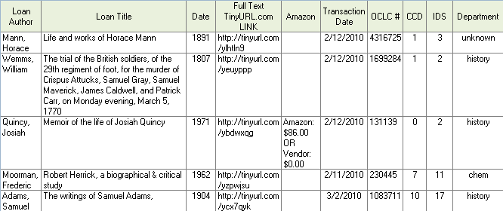
GIST 1.13 Update includes Hathi Trust & Tinyurl.com
Geneseo data from Feb. 9 – March 8, 2010

Slide 12
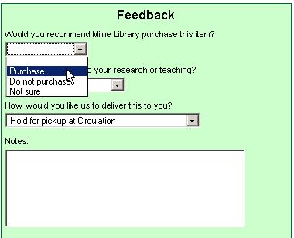
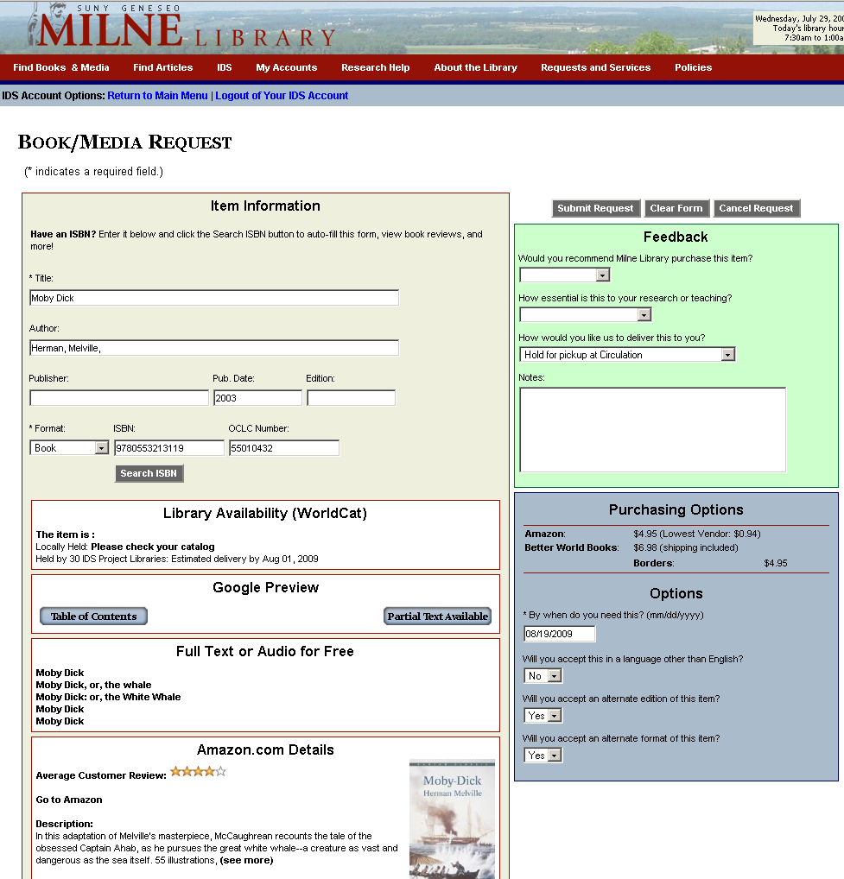
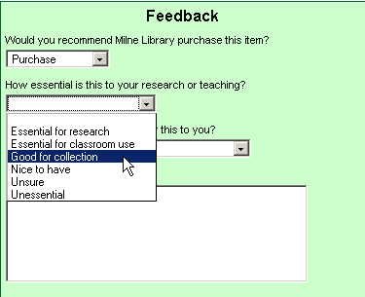
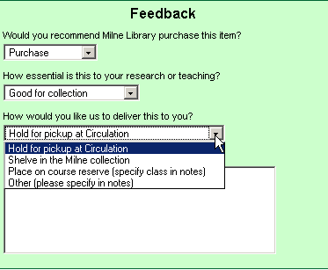
Bringing users into the conversation with customizable feedback
For Geneseo, Purchase = Acquisitions in Doc Del
Notes:
We ask our users for feedback – and you might call their responses tagging. An ILL request in ILLiad’s web pages becomes an Acquisitions request when the user selects Purchase to answer “Would you recommend Milne Library purchase this item?” As we said before, all the text, answers, and routings are customizable. The selection here is default blank, so unless the user specifies, it will be a borrowing request (unless the ILL librarian routes the ILL request to acquisitions).
Second feedback question is how essential is this to your research or teaching? Are you wondering how many people actually click on the unsure and unessential – wait, you will see?
Final feedback is finding out their delivery preference, and for the case of course reserves, they simply add the class info to the notes so when the purchased item comes in, it can be immediately placed on reserves and an email sent out from ILLiad. Again, all this is customizable by your ILLiad web and workflow experts.

Slide 13
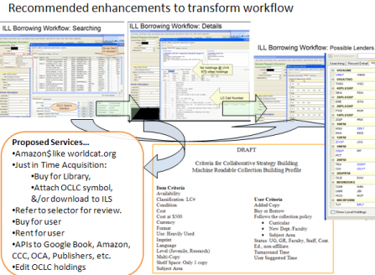

Adapt GIST to your setting
You choose and adapt the tools around what works for your setting.
Library A
Library B
Library C
Library D
Range of customization
GIST tools used to enhance ILL Purchase on Demand only.
GIST used by Librarians using status specific ILLiad web pages.
GIST also used only by Librarians to help their selection.
GIST used selectively based on ILLiad statuses.
GIST also used by Faculty, with Librarian Review.
GIST default with collection building parameters.
GIST used by all users, with some Librarian review for certain status. Collection building profiles, cooperative data, and gift management features used.
Notes:
Because GIST tools are customizable components, and libraries do love doing things there own way, we would expect to see a diversity of adaptation based on local practices and politics.
illustrate

Slide 14
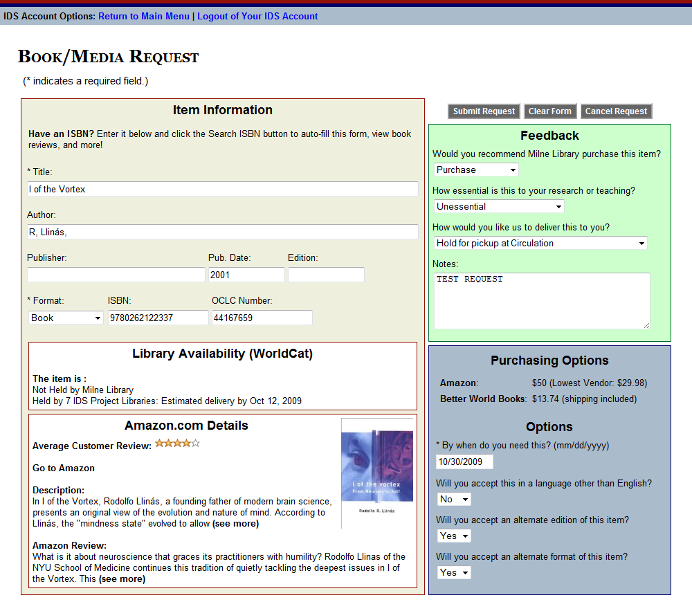
ILL & ACQ Workflow
GIST Request
Interlibrary Loan / IDS
Cancel or Unfilled
Filled
Borrow
Acquisitions
Filled
Buy
Cancel or Borrow
Requests are Transferable
Notes:
KATE
GIST requests can be either an ILL or Acquisitions request. For Geneseo, if the user recommends the library purchase the work, then the request is automatically routed into an acquisitions queue in ILLiad’s Document Delivery Module.

Slide 15
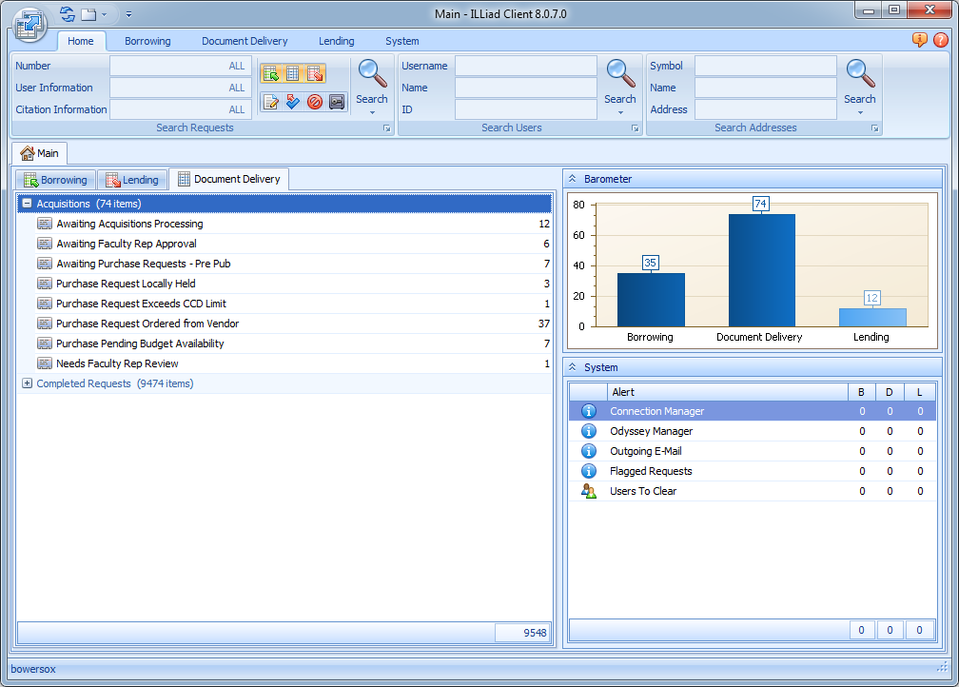
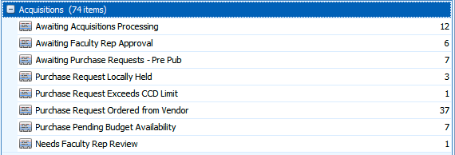
Notes:
GIST requests are placed in ILLiad’s Document Delivery menu – and processed by Acquisitions staff at Geneseo.
[ANIMATION AUTOMATICALLY IN 3 SECONDS]
You’ll notice that there are some custom queues specifically for purchase requests.
These queues are grouped within the Acquisitions category, which ILL staff can collapse to keep out of the way.
Likewise, the ILL queues have been similarly grouped, which allows Acquisitions staff to hide them.
In this example, my request went to Awaiting Acquisitions Processing because it wasn’t held locally and was not held by enough CCD libraries

Slide 16
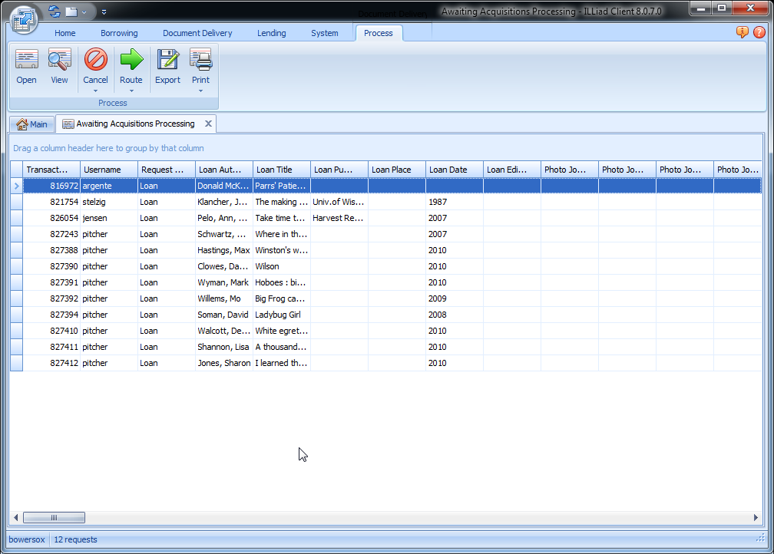
Notes:
GIST uses the WorldCat API to see how many libraries in the CCD group own the item, then sticks that number into the Call Number field.
You’ll also notice that GIST imports the number of IDS libraries that own the item into the Location field. For ILL, this is what allowed the web request form to provide a delivery estimate for the user, however, for acquisitions – it’s a way to gauge the diversity of a cooperative collection automatically.
Both fields were customized in the client to include more descriptive labels. And you can customize these fields to apply to whichever groups of libraries you’d like Summit, Oregon, NW, etc.
Also included are OCLC and ISBN numbers for quick cataloging or other searching as needed.

Slide 17
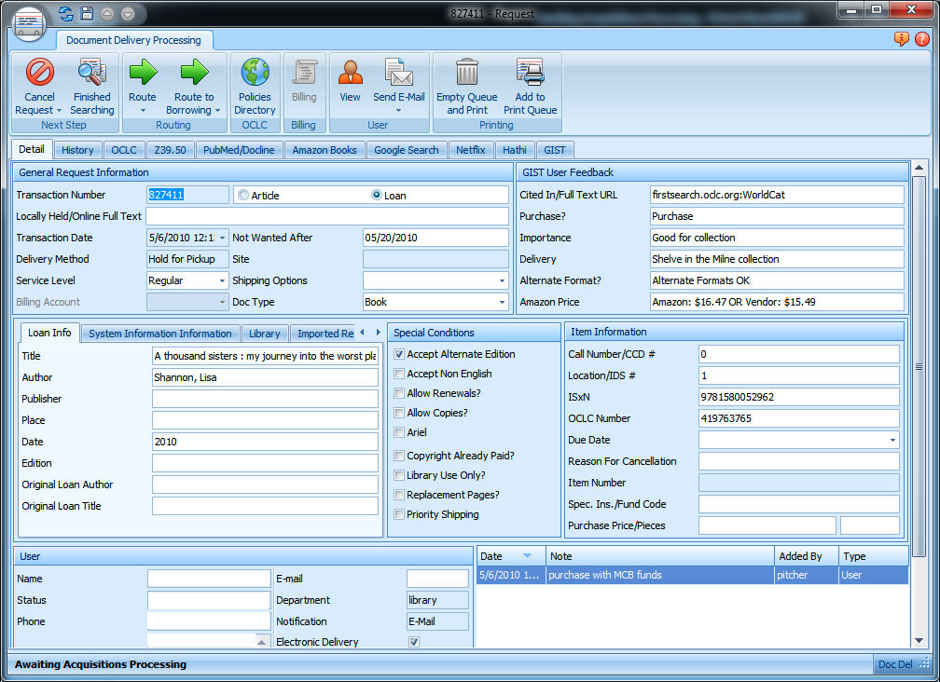
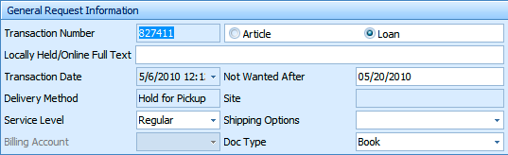
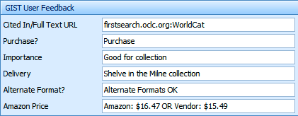
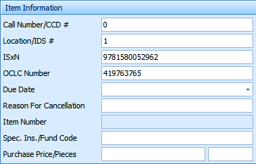
Notes:
ANIMATIONS:
Automatically in 3 seconds: item info
On click: item info disappears; general request info appears;
On click: general info disappears; user feedback appears

Slide 18
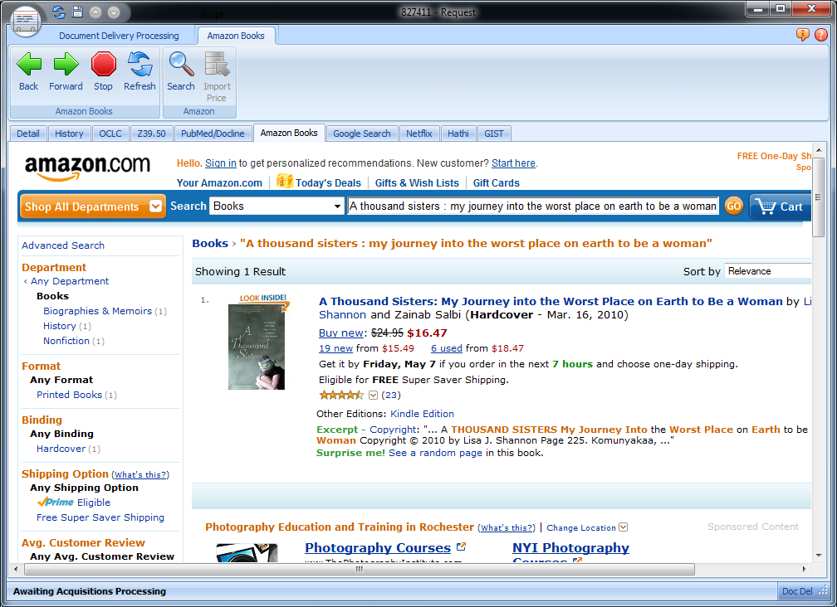
Notes:
Here’s a screenshot of the add-on in ILLiad for Amazon

Slide 19
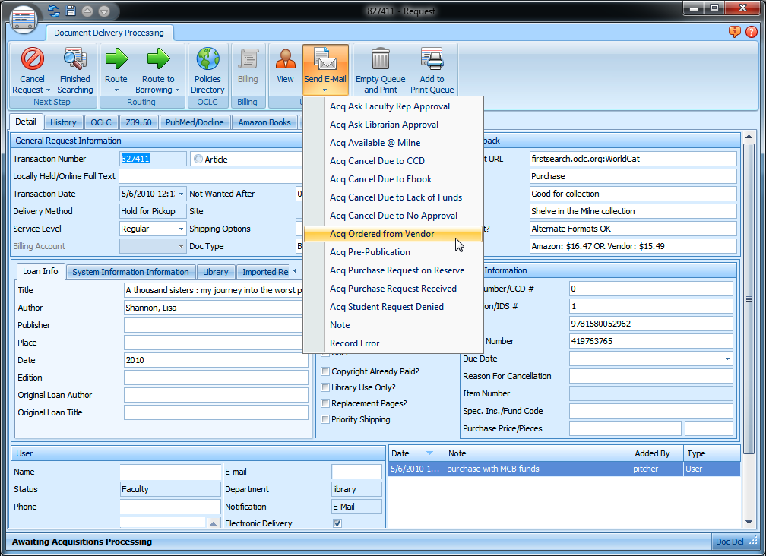

Slide 20
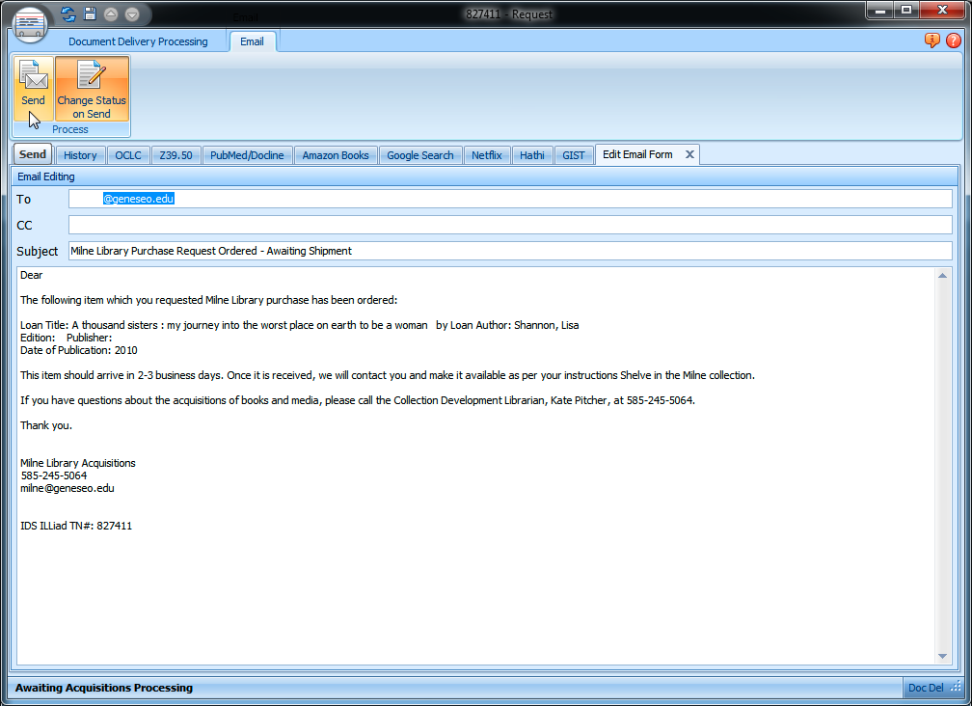
Notes:
One click of the button, and an email is sent to my patron, notifying them that the book has been ordered and we are awaiting shipment.
Email templates are completely customizable and editable, so it can say whatever you want it to say.

Slide 21
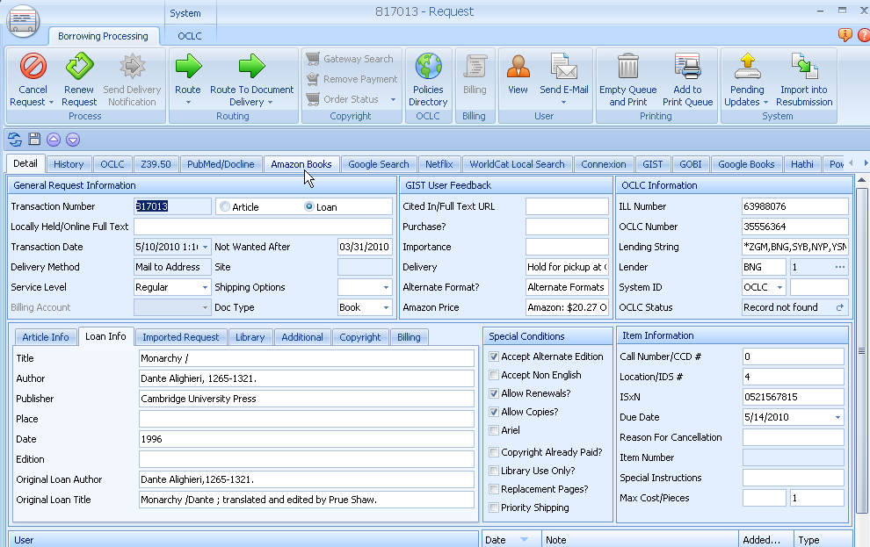
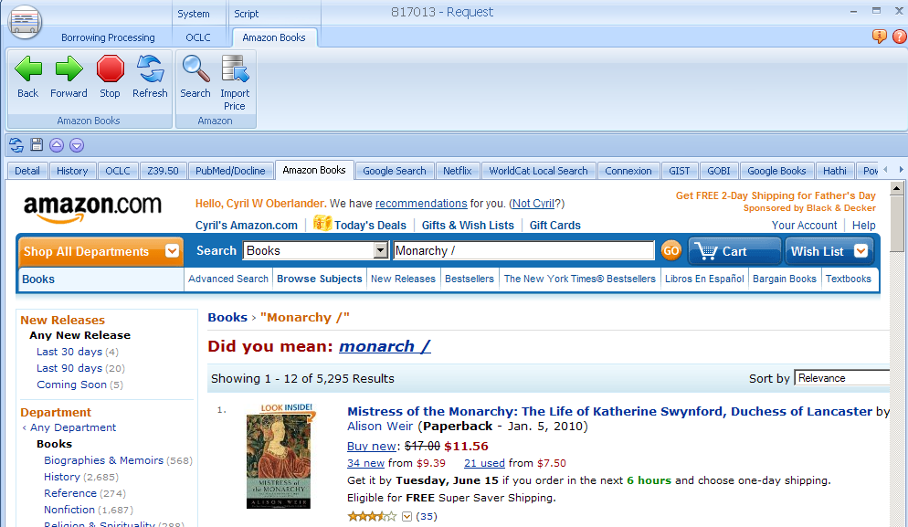
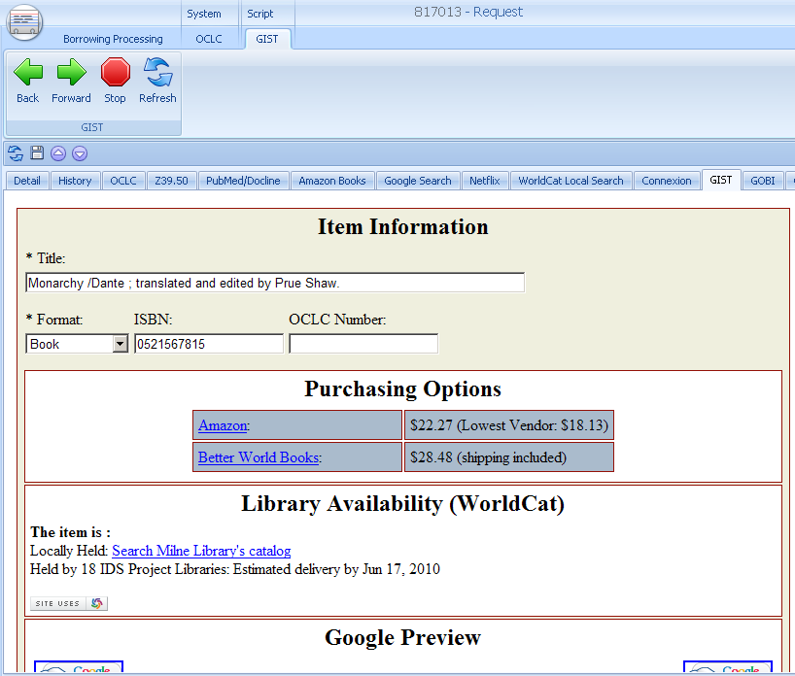
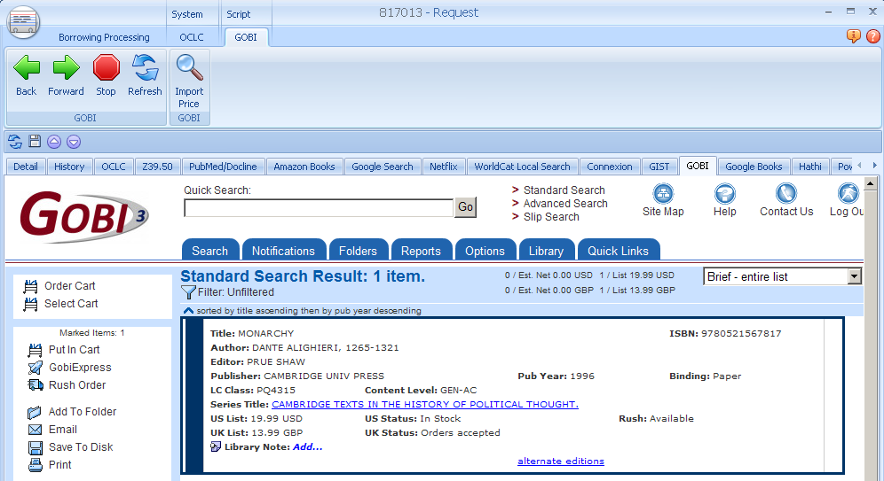
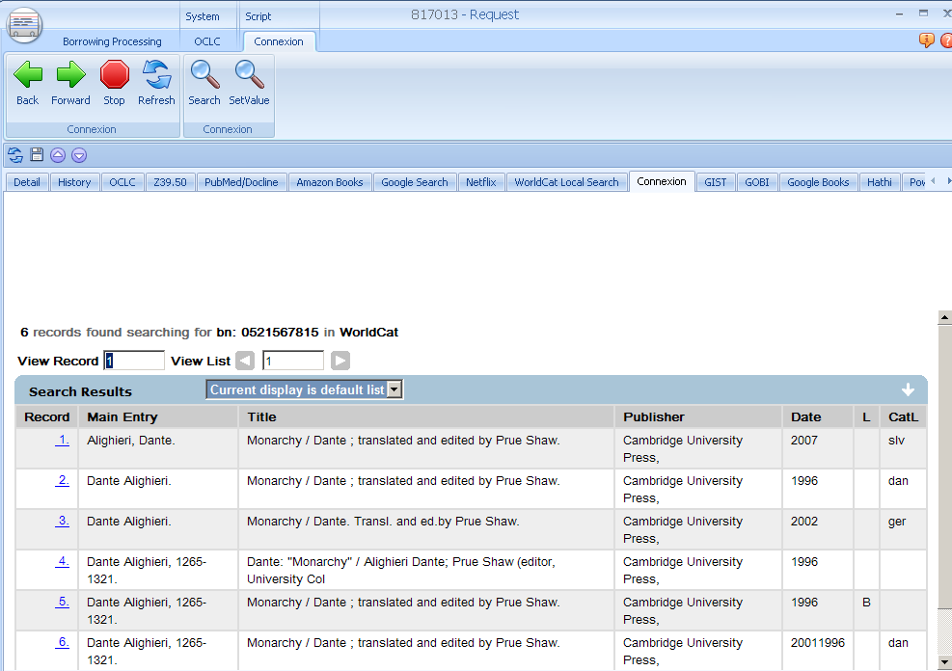
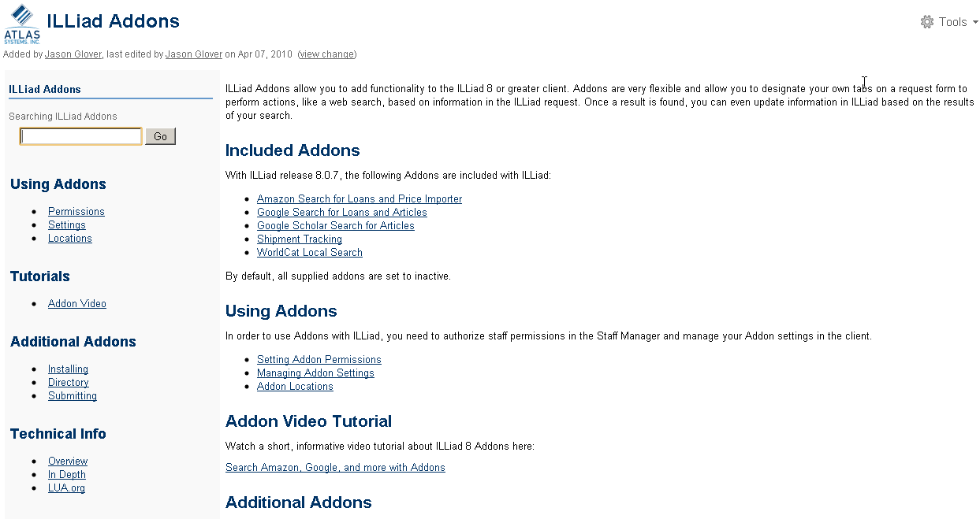
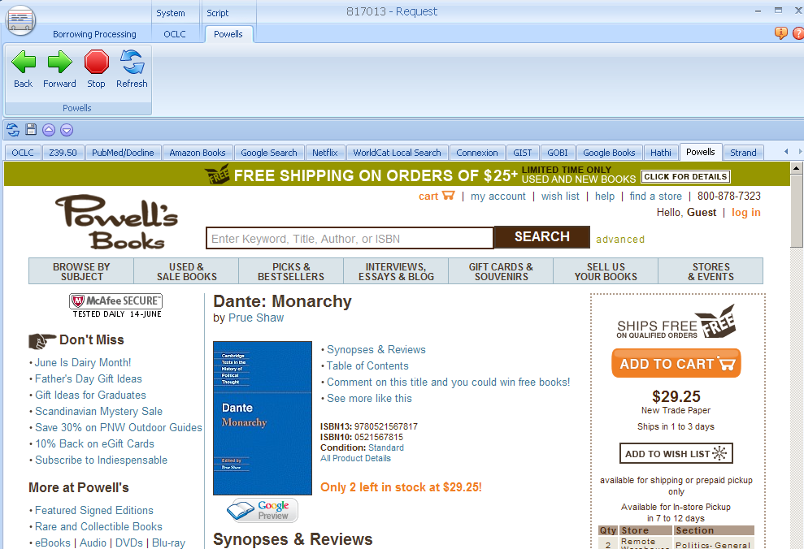
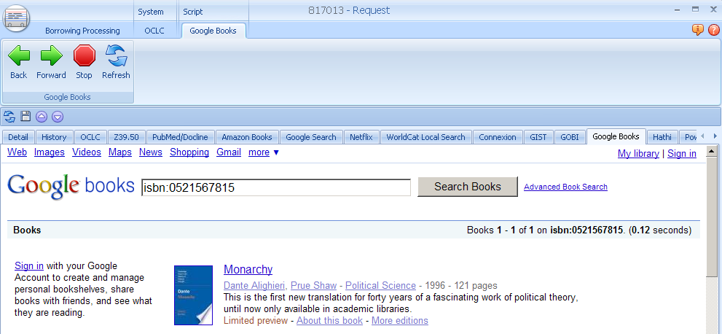
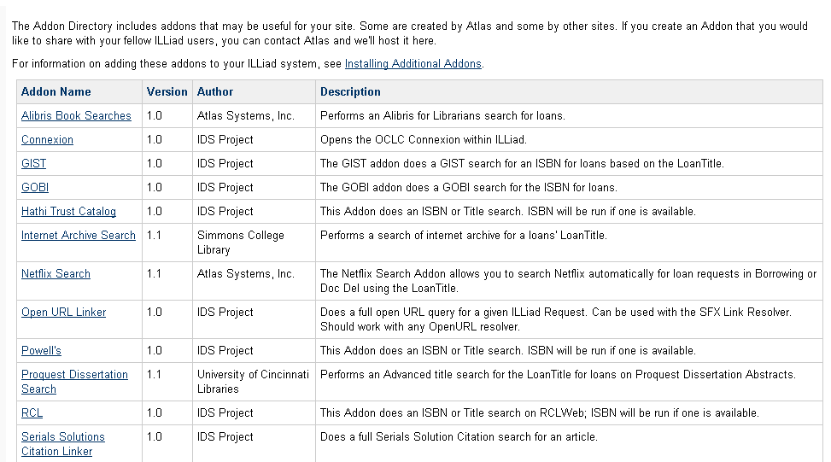
Connect any web service to your workflow:
Amazon, GIST, GOBI, OCLC Connexion, RCL Web…
A tab away
ILLiad Addons https://prometheus.atlas-sys.com/display/ILLiadAddons/Addons+Directory
Notes:
Wonderful features, a tab away! Amazon, GIST, GOBI portal, Powells, OCLC Connexion, RCL Web and more! Any suggestions for new add-ons are encouraged

Slide 22
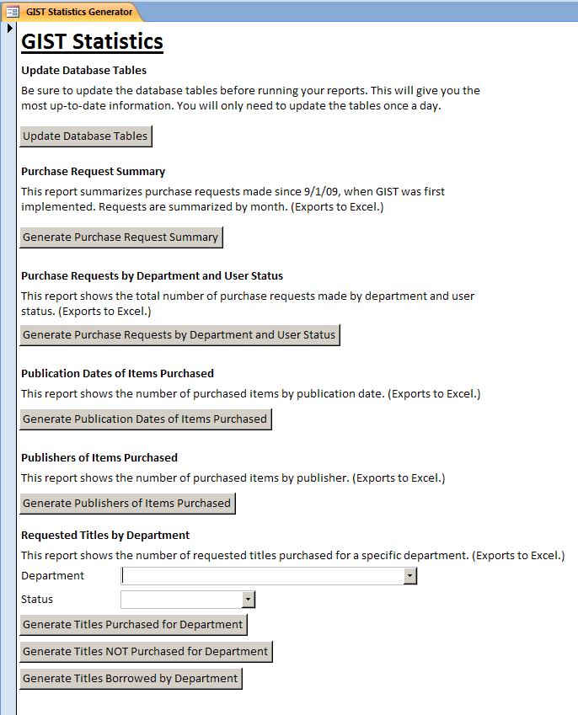
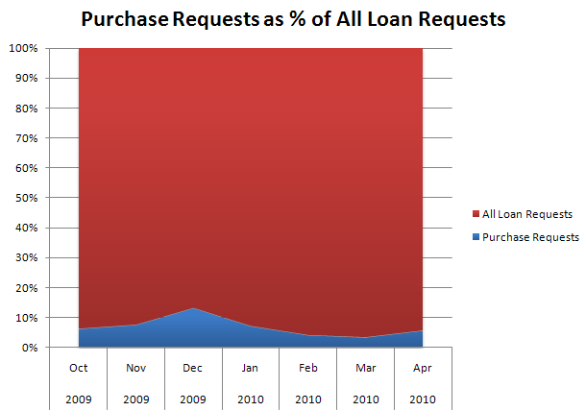
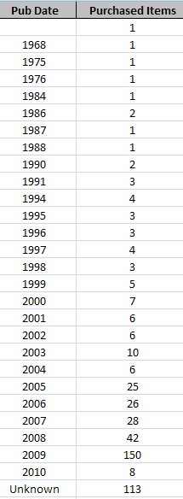
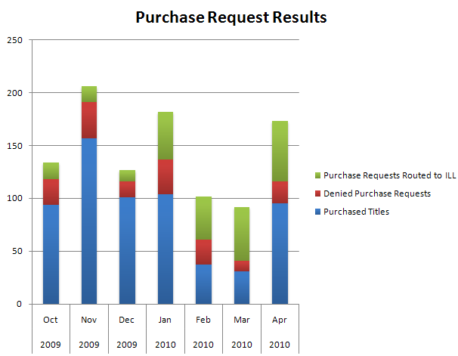
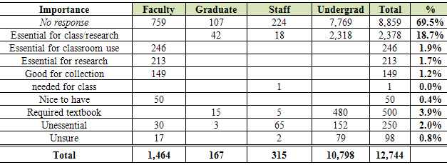
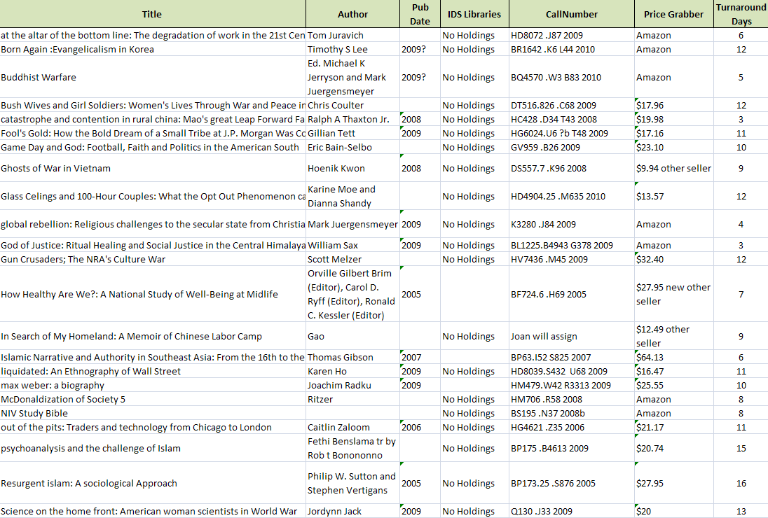
Statistical Tool
10/1/2009 – 3/1/2010 Users tagged 30% of ILL & Purchase requests…
Notes:
Cyril
The data below shows that in roughly 5 months, there were 838 purchase requests, but only 63% or 529 were purchased. Acquisitions routed purchase requests equally to ILL (16.5%) and cancelled purchase requests (16.83%) for a combined 37% of the purchase requests cancelled based on the data gathered by GIST for reasons; too widely held, locally owned, required textbook, etc. Similarly, ILL converted 28 ILL requests to purchase items based on cost to borrow and too new to borrow effectively.

Slide 23
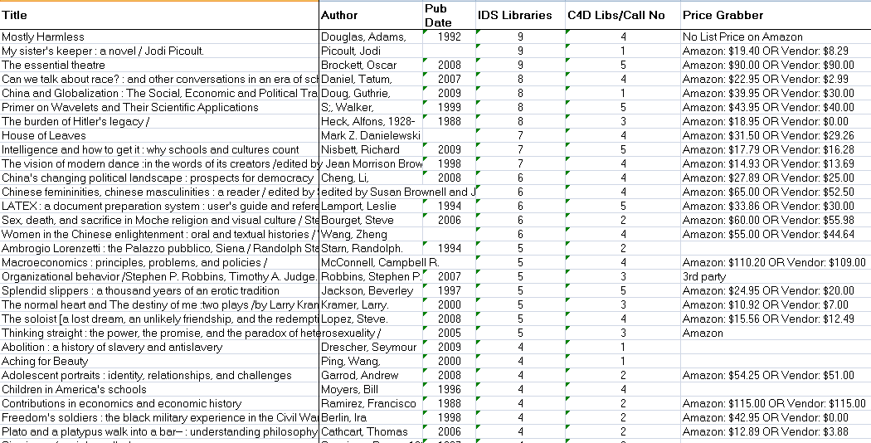
Outcome: Collection Diversity Achieved
Recommended titles not purchased because too widely held
# Holdings in IDS Libraries
Quick delivery libraries

Slide 24
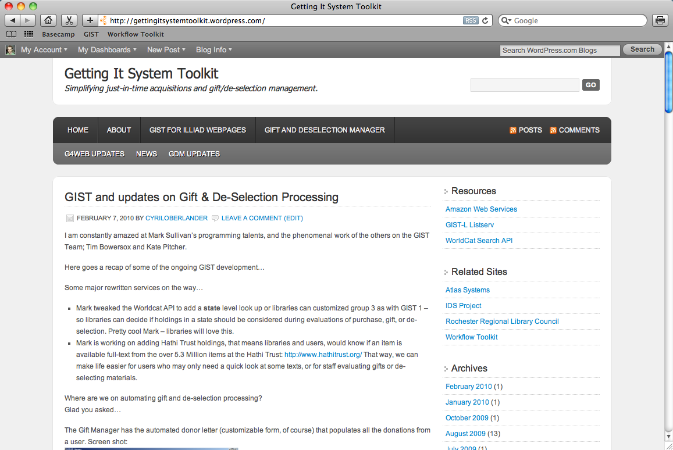
Documentation & downloads @ http://gist.idsproject.org
Notes:
MARK

Slide 25
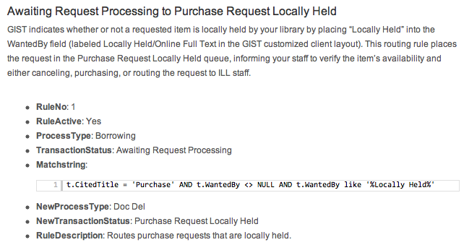
GIST Documentation
HTML, scripts, custom layouts, & email templates
Complete installation & implementation guide
Sample routing rules, email routing, & custom queues
How to get started using a test implementation
Sample routing rule with copy & paste MatchString

Slide 26
GIST Requirements
ILLiad 8 client
Staff manager access
Customization Manager access
Access to your ILLiad web server (written on .net framework so GIST will work for OCLC hosted sites)
Basic knowledge of HTML and CSS
Communication & coordination between your acquisitions, ILL, administration & web person

Slide 27
Installing the GIST Programs
Back up your current ILLiad Web Directory – not necessary but always a good practice just in case…
  For a local server, copy and paste \\illiadserver\webfolder
  For a hosted server, log in with an ftp client and download a copy of the web directory to your computer.
Download the current version of GIST: http://gist.idsproject.org
Notes:
Duplicate info – how do we resolve.

Slide 28
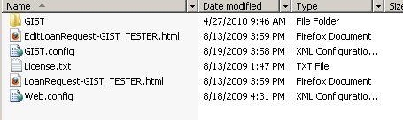

Installing the GIST Programs
Extract the GIST.zip file to your ILLiad Web Directory (or the NVTGC directory if you have multiple sites).
  If you get a warning about overwriting your web.config file, then click NO
  You will need to open the web.config file and modify the <appSettings> line to <appSettings file=“GIST.config”/>
  For a hosted server, you will need to extract the files locally, make the modifications, then upload the files using an ftp client.
Notes:
Duplicate info – how do we resolve.

Slide 29
Easy Installation
Obtain an Amazon Web Services key, an Amazon Secret Key (same page) and a WorldCat API key.
    http://aws.amazon.com/
    http://www.worldcat.org/affiliate/tools?atype=wcapi
  Also review the Google Book Search API branding guidelines.
  http://code.google.com/apis/books/branding.html

Slide 30
Configuring GIST
Enter the keys along with your library information into the GIST.config file.
  Open up the GIST.config file located in your ILLiad Web Directory or on your desktop for later upload to OCLC. Enter the keys along with your library information into the GIST.config file.
Update the web.config so that it has a newer Modified Date.
  After you make any changes to GIST.config you will need to update web.config so that it has a newer Modified Date. (just open it, add a space to a blank line and resave it.)
  If you are using a hosted server, make the changes to the GIST.config and web.config file prior to uploading the files. It will save time.

Slide 31
GIST.config
Below you will find a description of each section of the GIST.config file, which allows you to customize the GIST API widgets.
Note: If you make any changes to GIST.config, you will need to update web.config so that it has a newer Modified Date (just open it, add a space to a blank line and resave it).
Location of GIST files
This specifies the location of the GIST folder you installed. For the value, enter the URL to this folder on your ILLiad web server.
<!--Location of GIST Files--> <add key="File_Location" value="Enter URL here" /> <!--For Example: http://ids.geneseo.edu/gist-->
Library Name
GIST uses this whenever it needs to display the name of your library. For the value, enter your library's name.
<!--Library Name--> <add key="Library_Name" value="Your Library" /> <!-- i.e. Milne Library -->

Slide 32
GIST.config
Group members and labels
These settings are used by the WorldCat API in determining your local and group holdings, estimate ILL delivery times, and trigger routing rules based upon your coordinated collection development policies.
Group1: this value should be your local OCLC symbol and is used to determine your local holdings.
Group1Label: enter the text displayed when local holdings are found.
Group2&3: this value should contain the comma separated OCLC symbols for your primary resource sharing or coordinated collection development (CCD) group.
<add key="GroupX" value="XXX" />
<add key="GroupXLabel" value="Locally Held" />

Slide 33
GIST.config
Estimated delivery time in days
These settings are used to calculate the estimated delivery time for items borrowed from your second and third groups. When holdings are found for the second group, that delivery estimate is displayed. If there are no holdings in that group, then the third group's delivery estimate is displayed.
<!--Estimated delivery time in days-->
<add key="GroupXTime" value="3" />
Remember: Any change to GIST.config will not show up until you modify the web.config (just add a space) and save it.

Slide 34
We guide you through…
Creating the necessary routing rules & custom queues
Creating email routing for your workflow
Managing access to the client for acquisitions staff
Customizing your ILLiad web pages
Repurposing ILLiad’s request fields
Customizing the client interface
All found on the GIST Workflow Toolkit
http://gist.idsproject.org

Slide 35
Questions

Slide 36
Thank you
Tim Bowersox, bowersox@geneseo.edu
Cyril Oberlander, cyril@geneseo.edu
Kate Pitcher, pitcher@geneseo.edu
Mark Sullivan, sullivm@geneseo.edu
IDS Project: idsproject.org

