Slide 1
Getting It System Toolkit:
GIST Gift and Deselection Manager
Demo & Discussion
Tim Bowersox, Cyril Oberlander, Kate Pitcher, Mark Sullivan
State University of New York, Geneseo College
IDS Conference
August 3rd and 4th, 2010
Notes:
Cyril

Slide 2
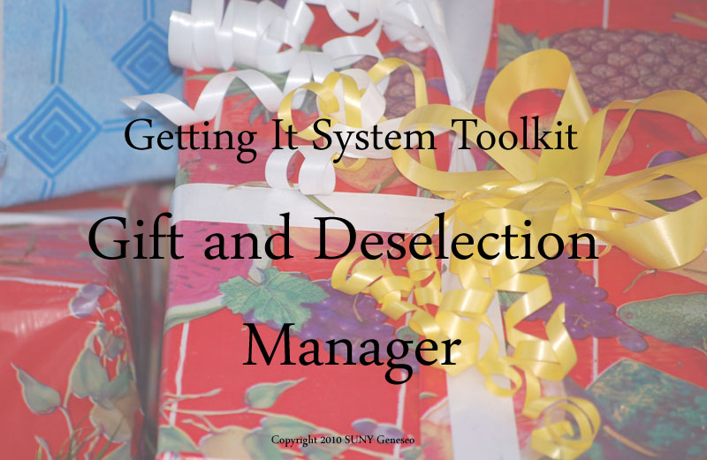
What is GIST Gift and Deselection Manager?
Notes:
So what is GIST?

Slide 3
The Solution to All of…
Your Wildest Dreams…
Ok, probably not but it will help you with…
Those boxes of donations you have hidden in storage somewhere…
Those books that no one has checked out in the last 20 years…

Slide 4
GIST GDM
Standalone system that is intended to automate and streamline Gifts and Weeding
  Data from your catalog, Amazon, Worldcat
  Local Holdings, and 2 configurable groups
  Has Better World Books desirability added
  Allows you to select donor if gift processing – with anonymous set as default
  Generates acknowledgement letters as needed.
  Has a complete Conspectus which can be adjusted.
  Has additional Book Lists, such as Newbery and Caldacot

Slide 5
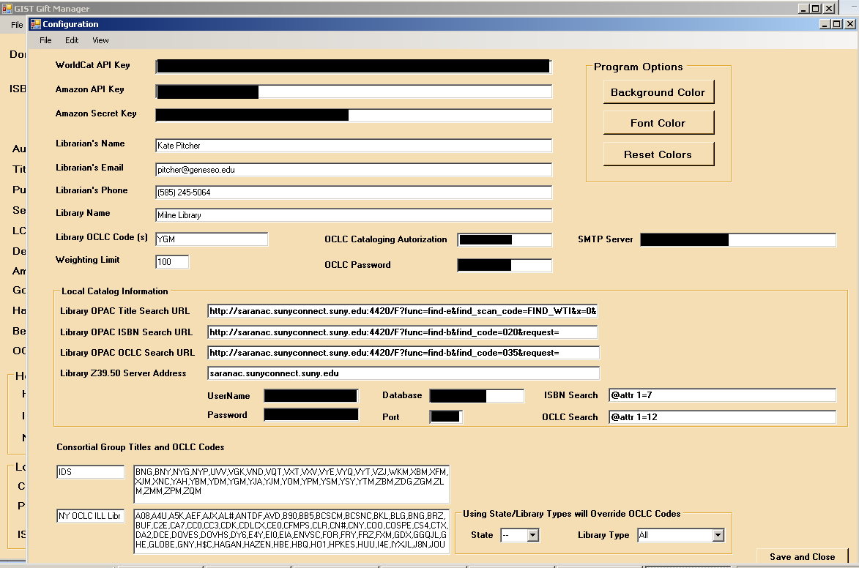
Setup
Notes:
First time you log in, you will be brought to the configuration screen.

Slide 6
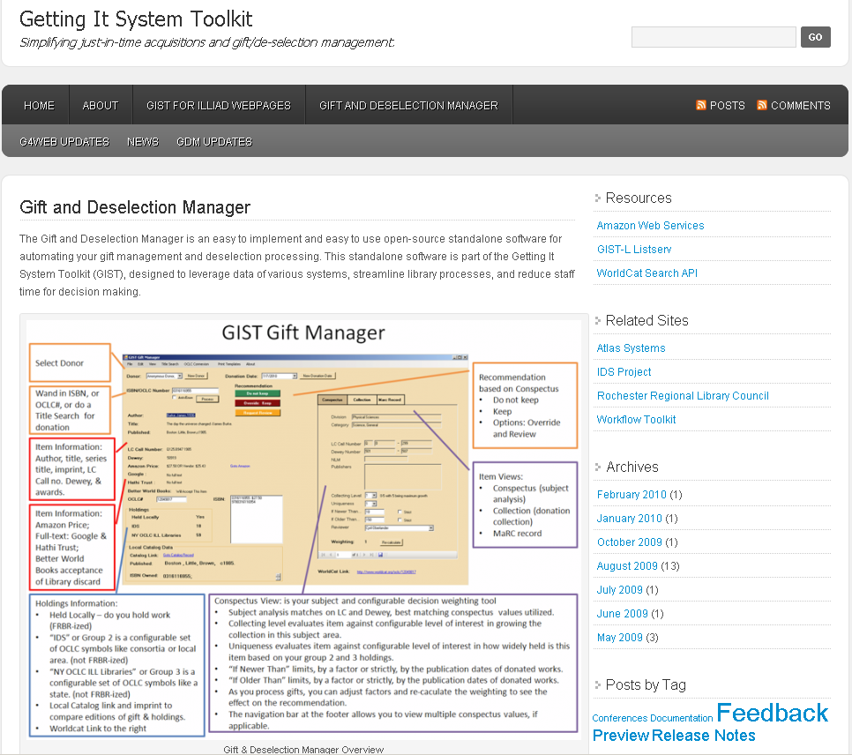
http://gist.idsproject.org

Slide 7
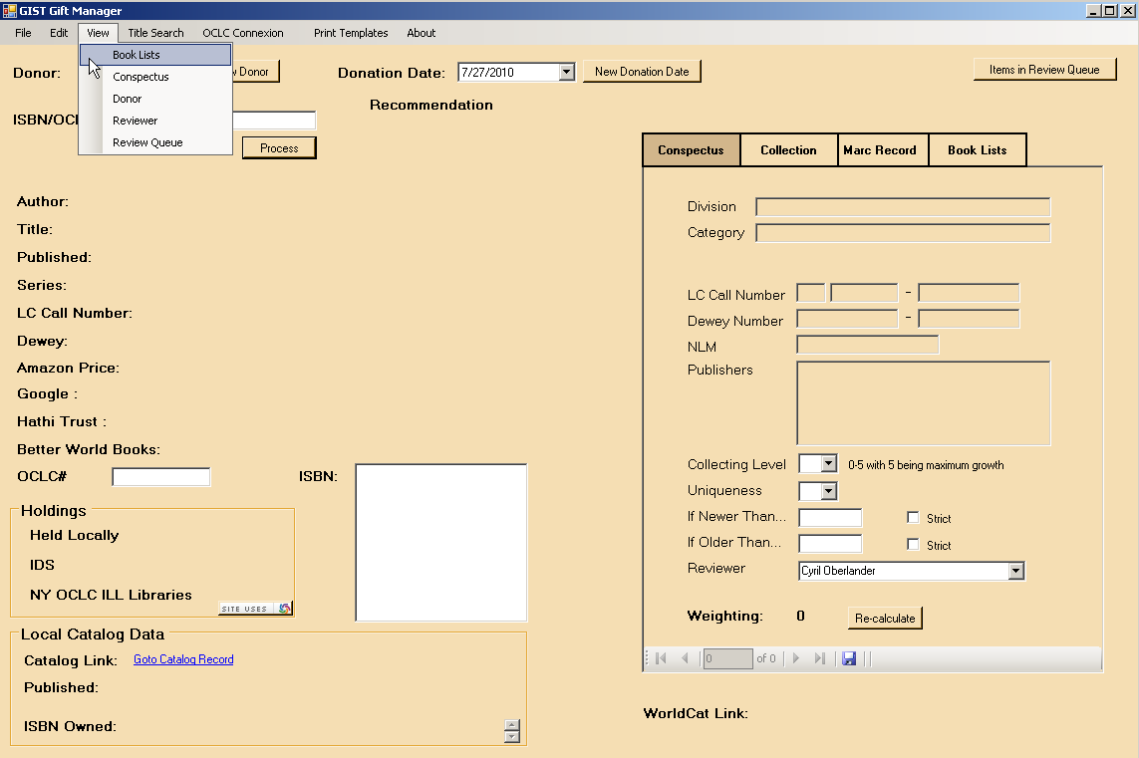
View

Slide 8
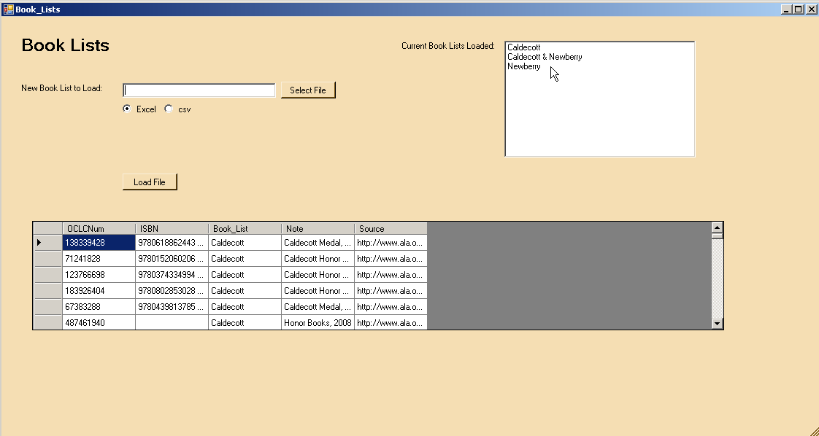
Book Lists

Slide 9
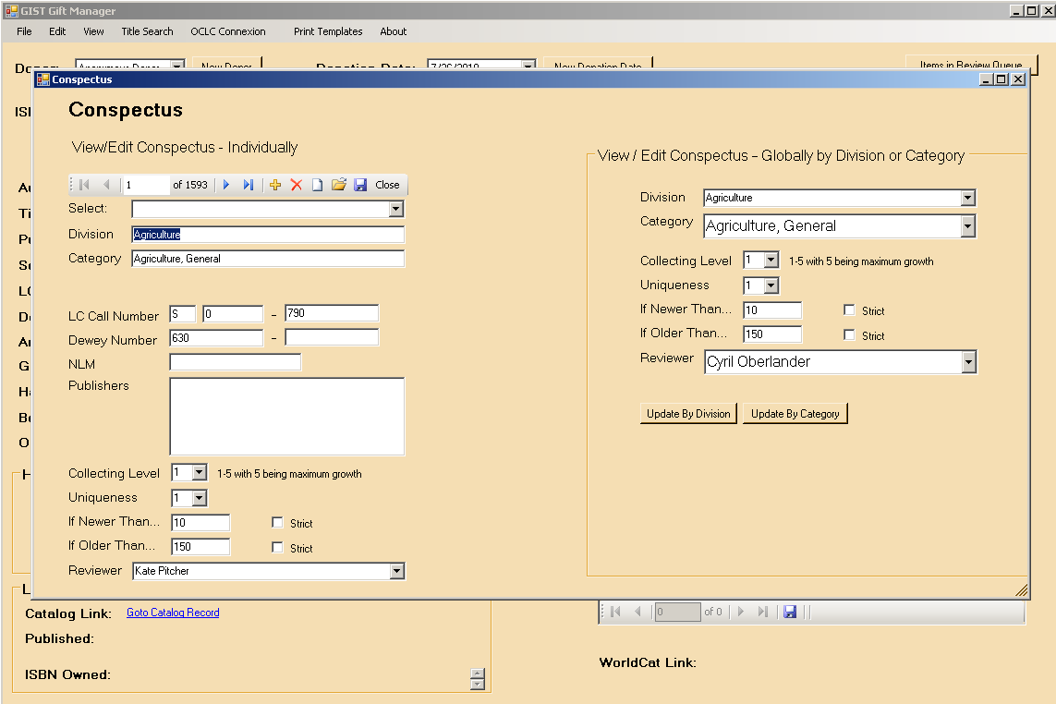
Conspectus

Slide 10
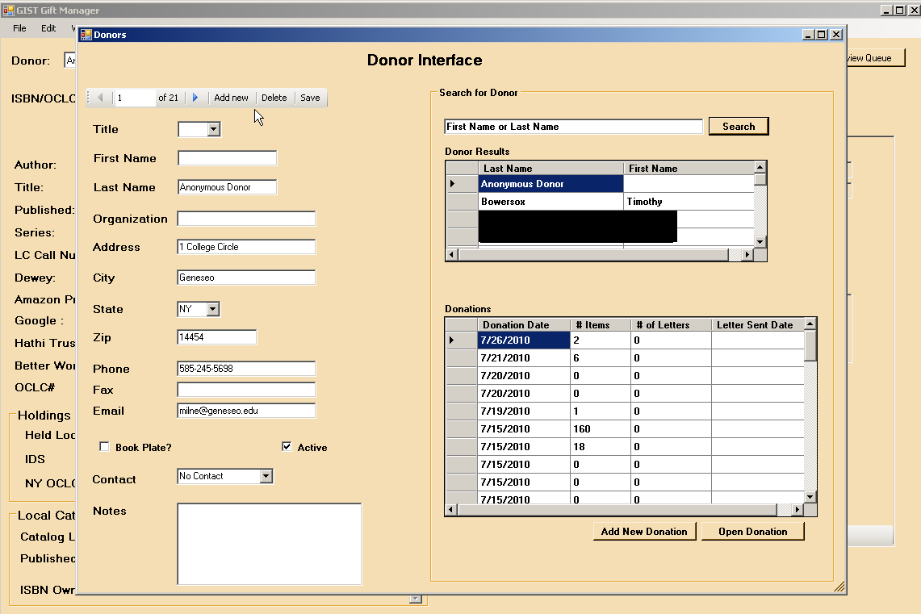
Donor

Slide 11
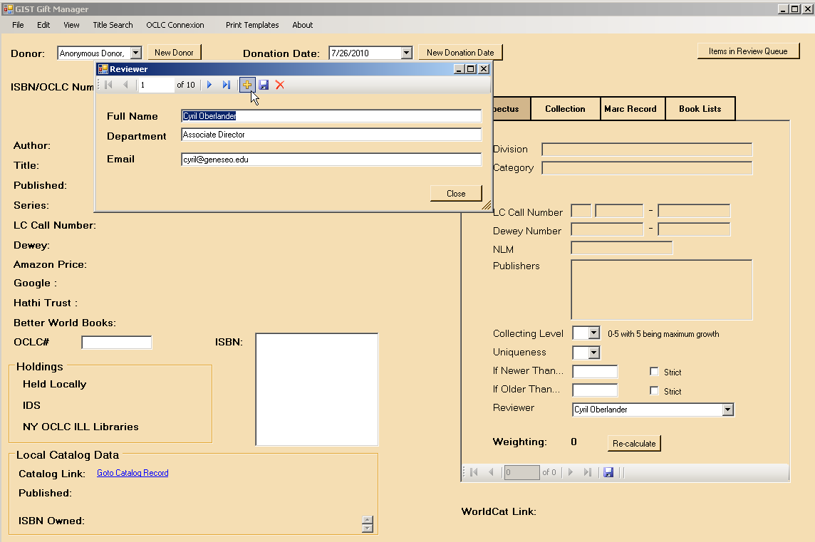
Reviewer

Slide 12
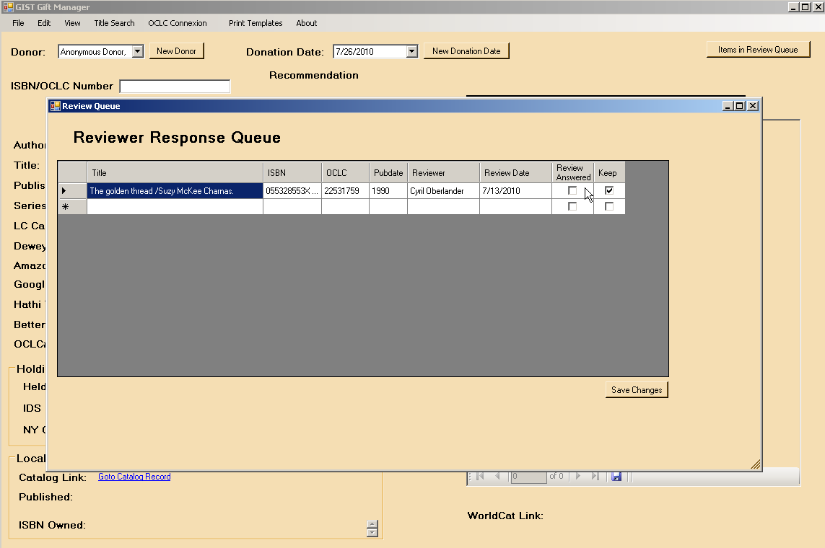
Reviewer Queue

Slide 13
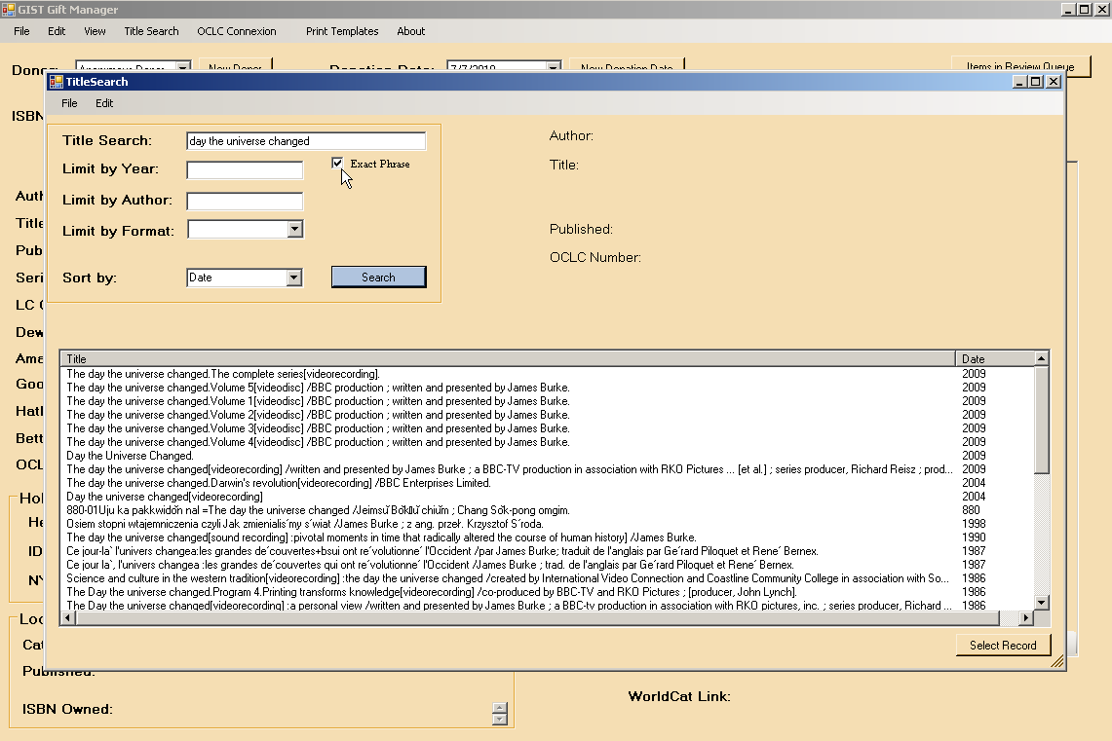
Title Search

Slide 14
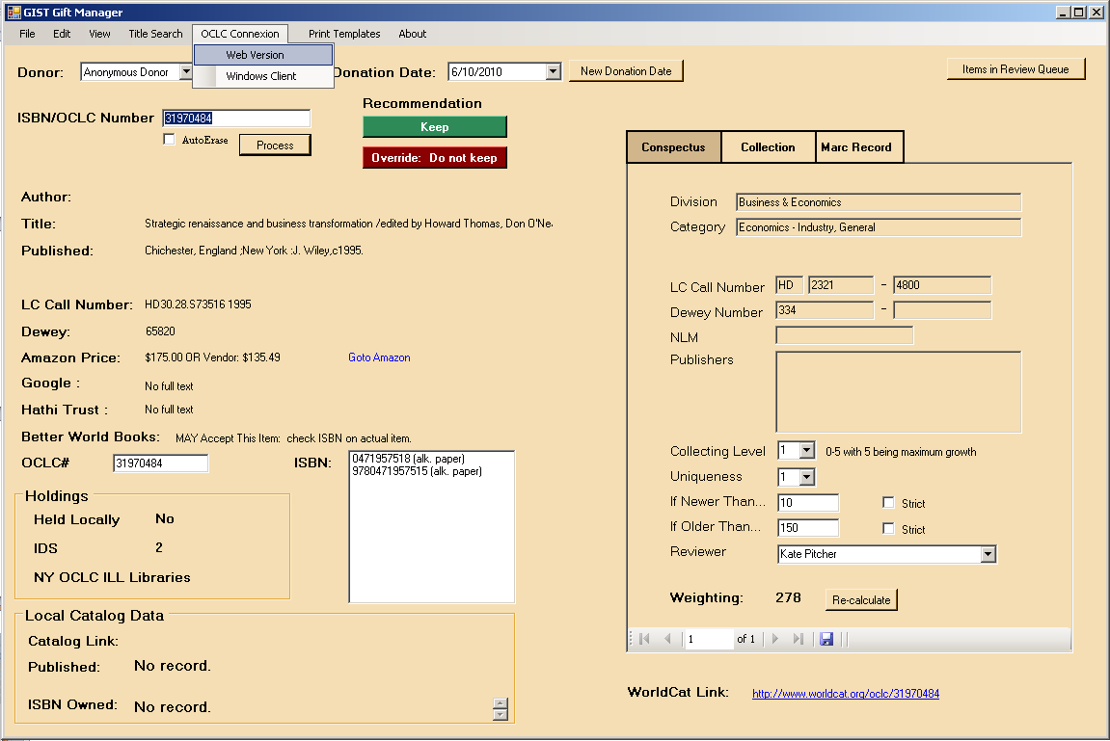
OCLC Connexion
Notes:
New screenshot of strategic rennaissance

Slide 15
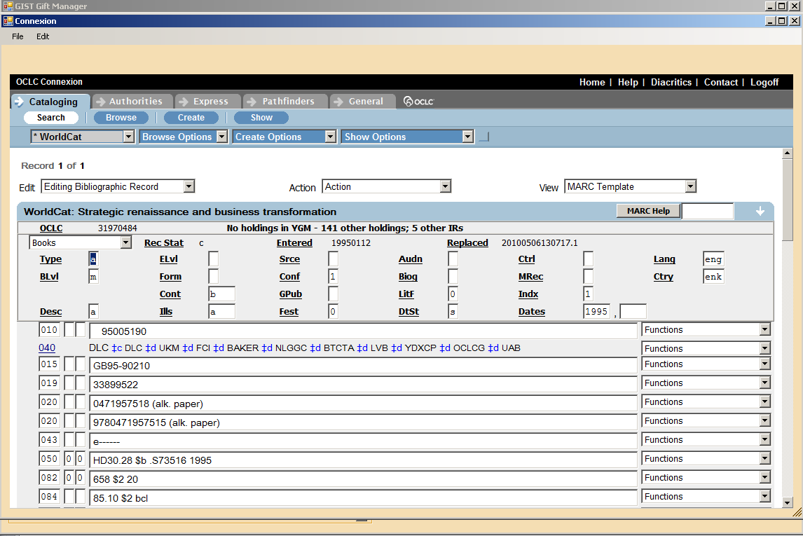
OCLC Connexion
Notes:
Need shot with keeper Strategic renaissance… oclc 31970484

Slide 16
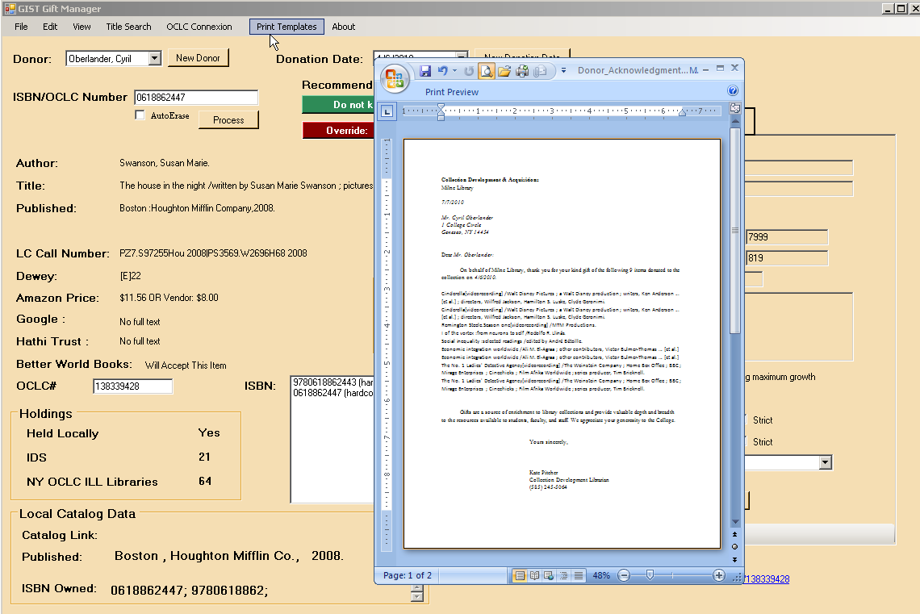
Thank You Letter

Slide 17
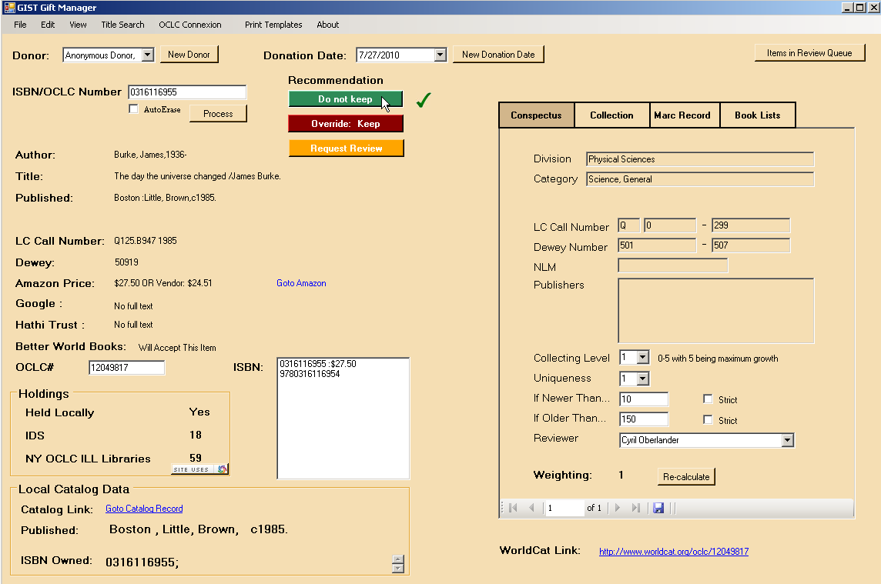
GIST Gift Manager
Select Donation Date
Select Donor
Recommendation based on Conspectus and Weighting
Do not keep
Keep
Options: Override and Review
Wand in ISBN, or OCLC#, or do a Title Search for donation
Item Information:
Author, title, series title, imprint, LC Call no. & Dewey
Item Views:
Conspectus (subject analysis)
Collection (donation collection)
MaRC record
Book Lists – awards & custom book list alert service
Item Information:
Amazon Price;
Full-text: Google & Hathi Trust;
Better World Books acceptance of Library discard
Holdings Information:
Held Locally – do you hold work (FRBR-ized)
“IDS” or Group 2 is a configurable set of OCLC symbols like consortia or local area. (not FRBR-ized)
“NY OCLC ILL Libraries” or Group 3 is a configurable set of OCLC symbols like a state. (not FRBR-ized)
Local Catalog link and imprint to compare editions of gift & holdings.
Worldcat Link to the right
Conspectus View: is your subject and configurable decision weighting tool
Subject analysis matches on LC and Dewey, best matching conspectus values utilized.
Collecting level evaluates item against configurable level of interest in growing the collection in this subject area.
Uniqueness evaluates item against configurable level of interest in how widely held is this item based on your group 2 and 3 holdings.
“If Newer Than” limits, by a factor or strictly, by the publication dates of donated works.
“If Older Than” limits, by a factor or strictly, by the publication dates of donated works.
As you process gifts, you can adjust factors and re-caculate the weighting to see the effect on the recommendation.
The navigation bar at the footer allows you to view multiple conspectus values, if applicable.
Notes:
0316116955
Conspectus: www.oclc.org/collectionanalysis/support/conspectus.xls

Slide 18
GIST Gift Manager Weighting
Is “If Newer Than” or “If Older Than” a strict value?
Does the item fall within the strict date range?
Set preliminary weight to 500
Yes
Yes
No
No
Do more than 50 Group 3 libraries own the item?
Set preliminary weight by age of item and “If Newer Than” and “If Older Than” preferences
Yes
No
pWeight = 1
Divide 10,000 by pWeight to obtain weighting score
Adjust pWeight by number of Group 2 holdings + 150
Adjust pWeight by number of Group 2 holdings + 2x the number of Group 3 holdings
Yes
No
Adjust pWeight if date within “If Newer Than” and by uniqueness and collection level
Yes
Is pWeight less than 1?
Is the Deselection Manager activated?
Adjust pWeight for local holdings, uniqueness, and collection level
No

Slide 19
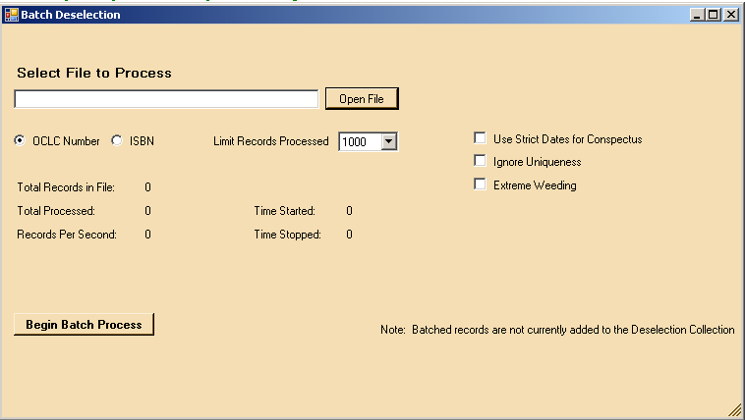
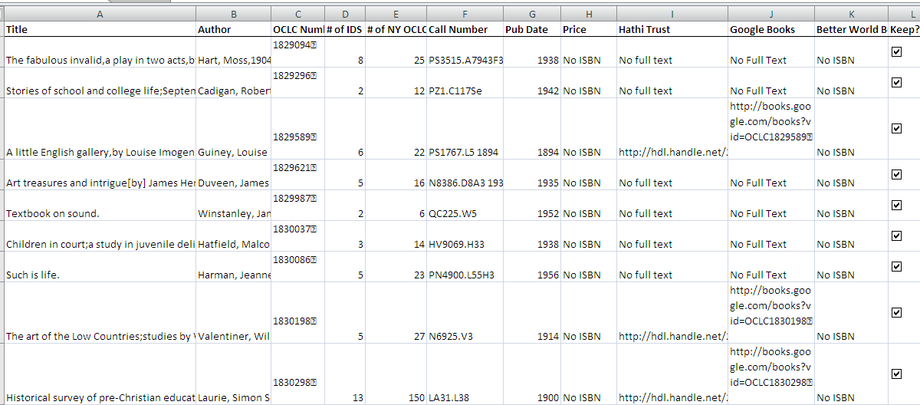
GIST Deselection Manager
Import ISBN or OCLC# an Aleph no or low use report as a simple delimited file.
Run Batch Processing – GIST exports Excel file.
Review results, sort by values – what criteria are important to you?
Results: Free full text, price, accepted by Better World Books, and regional holdings.
Batch Deselection

Slide 20
Extreme Weeding + Extreme Gifting
13 % of titles in storage are available FULL-TEXT through Hathi Trust digital repository
Notes:
Kate
Hathi trust holdings over 10% Google Books API also available
31,436 total
2 titles = 0 holdings in IDS project libraries
Using data from GIST, only 2596 titles were kept in the collection; the remainder are being weeded
Selecting donations

Slide 21
Questions?

Slide 22
Thank you
Tim Bowersox, bowersox@geneseo.edu
Cyril Oberlander, cyril@geneseo.edu
Kate Pitcher, pitcher@geneseo.edu
Mark Sullivan, sullivm@geneseo.edu
http://gist.idsproject.org

