Slide 1



The CSU/CCC Get It Now
Pilot Program
Tim Bowen, CCC
Marvin Pollard, CSU
August 3, 2010
Images used in this presentation were licensed and obtained thru Copyright Clearance Center’s ReadyImages Service

Slide 2

Presentation Objectives
Give you an overview of the CSU/CCC Get It Now Pilot Program
Share our results to date
Present our plans going forward
Obtain your feedback
IDS Project Conference
Transforming Discovery and Delivery

Slide 3
California State University
As of college year 2007-2008, The California State University system consisted of 23 campuses with a fall 2007 enrollment of 431,632 students and teaching force of 24,000 faculty.
During the 2007-2008 college year, the CSU conferred over 91,000 degrees.
This represents about 46 percent of all bachelor’s degrees and 30 percent of all master’s degrees granted by California colleges and universities.
Document Delivery/ILL Received Borrowed Non-returnable
  143,830 requests in 2008-09
  Costs exceed $1,000,000
IDS Project Conference
Transforming Discovery and Delivery

Slide 4
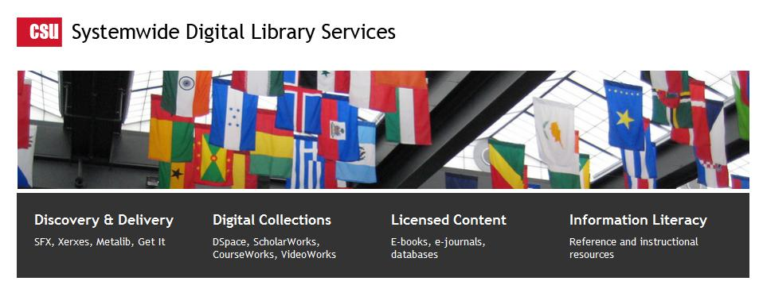
Student User Expectations 2008
Strong preference for online content
Disappointment when content is not available online
Less likely to use content not available during or immediately after the discovery process
Interlibrary Loan Office Experience in 2008
Cost for filling many articles requests is easily exceeding $50.00 per transaction
Users are not picking up or using requested articles – up to 50% +
IDS Project Conference
Transforming Discovery and Delivery

Slide 5
get it @ cal state
IDS Project Conference
Transforming Discovery and Delivery
Provides just-in-time fulfillment of unlicensed library journal content
Pay-per-view service with a large STM publisher
Real-time licensing of articles for users
Lowers library per-article cost
Increases utilization of licensed content.
September – November, restarted March 1st
Notes:
Marvin

Slide 6
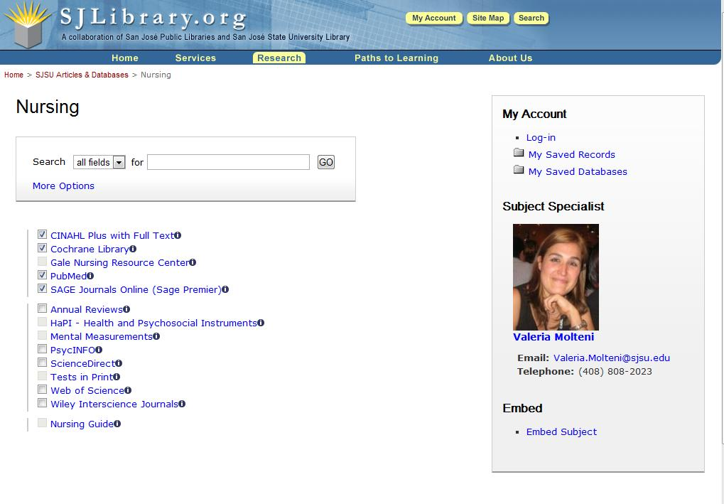
Search multiple databases at one time for books, articles, and other research data
IDS Project Conference
Transforming Discovery and Delivery
Notes:
6

Slide 7
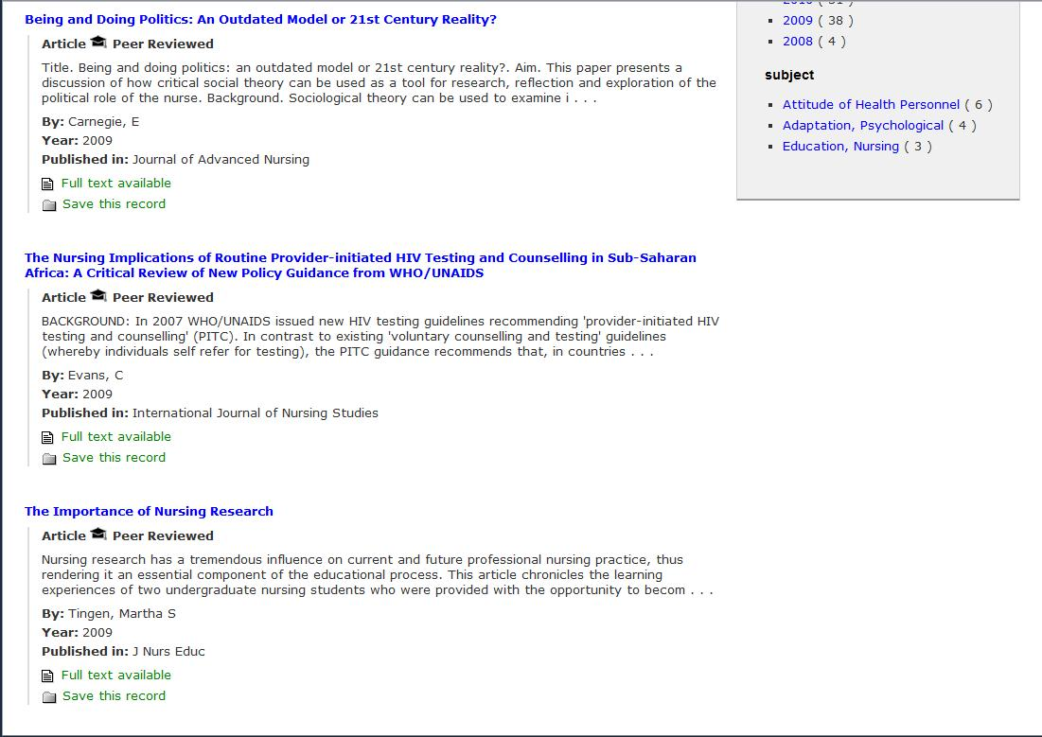
Highlight availability of online full text
IDS Project Conference
Transforming Discovery and Delivery

Slide 8
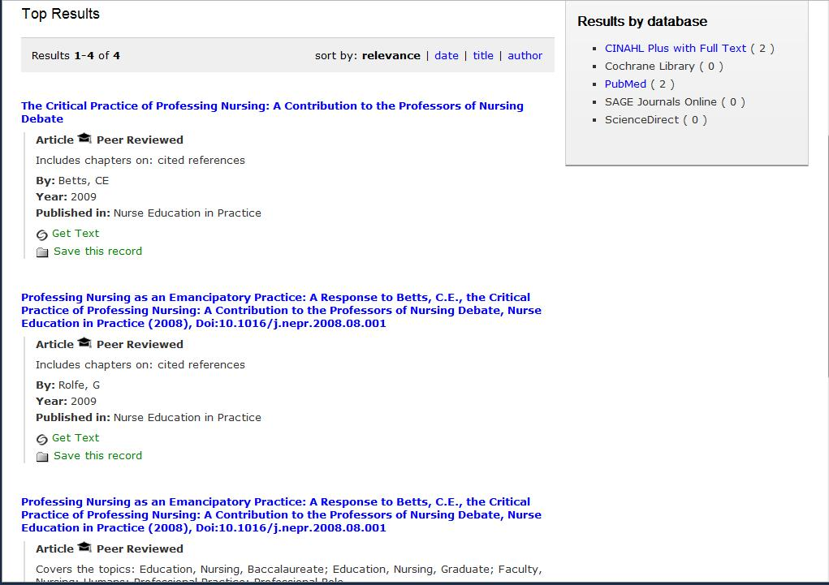
Discovery of content is nearly universal, but ECC has it limits
IDS Project Conference
Transforming Discovery and Delivery

Slide 9
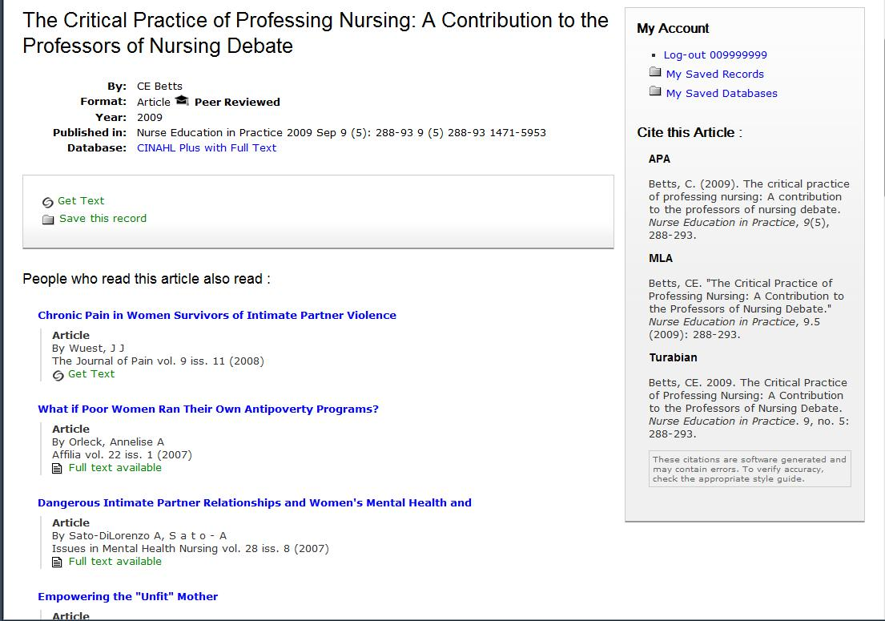
Recommendations from bX Service
IDS Project Conference
Transforming Discovery and Delivery

Slide 10
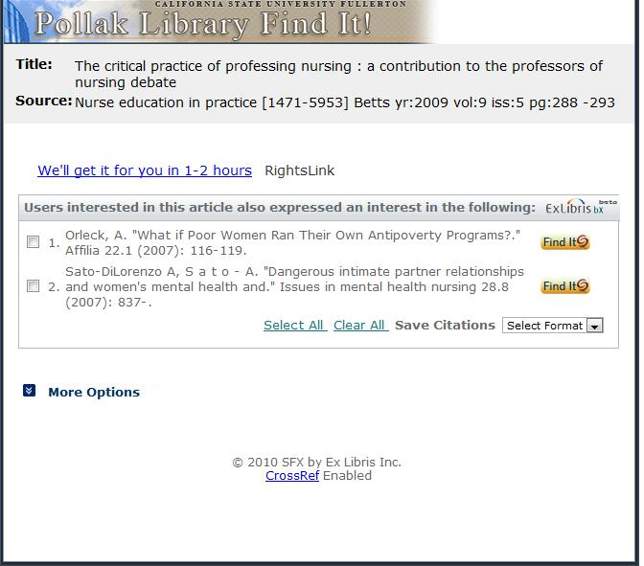
Link Resolver determines no local availability
Recommendations based on usage patterns of researchers at CSU and other institutions
IDS Project Conference
Transforming Discovery and Delivery

Slide 11
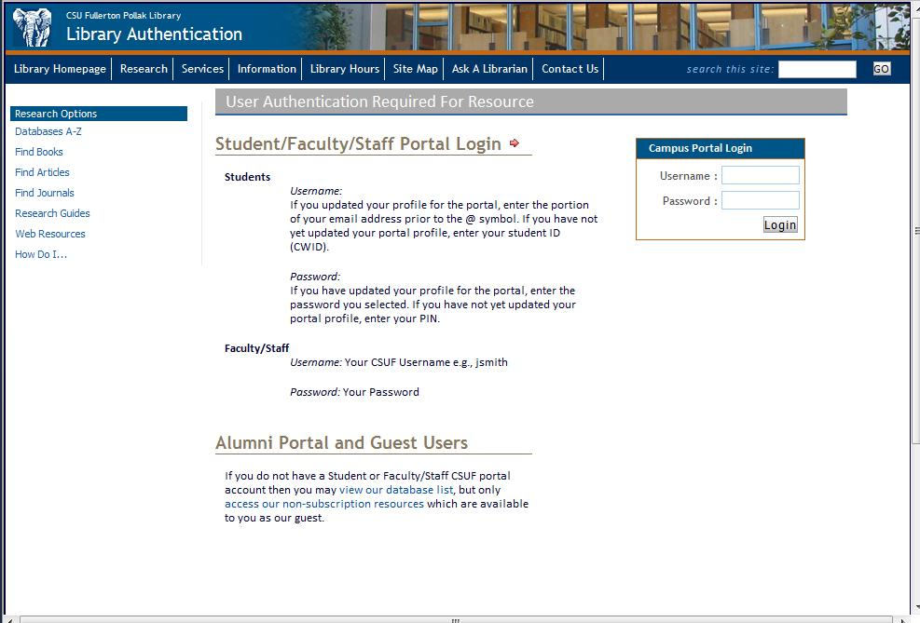
Campus Identity challenge
IDS Project Conference
Transforming Discovery and Delivery

Slide 12
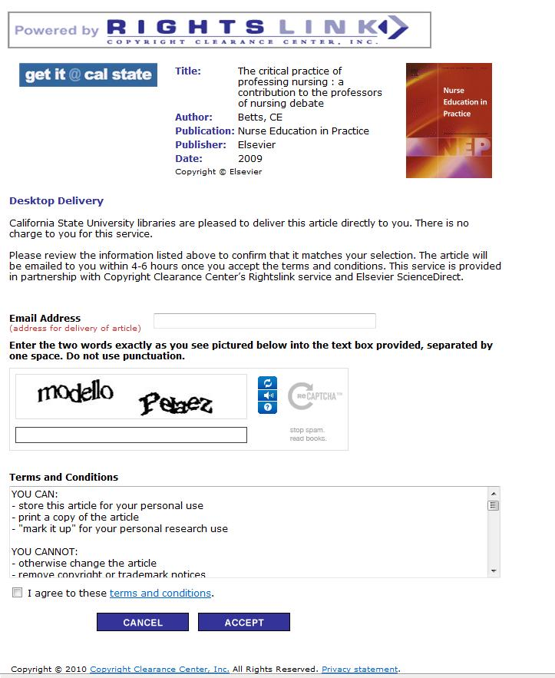
User enters preferred email address and Captcha
IDS Project Conference
Transforming Discovery and Delivery

Slide 13
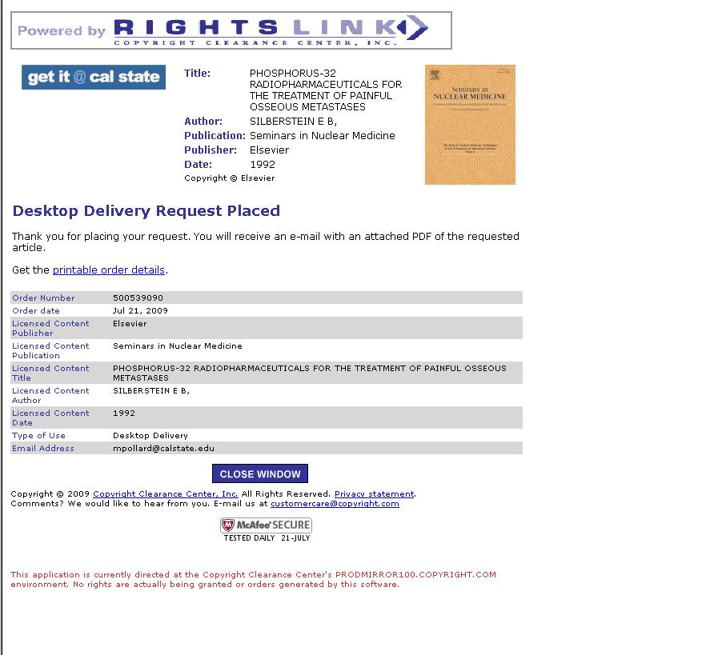
Completed Request
IDS Project Conference
Transforming Discovery and Delivery

Slide 14
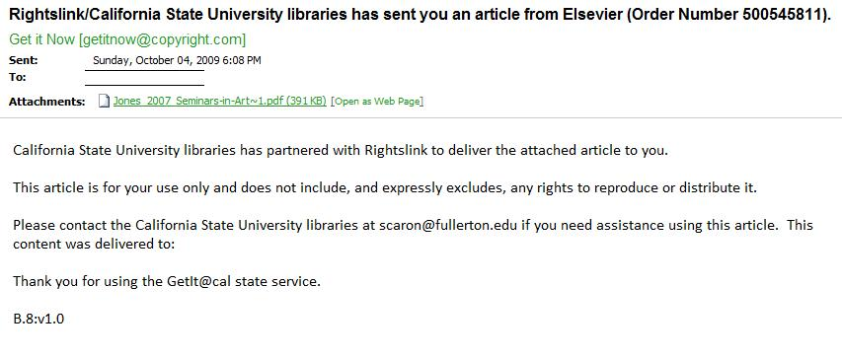
e-mail sent to user
IDS Project Conference
Transforming Discovery and Delivery

Slide 15
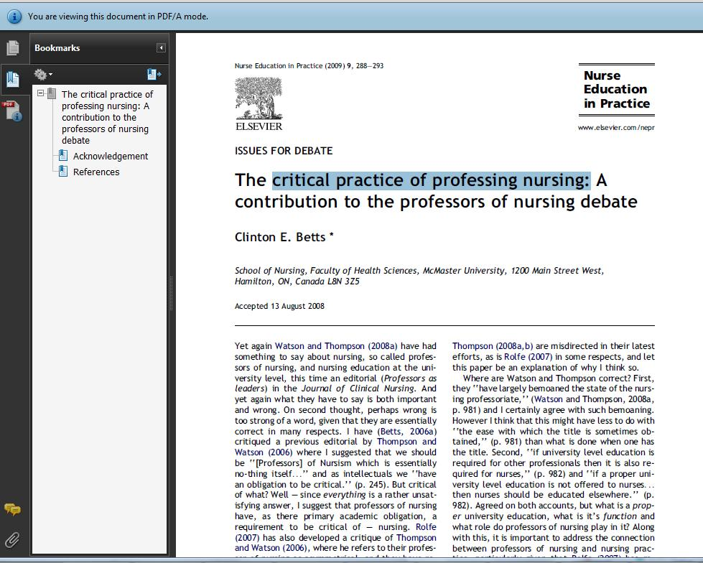
User is reading in minutes
Transforming Discovery and Delivery

Slide 16
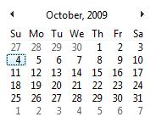
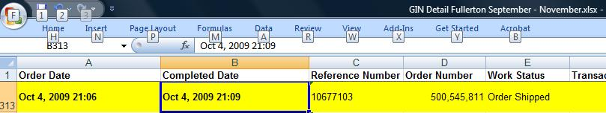
Sunday Night Fill Time -3 Minutes
IDS Project Conference
Transforming Discovery and Delivery

Slide 17
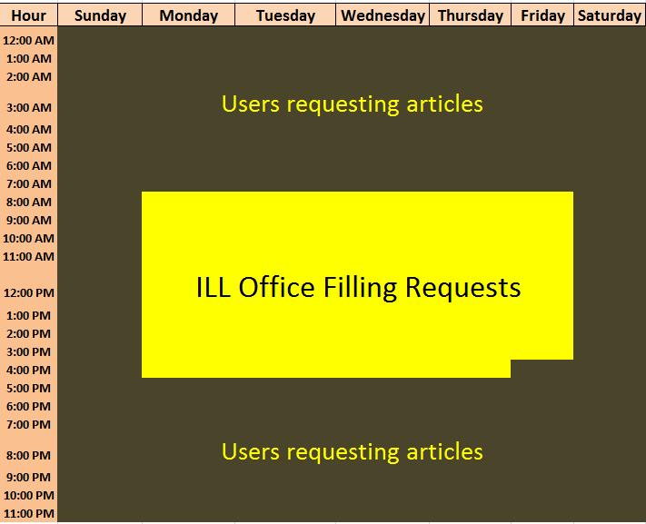
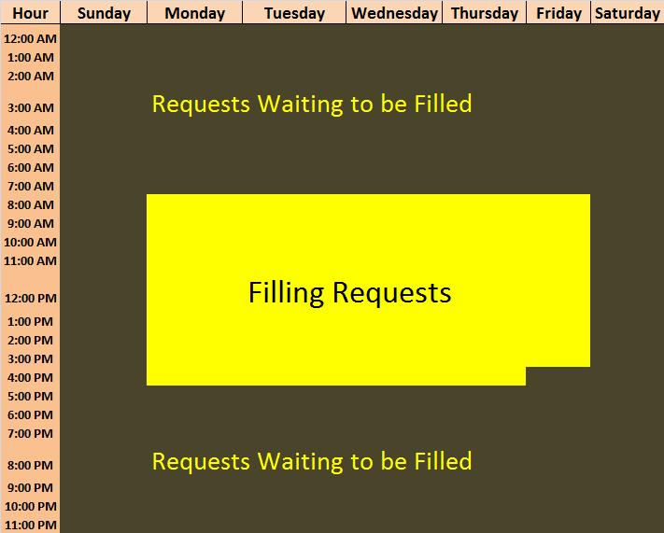
When Users Need Information
IDS Project Conference
Transforming Discovery and Delivery

Slide 18
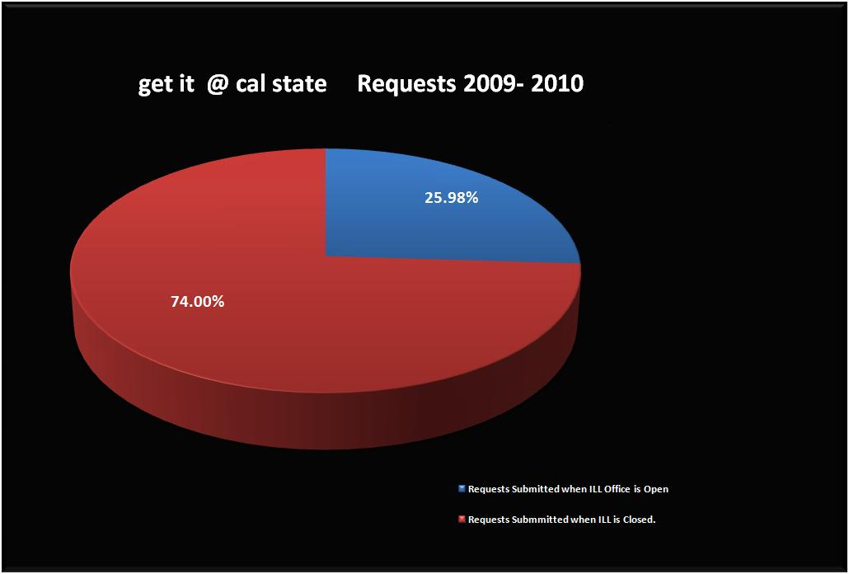
IDS Project Conference
Transforming Discovery and Delivery

Slide 19
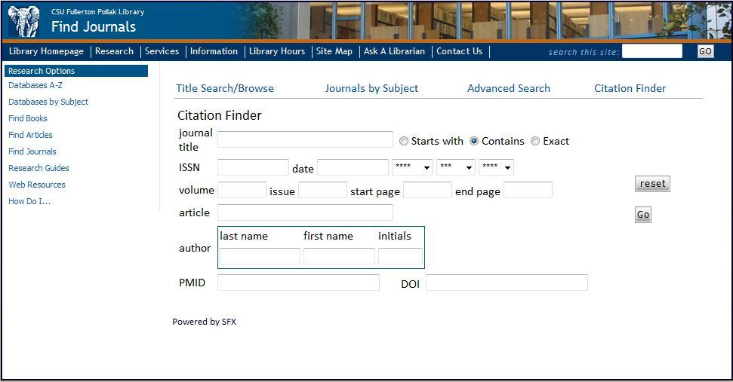
ILL Office and Mediated Request Form
IDS Project Conference
Transforming Discovery and Delivery

Slide 20
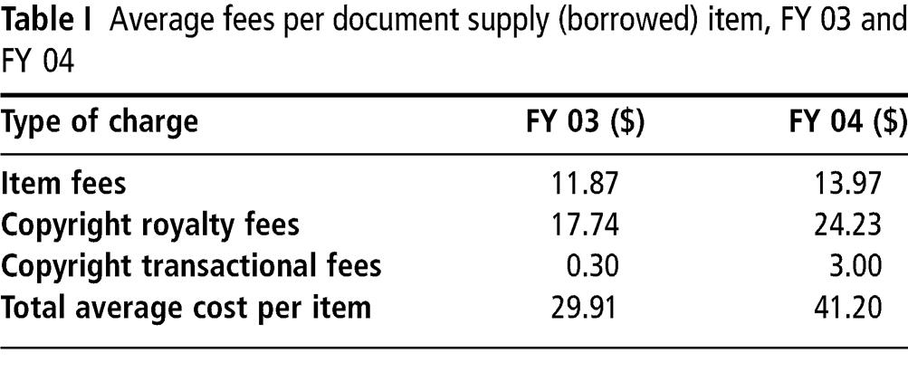
Marginal ILL Costs Way Up!
IDS Project Conference
Transforming Discovery and Delivery

Slide 21
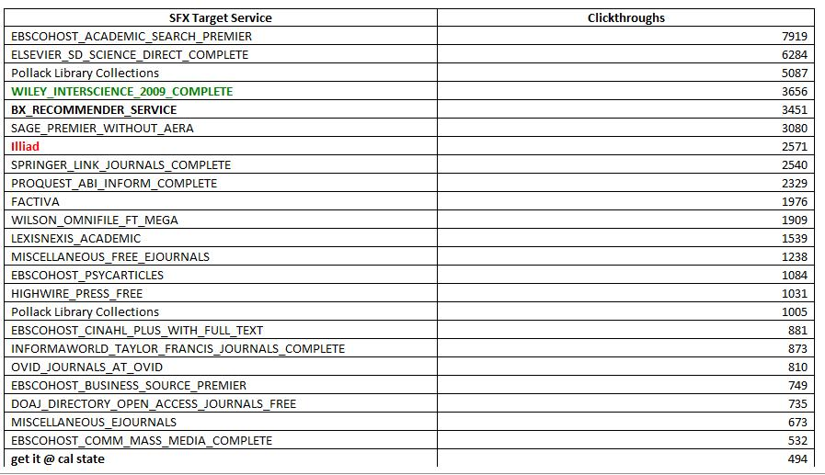
Top 25 Destinations
IDS Project Conference
Transforming Discovery and Delivery

Slide 22
Get It Now User Quotes
“We calculate the cost for a Get It Now article are less than our traditional ILL per-article delivery cost. ”
“It’s proved very popular with our students/faculty. ”
“It’s great to be able provide quick access to so many electronic articles that can be delivered very quickly!”
IDS Project Conference
Transforming Discovery and Delivery

Slide 23
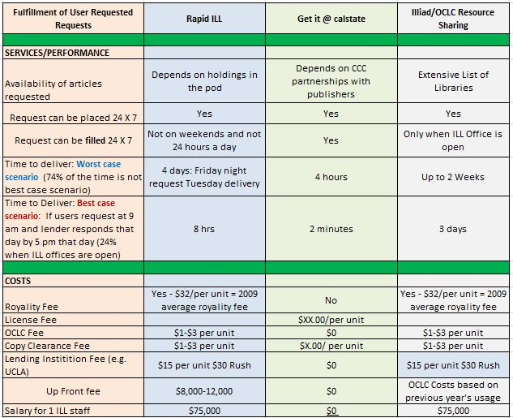
Comparative Analysis
IDS Project Conference
Transforming Discovery and Delivery

Slide 24

Features & Benefits
Quick turnaround time on requests
24 x 7 article delivery
Priced less than most royalty fees
Mediated and unmediated options
High-quality, full-color PDF articles
Saves staff time and money
Convenient invoicing
IDS Project Conference
Transforming Discovery and Delivery

Slide 25

Planned New Features/Enhancements
Allow institution to charge a user fee via their PayPal merchant account
Brand Get It Now pages at the institution level
Productize the service
Verify requestor email addresses
Discovery Efforts
  Research institution integration requirements (ILLiad, Serials Solutions, etc..)
  Sponsorship advertising
Recruiting additional publishers
Expanding with CSU
Recruiting additional institutions
IDS Project Conference
Transforming Discovery and Delivery

Slide 26

Calling All Campuses….
We invite you to join CSU & CCC in the Get It Now pilot program
Help shape the evolution of the service
Fall 2010 semester
Contact:
  Tim Bowen
  Product Manager
  Copyright Clearance Center
  978-646-2592
  tbowen@copyright.com
IDS Project Conference
Transforming Discovery and Delivery

