Slide 1
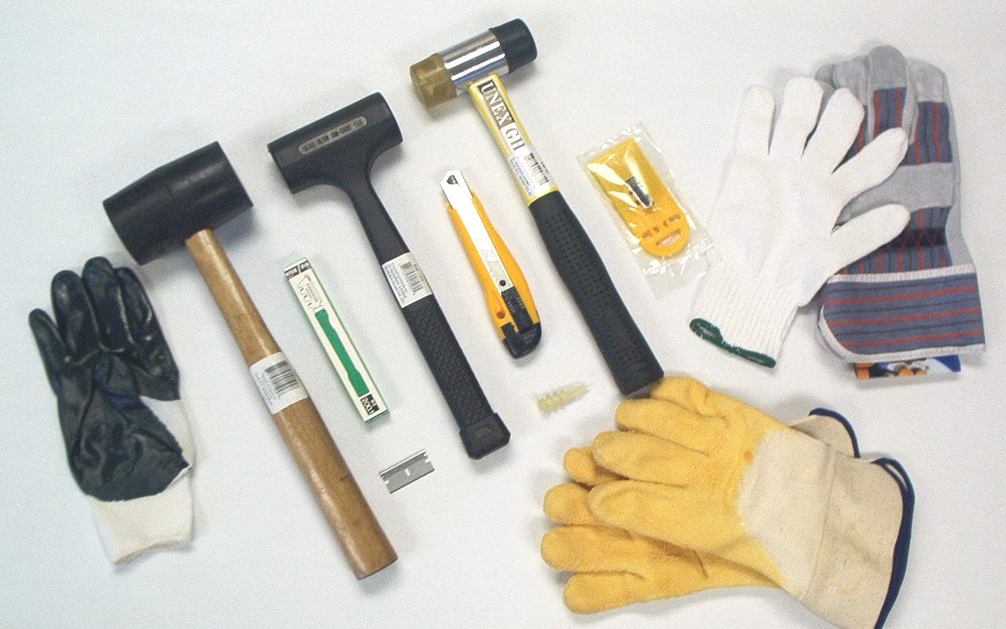
Cool Tools: Assorted Addons
Mark Sullivan
IDS Conference, August 3rd and 4th 2010

Slide 2
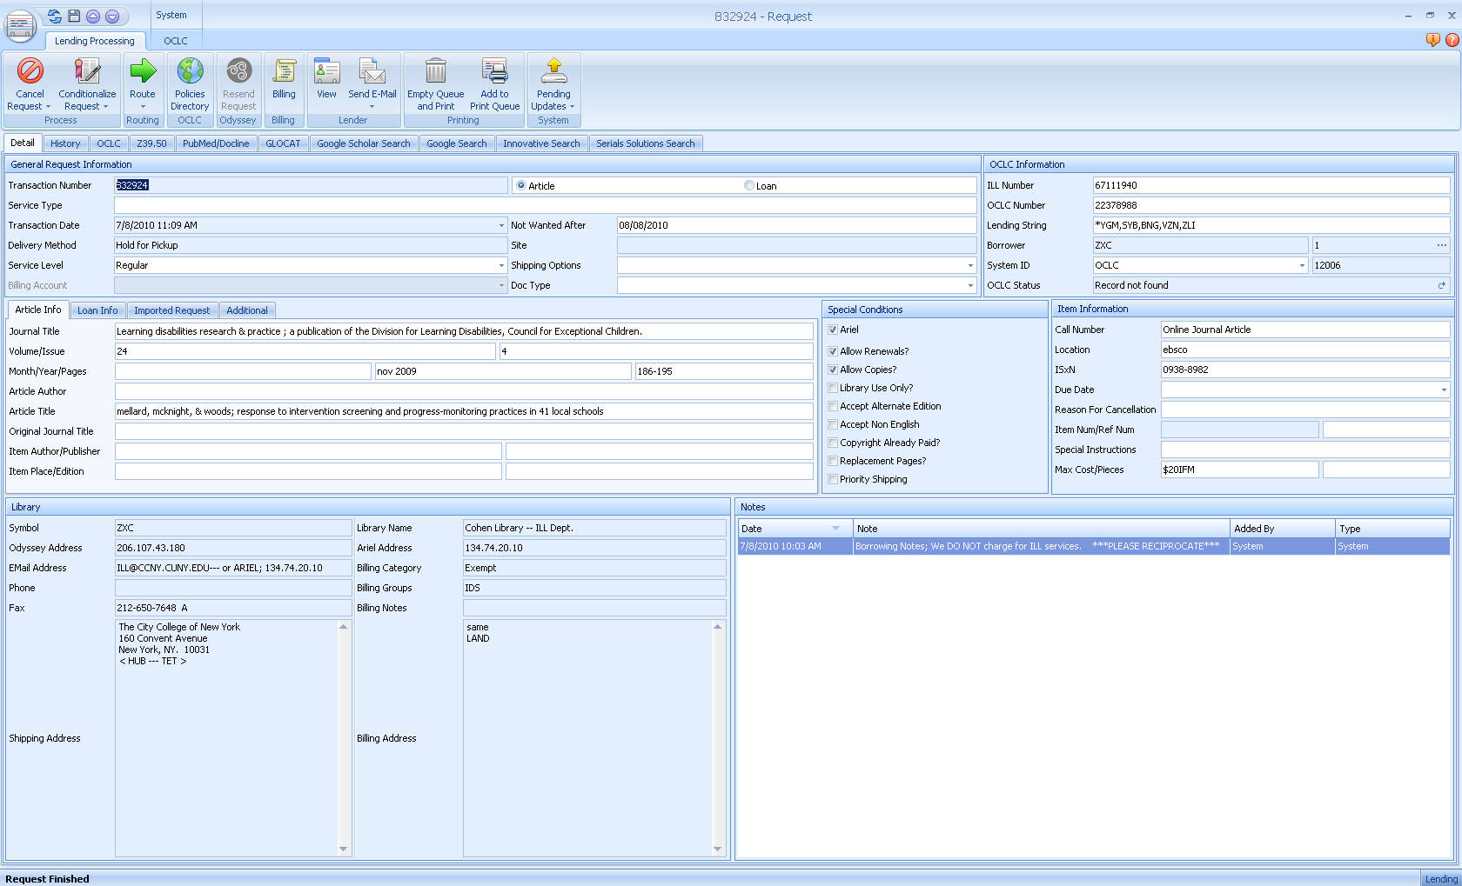
Processing a Lending Request

Slide 3
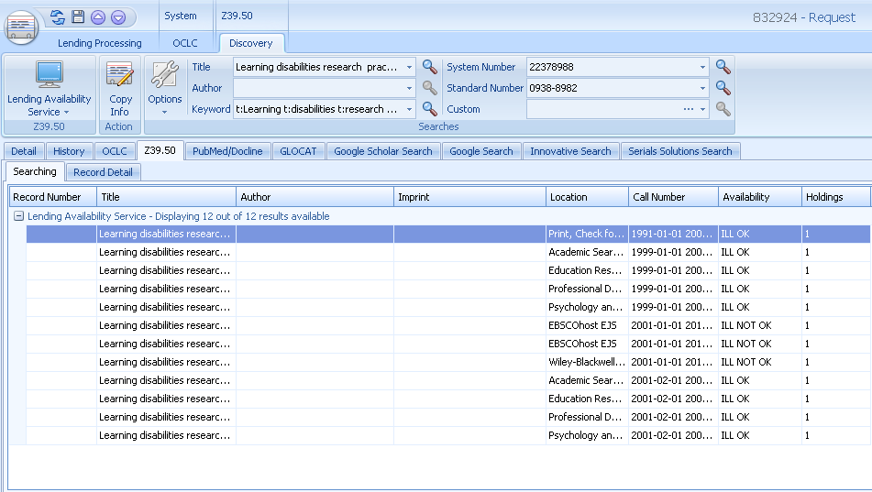
Lending Availability Service

Slide 4
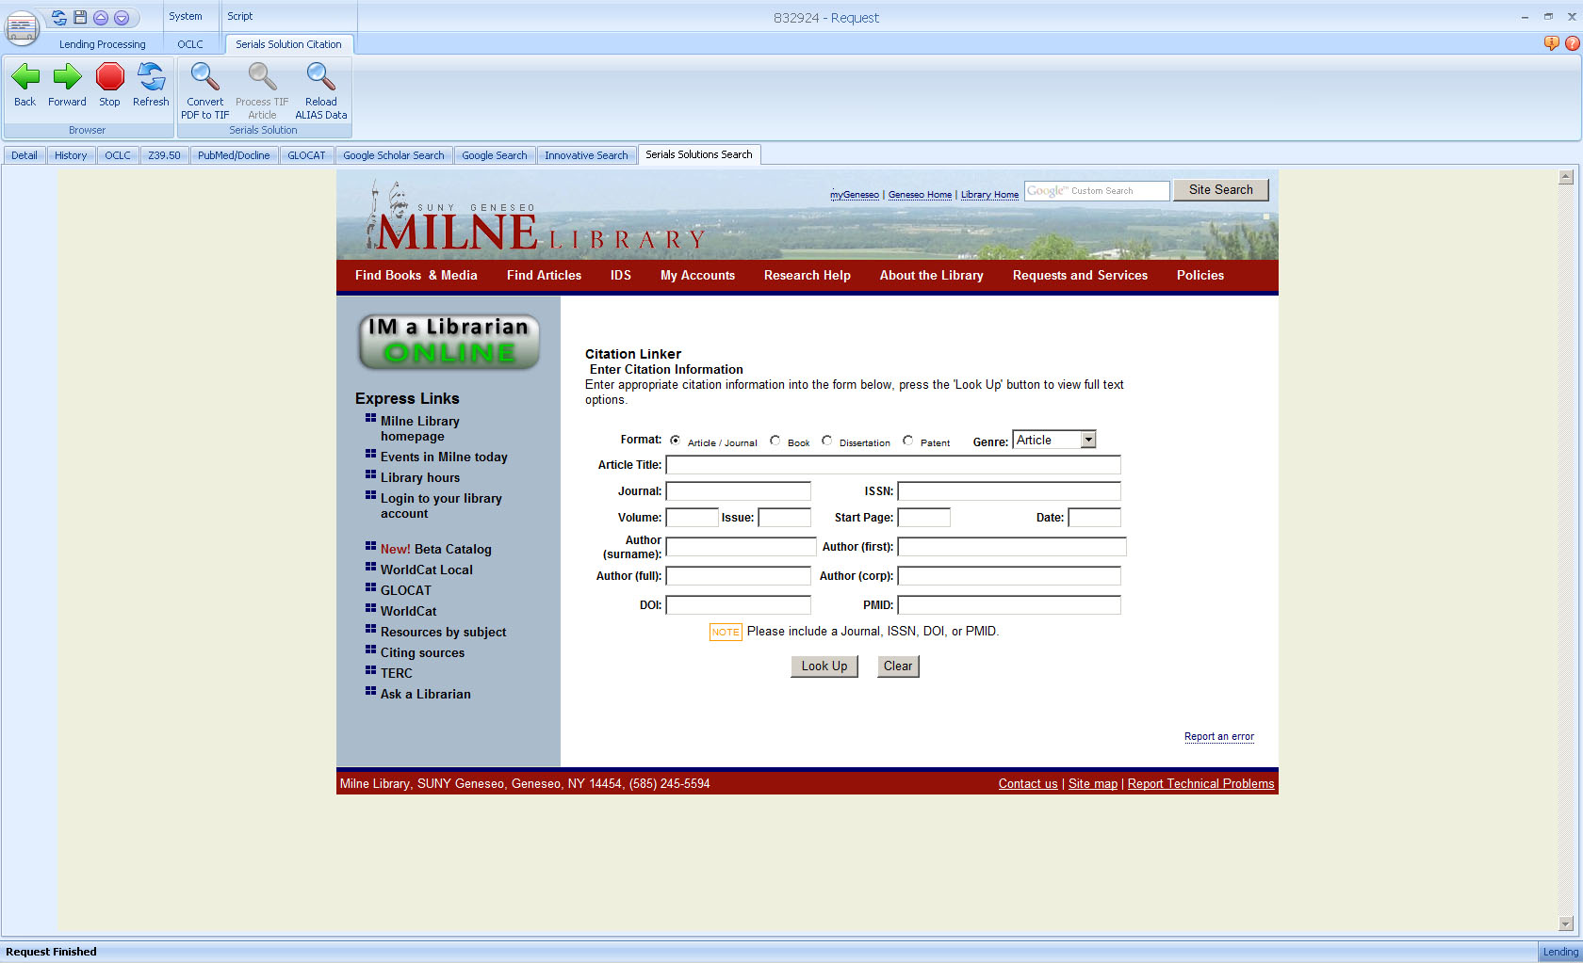
Serials Solutions Addon

Slide 5
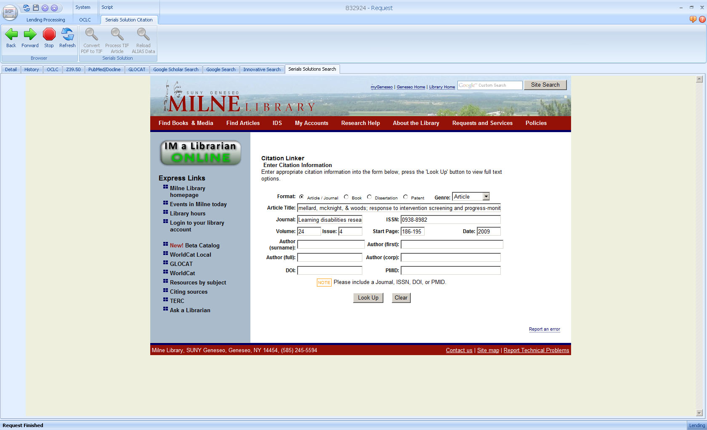
Serials Solutions Addon

Slide 6
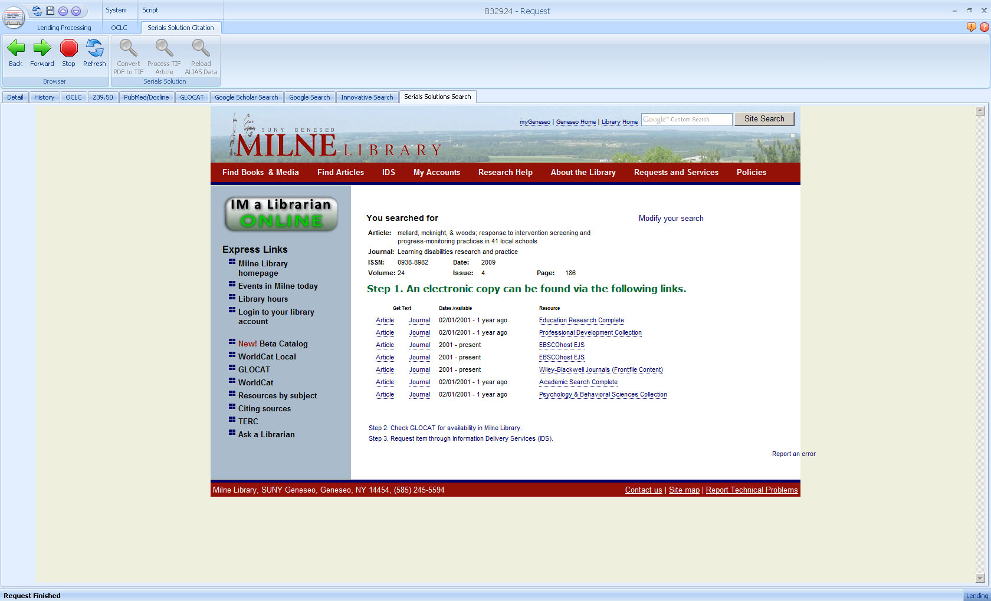
Serials Solutions Addon

Slide 7
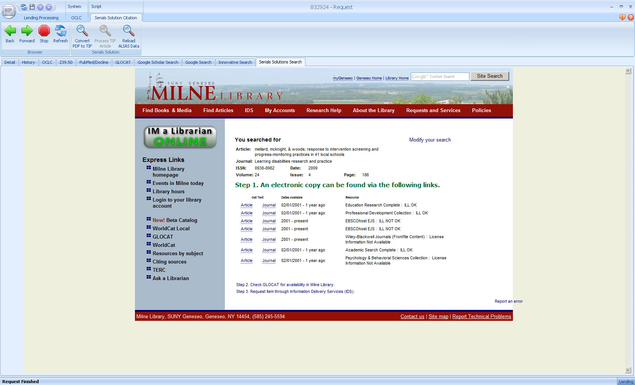
ALIAS - Serials Solutions Addon

Slide 8
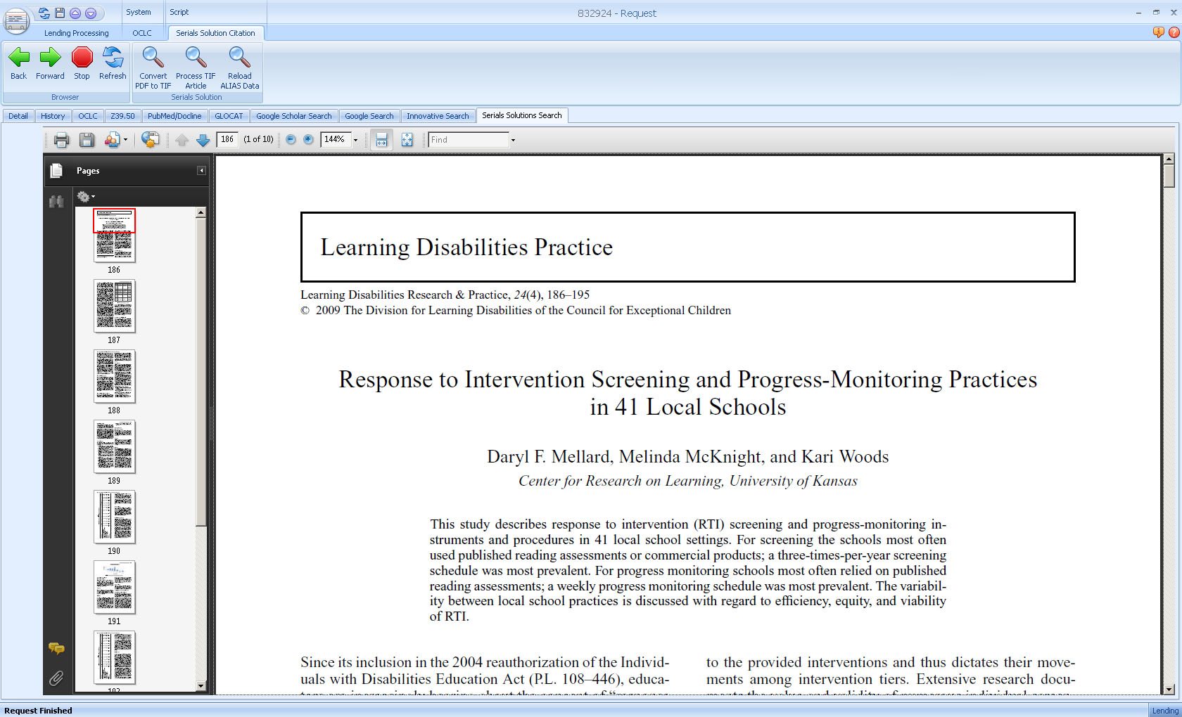
Loading Article Within ILLiad

Slide 9
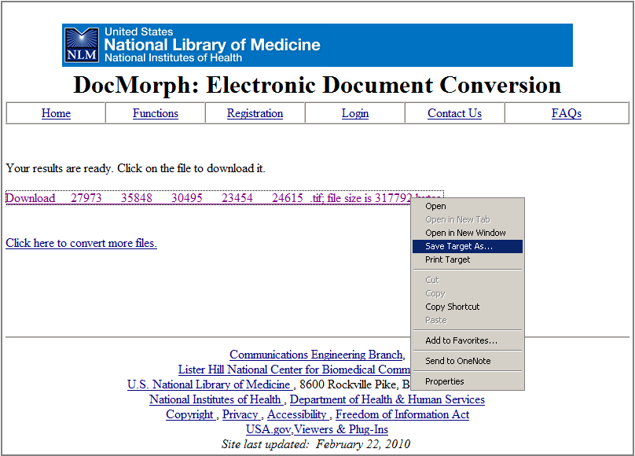
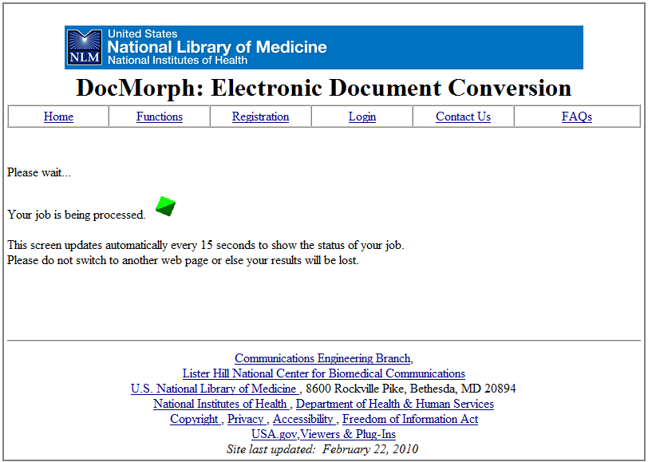
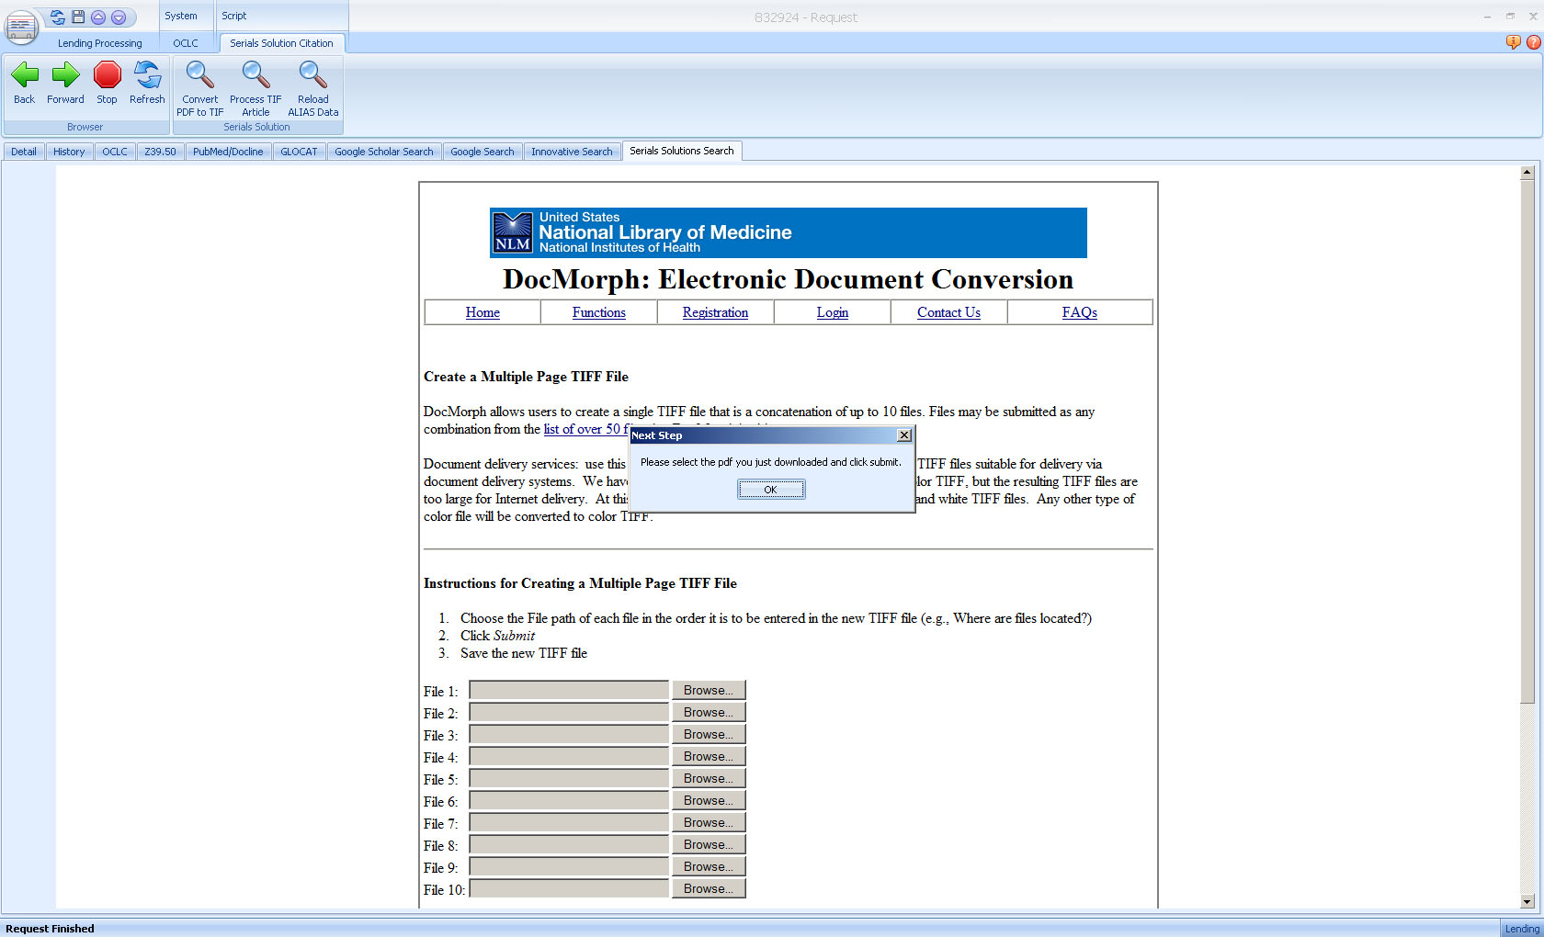
DocMorph Included

Slide 10
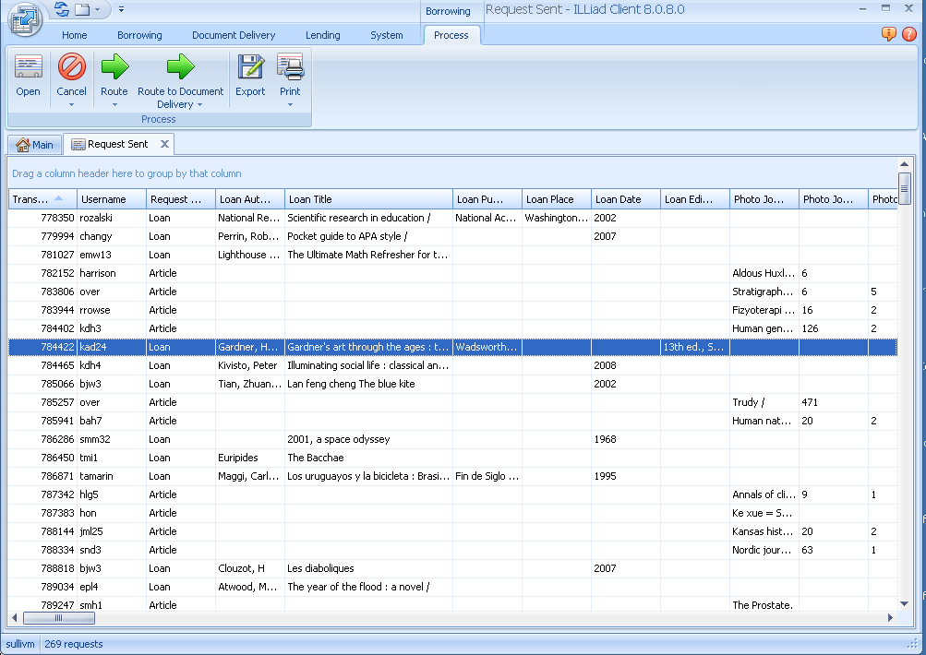

Booklist Checker

Slide 11
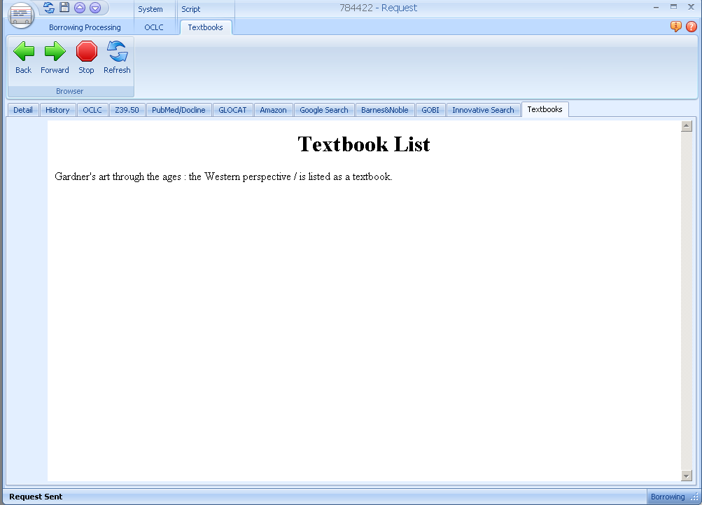
Booklist Display Tab

Slide 12

Proof of concept
Could I create an addon that would read an Excel file?
No, not easily but a text file was simple.

Slide 13
Sample of the Text File
AGUIRRE,GRIMSPACE,,,PENG USA,PENG USA,978-0-4-4101599-3
AIKEN,"DYING,DEATH+BEREAVEMENT",4TH 01,PB,TAYLOR,ERLBAUM,978-0-8-0583504-5
AITKEN,APPROACHES TO HUMAN GEOGRAPHY,6,PB,SAGE,SAGE,978-0-7-6194263-4
ALBANESE,PROFESSIONAL ETHICS IN CRIMINAL JUS,2ND 08 N,PB,PEARSON,A+B,978-0-2-0559409-2
ALBERTO,APPLIED BEHAVIOR ANALYSIS FOR TEACH,8TH 09,PB,PEARSON,MERRILL,978-0-1-3159289-6
ALBERTS,ESSENTIAL CELL BIOLOGY-W/DVD,3RD 10,,TAYLOR,GARLAND,978-0-8-1534129-1
ALBERTS,"MOLECULAR BIO.OF CELL,STUDENT ED.-W",5TH 08,,TAYLOR,GARLAND S,978-0-8-1534105-5
ALBOM,TUESDAYS WITH MORRIE,97,,RANDOM,DD,978-0-3-8548451-0
ALBRIGHT,MATHEMATICAL MODELING WITH EXCEL,10,,JONES+BART,JONES+BART,978-0-7-6376566-8
ALCOCK,ANIMAL BEHAVIOR,9TH 09,PB,SINAUER,SINAUER,978-0-8-7893225-2
ALDWIN,"HEALTH,ILLNESS,+OPTIMAL AGING",4,PB,SAGE,SAGE,978-0-7-6192259-9
ALESSI,MULTIMEDIA FOR LEARNING,3RD 01,PB,PEARSON,PH,978-0-2-0527691-2
ALEXANDER,AMERICAN COLLEGE & UNIVERSITY LAW,,,TAYLOR,RUTLEDGE,978-0-4-1580031-0
ALEXIE,ABSOLUTELY TRUE DIARY OF A PART TIM,7,,HACHETTE B,LB,978-0-3-1601368-0
ALFARO-LEFEVRE,CRITICAL THINKING+CLINICAL JUDGMENT,4TH 09,PB,ELSEVIER,SAUNDERS,978-1-4-1603948-8
ALGOZZINE,FUNDAMENTALS OF SPECIAL EDUCATION,6,PB,SAGE,CORWIN PR,978-1-4-1293894-5
ALLAN,EARTH SCIENCE 1101,,,HAYDEN MCN,HAYDEN MCN,978-0-7-3804019-6

Slide 14
The Entire Script
local autoSearch = GetSetting("AutoSearch");
local scriptActive = GetSetting("Active");
local interfaceMngr = nil;
local browser = nil;
function Init()
if scriptActive then
if GetFieldValue("Transaction", "RequestType") == "Loan" then
interfaceMngr = GetInterfaceManager();
-- Create browser
browser = interfaceMngr:CreateBrowser("Textbooks", "Textbooks", "Script");
browser:Show();
browser:Navigate("about:blank")
if autoSearch then
Search();
end
end
end
end
function Search()
local obrowser = browser.Browser;
local document = obrowser.Document;
local isbn = string.gsub(GetFieldValue("Transaction", "ISSN"),"-","");
local title = GetFieldValue("Transaction", "LoanTitle");
local checkresult = "false";
if isbn=="" then
isbn="nomatch"
end
local html = "<HTML> <TITLE>Textbooks</TITLE> <BODY><h1 align=center>Textbook List</h1>";
local fp = assert(io.open("c:\\illiad8\\addons\\textbookcheck\\textbooks.csv", "r"))
for line in fp:lines() do
local tmpline = string.gsub(line,"-","");
if string.match(tmpline,isbn)~=nil or string.match(tmpline,title)~=nil then
interfaceMngr:ShowMessage(GetFieldValue("Transaction", "LoanTitle") .. " is listed as a textbook.","Textbooks");
html = html .. title .. " is listed as a textbook.<br>";
checkresult = "true";
break;
end
end
if checkresult == "false" then
html = html .. title .. " is not on the list."
end
html = html .. "</body></html>"
document:Write("");
obrowser.DocumentText=html;
fp:close();
ExecuteCommand("SwitchTab", {"Detail"});
end

Slide 15
Cool Tools: Assorted Addons
Mark Sullivan
IDS Conference, August 3rd and 4th 2010

