Slide 1
Making Smart Choices:
Data-Driven Decision Making in Academic Libraries
IDS Project Conference
August 3, 2010
Oswego, NY
Michael Levine-Clark
Collections Librarian
University of Denver

Slide 2
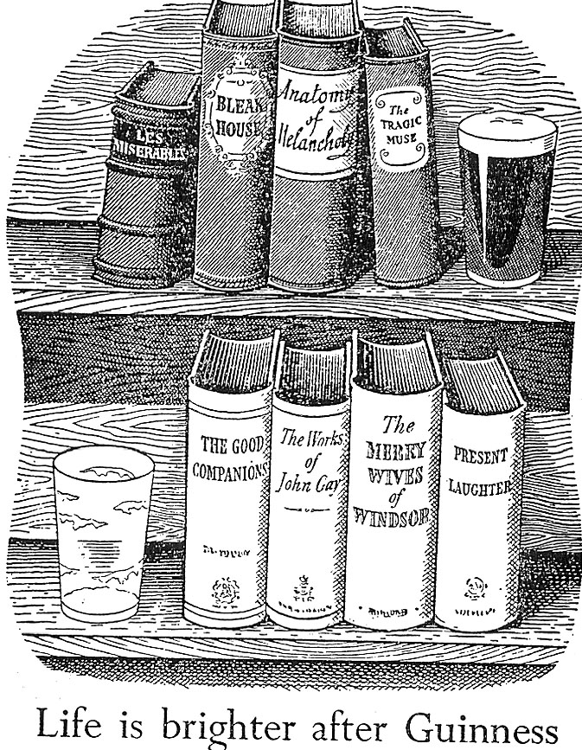

Slide 3
Could a library buy
used books instead of new?

Slide 4
Used Book Sites
ABEBooks
Alibris
Amazon

Slide 5
Availability of Discounted
In-Print Books
Choice Outstanding Academic Titles 2002
  466 titles (294 cloth/paper = 760 items)
  11.05 listings per title
  Average discount: 25.65%
NY Times Notable Books 2002
  320 titles
  31.63 listings per title
  Average discount: 34.16%
Levine-Clark, Michael, “An Analysis of Used Book Availability on the Internet.” Library Collections, Acquisitions, and Technical Services 28, no. 3 (Autumn 2004): 283-297.

Slide 6
Initial Conclusions
Most recent books available used/discounted
Approval vendors may still be better option
Discount sites useful for firm ordering

Slide 7
Later Thoughts
Widespread availability of discounted books =
  No need to buy up-front
  Replacement for ILL

Slide 8
What do users really think about ebooks?

Slide 9
Do our users hate ebooks as much as we do?

Slide 10
What the librarians thought:
Ebooks confusing
  Poor interface
  Unreasonable restrictions
Users hate ebooks
Users prefer print

Slide 11
2005 Survey
2,067 respondents
  30% undergraduates
  39% graduate students
  13% faculty
59% aware of library ebooks
51% have used an ebook
Levine-Clark, Michael, “Electronic Book Usage: A Survey at the University of Denver,” portal: Libraries and the Academy 6, no. 3 (2006): 285-299.
Levine-Clark, Michael, “Electronic Book Usage and Humanities: A Survey at the University of Denver,” Collection Building 26, no. 1 (2007): 7-14.

Slide 12
2005 Survey
How often do you use ebooks?
  One time only: 28%
  Occasionally: 62%
  Frequently: 10%

Slide 13
2005 Survey
Why do you use ebooks?
  No print version available: 40%
  Not at library: 42%
  Ability to search: 55%

Slide 14
2005 Survey
How much of the ebook do you typically read?
  Entire book: 7%
  Chapter: 57%
  Single entry/ a few pages: 36%
Do you read online or print?
  Computer screen: 46%
  PDA: 5%
  Print: 26%
  It depends: 23%

Slide 15
2005 Survey
Users
  don’t care about the interface, but often don’t want to read on screen
  prefer print (61%)
  would use either format (80%)
  generally read only a small portion of the book (93%)

Slide 16
Initial Conclusions
We need to provide more ebooks
We need to better market ebooks
We should figure out how to provide access to e and p
Librarians and patrons have different concerns

Slide 17
2010 Survey
1,818 respondents (2005: 2,067)
  31% undergraduates (30%)
  43% graduate students (39%)
  11% faculty (13%)
67% aware of library ebooks (59%)
61% have used an ebook (51%)

Slide 18
2010 Survey
How often do you use ebooks? (2005)
  One time only: 18% (28%)
  Occasionally: 64% (62%)
  Frequently: 18% (10%)

Slide 19
2010 Survey
Why do you use ebooks? (2005)
  No print version available: 43% (40%)
  Not at library: 43% (42%)
  Ability to search: 54% (55%)

Slide 20
2010 Survey
How much of the ebook do you typically read?
  Entire book: 1) 18% 2) 6% (7%)
  Chapter: 1) 29% 2) 36% (57%)
  Single entry/
  a few pages: 1) 34% 2) 26% (36%)
  Multiple portions: 1) 19% 2) 32%
Asked to rank these 1-4

Slide 21
2010 Survey
Do you read online or print? (2005)
  Computer screen: 76% (46%)
  Portable device: 12% (PDA: 5%)
  Read on dedicated
  e-reader: 9%
  Print: 53% (26%)
2010: Choose all that apply
2005: Choose one

Slide 22
2010 Survey
If you had access to p and e of same title, which would you choose?
  Always print: 19%
  Usually print, sometimes electronic: 43%
  Usually electronic, sometimes print: 21%
  Always electronic: 4%
  It depends: 13%
Either format: 77%

Slide 23
2010 Survey
Do you read e and p books differently?
  Yes: 59%
  No: 30%

Slide 24
2010 Survey
For which would you prefer e over p?
  Textbook: 39%
  Reference: 69%
  Edited collection: 51%
  Single-author narrative: 28%
  Fiction: 18%
  Would never prefer e: 14%

Slide 25
2010 Survey
In which cases would you use an ebook?
  Course-related assignment: 74%
  Course-assigned textbook: 49%
  Research: 81%
  Never: 7%

Slide 26
2010 Survey
Users prefer print
  For pleasure
  For longer reading
  For highlighting
Users prefer electronic
  For research
  For shorter reading
  If they can use an e-reader

Slide 27
2010 Conclusions
Must provide e and p
Must provide ability to download to e-reader
Most would use ebooks for research (81%)
Patron-Driven Acquisition

Slide 28
Do book reviews matter?

Slide 29
Are we buying the right books?

Slide 30
Spectra Dimension
Collection analysis tool
8 Colorado academic libraries
6 undergrad libraries
Holdings and circulation data – 10 years
Comparison sets
  Choice
  LC English

Slide 31
Choice Reviews
Colorado libraries buy more copies of books reviewed in Choice:
  General titles: 2.28 copies
  Choice titles: 4.01 copies
  Choice Outstanding Academic Titles: 4.88 copies
Levine-Clark, Michael and Margaret M. Jobe, “Do Reviews Matter? An Analysis of Usage and Holdings of Choice-Reviewed Titles within a Consortium,” Journal of Academic Librarianship 33, no. 6 (2007): 639-646.
Jobe, Margaret M. and Michael Levine-Clark, “Use and Non-Use of Choice-Reviewed Titles in Undergraduate Libraries,” Journal of Academic Librarianship 34, no. 4 (2008): 295-304.

Slide 32
Choice Reviews
Annual use per title
  General 0.46
  Choice 0.48
  Choice OAT 0.53

Slide 33
Choice Reviews
Percentage unused
  General 40%
  Choice 15%
  Choice OAT 13%

Slide 34
Choice Conclusions
Choice reviews
  Do predict use
  Don’t predict higher use rates
Good reviews are almost irrelevant
40% of books at most institutions not used

Slide 35
What does this all mean?

Slide 36
Responses
Adjusted approval plan
Added more ebooks
Decided to duplicate p/e on request
Instituted demand-driven acquisition
  Some ILL
  EBL
  Slips

Slide 37
Data Sources
ILS
  Circulation/reshelving data
ILL requests
Collection analysis tools
  WorldCat
  Spectra Dimension
eBook use data
Google Analytics

Slide 38
Data Sources
Ask the user
  Surveys
  Observation
  Focus groups

Slide 39
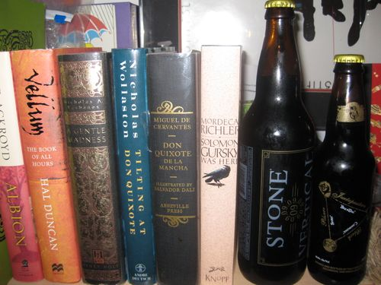

Slide 40
Thank You
Michael Levine-Clark
michael.levine-clark@du.edu
303.871.3413

