Slide 1


Libraries and Nylink Deliver
“You get what you Inspect not what you Expect”
--Hyman G. Rickover
July 21, 2010

Slide 2



The Information Delivery Services (IDS) Project:
Creating a Highly-effective &
Innovative Resource Sharing System
2008 Innovation
Award Winner
IDSProject.org
2

Slide 3






















































Spring 2010
53 Libraries
Student Head-Count: ~ 303,000
Faculty Head-Count: ~ 16,500
Total Volumes: ~ 33,000,000
CUNY
Notes:
As of 9-28-09

Slide 4

4
Notes:
What are the OUTCOMES – interestingly the fill rate has been consistently half articles and half loans.
APRIL 2009 ~252,000

Slide 5
User-centric Definition of IDS Transaction
From the time the user places a request until the time the user is notified the loan is ready for pickup or the article is ready to be retrieved from the Web
Notes:
Another part of the Project’s strategy was to define how we would measure the turnaround time of an ILL transaction.

Slide 6
Adherence to contractual performance standards
Articles: 48 hours
Loans: 72 hours
(Weekends and Holidays Excluded)
6
Notes:
These are the IDS Project benchmarks for resource sharing.

Slide 7

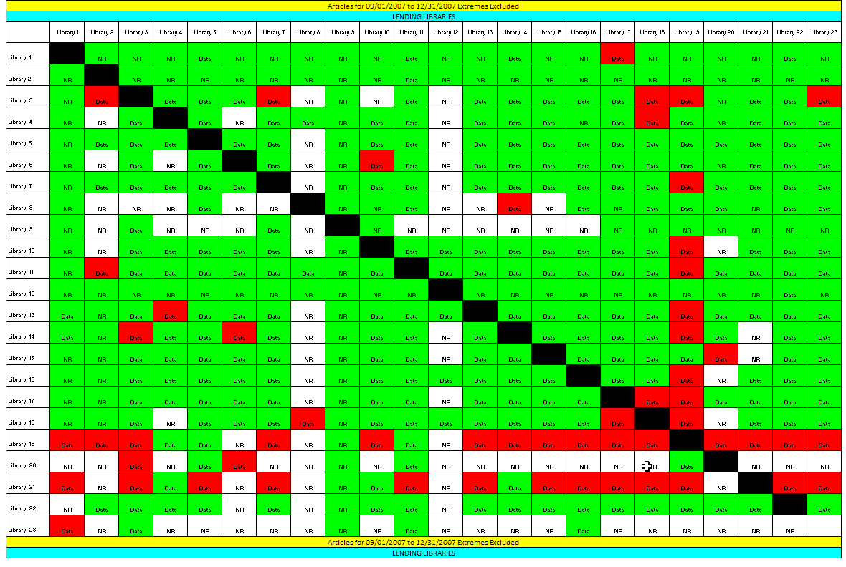
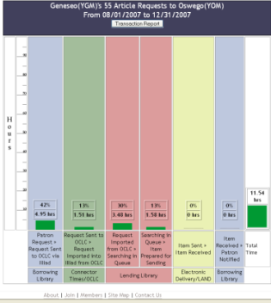
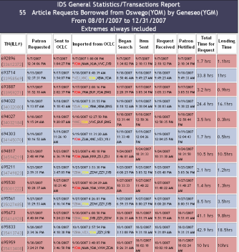
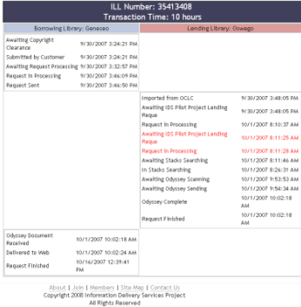
IDS Transaction Performance Analysis Module (TPAM)
7
Notes:
TPAM provides libraries with a series of hierarchically linked charts.

Slide 8
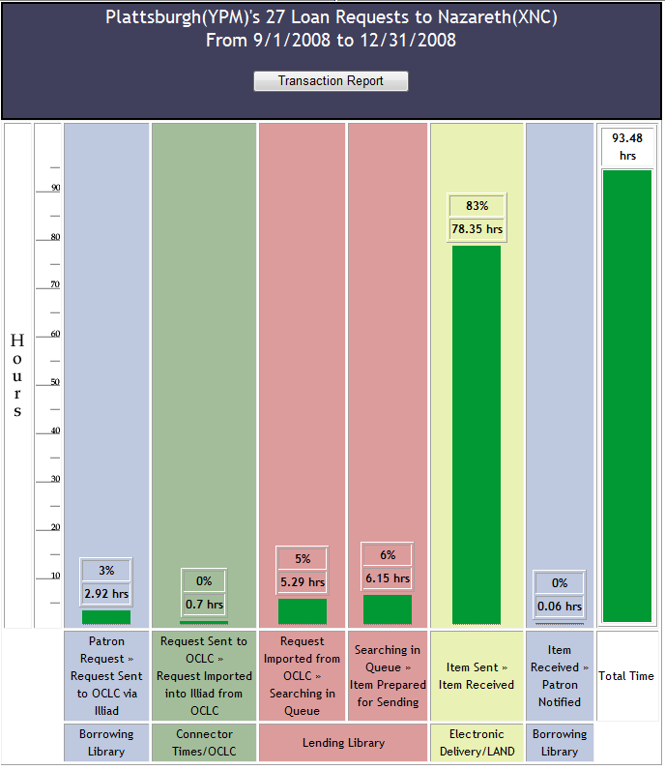

Slide 10
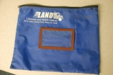
LAND
Pick-up @
Library “A”
LAND
Delivery @
Library “B”
Libraries and Nylink Deliver
Item Prepared for Shipping
Item Check-in by Borrowing Library

Slide 11
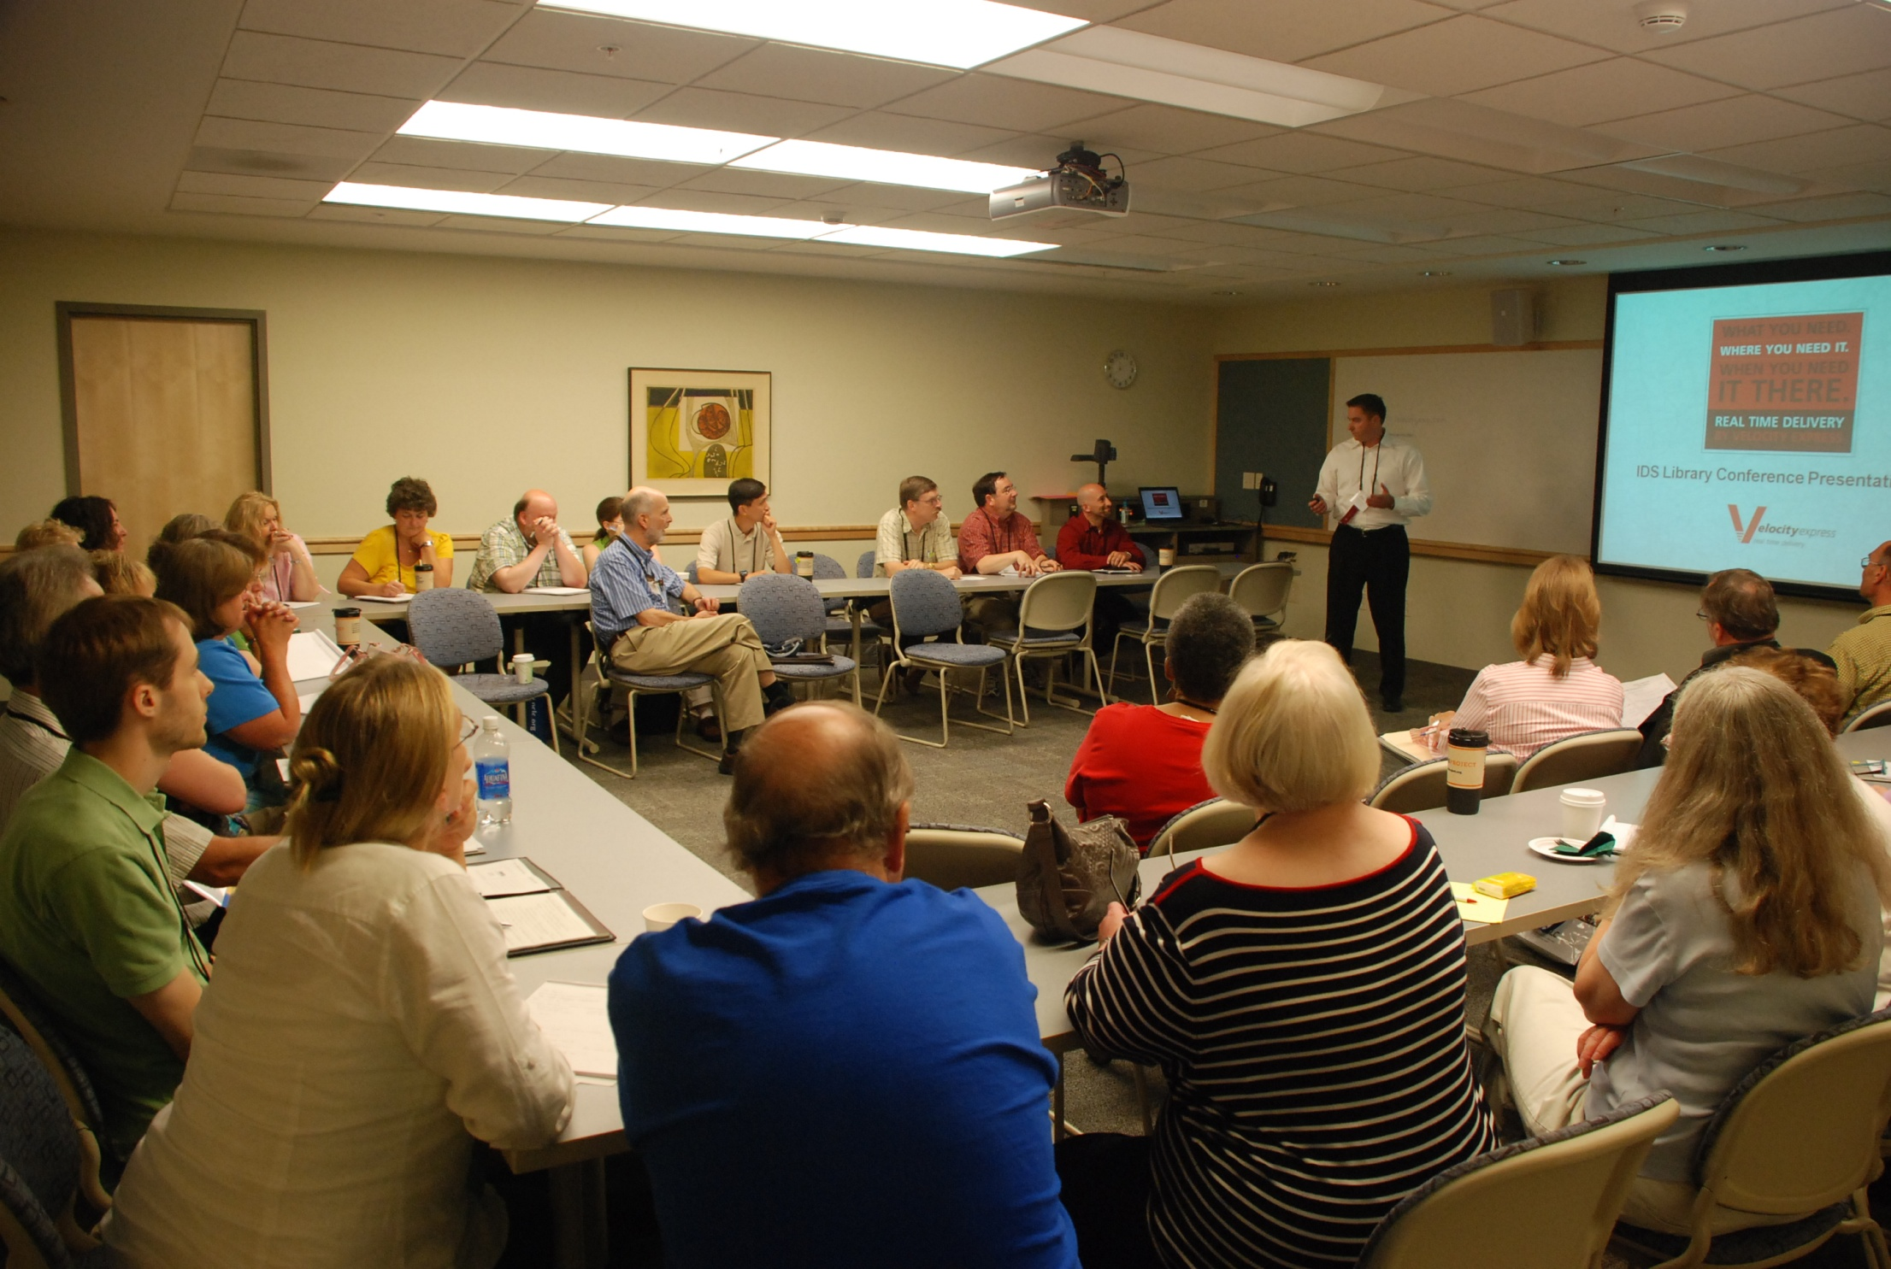

Slide 12
“Reset the Program”
August 4, 2009
Plus/
Delta
Velocity Express, Inc.
Delta:
“Reset the Program”
a. New Barcodes and new deployment approach
b. 10% Phone Audit per week
c. Vehicle Inspections and Driver Orientations
Implement upgrades to management in Syracuse Market
Align Velocity Reporting with TPAM statistics
Create refined reporting to capture variances on delivery times
Develop “flex” solution for Semester End volume spikes
Partner more actively toward next generation solutions

Slide 13
“Reset the Program”
August 4, 2009
Plus/
Delta
Velocity Express, Inc.
Delta:
“Reset the Program”
a. New Barcodes (and new deployment approach) ???
b. 10% Phone Audit per week
c. Vehicle Inspections and (Driver Orientations)
Implement upgrades to management in Syracuse Market Yes
Align Velocity Reporting with TPAM statistics
Create refined reporting to capture variances on delivery times
Develop “flex” solution for Semester End volume spikes
(Partner more actively toward next generation solutions) ???
Yes
Not done
Not sufficient nor consistent
Not done
If data collected, not used
No report

Slide 14
Expected Turnaround Time
Nylink contracts with a courier service to provide LAND, with expected turnaround times of 24 hours within a zone (meaning north or south of Newburgh) and 48 hours between zones (if an item has to cross Newburgh to the north or south to reach its destination). Courier service drivers are expected to arrive at the same time each day within a one-hour window.

Slide 15
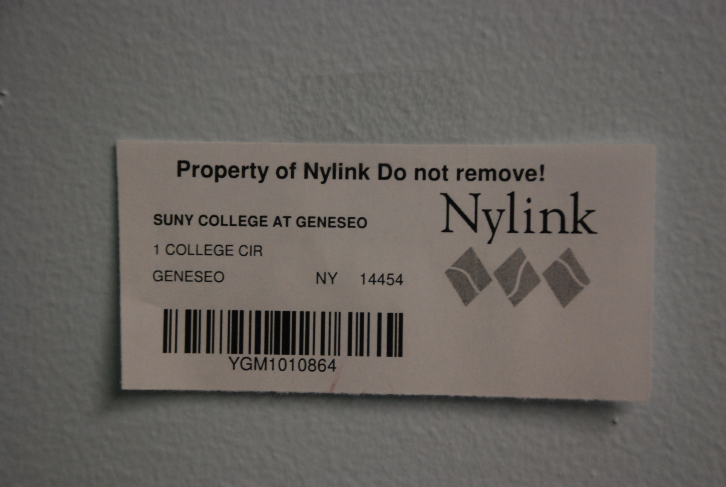

Slide 16
Statistics: Percent of time within contractual one-hour window based upon barcode readings
Raw data and aggregated analysis forthcoming from Velocity

Slide 17
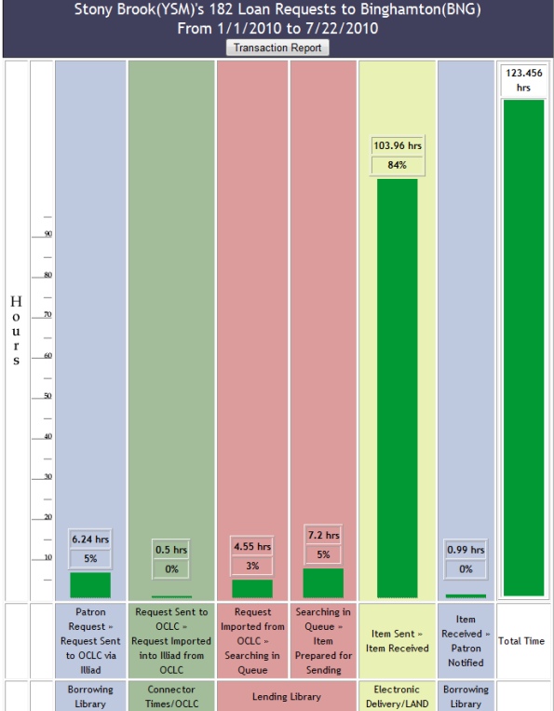

Slide 18
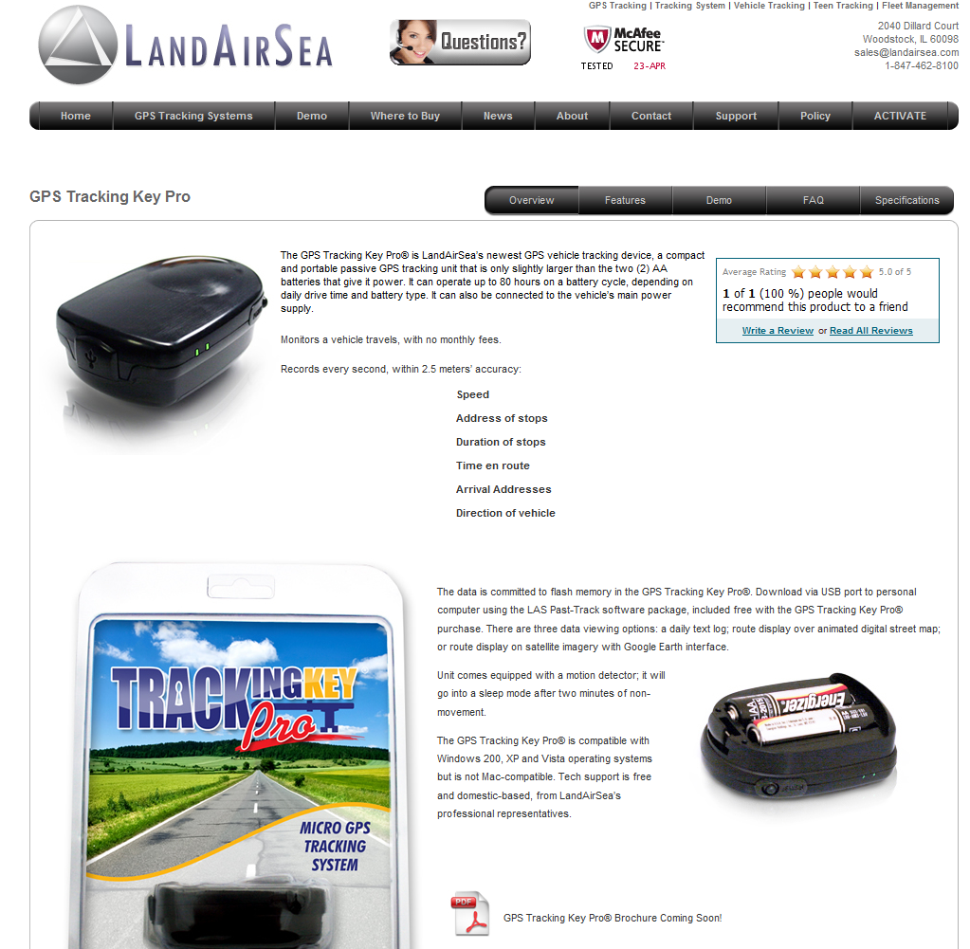

Slide 19
Equipment (x4)

Slide 20
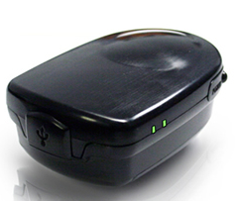
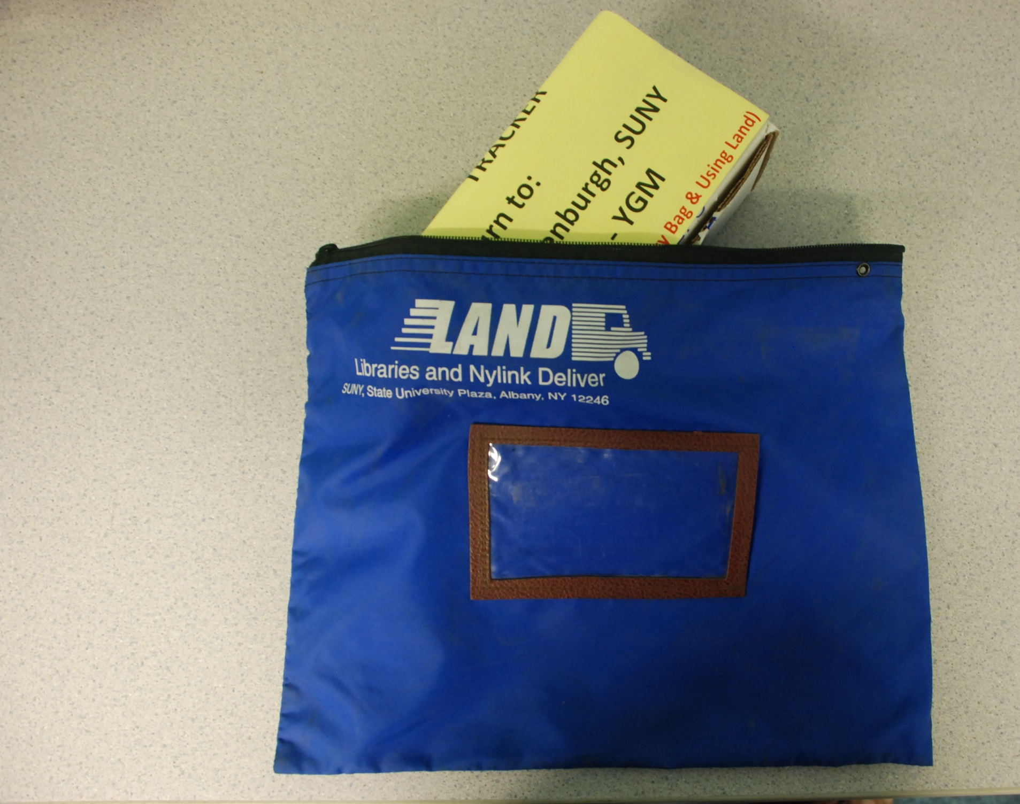

Slide 21
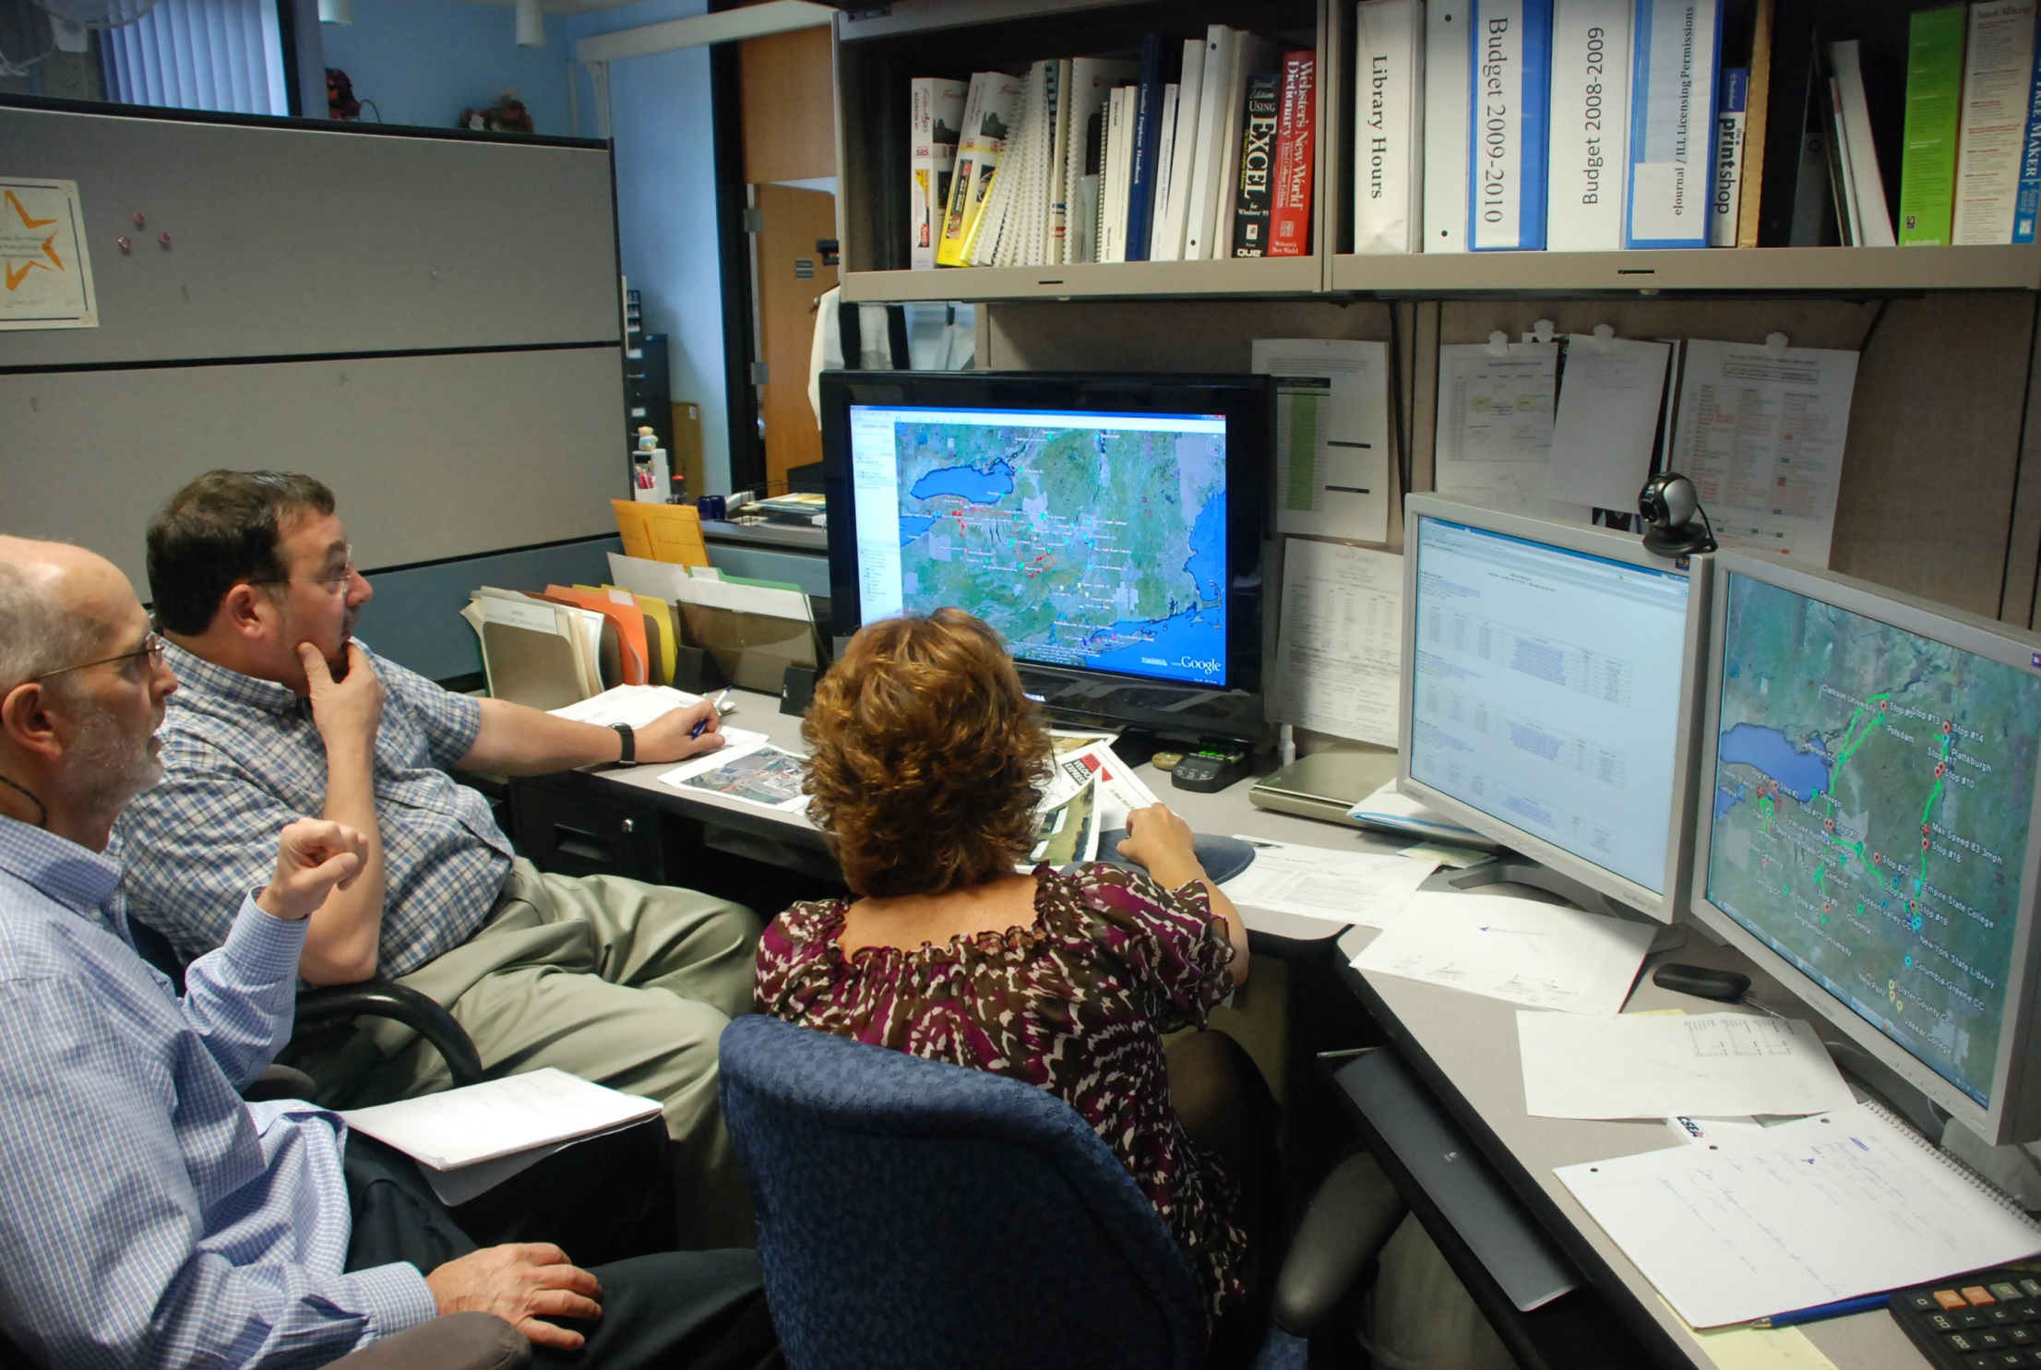

Slide 22
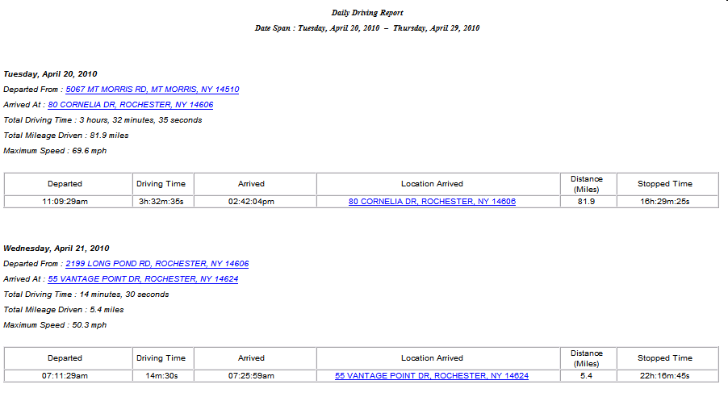

Slide 23
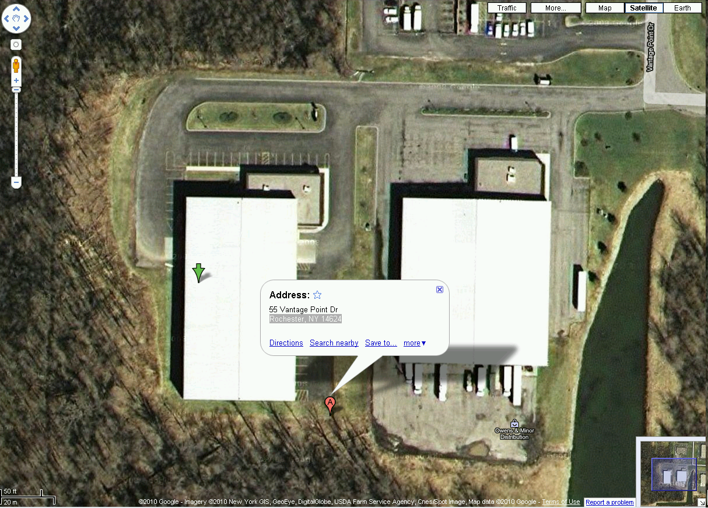
Google map from report link

Slide 24
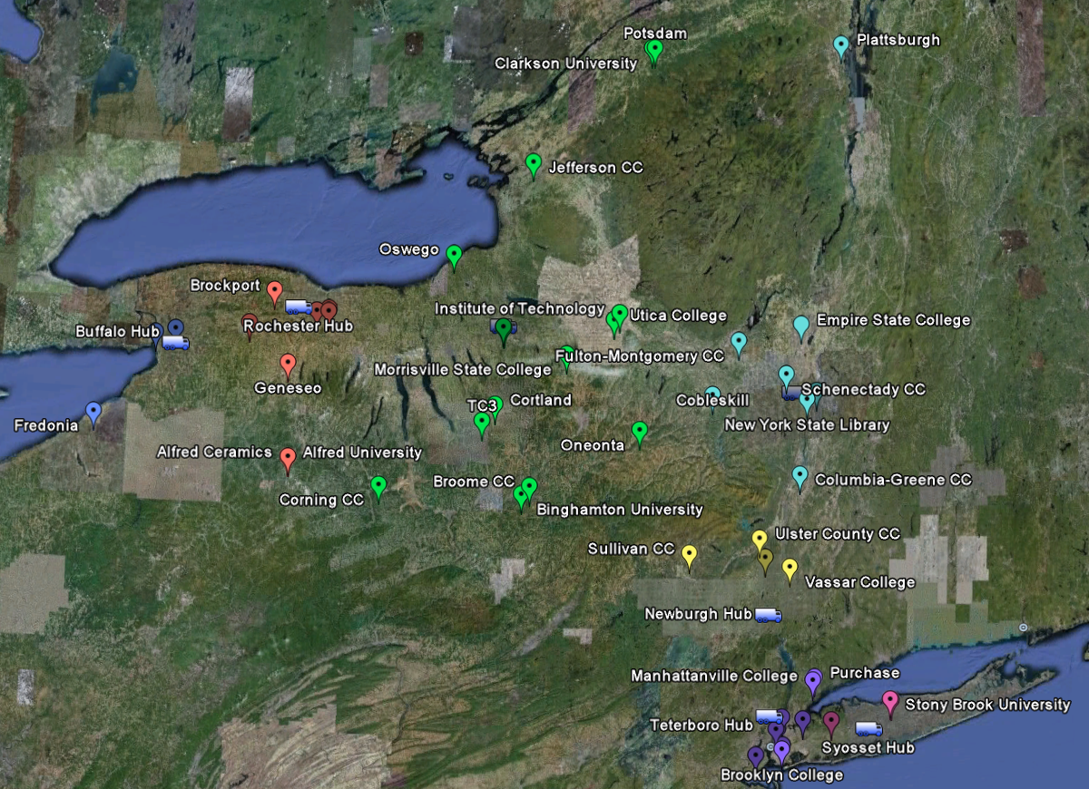

Slide 25
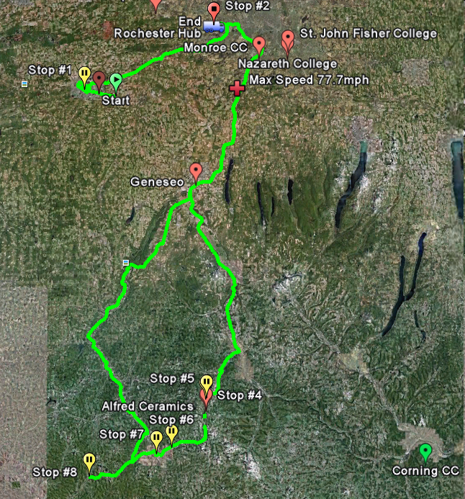

Slide 26
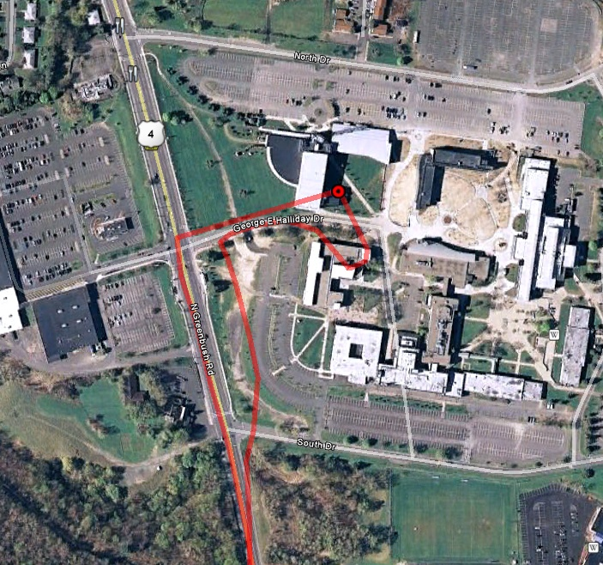
Hudson Valley CC

Slide 27
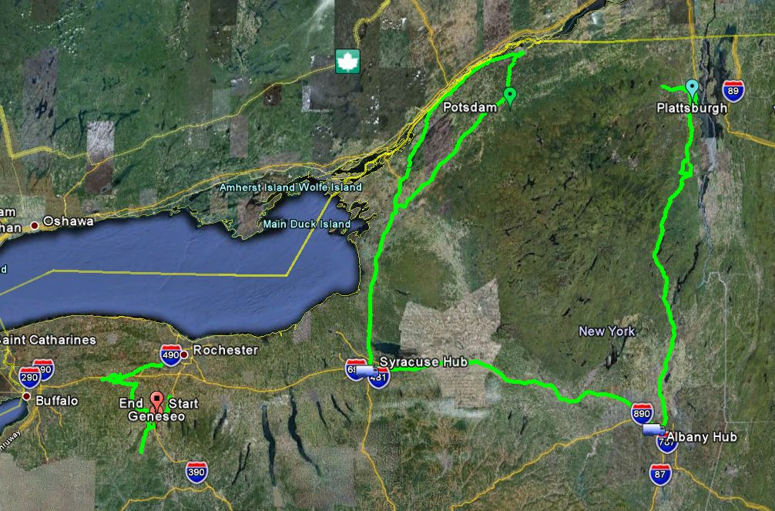

Slide 28
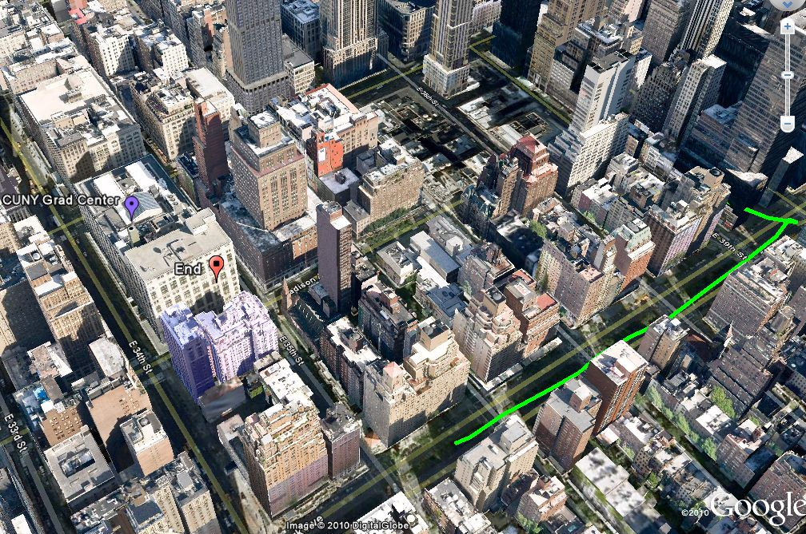
GPS in NYC

Slide 29
Expected Turnaround Time
Nylink contracts with a courier service to provide LAND, with expected turnaround times of 24 hours within a zone (meaning north or south of Newburgh) and 48 hours between zones (if an item has to cross Newburgh to the north or south to reach its destination). Courier service drivers are expected to arrive at the same time each day within a one-hour window.

Slide 30

Line Haul Network and Transit Flow
24 Hr
Transit Delay
Combining cross-industry knowledge with your specific profile
to deliver a cost effective solution that meets your needs.
Notes:
First, we understand that one-size fits approach doesn’t work. We apply our knowledge and expertise to develop personalized solutions for you that are appropriate for your industry, your footprint, your software profile and importantly your commitments and operating constraints.
We combine our knowledge across multiple industries with your specific profile to deliver cost effective solutions that meet your needs.

Slide 31
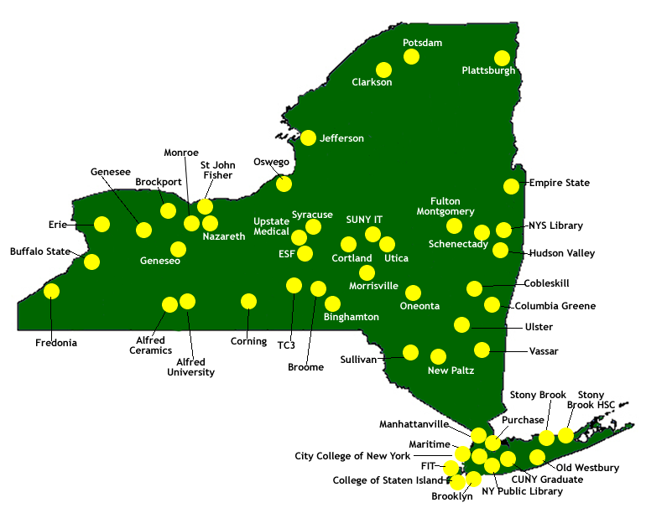
IDS Project Libraries
Spring 2010
Newburgh dividing line pre-May 2010
Notes:
Updated 1-14-10

Slide 32
LAND Delivery Time is Based on Hub
There are 2 zones:
  Buffalo, Syracuse, Rochester and Albany hubs are in a zone.
  Syosset, Teterboro, Newburgh and Albany hubs are in a zone.
(Yes, Albany is in both zones)

Slide 33
LAND HUB | Albany | Buffalo | Newburgh | Rochester | Syosset | Syracuse | Teterboro
Albany | 1 day | 1 day | 1 day | 1 day | 1 day | 1 day | 1 day
Buffalo | 1 day | 1 day | 2 days | 1 day | 2 days | 1 day | 2 days
Newburgh | 1 day | 2 days | 1 days | 2 days | 1 day | 2 days | 1 day
Rochester | 1 day | 1 day | 2 days | 1 days | 2 days | 1 days | 2 days
Syosset | 1 day | 2 days | 1 day | 2 days | 1 day | 2 days | 1 day
Syracuse | 1 day | 1 day | 2 days | 1 day | 2 days | 1 day | 2 days
Teterboro | 1 day | 2 days | 1 day | 2 days | 1 day | 2 days | 1 day
May 2010

Slide 34
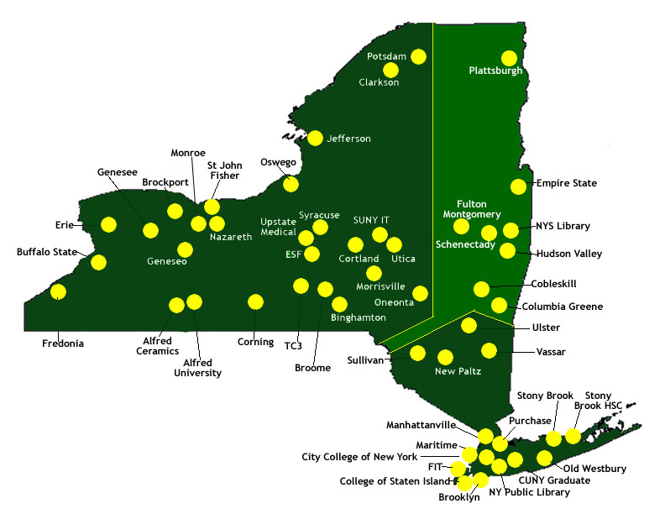
IDS Project Libraries
Spring 2010
Delivery Zones post-May 2010

Slide 35
Land GPS Tracker Results February – May 2010

Slide 36
Inadequate Driver Supervision

Slide 37
Velocity Express Workflow
Drivers stop daily (M-F) at each LAND library.
At each stop, the driver scans the barcode and delivers/picks-up materials.
After completing route, driver returns to the Velocity Express regional hub.

Slide 38
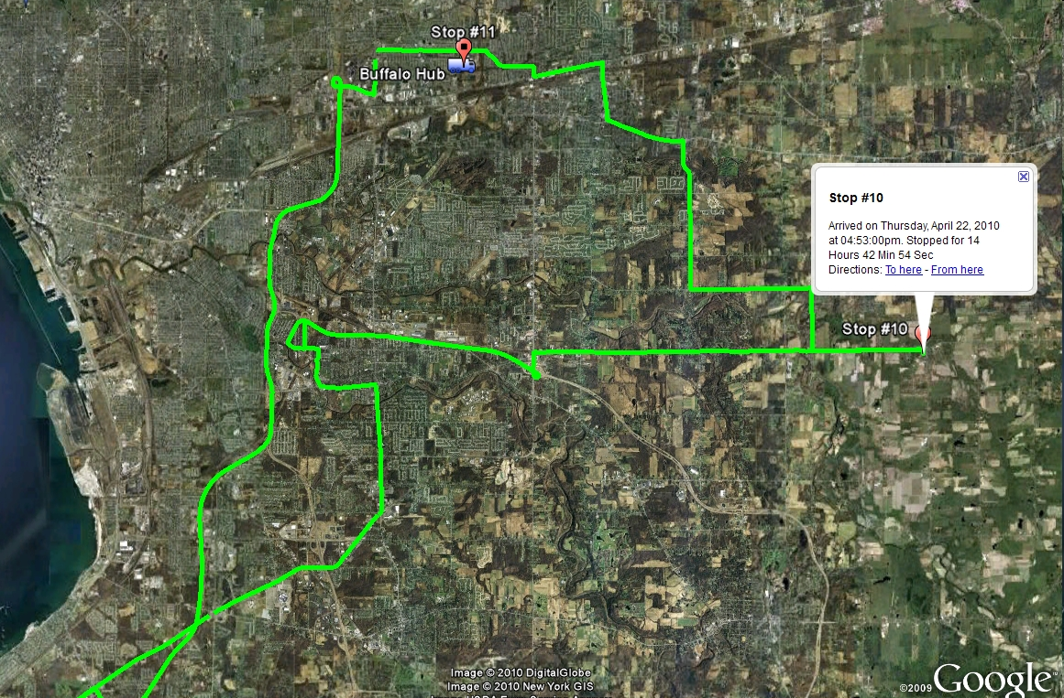

Slide 39
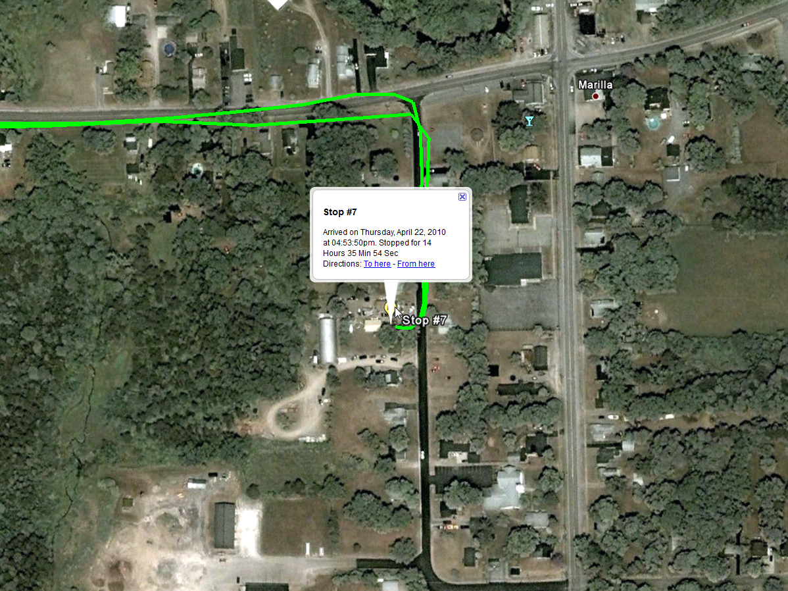
Stop #10

Slide 40
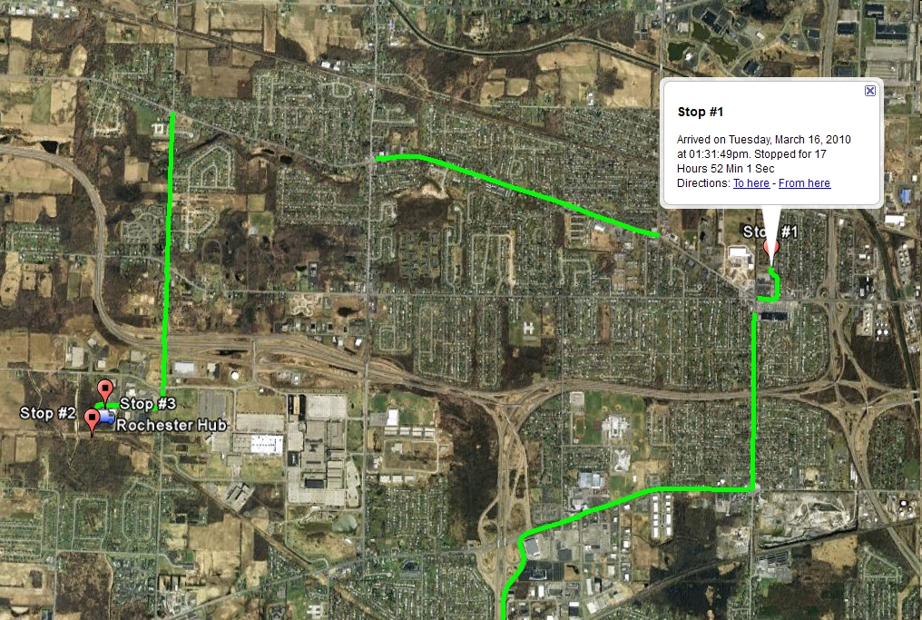

Slide 41
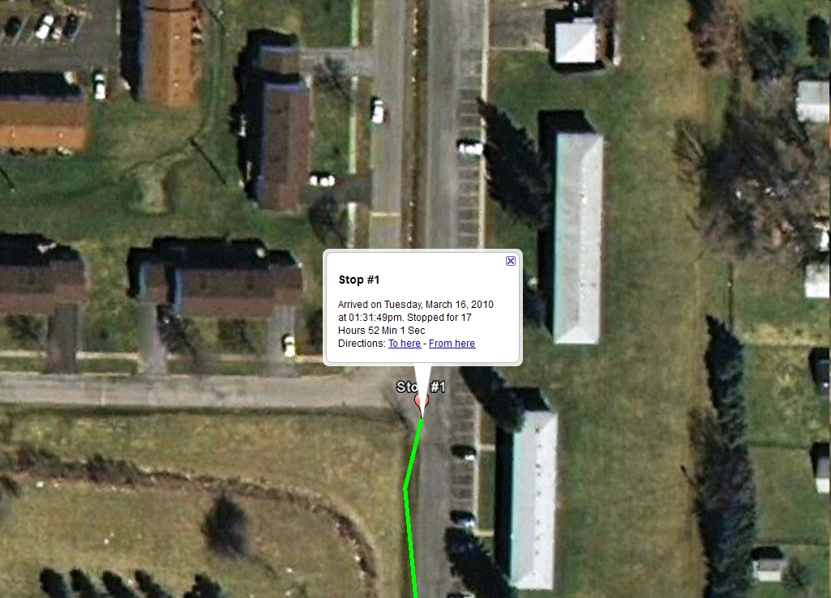

Slide 42
Structural Problems

Slide 43
IDS Project Libraries
Spring 2010
1 day each way
Delivery Zones post-May 2010

Slide 44
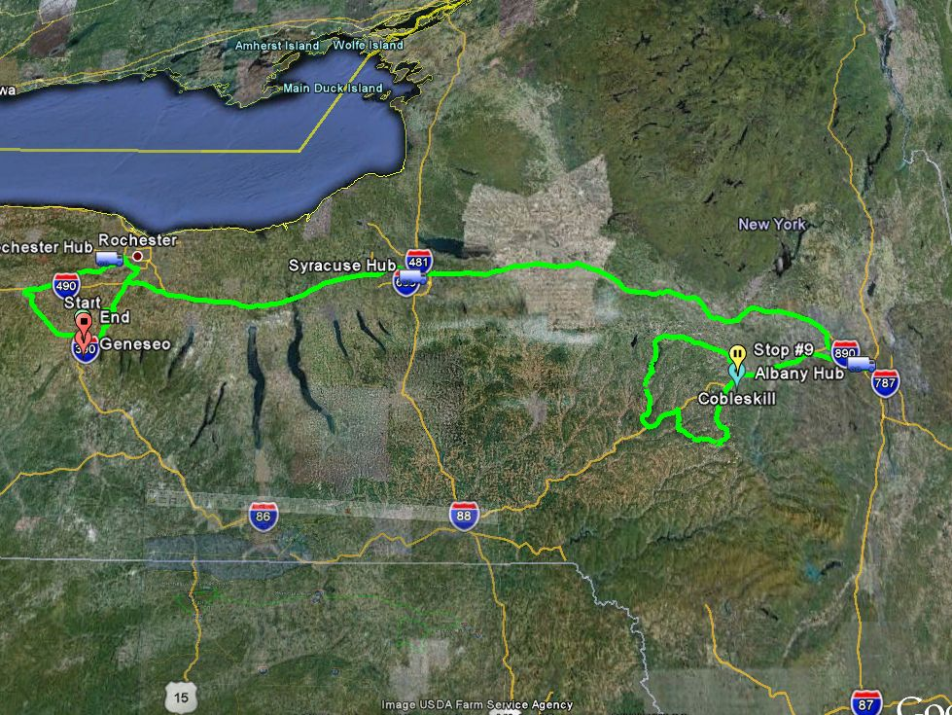
Package arrives Albany about 8 am but local delivery leaves Albany about 7:15 am. Day lost.

Slide 45
Package arrives Syracuse about 5 am but misses 5:30 am departure for Rochester. Day lost.

Slide 46
IDS Project Libraries
Spring 2010
1 day each way
Delivery Zones post-May 2010

Slide 47
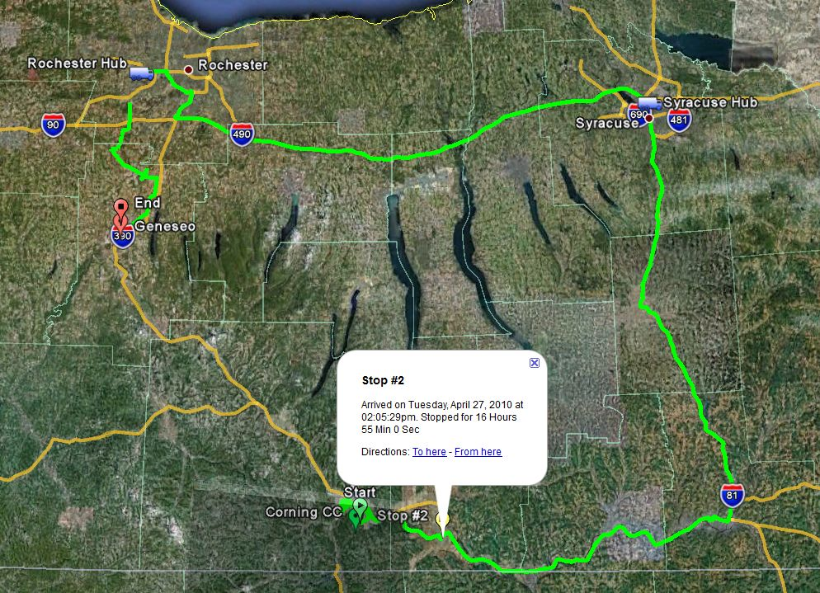
Driver leaves Binghamton for Syracuse about 1:30 pm each day.
Driver leaves Corning CC at about 11:30 am.

Slide 48
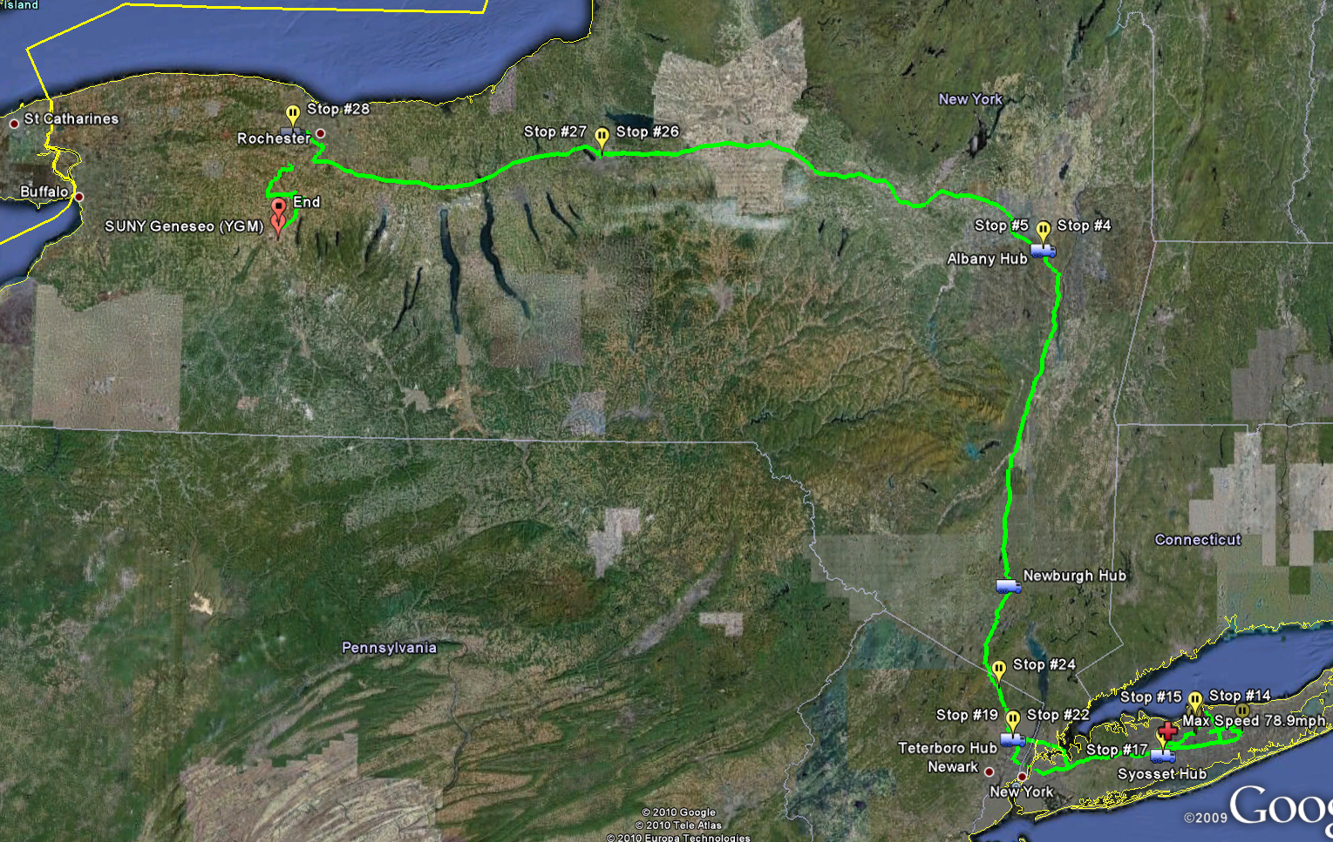

Slide 49
Hub transfer timing problems

Slide 50
Contact Information
Ed Rivenburgh Director of IDS Project edr@geneseo.edu 585-245-5591
Paul MacLean Director of GPS Courier Study maclean@geneseo.edu 585-245-5590
Donna Howe PowerPoint Editor howe@geneseo.edu 585-245-5591
2009
50
Notes:
Thank you, we are interested in hearing your comments, questions and suggestions .

