Slide 1
ALIAS and Serials Solutions Addon
Mark Sullivan
IDS Conference, August 3rd and 4th 2010

Slide 2
Processing a Lending Request

Slide 3
Lending Availability Service

Slide 4
Serials Solutions Addon

Slide 5
Serials Solutions Addon

Slide 6
Serials Solutions Addon

Slide 7
ALIAS - Serials Solutions Addon

Slide 8
Loading Article Within ILLiad

Slide 9
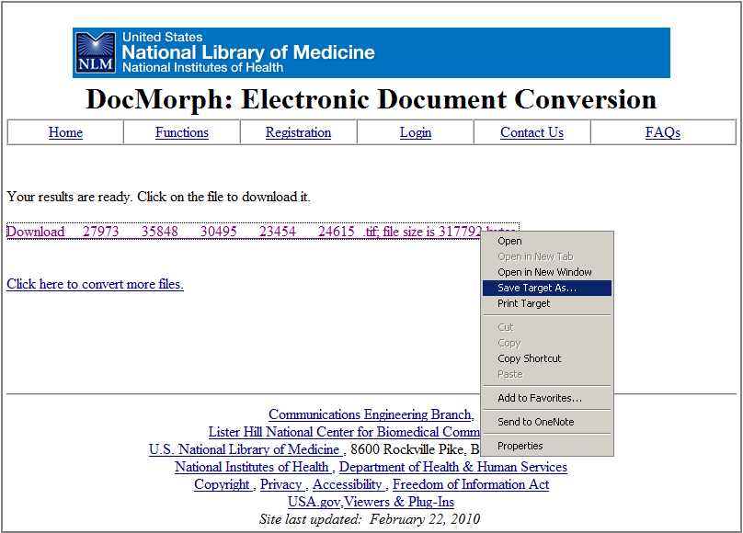
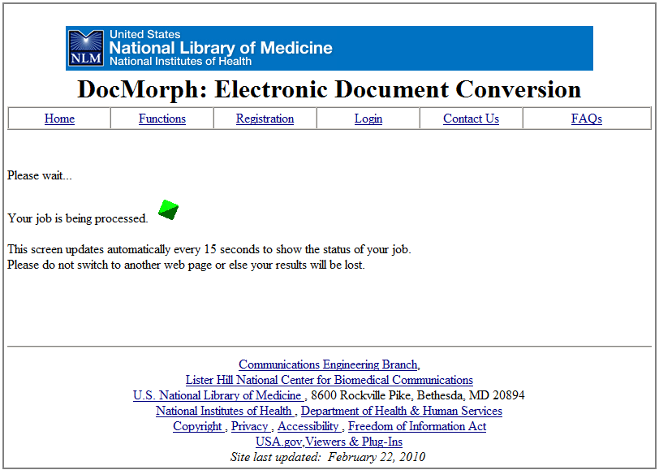
DocMorph Included

Slide 10
ALIAS and Serials Solutions Addon
Mark Sullivan
IDS Conference, August 3rd and 4th 2010

