Slide 1
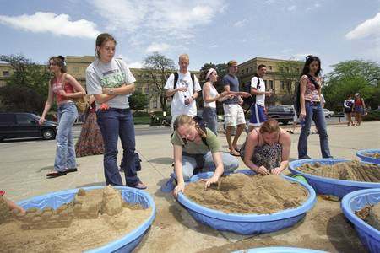
KU University Relations

Slide 2
Getting to the Beach
Lars Leon
University of Kansas Libraries
IDS Project Conference 2010
Lightning Round

Slide 3
Do you need to obtain Elsevier articles via ILL for your patrons?

Slide 4
Do you pay ILL copyright royalties on Elsevier articles?

Slide 5
Do you have a license for access to some Elsevier journals ?

Slide 6
If yes, then how are you obtaining these articles?

Slide 7
Getting to the Beach ~ Regular process
Receive requests from patrons
Obtain articles via ILL from other libraries (or pay a document supplier).
Pay copyright ($36 + fees)

Slide 8
Getting to the Beach ~ Our process
1. Receive requests from patrons via ILLiad.
2. Obtain articles via ILL from other libraries until we have reached our “five free”.
3. Staff download recent journal years from ScienceDirect for $22.
4. Staff delivery article to patron through ILLiad.
KU University Relations

Slide 9
Getting to the Beach ~ Individual Results
1. We save at least $14 per article on copyright fees.
2. We provide the patron:
publisher’s “pristine” pdf copy
Faster turnaround in many cases
3. Main additional cost is staff time which is minimal in this process.

Slide 11
Getting to the Beach ~ Aggregated Results
We save noticeable amount of money on individual request basis.
Overall, filled requests have gone up which impacted “overall” savings.
Added another access “tool” to use.
Can be applied to Wiley+ titles.

Slide 12
Getting to the Beach ~ How
Use Access queries (linked into ILLiad) to identify titles where we have already received our five free.
Match this file against “Non-subscribed/non-entitled titles” from ScienceDirect.
Send these as holdings to Rapid weekly (or one could build a table within ILLIad to store this information).

Slide 13
Getting to the Beach ~ How
4. Regular Rapid request process occurs. Requests we need to order from Elsevier ScienceDirect are marked in an ILLiad queue.
5. Staff download from ScienceDirect (using deposit account) then get article to patron through ILLiad.

Slide 14
Getting to the Beach ~ Impact
Works great with Rapid but could work routine up with adding table in ILLiad and maybe using routing rules for non-Rapid libraries.
Reduced burden on our Rapid partners.
Emphasize – aspect of this as an additional tool in access.

Slide 15
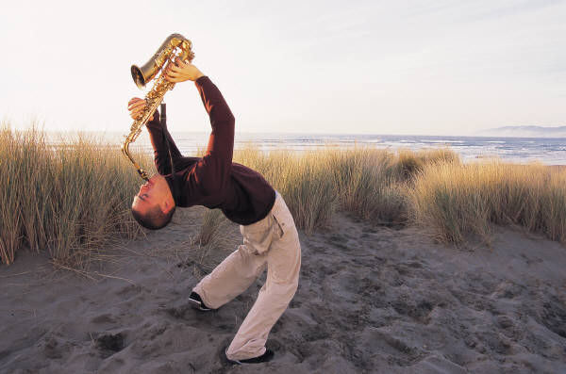
Disclaimer (for State auditors of Kansas) Beach story just presented for show. Savings plowed back into collections budget. (Besides we’re perfectly happy digging our toes into sand in wading pools on Wescoe beach).

