Slide 1
Diversifying SUNY Collections Pilot
Logo by Pam Peters with Wordle
Notes:
What started out as Diverisfying SUNY Collections Pilot, quickly morphed into the SUNYONE Pilot Project.

Slide 2
Mosaic of select purchased titles made with AndreaMosaic for PC
Notes:
Ten SUNY Libraries
Contributed varrying sums to reach $43,000 (min. $500 buy-in)
Over 460 titles purchased
It’s ONE SUNY Collection

Slide 3
Operations Group
Mosaic made with AndreaMosaic for PC featuring covers from purchased titles
Notes:
Community Colleges, Comprehensive Colleges (4-years) and University Centers
Upstate Medical
OLIS liaison

Slide 4
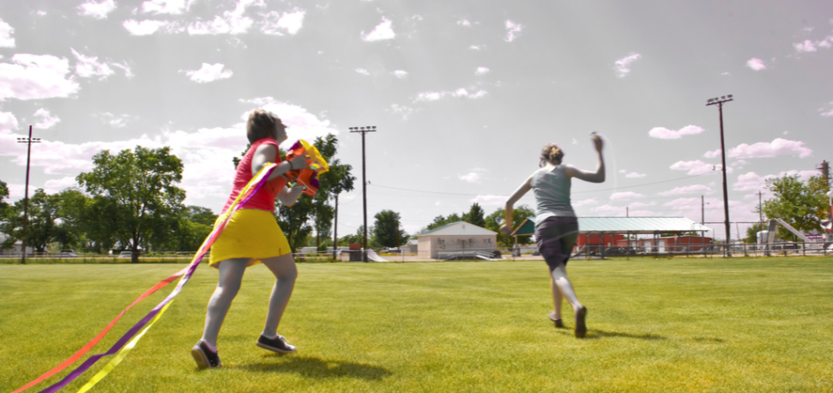
http://www.flickr.com/photos/chovy/2582512132/
Notes:
How did this project get off the ground?
2008 - SUNY Borrowing Task Force Recommendations
reliable and robust resource sharing environment,
utilize purchase-on-demand programs,
just-in-time acquisitions, and
cooperative collection development
April 2009 - SCLD Meeting
Directed SAC to undertake a pilot project to test the efficacy of a coordinated purchase-on-demand program as a means of building a more diversified, richer SUNY-wide library collection.
Fall 2009 - Formed operations team. Participating Directors and Collection Development/Acquisitions Librarians met at OLIS to discuss the charge from SAC.
January 2010- SUNYOne Pilot makes its first purchases

Slide 5
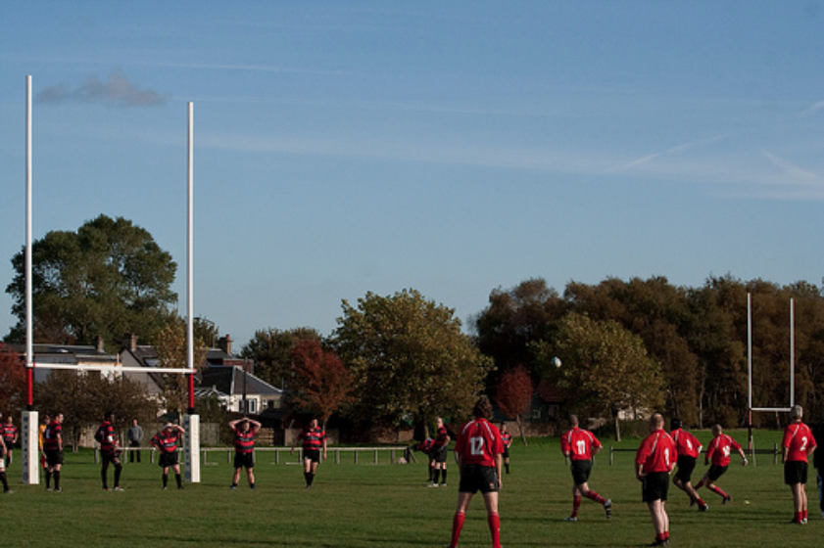
http://www.flickr.com/photos/vegansoldier/4022047799/
Notes:
To diversify the SUNY collection by adding a “first copy” of a title that has been identified by a known user
To use limited resources more effectively by purchasing titles not held within SUNY rather than borrowing those titles from outside SUNY
To continue to fulfill the research needs of SUNY faculty and students in a timely and cost-efficient manner

Slide 6
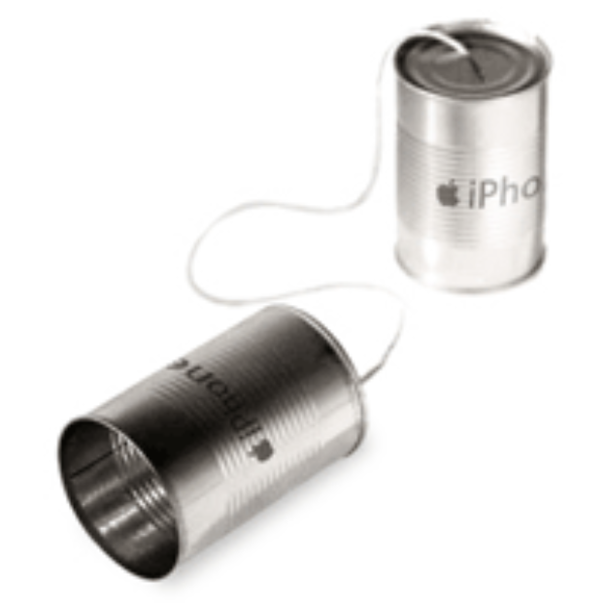
http://www.flickr.com/photos/markhillary/353738538/sizes/o/
Notes:
PBWorks-Wiki
On the Pilot wiki we are able to document campus policies and purchasing criteria, meeting summaries, and other information we share with one another.
Skype
After initial face-to-face meeting in Albany in October, group decided to meet regularly using Skype, and have met via Skype 7 times.
F2f meetings: Initial, June at UB and Sept. in Albany
GoogleDocs
Collaborative workspace for statistics and presentations.
Listserv

Slide 7
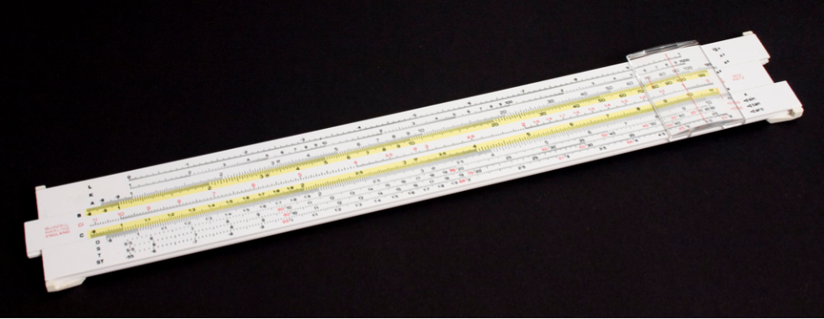
http://www.flickr.com/photos/dominicspics/3915875555/
Notes:
Criteria AKA What are the Rules?
Not held by any other SUNY library
Published within the last 5 years; there are exceptions here based on local collection need/ common sense
No initial reserve requests; textbooks may be considered
Initial $300 price point with some exceptions.
Formats excluded: ebooks (licensing issues); journals/magazines; serials

Slide 8
http://www.flickr.com/photos/jorge-11/2504709354/
Notes:
So what have we done with our time so far?
Deborah Curry from Oswego is leading the Operations Group.
Using single vendor - Amazon
Primarily for fast turn around time and that UB had previous purchase on demand experience with them.
Cindy Bertuca at UB is handling the accounting aspects for us.
Source of requests - user requests, ILL, GIST & Banner, web forms
Each campus orders directly with their own Amazon login.
All orders input and tracked through shared Google docs spreadsheet
Fast turnaround--we aim for 2-4 days
OLIS created Aleph report: Circulation Statistics by Item for SUNYONE titles
As of the end of July $12,000 left.

Slide 9
Notes:
Sample Covers from some of the titles we have purchased.
Some even got repeated use.
Favorite Example at Brockport:
Dulcan's Texbook of Child and Adolescent Psychiatry.
It's gone out so many times that it is already falling apart from use. (Lots of ILL uses too!)

Slide 10
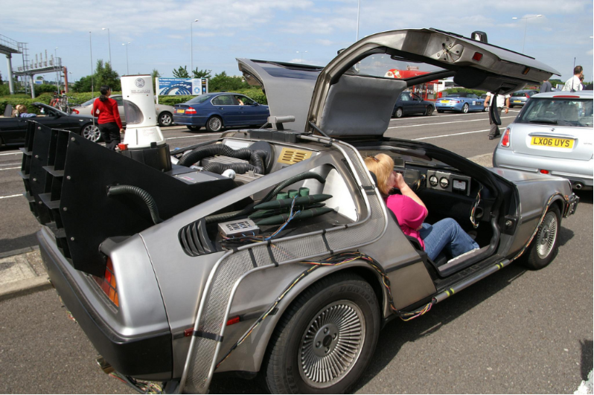
http://www.flickr.com/photos/davehamster/2661937042/
Notes:
What does the future hold?
Continue pilot through the year until funds are expended
Begin assessment of pilot in September at Albany Meeting
Measures will include:
Average turnaround time
Circulation data
Vendor issues
DISTANT FUTURE:
Pilot Round 2?
More Libraries?
Scalability?
Additional/Different Vendors?
Different Accounting / Disbursement & Collecting of funds.

Slide 11
http://www.flickr.com/photos/st3f4n/143623934/
Notes:
Questions?
Feel free to contact me in person with questions. Included via IM/Twitter as HockeyLibrarian.
Each Library places its own orders wtih Amazon. Titles are usually shipped directly to that library.
Most titles are RUSH cataloged to meet user needs. Discussed direct shipment pre-cataloged to users, did not implement.

