Slide 1
Map Roads to ILL
Creating cheat sheets, shortcuts and more!
Presented by Chris Sisak/Nazareth College of Rochester

Slide 2

Why create them?
Empower your new hires
Free up your time
Prepare for the unexpected…

Slide 3
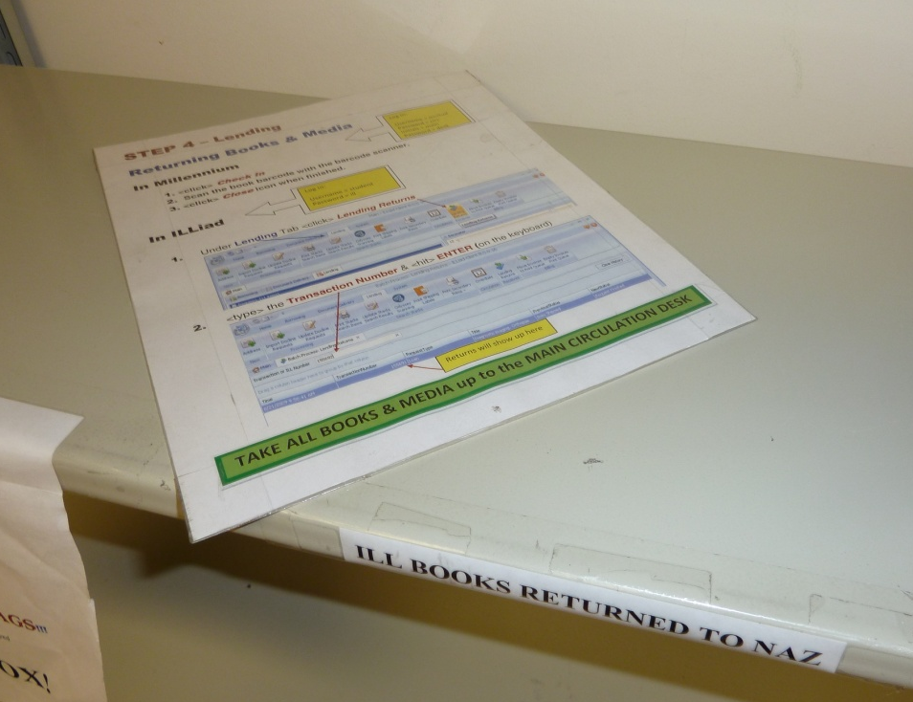
Getting Started
Examine your workflow
Examine your office layout
Begin breaking down the process into steps

Slide 4
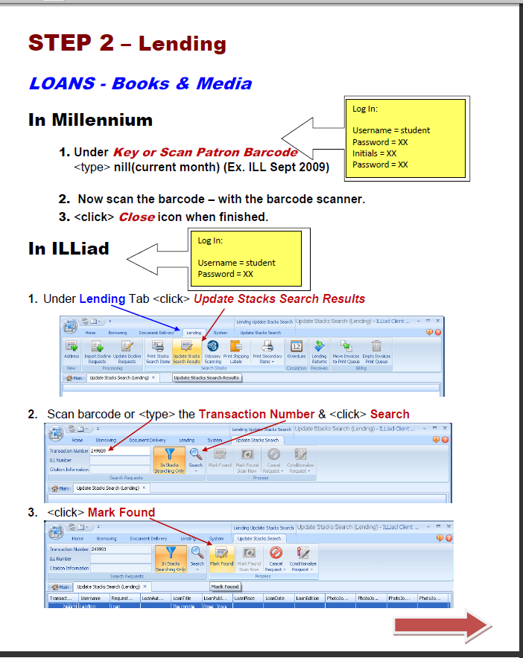
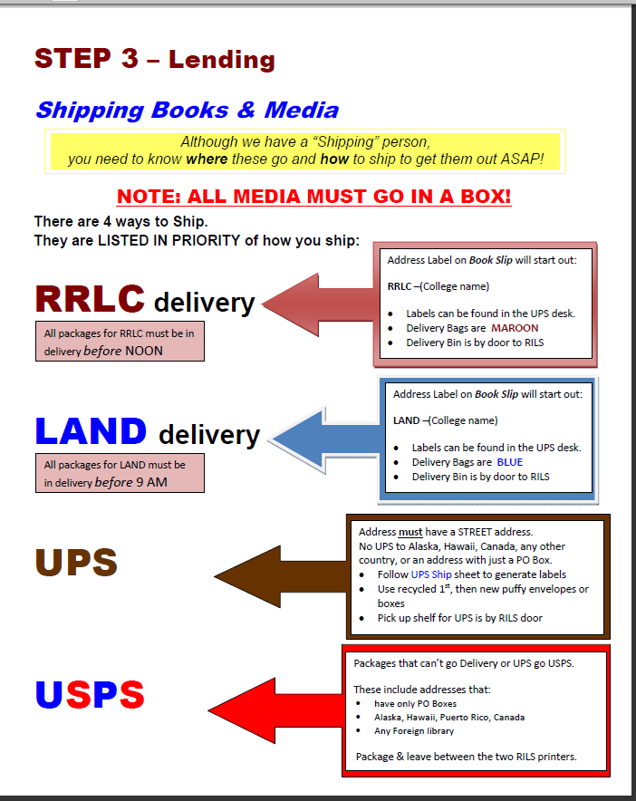
Guidelines to creation: less is more

Slide 5
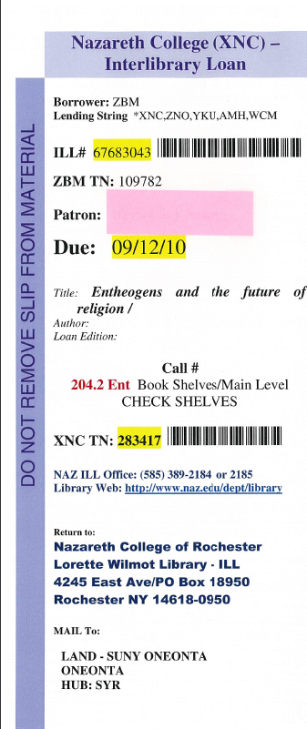
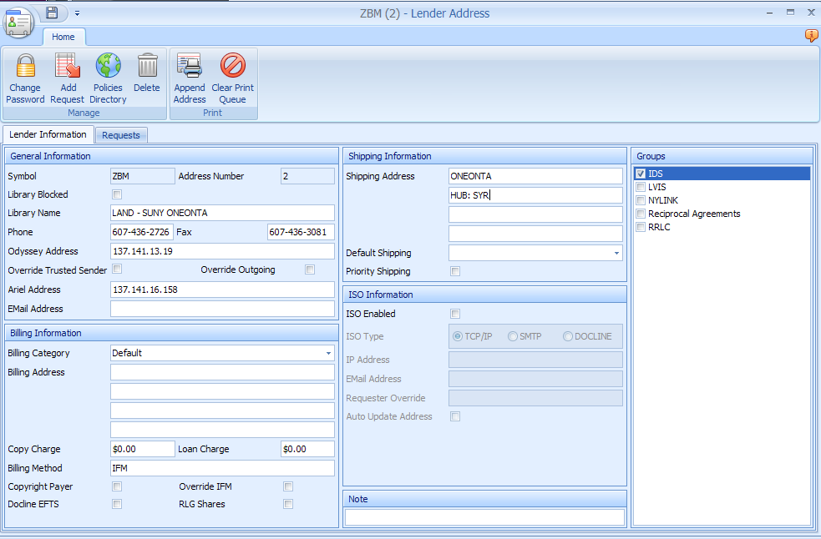
minimize guesswork

Slide 6
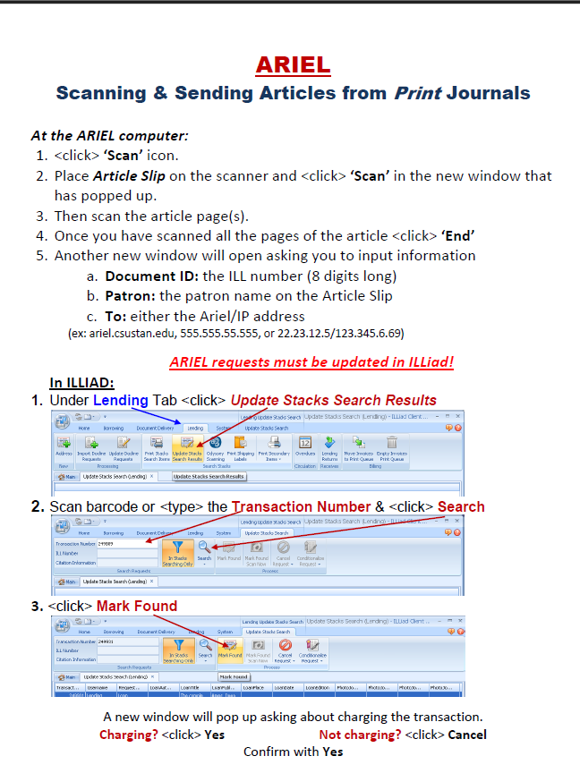
Be creative!
Use:
Color, font size, italics
Screen shots and arrows
Remember to be timeless!

Slide 7
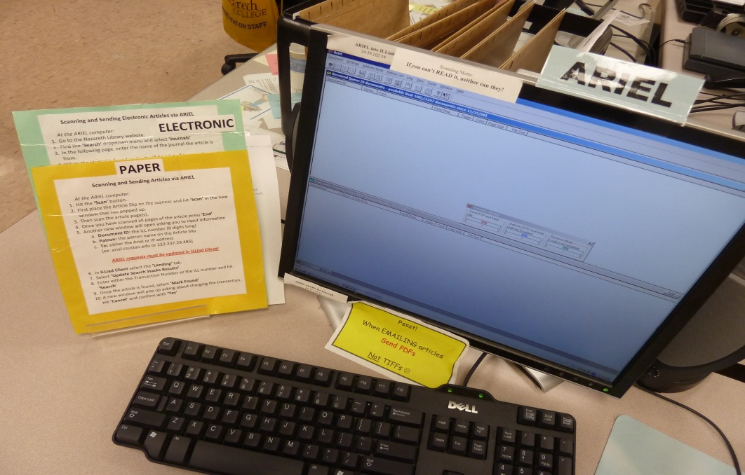
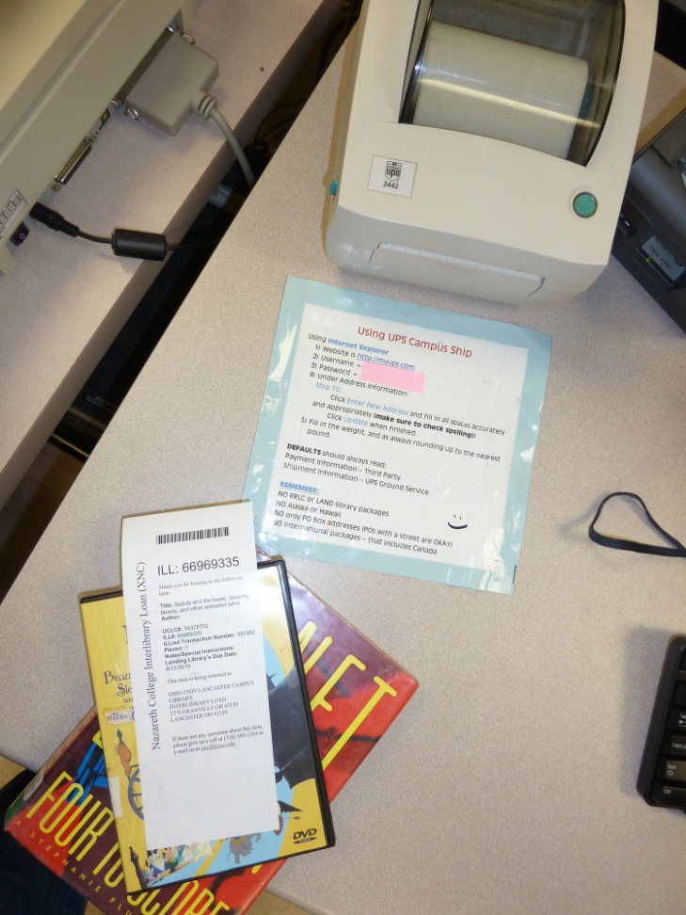
Proximity
Keep sheets at the workstation or in close proximity

Slide 8
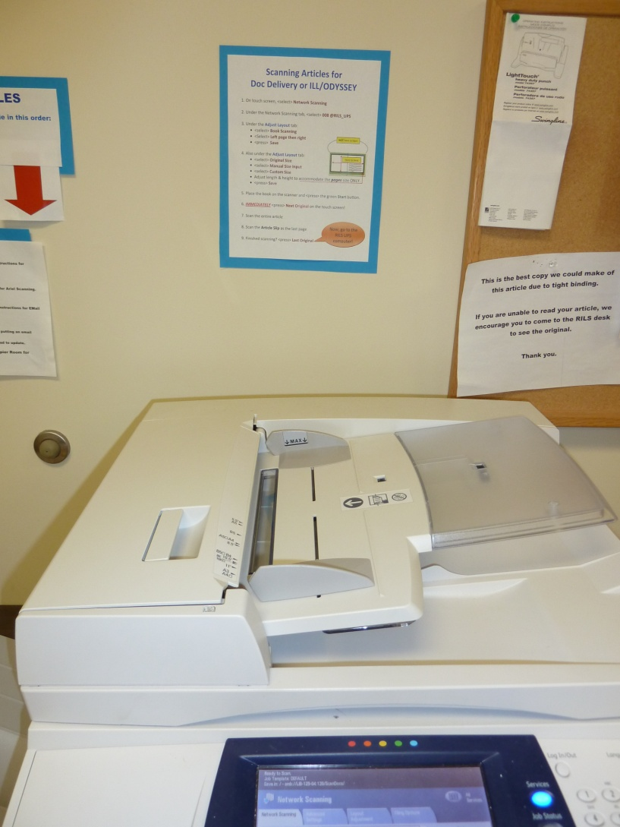
Everything is Fair Game!
Copiers
Microfilm Equipment
UPS or USPS shipping instructions

Slide 9
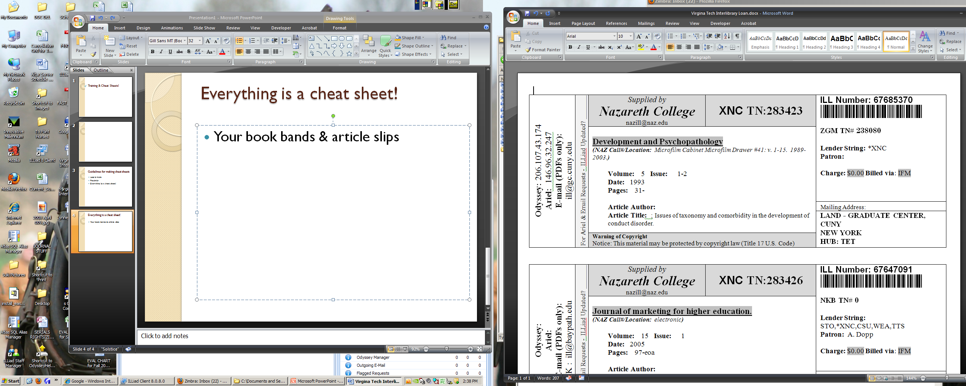
Everything is fair game continued….
Your article slips & book bands

Slide 10
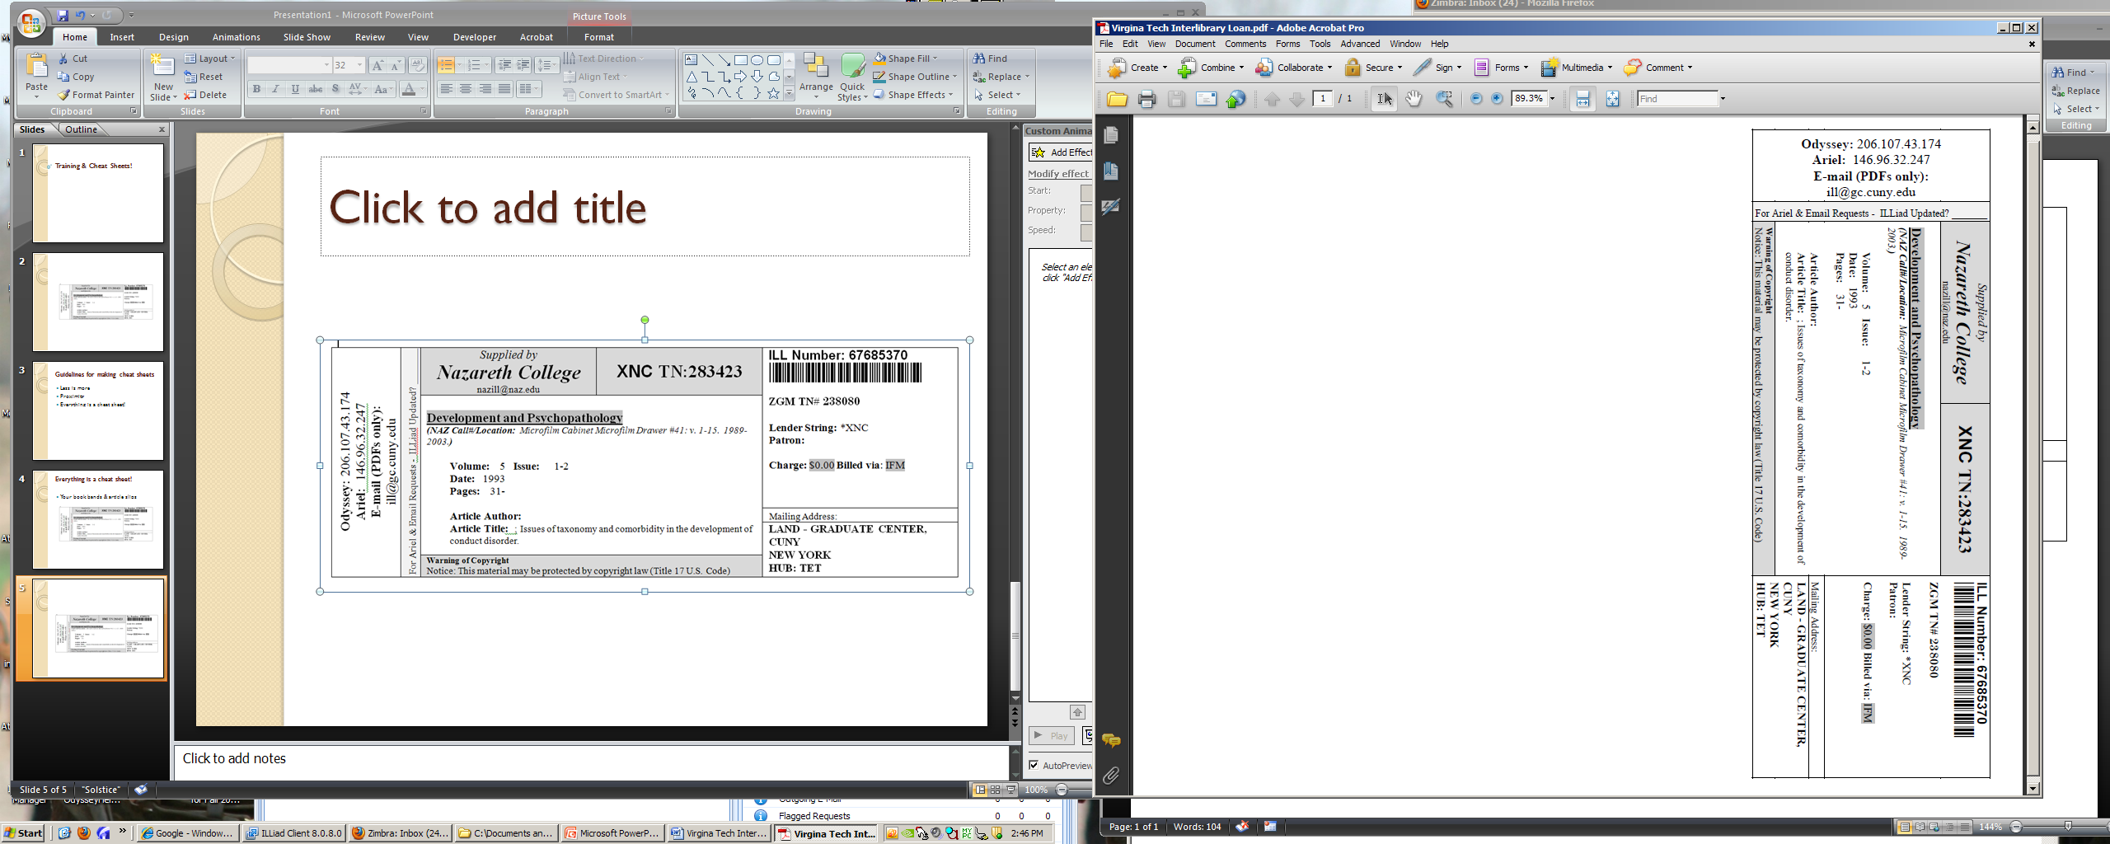
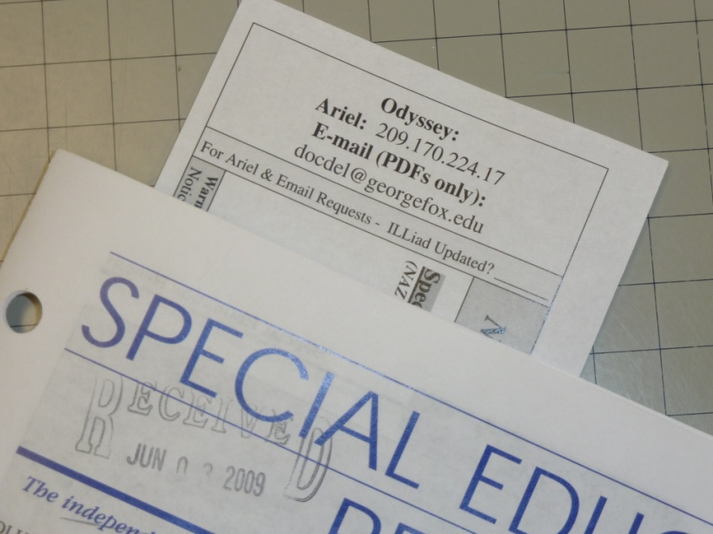
Order in which to send…

Slide 11
Short cut for other libraries…

Slide 12
A little work goes a long way…
Questions?

