Slide 1

ILLiad Addons:
Significant Improvement to Your Staff Productivity
Dave Williams (Notre Dame)
and
Mark Sullivan (Suny Geneseo)

Slide 2
Agenda
Part 1: What’s an addon?
Part 2: How do I install an addon? (single user)
Part 3: How do I (or my tech geek) create my own?

Slide 3

Part 1: What is an addon?

Slide 4
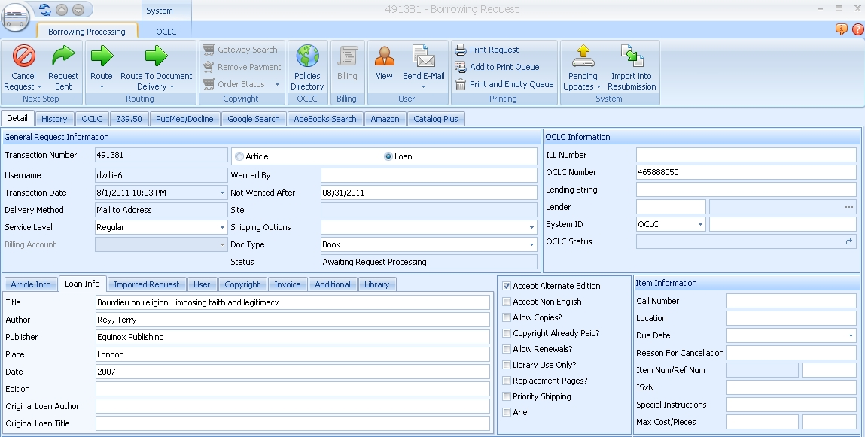
An addon is…
Customized tab on ILLIad 8.0 + request form
Based on request information, addon can:
  Perform search in preferred vendor website for item
  Perform search for item in your ILS
  Import data/update request in ILLiad
  In other words, an addon can
  significantly improve productivity!
  For example…

Slide 5
Specific Example: The Amazon Books Addon
Instead of having to:
Open a browser outside of ILLiad;
Go to Amazon.com;
Cut and paste request from ILLiad into Amazon;
Click on “search” or “submit”; and
Cut and paste info from Amazon into ILLiad e.g. price
The Amazon Books Addon can…

Slide 6
From within an ILLiad request…

Slide 7
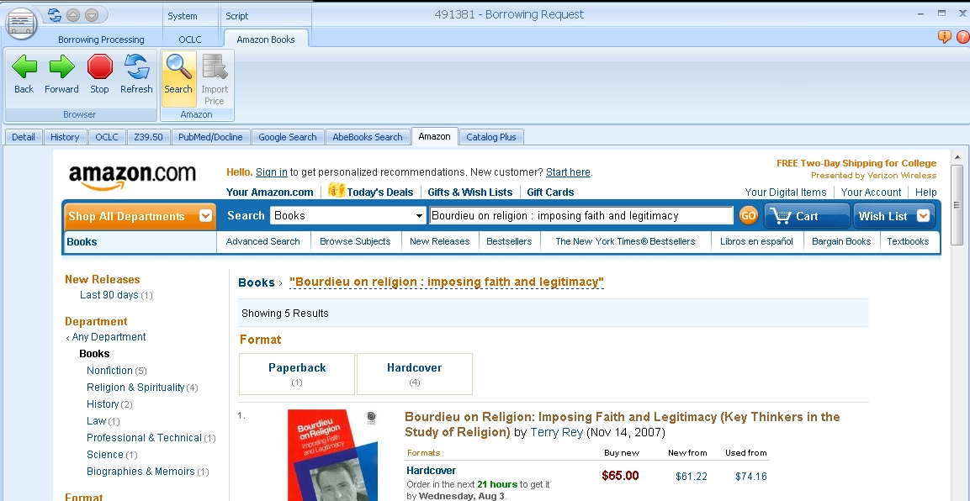
1. Automatically search for item in Amazon.com

Slide 8
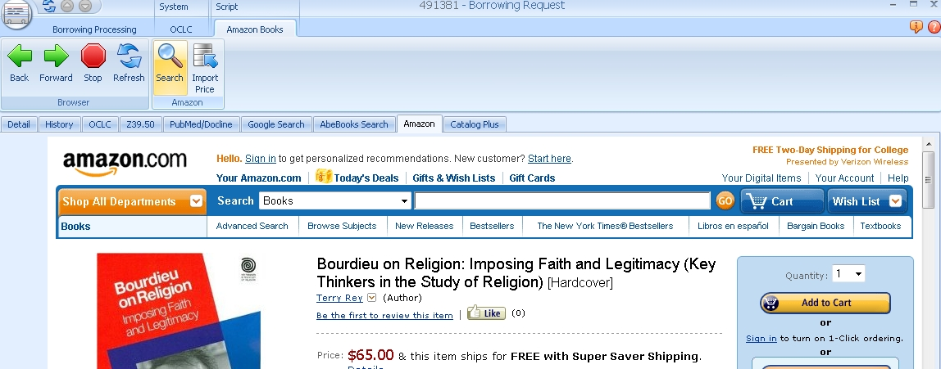
And once you verify the item matches request

Slide 9
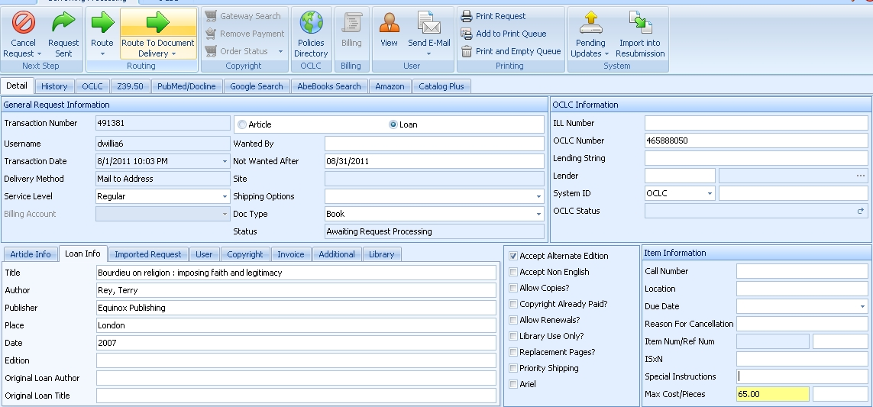
2. Import the Price into the “Max cost” field.

Slide 10

Thank you, Atlas Systems!

Slide 11
Part 2: How do I install them? (single user)
3 Quick and Easy Steps

Slide 12
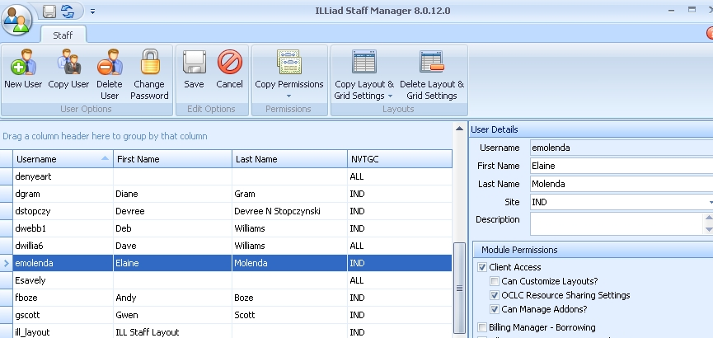
Step 1. In Staff Manager, set permission for staff to: “Can manage addon”

Slide 13
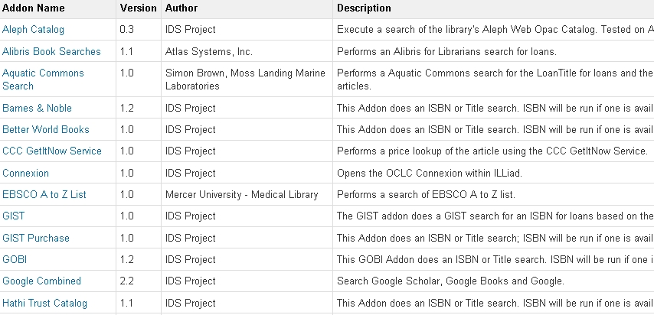
Step 2. Download addon to c:\ILLiad8\addon folder (version 8.0)
Addon repository (Directory) is found at:
https://prometheus.atlas-sys.com/display/ILLiadAddons/Addons+Directory

Slide 14
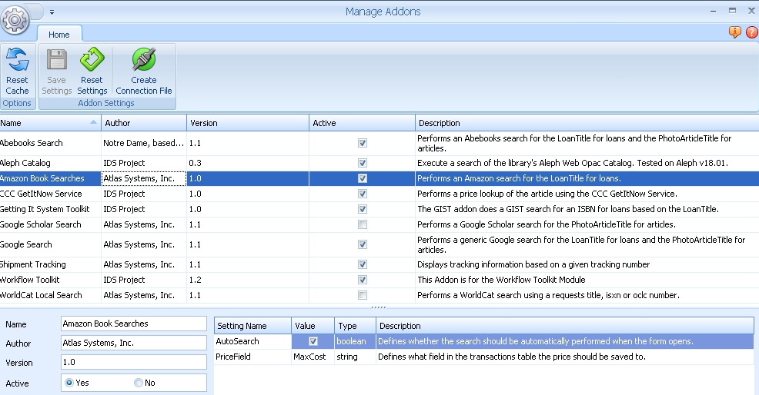
Step 3. Activate addon
System (tab) | Manage Addons | Yes | Save Settings

Slide 15

Part 3: How do I (or my tech geek) create my own?

Slide 16

Use a “template!”
In other words, copy and modify existing addon that basically does what you want to do.

Slide 17
What you’ll need to copy and modify
(Wannabe Developer's Toolkit)
Notepad ++
(Download from: http://notepad-plus-plus.org/download/v5.9.2.html)
Template eg. AbeBooksSearch Template
Key website html elements for new addon (alibis)
  URL of search page (e.g. “http://www.alibris.com/booksearch”)
  “Search” Form Name (e.g. “searchform”)
  “ISBN” Form Name (e.g. “qisbn”)
  “Book Title” Name (e.g. “wtit”)
Basic to moderate knowledge of html
Staff programmer or technical support person with basic programming knowledge. (Optional)

Slide 18
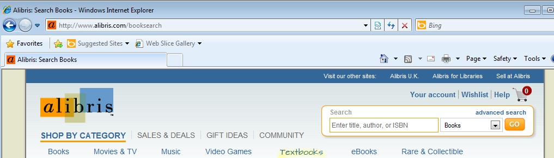
Step 1: Identify key website data
Key element 1: URL
In browser, open book search page of desired website.
  In address bar, identify“Search URL” ;

Slide 19
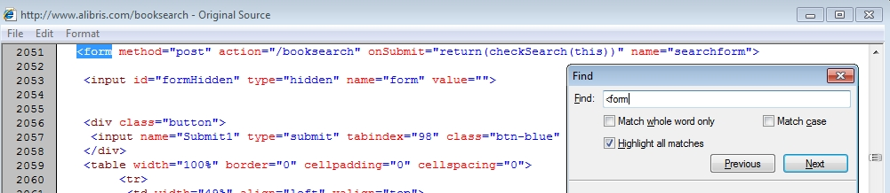
Step 1: Identify key website data
Key element 2: Search form name
With browser open on page, open “View Source”
Search (“Find”) source code for name of the search form:
(Open “Find” option and type: “<form” in “Find” field and click “Next” button; look for value in “name= “.) Search form name is value within quotes.
NOTE: If you’re unsure of the Search form name, ask you web guru for help!

Slide 20
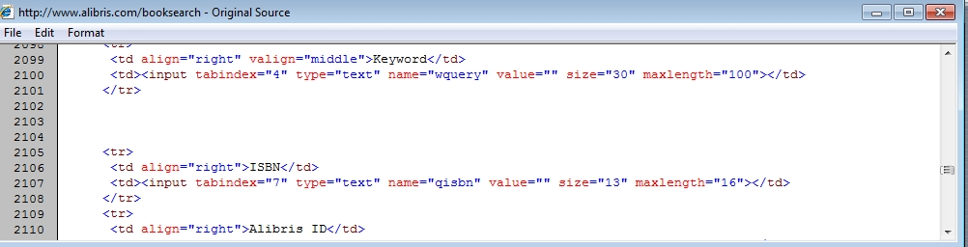
Step 1: Identify key website data
Key element 3: ISBN field name
With “View Source” still open…
In vicinity of form name (key element 2), look for reference to ISBN field, then for code “name= “ close by. ISBN Field name is value within quotes.

Slide 21
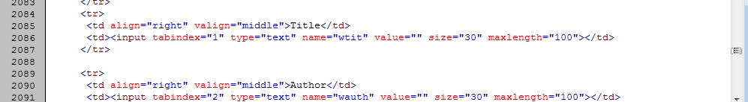
Step 1: Identify key website data
Key element 4: Title field name
With “View Source” still open…
In vicinity of form name (key element 2), look for reference to Title field, then for code “name= “ close by. Title field name is value within quotes.

Slide 22
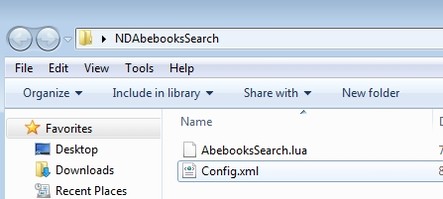
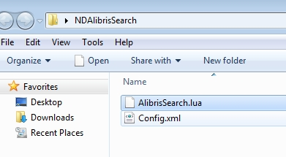
Step 2: Download and rename two items
Rename the following files:
NDAbebooksSearch folder -> VendorNameSearch
AbebooksSearch.lua -> VendorNameSearch.lua
Template folder & lua names Renamed folder & lua names
NOTE: Config.xml file name keeps the same file name.

Slide 23
Step 3: Modify config.xml file
(But before modifying it, what is it? What does it do?)
Contains simple information about the lua file.
Points ILLiad client to the LUA file which does all the magic.

Slide 24
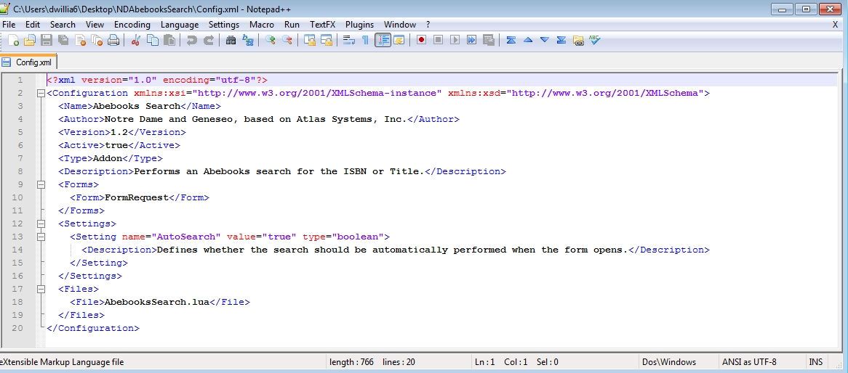
Step 3: Modify config.xml file
Using Notepad++, open config.xml file
Replace the <Name>, <Author>, <Description>, and <File> portions with updated info. Then SAVE.

Slide 25
Step 4: Modify lua file
(But before modifying it, what is it? What does it do?)
The lua file contains instructions for creating the tab in ILLiad and performing search. It consists of the following sections:
Description of what addon does: About AbeBooksSearch.lua
Instructions to create tab and form in request: function Init()
Instructions to load search page: function LoadPage()
Instructions to search and display results: function Search()

Slide 26
Step 4: Modify lua file
Using Notepad++, open renamed lua file
Update the following parts or values:
  Description (Briefly describe what addon is designed to do.)
  URL (see “Step 1: Identify key website data”)
  Search form name (see “Step 1: Identify key website data”)
  ISBN name (see “Step 1: Identify key website data”)
  Title name (see “Step 1: Identify key website data”)
  References to “old” lua template name with “new” lua name. (Use the “replace” option in notepad++ to save time.)

Slide 27
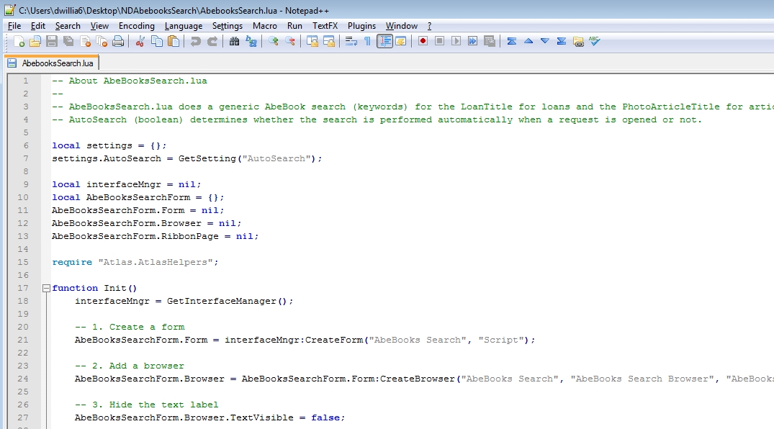
Step 4: Modify lua file (Before)

Slide 28
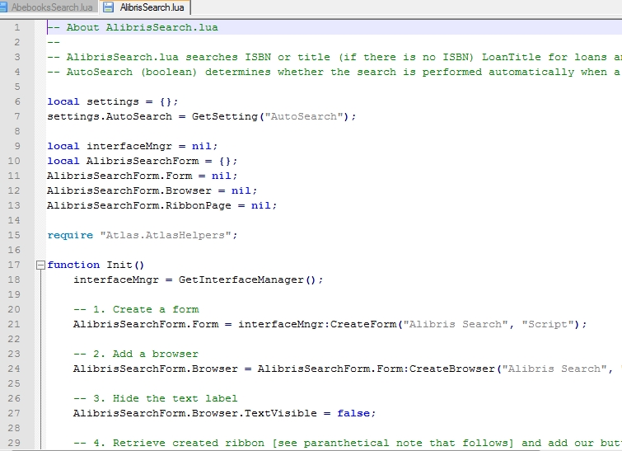
Step 4: Modify lua file (After)

Slide 29
Documentation & Assistance
Need additional information on addons?
https://prometheus.atlas-sys.com/display/ILLiadAddons/ILLiad+Addons
Need assistance with writing new Addons?
Send a message to the IDS community (Workflowtoolkit-l) to talk to and ask questions of other ILLiad users and IDS team members.
Contact Mark Sullivan (sullivm@geneseo.edu) or Dave Williams (williams.210@nd.edu).

Slide 30
Thanks

